Slide 1
Hallucinate: Edge-First MLOPS for Decentralized AI
A Framework for Low-Latency, Decentralized Machine Learning
Powered by IPFS and libp2p

Slide 2
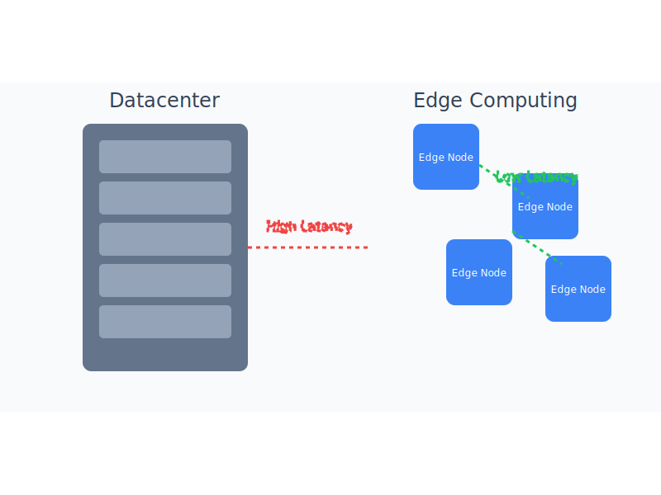
The Challenge of Centralized AI
Current Limitations:
• High latency due to datacenter-dependent compute
• Network bandwidth bottlenecks
• Scalability constraints with increasing demand
• Dependency on continuous internet connectivity
• Limited offline capabilities
datacenter_vs_edge

Slide 3
Hallucinate: A New Paradigm
Key Features:
• Edge-first architecture for minimal latency
• Decentralized storage and computation
• Offline-capable after initial model download
• Seamless integration with existing ML frameworks
• Resilient peer-to-peer communication

Slide 4
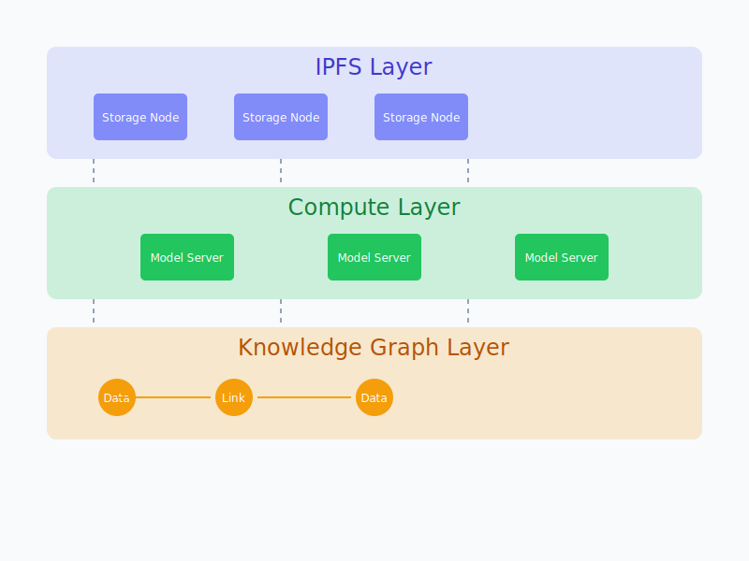
Architecture Overview
Three-Layer Architecture:
architecture

Slide 5
Key Modules
Core Components:
IPFS_Accelerate_Py
• Model server endpoint multiplexer
• Supports CUDA, CPU, and OpenVINO inference
IPFS_Model_Manager_Py
• Intelligent model caching and retrieval
• Multi-source model downloads
IPFS_Kit_Py
• Local IPFS node management
• Tiered caching system

Slide 6
Implementation Details
Technical Specifications:
Model Support
• Hugging Face Transformers integration
• ONNX and OpenVINO optimization
Network Layer
• libp2p for peer discovery and routing
• IPFS for content-addressed storage

Slide 7
Future Development
Roadmap:
Near-term Goals
• WebNN integration for browser-based inference
• Enhanced knowledge graph capabilities
Long-term Vision
• Fully decentralized AI infrastructure
• Edge-first compute paradigm

Slide 8
Thank You!
Pushing AI Compute to the Edge
GitHub: github.com/endomorphosis/hallucinate
Contact: hallucinate@example.com

