Slide 1


SMART INDIA HACKATHON 2026
AgroBridge
AgroBridge - Smart Queue and Slot Management for APMC Procurement Centres
Problem Statement ID- 26032
Problem Statement Title- Farmers often face long waiting times, lack of information regarding procurement schedules and uncertainty about procurement status.
Theme- Smart automation
PS Category- Software
Ministry- Ministry of Consumer Affairs, Food & Public Distribution
Team ID- [PENDING — provide before final submission]
Team Name- AgroBridge

Slide 2
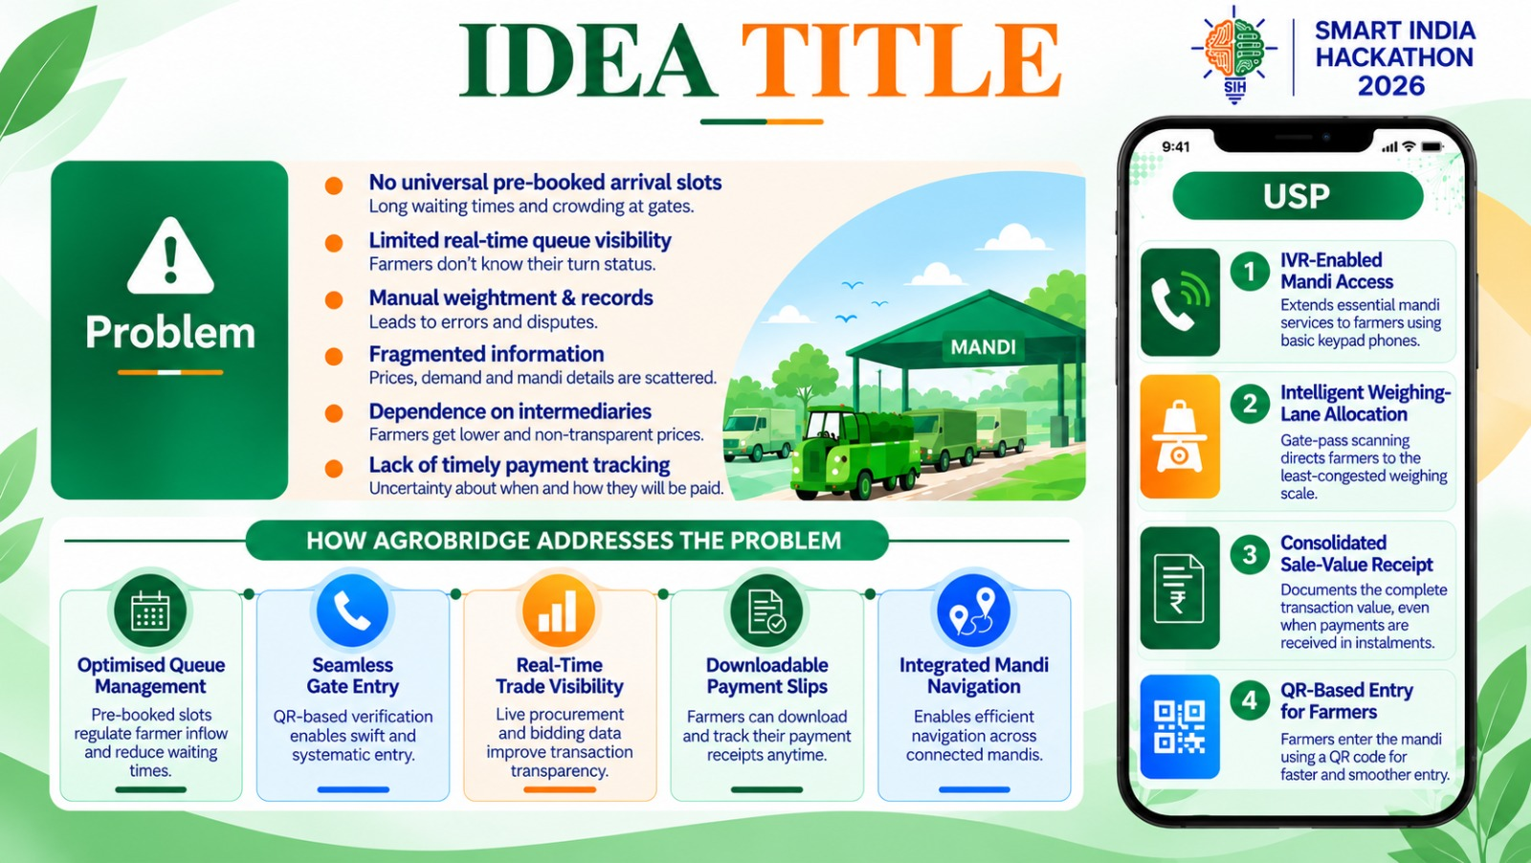
AgroBridge
AgroBridge – Smart Mandi Access & Management Platform
Digitalizing mandi access, queues and procurement for faster, more transparent farmer transactions (working prototype, SIH 2026 Round 2)
PROBLEM
SOLUTION
DIFFERENTIATORS
• Long waiting times / crowding at mandi gates
• No universal pre-booked arrival slots
• Limited real-time queue visibility for farmers
• Fragmented procurement schedules & status info
• Manual weightment / records → errors & disputes
• Uncertainty about payment timing
• Role-based app: Farmer, Mandi Staff, Trader, Arhtiya
• Slot booking + live queue / token visibility
• Gate scan → stage queues → assay → weigh → mark paid
• Capacity-aware yard / slot engine (JS)
• Multilingual UI: EN / HI / PA / MR
• Gemini chatbot + IVR path for feature phones (prototype)
• Crop / quintal-aware slot allocation model
• End-to-end mandi workflow in one prototype
• Offline-tolerant gate pass (QR / code)
• SMS outbox + Expo push notifications
• Mock gov adapters (govRail) for staged e-Kharid / MFMB
• Honest scope: prototype — not a live mandi deployment
ROUND 1 → ROUND 2 concept → working multi-role prototype
Delivered in repo: React Native / Expo app + Firebase / Firestore + capacity & queue engine + Node IVR/chatbot services (Render) + Gemini assistant + Firebase Hosting web build. Still pending: live telephony account (sim mode active), SMS gateway, production Firestore rules (Mode B), real government / MFMB / e-Kharid integration (mock adapters only), measured field impact.

Slide 3

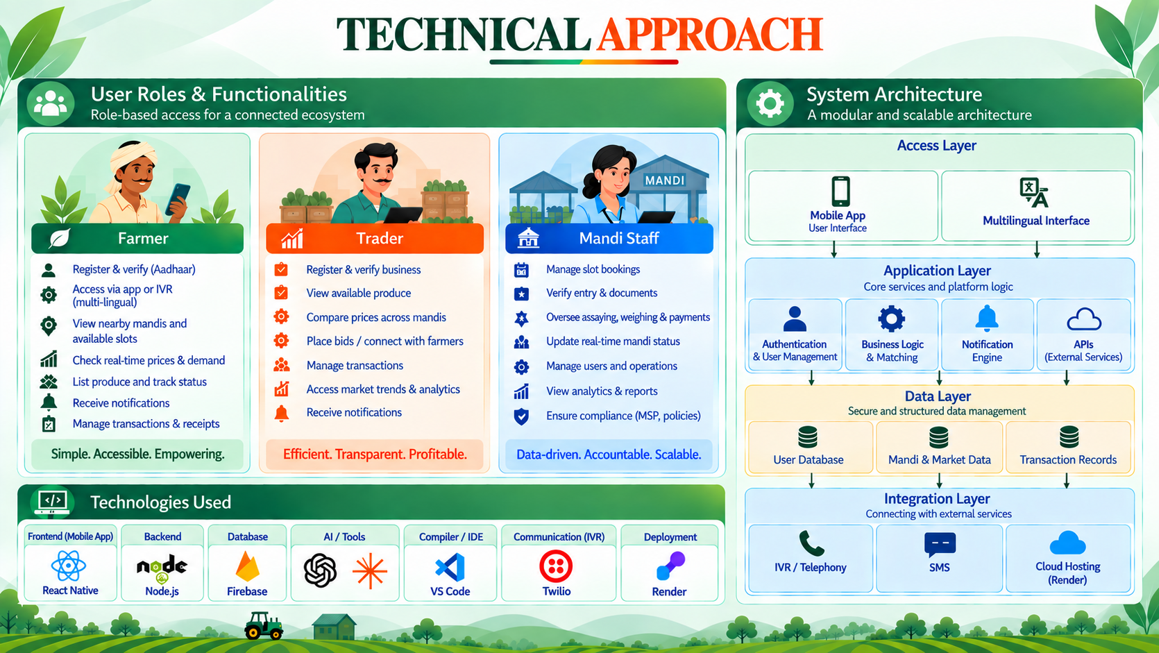
AgroBridge
SYSTEM ARCHITECTURE (CURRENT IMPLEMENTATION)
TECH STACK
Users: Farmer / Trader / Mandi Staff / Arhtiya
Layer | Technology | Purpose
Frontend | React Native 0.86 / Expo ~57 (JS) | Multi-role mobile app
Backend | Node.js Express on Render | IVR + chatbot services
Database | Firebase / Firestore | Bookings, queues, users, rules
AI | Gemini API | Assistant chatbot (EN/HI/Hinglish)
IVR / Voice | sim active; Plivo, Twilio coded | Feature-phone booking path
Web | Firebase Hosting | Static web build (dist)
Push / SMS | Expo push; SMS outbox queued | Notifications (SMS GW pending)
Engine | JS capacity / queue / noshow models | Slot & throughput logic
Testing | Firebase Emulator Suite | Local functions / firestore tests
▼
React Native + Expo app (iOS / Android / Web)
▼
App services + capacity / queue engine (JS)
▼
Firebase / Firestore
bookings, queues, users, rules
Node.js (Express) on Render
IVR + chatbot: /health /voice /chat…
Queue / slot data + notifications
Expo push + SMS outbox (gateway pending)
Telephony: sim (active)
Plivo / Twilio coded, not live
Chatbot: ChatbotScreen → Node /chat → Gemini API
USER ROLES (IMPLEMENTED)
Honest stack notes: Firebase project agrobridge-sih26; TESTING_MODE=true; government rail = mock adapters; hosting = Firebase Hosting (dist) + Render free tier.
Farmer: register, book slot, queue/token, status, chatbot. Mandi Staff: gate scan, stages, assay, weigh, mark paid, reports.
Trader: auction board & bidding (prototype). Arhtiya: bulk booking for linked farmers (prototype).

Slide 4
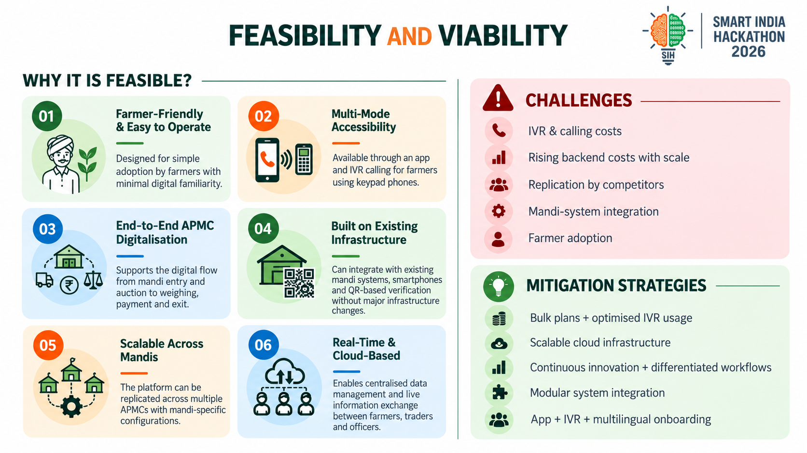
AgroBridge
WHY IT IS FEASIBLE?
CHALLENGES
MITIGATION STRATEGIES
• Working multi-role prototype already in repo
• Modular RN/Expo + Node + Firestore architecture
• Firebase Hosting web build + emulator tests present
• Capacity / queue engine + noshow models implemented
• Gemini chatbot wired through Node /chat
• SIM-based IVR path coded (default PROVIDER=sim)
• Mock govRail adapters ready for staged integration
• Farmer digital literacy & rural connectivity
• Adoption by mandi staff on legacy workflows
• IVR reliability — Twilio/Plivo accounts not live yet
• SMS gateway still queued in outbox (not delivered)
• External govt systems mocked (no live MFMB/e-Kharid)
• Data sync & scale during harvest peaks
• Firestore rules still Mode A (open) for testing
• Multilingual UI (EN / HI / PA / MR)
• IVR / keypad path for basic-phone users
• Simple farmer booking flow + QR gate pass
• Offline-tolerant gate pass verification
• Staged integration via mock adapters → live APIs
• Telemetry + report screens for monitoring
• Plan Mode B rules hardening before production
• Free-tier cloud (Firebase + Render) for cost control
ROUND 1 → ROUND 2: concept → working multi-role prototype (app + backend + engine + IVR/chatbot prototype).
Viability notes: cloud on free tiers for demo scale; telephony/SMS costs need paid accounts before production; no claimed government or mandi deployment yet.
Still pending: production security rules, SMS gateway, live Twilio/Plivo, real e-Kharid / MFMB integration, field pilot data.

Slide 5
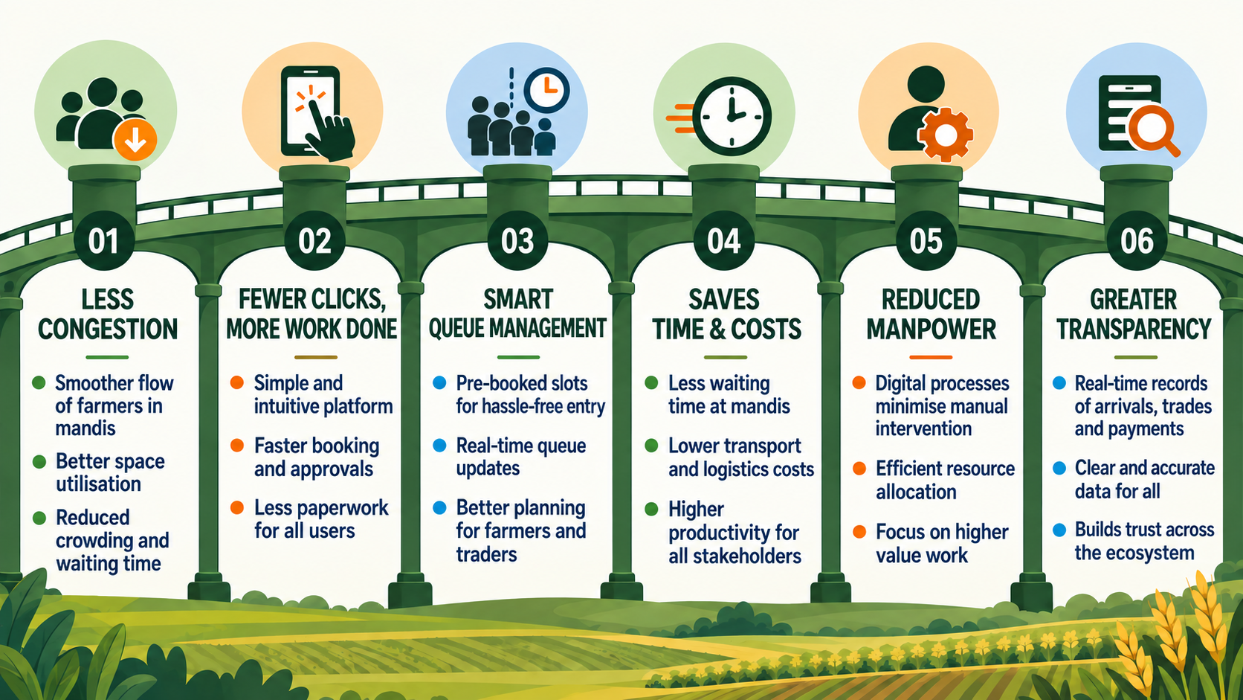
IMPACT AND BENEFITS
AgroBridge
FARMERS
MANDI STAFF
SYSTEM / TRANSPARENCY
• Know when to arrive via booked slot & live queue
• Less uncertainty on procurement schedule / status
• App + chatbot + IVR access path (prototype)
• Digital gate pass & downloadable receipts (in-app)
• Clearer visibility of assay / weigh / payment stages
• Stage-wise queue visibility (gate → assay → weigh → paid)
• Capacity / yard setup tools for planned inflow
• Gate scan reduces manual headcounts
• Reports & telemetry screens for operations
• Less ad-hoc coordination on peak days
• Digital records across the procurement chain
• Status visible to farmer, trader & staff together
• Modular workflow ready for staged govt integration
• Audit-friendly bookings, auctions & receipts (prototype)
IMPACT QUANTIFICATION — HONEST STATUS
Current prototype: no measured waiting-time, manpower or economic-impact results yet. Demo runs on seeded test accounts / simulator mode — not live mandi field data.
Projected / modelled benefits (to be validated with pilot data — not measured claims): scheduled arrival → fewer pre-dawn road queues; live status → fewer counter enquiries; capacity-aware slots → smoother peak-day flow; digital records → greater transparency.
Do not cite as achieved reductions: “less waiting time”, “saves time & costs”, “reduced manpower” are design goals only until pilot metrics exist.

Slide 6
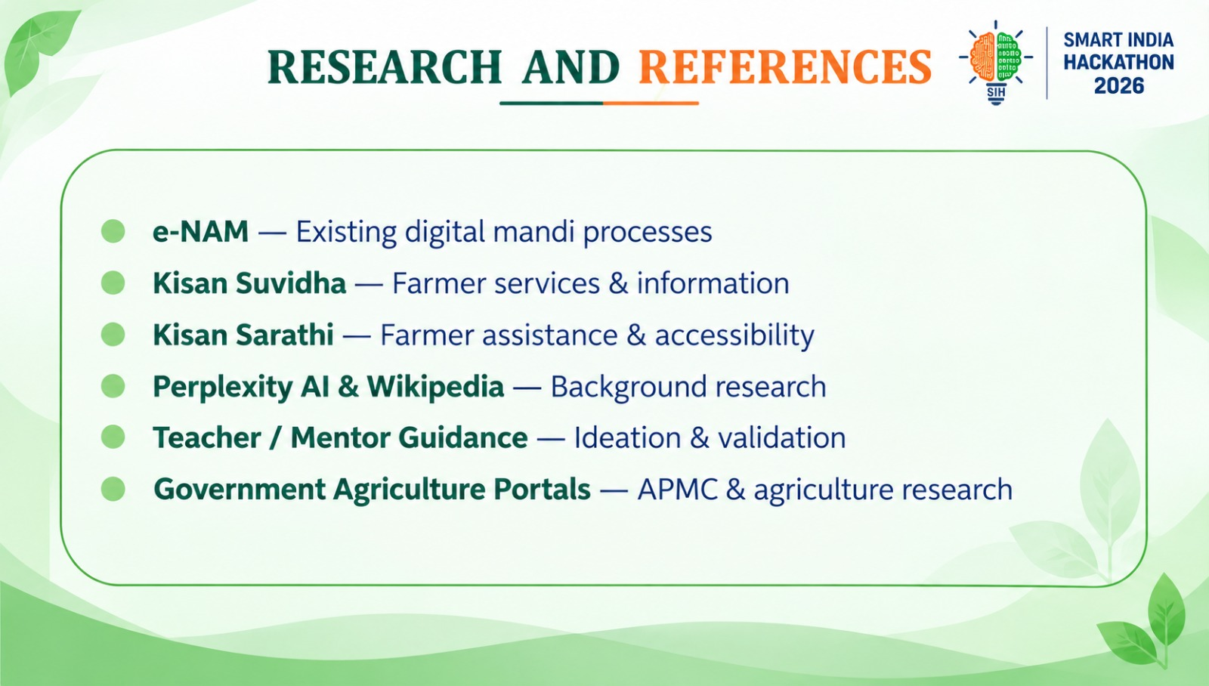
AgroBridge
Area | Source
APMC / mandi process | State APMC Act summaries; AgriStack & state marketing-board guidance (e.g., Haryana Agricultural Produce Markets Act) — agriharyana.gov.in
Govt procurement & MSP | Dept. of Food & Public Distribution; CACP MSP notifications — dfpd.gov.in; acac.gov.in
eNAM national e-trading | National Agriculture Market (eNAM), Ministry of Agriculture — enam.gov.in
Farmer registration | Meri Fasal Mera Byora (Haryana) & e-Kharid portals — mfmb.haryana.gov.in; ekharid.in
Quality norms (FAQ) | FCI / Govt of India FAQ norms for foodgrains — fci.gov.in
Digital agriculture context | ICAR / Ministry of Agriculture digital-agriculture material; NASSCOM & NABARD digital-inclusion studies
Technical: mobile & data | React Native / Expo docs (docs.expo.dev); Firebase / Firestore docs (firebase.google.com/docs)
Technical: AI & voice | Google Gemini API docs (ai.google.dev); Twilio & Plivo voice API docs (twilio.com/docs/voice; plivo.com/voice/api/)
In-product references | Kisan Suvidha & Kisan Sarathi (farmer services); eNAM — used as competitive/landscape research in Round 1
All sources are public government portals or official technical documentation. Round 1 background also used Kisan Suvidha / Kisan Sarathi / eNAM and mentor guidance — no fabricated references.

