Slide 1
UNCERTAINTY THROUGH THE SSC MODELLING CHAIN
From turbidity sensors
to SWAT, ANFIS and
climate-change projections
Six coastal watersheds of eastern Canada • 2026
Observed / reported evidence + explicitly identified remaining uncertainty
Notes:
Opening script (about 35 seconds):
"The objective is not simply to list uncertainty sources, but to show which parts of our observational and modelling chain have already been quantified and which require further propagation. I distinguish sensor and rating-curve errors, SWAT's SUFI-2 ensemble, ANFIS predictive uncertainty, and uncertainty across the CMIP6-driven climate projections. These components are not automatically additive."
Source: Es Salhi et al., manuscript dated 19 October 2026 and revised supplementary figures; Cocagne rating curve supplied 11 November 2026.

Slide 2
UNCERTAINTY PROPAGATION
A scientifically correct propagation architecture
The observed SSC series constrain two model pathways; future climate forcing is propagated through the actual projection model.
1 Sensor and lab SSC
2 Rating curves
Turbidity, sampling, sensor drift
Six watershed-specific relationships
3A SWAT | six basins
3B Local + regional ANFIS
SUFI-2 95PPU; p-factor; r-factor
Cross-validation and predictive spread
4 CMIP6 climate forcing
5 Future SSC / GEV
5 GCMs × 2 SSPs → bias correction
Climate-driven SWAT and return levels
No SWAT → ANFIS uncertainty propagation is assumed unless ANFIS explicitly uses SWAT-generated inputs.
Dunk / West / Morell / Bouctouche / Cocagne / South Antigonish
2
Notes:
Suggested spoken comment (about 60 seconds):
"The first two stages generate uncertain SSC observations. SWAT and ANFIS then learn from, or are evaluated against, these same observations. They are parallel approaches, not a compulsory SWAT-to-ANFIS chain. My climate-change analysis uses the CMIP6 forcing through the SWAT modelling pathway, followed by extreme-value analysis. Thus I would not transfer SWAT's p-factor or r-factor numerically to ANFIS, or add all errors into a single percentage. Instead I would draw joint realizations for the particular quantity being projected."
Technical notes: The published SWAT manuscript details six basins and SUFI-2; the 15-minute prior presentation describes CMIP6 → SWAT; ANFIS climate simulation would need separate future Q/Kr/LAI drivers. Any line representing those drivers must match the actual implemented workflow.
References: JCGM 101:2008, DOI 10.59161/JCGM101-2008; IPCC AR6 WGI Chapter 10, sec. 10.3.4, https://www.ipcc.ch/report/ar6/wg1/chapter/chapter-10/.

Slide 3
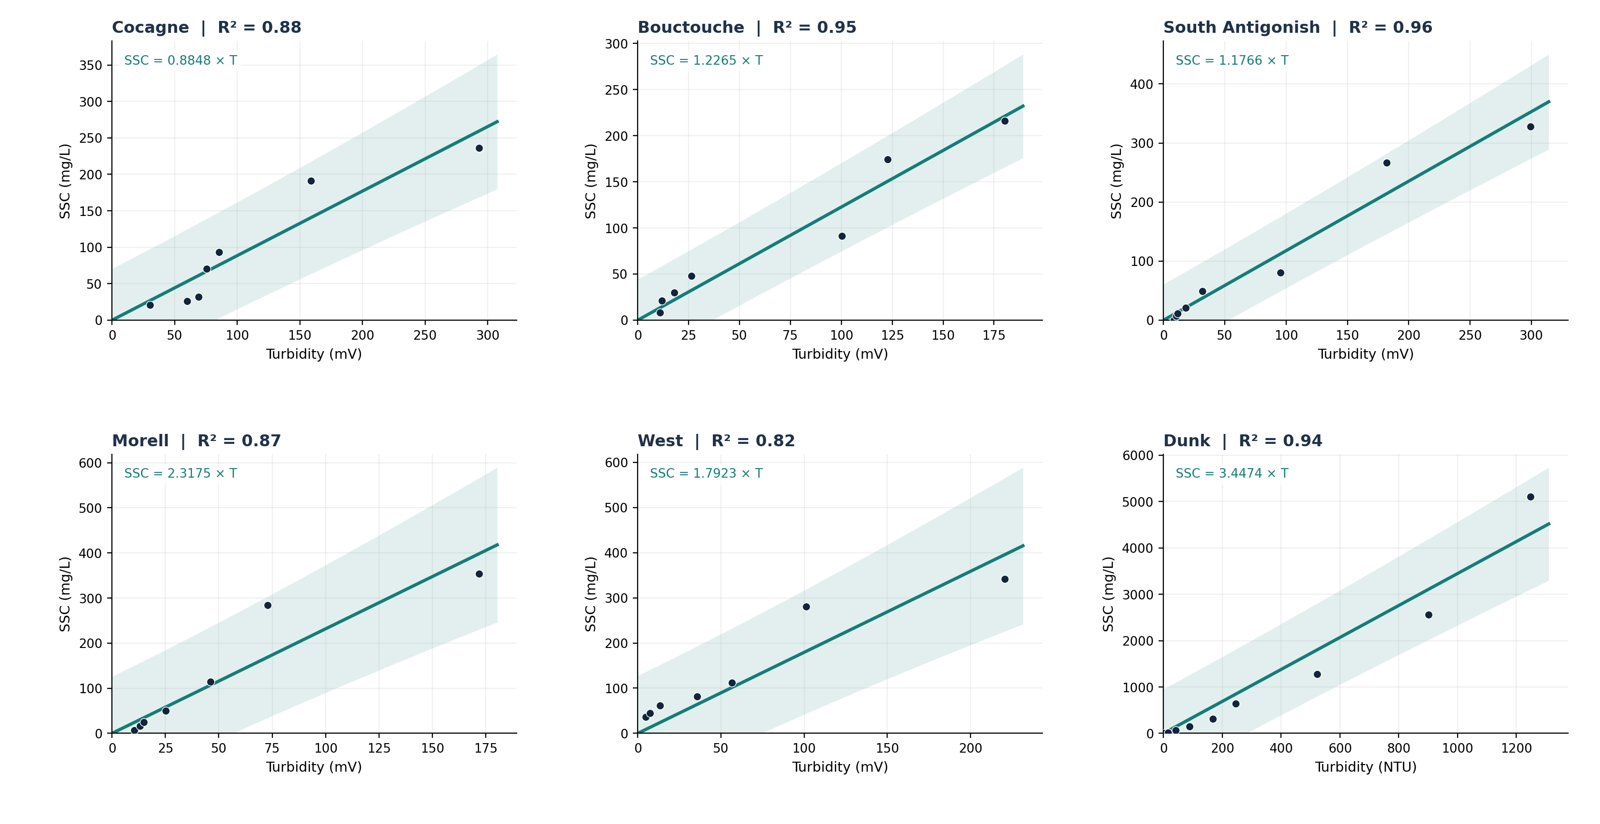
UNCERTAINTY PROPAGATION
Six turbidity–SSC rating curves, now including Cocagne
Black points are digitized from figures; lines use the published coefficients; shading is reconstructed, not the original dashed confidence band.
Exploratory constant-variance through-origin PIs; USGS TM 3-C4 advises log-space fits. Sensor/lab error not yet included.
Dunk / West / Morell / Bouctouche / Cocagne / South Antigonish
3
Notes:
Suggested spoken comment (about 70 seconds):
"The six rating curves are now included. The five originally in Figure S8 were Morell, Dunk, West, South Antigonish and Bouctouche; Cocagne was supplied separately. Black points are read approximately from the printed plots; the straight lines use the coefficients printed on the plots. The pale bands are OUR approximate pointwise 95% prediction intervals based on the reconstructed residuals. They must not be confused with the published dashed intervals, which are labelled '95% confidence interval' but whose exact construction is not provided in the present PDF. These preliminary estimates quantify rating-curve residual and fitting uncertainty under a simple model, not the complete instrumental or sampling error."
Published slopes/R²: Cocagne SSC=0.8848T, R²=.88; Bouctouche SSC=1.2265T, R²=.95; South Antigonish SSC=1.1766T, R²=.96; Morell SSC=2.3175T, R²=.87; West SSC=1.7923T, R²=.82; Dunk SSC=3.4474T, R²=.94. Cocagne from supplied image; remaining curves from Supplemental Material-rev2, Figure S8, PDF p.7. T in NTU at Dunk and in mV elsewhere (manuscript section 2.3).
Approximation: y=b*x with forced zero intercept. Residual SD s=sqrt(sum[(y_i-bx_i)^2]/(n-1)); at x0, PI yhat +/- t(0.975,n-1)*s*sqrt(1+x0²/sum(x_i²)). Negative SSC lower bounds clipped at zero for plotting. This is a first-pass formula; unmodeled heteroscedasticity, turbidity sensor accuracy, laboratory preparation bias, time-series dependence and reconstruction error could affect interval calibration.
Reference: Rasmussen et al. (2009), USGS TM 3-C4, DOI 10.3133/tm3C4, recommends site-specific regression, diagnostics and uncertainty analysis.
Reviewer caveat (added): The through-origin, constant-variance fit conflicts with USGS TM 3-C4 (Rasmussen et al., 2009), which recommends log-transformed regression with a bias-correction (smearing) factor. A symmetric normal PI can also fall below zero at low turbidity, which is physically impossible for SSC — a sign the low end is mis-specified. Treat these bands as a deliberately simple exploratory layer pending log-space refits with the original calibration tables.
Cocagne worked example (merged from former slide 4): Cocagne is the sixth curve, supplied separately on 11 November 2026 and now shown in the grid above. Its published fit is SSC = 0.8848 × T with R² = 0.88 from ~7 visible points. Under the simple through-origin model, 100 mV gives ≈ 88.5 mg/L with an approximate individual-value 95% prediction interval of 14.8–162.1 mg/L — indicative only, given the digitized points. Two interpretation points to state aloud: (1) do NOT equate 1 − R² (here 12%) with a 12% measurement uncertainty — it is variance unexplained, not an error budget; (2) this individual-value prediction interval is wider than a confidence interval for the regression mean, and neither equals the plotted dashed “95% CI”, whose construction is not given in the source.

Slide 4
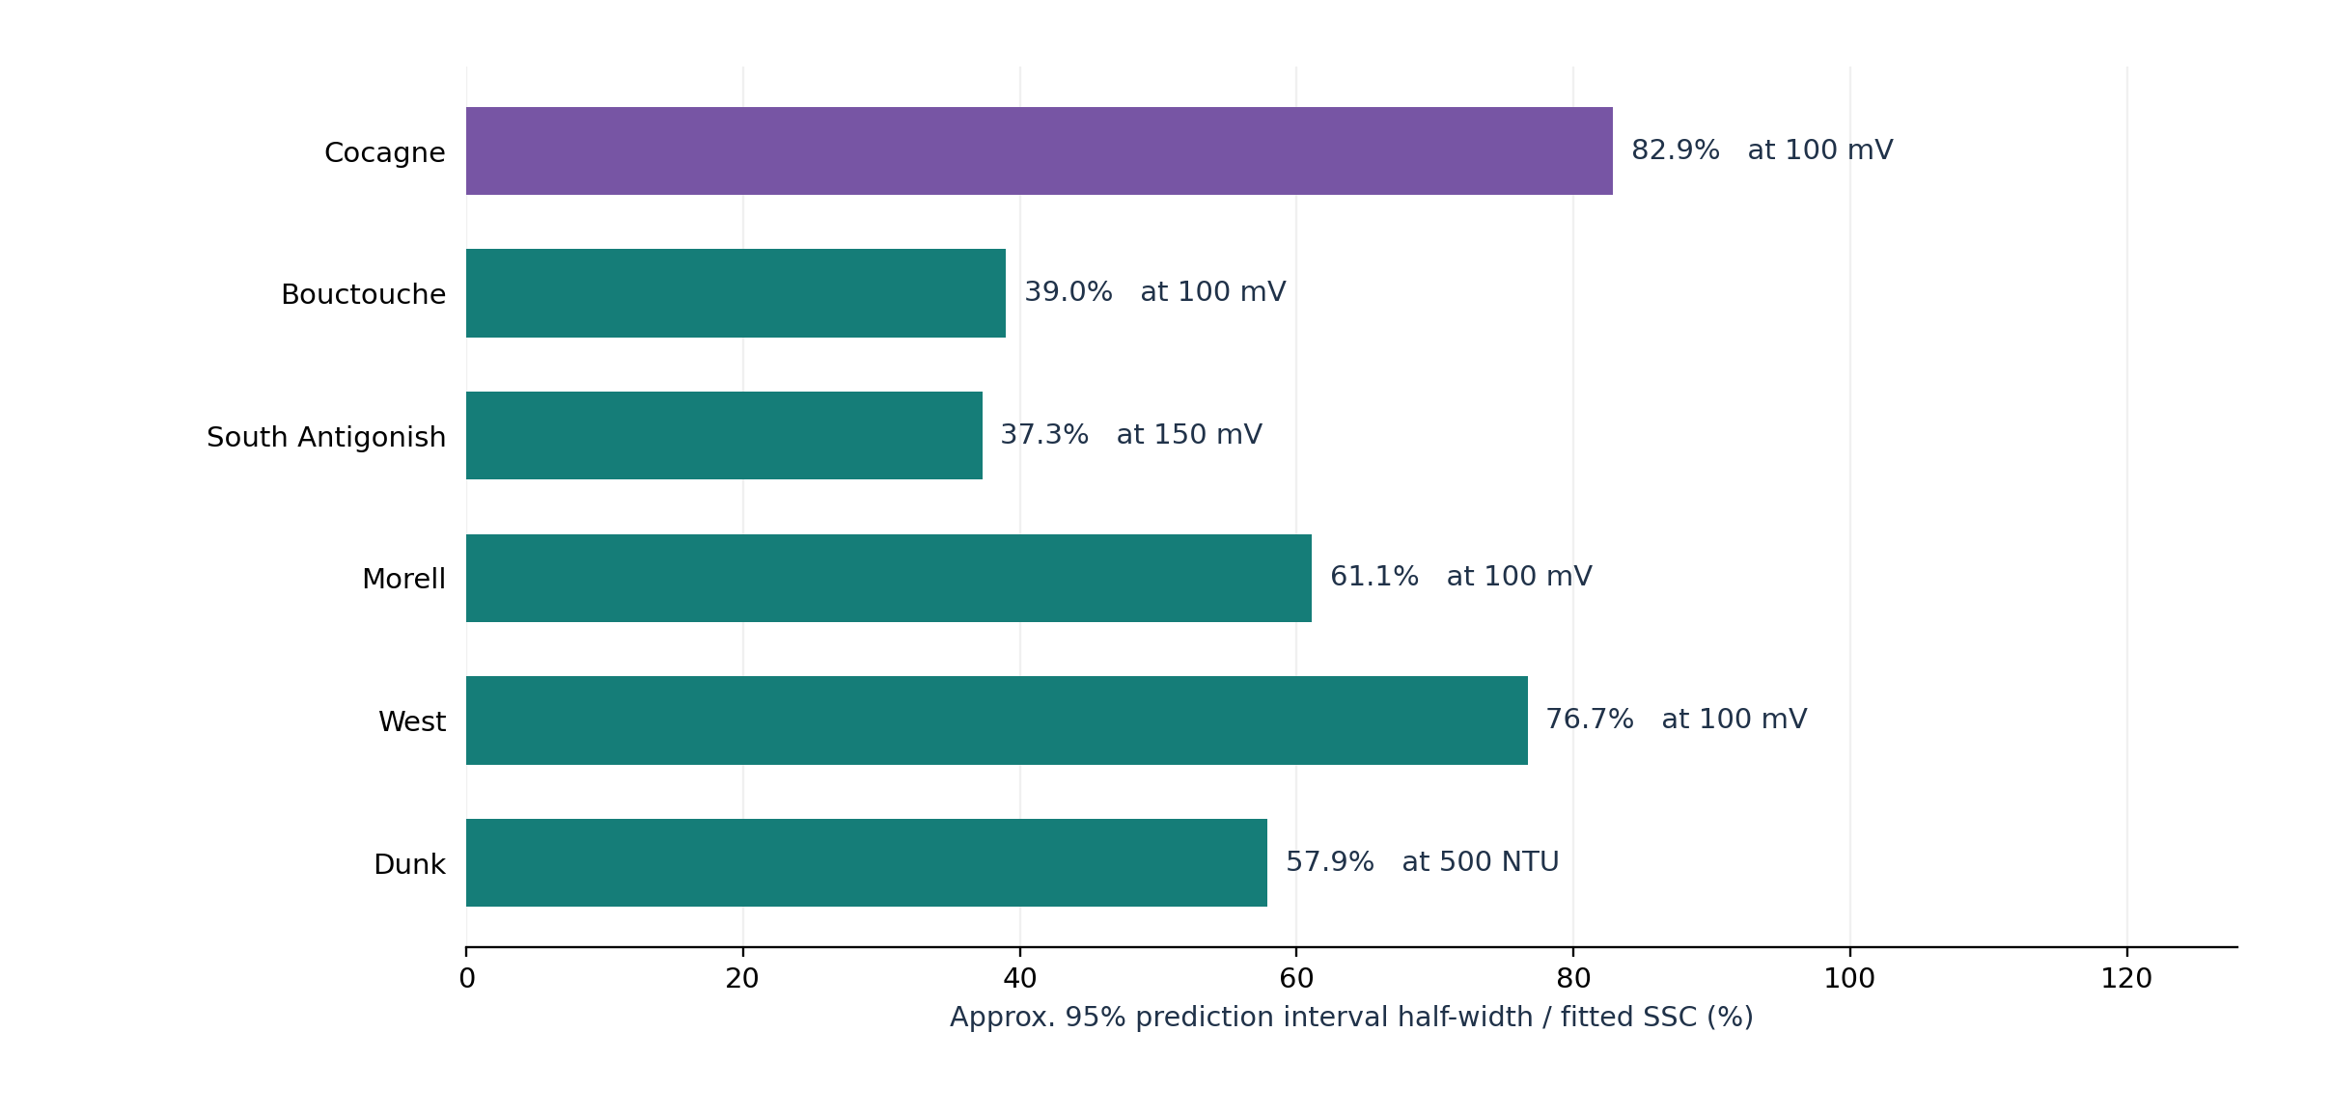
UNCERTAINTY PROPAGATION
Rating-curve uncertainty: first quantitative layer
Approximate 95% PI half-width relative to fitted SSC, evaluated at an illustrative turbidity for each watershed.
Not end-to-end: half-widths are read at differing turbidities, so they rank neither instrument nor watershed quality; sensor/lab error excluded.
Dunk / West / Morell / Bouctouche / Cocagne / South Antigonish
4
Notes:
Suggested spoken comment (about 55 seconds):
"This chart summarizes one specific uncertainty source: residual dispersion around each individual turbidity-to-SSC relation, converted to a 95% prediction-interval half-width. It is not an instrument accuracy percentage, nor a full SSC uncertainty budget. The values are calculated at illustrative turbidity levels indicated alongside each bar; therefore the percentages are not a direct ranking of instrument quality or watershed quality. Cocagne is included. Before publication, I would replace the digitized coordinates with the original calibration table and assess residual heteroscedasticity, especially for very high SSC values at Dunk."
Sources: Supplement Figure S8 (five curves), supplied Cocagne curve; pointwise PI formula from through-origin linear regression. Data plotted from the new Six_Watershed_Rating_Uncertainty_Summary.csv.
Important: all intervals rely on just 7–9 approximate points. The 95% label reflects nominal statistical assumptions, not empirically validated 95% coverage.
References: Rasmussen et al., 2009, DOI 10.3133/tm3C4; JCGM 101, DOI 10.59161/JCGM101-2008.
Reviewer caveat (added): For a through-origin fit the PI half-width expressed as a fraction of the fitted SSC falls as turbidity rises, so bars evaluated at different turbidities cannot be read as a ranking of instrument or watershed quality. Before publication, recompute at a common reference turbidity (or over each curve's observed range) and test for residual heteroscedasticity, especially the high-SSC tail at Dunk.

Slide 5
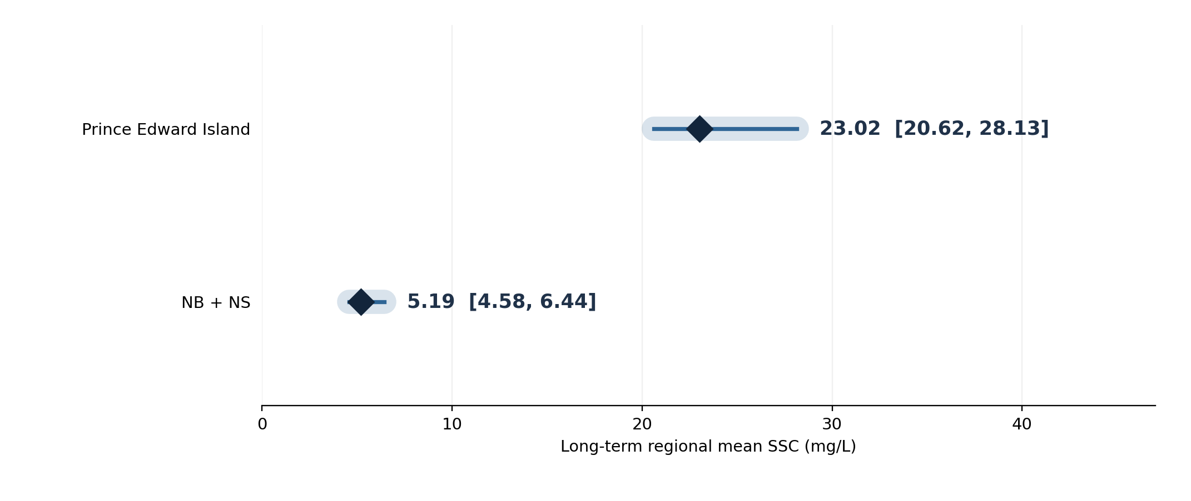
UNCERTAINTY PROPAGATION
SWAT: SUFI-2 already quantifies one part of model uncertainty
Reported regional mean SSC and 95PPU ranges, SWAT manuscript dated 19 October 2026.
301
57–100%
1.06 / 2.53–3.89
parameter sets / basin
SSC 95PPU p-factor
r: Dunk / other five
r-factor is tight only for Dunk (1.06); 2.53–3.89 elsewhere means wide, weakly-identified 95PPU — a high p-factor there is not reassurance.
Dunk / West / Morell / Bouctouche / Cocagne / South Antigonish
5
Notes:
Suggested spoken comment (about 70 seconds):
"SWAT is the most advanced quantified component in this uncertainty assessment. The October 2026 manuscript reports 301 Latin-hypercube parameter sets per watershed, includes precipitation adjustments from minus fifteen to plus fifteen percent and retains 257 to 301 behavioral simulations. The observed SSC series falls inside the daily 95PPU envelope 57 to 100 percent of the time. The r-factor is 1.06 for Dunk and 2.53 to 3.89 for the other five short-period sites. The long-term regional mean SSC for PEI is 23.02 mg/L with a 95PPU range 20.62 to 28.13; the New Brunswick and Nova Scotia regional mean is 5.19 mg/L with a range 4.58 to 6.44. Those intervals do not overlap in the reported SWAT analysis."
Distinguish the terms: p-factor = percentage of observations falling inside the model ensemble band, NOT parameter uncertainty in percent. r-factor = mean 95PPU width divided by observational SD; larger bands can give artificially high coverage. NSE and KGE are goodness-of-fit statistics, NOT prediction intervals.
Explicit limitation: the existing 95PPU was generated from parameter/rainfall perturbations; observational uncertainty from sensor and rating regression was not independently sampled and propagated through the SWAT calibration. Five sites have calibration-only SSC results; Dunk was temporally validated (2012–2021 calibration, 2022–2023 validation), as stated in the manuscript.
Primary source: Manuscript_AzizEssalhi_20261019_submission_clean.pdf, section 'Uncertainty analysis', lines 390–402; Results lines 472–486; Discussion uncertainty limitations; cited Abbaspour 2015 SWAT-CUP manual.
Reviewer caveat (added): A high p-factor is only reassuring alongside an acceptable r-factor. Only Dunk (r = 1.06) is well constrained; r = 2.53–3.89 for the five short-record basins indicates wide, weakly-identified 95PPU bands, so p-factors near 100% there reflect a permissive envelope, not tight calibration. The non-overlapping PEI vs NB/NS 95PPU ranges are suggestive of a regional difference, not a formal significance test, since the envelopes are parameter-uncertainty ranges over different stations and periods.

Slide 6
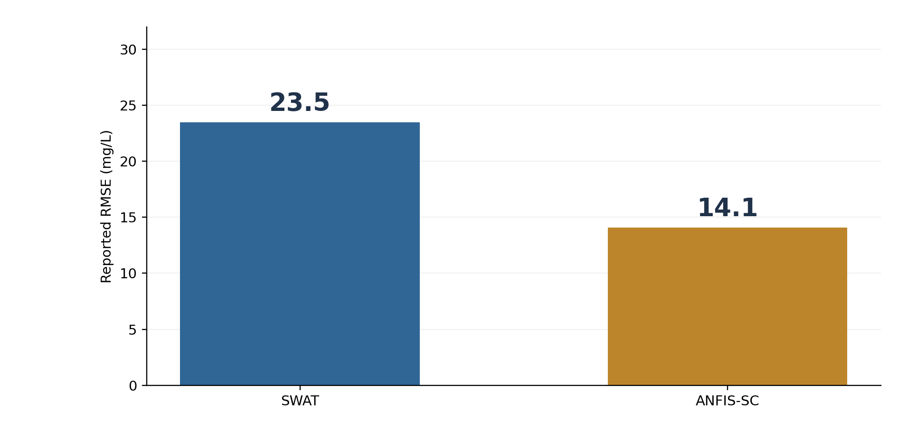
UNCERTAINTY PROPAGATION
Local ANFIS: smaller errors do not prove smaller uncertainty
Dunk reported performance must be evaluated on comparable test periods before making model-to-model uncertainty claims.
Performance
Reported SWAT KGE ≈ 0.63; ANFIS-SC KGE ≈ 0.81
Needed for uncertainty
Time-aware out-of-fold SSC; 95% PI; empirical coverage; interval width
RMSE and KGE measure prediction skill; they are not direct measures of prediction-interval coverage or width.
Dunk / West / Morell / Bouctouche / Cocagne / South Antigonish
6
Notes:
Suggested spoken comment (about 65 seconds):
"In previous Dunk comparisons, the reported RMSE was 23.5 mg/L for SWAT and 14.1 mg/L for ANFIS-SC, with corresponding KGE values near 0.63 and 0.81. But ANFIS-SC KGE of about 0.806 was previously discussed as a full-fit statistic, whereas the SWAT manuscript reports temporal validation for Dunk. Until the evaluation design and years are matched, these numbers cannot support an independent generalization claim. More importantly, neither RMSE nor KGE measures the coverage or width of an SSC prediction interval. To quantify ANFIS uncertainty, create leakage-free out-of-fold predictions, use block-based calibration for serially dependent data, and report empirical 95% interval coverage and mean interval width."
This slide quotes earlier user-reported performance values; these ANFIS numbers are not verified in the two PDFs used here. Please check the final ANFIS dataset before using them as a journal result.
Reference: Roberts et al. (2017), Cross-validation strategies for data with temporal, spatial, hierarchical, or phylogenetic structure, Ecography 40, 913–929, DOI 10.1111/ecog.02881; Gneiting and Raftery (2007), JASA, DOI 10.1198/016214506000001437.

Slide 7
UNCERTAINTY PROPAGATION
Regional ANFIS: quantify transfer beyond the training watersheds
A watershed-held-out experiment answers a different question from ordinary random K-fold cross-validation.
Cocagne
Bouctouche
South Antigonish
Hold out this basin → predict SSC
Hold out this basin → predict SSC
Hold out this basin → predict SSC
Morell
West
Dunk
Hold out this basin → predict SSC
Hold out this basin → predict SSC
Hold out this basin → predict SSC
Per held-out watershed: RMSE / KGE + 95% interval coverage + mean interval width
No regional ANFIS uncertainty numbers are invented here: grouped held-out predictions are required.
Dunk / West / Morell / Bouctouche / Cocagne / South Antigonish
7
Notes:
Suggested spoken comment (about 55 seconds):
"For a regional ANFIS model trained on six rivers, uncertainty has a spatial component. If the aim is transferability to a new watershed, random K-fold cross-validation can leak basin-specific information between train and test partitions. I would therefore repeat the assessment six times, holding out one entire watershed at a time. For each held-out basin I would report RMSE, KGE, and, after constructing prediction intervals, interval coverage and mean interval width. This does not require claiming that the six folds are independent random experiments; with six basins the sampling uncertainty remains substantial."
Caveats: A leave-one-watershed-out test measures extrapolation to a new watershed, not necessarily accuracy for new dates in already-observed watersheds. Evaluate both tests if both operational purposes matter. If the regional data record or predictor architecture already contains a legitimate group-based CV, reuse the predictions before retraining.
Reference: Roberts et al. 2017 Ecography 40:913–929, DOI 10.1111/ecog.02881; Gneiting & Raftery 2007 JASA on predictive distributions and interval scores.

Slide 8
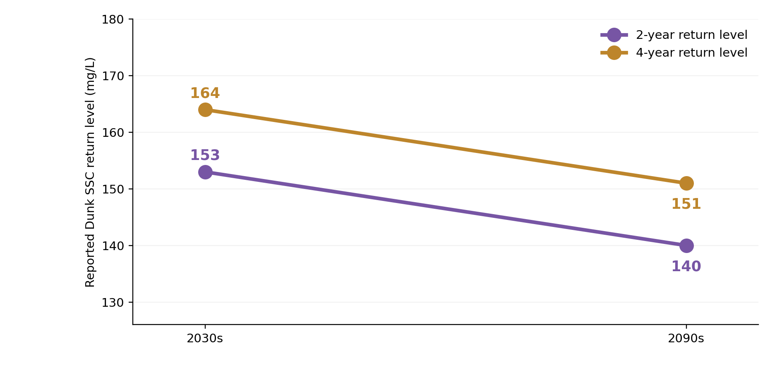
UNCERTAINTY PROPAGATION
Climate change: reported signal is not its uncertainty
Dunk example: SSP5-8.5, reported return-level change from the 2030s to the 2090s (values from prior discussion).
−8.5%
2-year level
−7.9%
4-year level
Missing from this chart: individual GCM spread, bias correction spread, SWAT parameter spread, GEV estimation uncertainty.
Do not describe these two trend lines as 95% uncertainty intervals. They show change estimates only.
Dunk / West / Morell / Bouctouche / Cocagne / South Antigonish
8
Notes:
Suggested spoken comment (about 65 seconds):
"For Dunk under SSP5-8.5, our previously discussed summary reports the 2-year SSC return level changing from about 153 to 140 mg/L, and the 4-year level from about 164 to 151 mg/L, between the 2030s and 2090s. These correspond to reductions of approximately 8.5 and 7.9 percent. But these are changes in the estimated return levels—not climate prediction intervals. A defensible uncertainty interval requires retaining the individual GCM outputs, the uncertainty of the bias correction, uncertainty in SWAT parameters or ANFIS predictions if actually used, and GEV estimation uncertainty. Until that is computed, the sign of change should not be called statistically robust."
Caution: These specific Dunk values were retrieved from the previously discussed PhD results; the two uploaded PDFs do not contain climate GEV output, so verify against the original Article 3 calculations before public release. The term '2030s' is carried over from the user's previously reported summary; verify its exact period definition in Article 3.
References: IPCC AR6 WGI Chapter 10, section 10.3.4, model, scenario and internal variability; Coles (2001), An Introduction to Statistical Modeling of Extreme Values, DOI 10.1007/978-1-4471-3675-0; Hawkins and Sutton (2009), BAMS, DOI 10.1175/2009BAMS2607.1.

Slide 9
UNCERTAINTY PROPAGATION
What a true end-to-end propagation experiment would do
Use aligned ensembles, not additive NSE/KGE or an arithmetic sum of the six-stage percentages.
A Observation ensemble
B SWAT or ANFIS
C Climate-driven runs
Perturb sensor + refit SSC rating
Refit / sample the applicable model
GCM × SSP × model realizations
For each realization m:
Y(m) = F[SSCobs(m), parameters(m), climate(m)]
Daily SSC: 2.5th / 50th / 97.5th percentiles
GEV return levels: ensemble + sampling intervals
When uncertainty sources are correlated, sample them jointly; do not double-count variability already in SUFI-2.
Dunk / West / Morell / Bouctouche / Cocagne / South Antigonish
9
Notes:
Suggested spoken comment (about 65 seconds):
"For an end-to-end uncertainty statement, we must define a final quantity first, such as the mean SSC, the annual sediment load, or a future 4-year SSC return level. In each realization, perturb the upstream observations according to justified sensor and rating distributions, then run or sample the relevant calibrated model, and for future projections combine the result with climate ensemble members and a resampled GEV fit. Quantiles across these realizations create intervals. Because some uncertainty components are dependent or already represented by SUFI-2, we must not assume independence or sum uncertainties in quadrature indiscriminately."
Technical qualifications: The formula is conceptual. If an existing SWAT behavioral ensemble is reused without recalibration, observational rating uncertainty is not fully propagated into parameter inference, so label it a conditional/sensitivity experiment. For ANFIS, perturb both targets and, where appropriate, predictor measurement errors; refit in leakage-safe folds. For climate, keep separate draws for GCM selection, emission scenario, internal variability if available, bias adjustment and GEV fitting. In Bayesian terms, integrate over the corresponding hierarchical predictive distributions; in a frequentist approach, use a hierarchical/bootstrap ensemble with explicit assumptions.
Reference: JCGM 101:2008, https://doi.org/10.59161/JCGM101-2008; IPCC AR6 Chapter 10, sec. 10.3.4; Gneiting and Raftery (2007), DOI 10.1198/016214506000001437.

Slide 10
UNCERTAINTY PROPAGATION
What you can defend now versus what is still needed
Uncertainty definitions have to remain consistent in the figures and oral explanation.
Layer
Current evidence
Claim supported now
Instruments
Sensor types and QA described
Accuracy contribution not yet estimated
Rating curves
6 curves; 45 digitized plot points
Approx. PI under stated assumptions
SWAT
301 sets; 95PPU; p and r
Partial parameter/forcing uncertainty
Local ANFIS
Reported error metrics
Predictive interval not established
Regional ANFIS
Six-basin regional framework
Transferability interval not established
Climate / GEV
Previously reported Dunk changes
Full 95% future interval not established
Do not label the reconstructed rating-curve PI or SUFI-2 95PPU as the total propagated uncertainty.
Dunk / West / Morell / Bouctouche / Cocagne / South Antigonish
10
Notes:
Suggested spoken comment (about 60 seconds):
"This slide is the audit table for a defensible thesis presentation. For sensors, we know the instruments used, but cannot estimate site-specific calibration drift and accuracy without the original records. For rating curves, we have six published fits and 45 approximately digitized points, producing indicative prediction intervals—not final laboratory uncertainty. For SWAT, we do have SUFI-2 parameter and rainfall ensembles and their coverage diagnostics. For local ANFIS we have model skill metrics but not a statistically validated 95% SSC predictive interval. For regional ANFIS we need spatially held-out predictions. For the climate study we have estimated changes but not joint GCM, hydrological model and GEV intervals. This is a coherent uncertainty assessment rather than an unsupported all-in-one percentage."
Sources: Es Salhi et al. (2026) manuscript; supplemental Figure S8; supplied Cocagne graph; prior ANFIS and climate summaries noted as not independently validated against original output files.

Slide 11
UNCERTAINTY PROPAGATION
Three messages to emphasize during your defense
Short, accurate comments that do not overstate predictive certainty.
01
Observation uncertainty
The turbidity–SSC conversion is uncertain. Six site-specific curves now permit a first approximate 95% prediction-interval analysis.
02
Model uncertainty
SWAT uncertainty is already represented conditionally by SUFI-2 95PPU; NSE and KGE assess fit, and ANFIS needs out-of-sample predictive intervals.
03
Climate uncertainty
A projected shift in SSC return levels is not itself an uncertainty interval; GCM, scenario, model, and GEV effects must be quantified separately.
Final objective: estimate a 95% interval for a clearly named output, not one generic uncertainty percentage.
Dunk / West / Morell / Bouctouche / Cocagne / South Antigonish
11
Notes:
Suggested closing script (about 50 seconds):
"The present work has established the observational foundation, including six site-specific turbidity-to-SSC curves. The SWAT component already includes a carefully designed SUFI-2 uncertainty ensemble, which can be reported directly. The principal remaining task is to carry measurement uncertainty into model evaluation and derive prediction intervals for local and regional ANFIS, before quantifying the combined future climate and GEV uncertainty. The essential scientific distinction is between goodness of fit, model ensemble width, and the confidence with which we can forecast a specific SSC quantity."
References: USGS 2009; JCGM 101:2008; Roberts et al. 2017; IPCC 2021 Chapter 10; Coles 2001.

Slide 12
UNCERTAINTY PROPAGATION
Key methodological references and source provenance
Full URLs are provided in the PowerPoint speaker notes.
Rasmussen et al. (2009)
USGS TM 3-C4 • SSC from turbidity and streamflow • DOI: 10.3133/tm3C4
Abbaspour (2015)
SWAT-CUP user manual • SUFI-2 / 95PPU / p-factor / r-factor
JCGM (2008)
GUM Supplement 1 • Monte Carlo propagation • DOI: 10.59161/JCGM101-2008
Roberts et al. (2017)
Ecography • Structured spatial/temporal cross-validation • DOI: 10.1111/ecog.02881
Gneiting & Raftery (2007)
JASA • Probabilistic intervals and scoring • DOI: 10.1198/016214506000001437
IPCC AR6 WGI (2021)
Chapter 10 §10.3.4 • Regional-climate uncertainty and propagation
Coles (2001)
Springer • GEV/return-level inference • DOI: 10.1007/978-1-4471-3675-0
Data source: 19 Oct 2026 SWAT manuscript, Supplement Figure S8, Cocagne image, and previously discussed ANFIS/climate summaries.
Dunk / West / Morell / Bouctouche / Cocagne / South Antigonish
12
Notes:
Bibliographic details and verified links:
1. Rasmussen, P. P., Gray, J. R., Glysson, G. D., & Ziegler, A. C. (2009). Guidelines and Procedures for Computing Time-Series Suspended-Sediment Concentrations and Loads from In-Stream Turbidity-Sensor and Streamflow Data. USGS Techniques and Methods 3-C4. https://doi.org/10.3133/tm3C4
2. Abbaspour, K. C. (2015). SWAT-CUP user manual / SUFI-2. https://14631662684144277490.googlegroups.com/attach/117877ebeb3be6e2/Usermanual_SwatCup.pdf (public manual as retrieved; may change). Method described and cited by the 19 Oct 2026 manuscript.
3. JCGM (2008). Evaluation of measurement data—Supplement 1 to the Guide to the expression of uncertainty in measurement: Propagation of distributions using a Monte Carlo method. https://doi.org/10.59161/JCGM101-2008
4. Roberts, D. R., et al. (2017). Cross-validation strategies for data with temporal, spatial, hierarchical, or phylogenetic structure. Ecography, 40, 913–929. https://doi.org/10.1111/ecog.02881
5. Gneiting, T., & Raftery, A. E. (2007). Strictly Proper Scoring Rules, Prediction, and Estimation. Journal of the American Statistical Association 102, 359–378. https://doi.org/10.1198/016214506000001437
6. IPCC (2021). AR6 Working Group I, Chapter 10, Linking Global to Regional Climate Change, Section 10.3.4. https://www.ipcc.ch/report/ar6/wg1/chapter/chapter-10/
7. Coles, S. (2001). An Introduction to Statistical Modeling of Extreme Values. Springer. https://doi.org/10.1007/978-1-4471-3675-0
8. Hawkins, E., & Sutton, R. (2009). The Potential to Narrow Uncertainty in Regional Climate Predictions. Bulletin of the American Meteorological Society 90, 1095–1108. https://doi.org/10.1175/2009BAMS2607.1
Study data: supplied Manuscript_AzizEssalhi_20261019_submission_clean.pdf, Supplemental Material-rev2.pdf, new Cocagne image SSCRatingCurve_CR(20261111-174056).png. Digitization uses manually approximated graph points. The ANFIS and climate figures use previously discussed values, not validated against the original ANFIS or climate spreadsheets in this turn. The source for SWAT regional mean 95PPU is manuscript results and cited (but not included) Table S8.

