Slide 1

Intro to Django
SoftUni Team
Technical Trainers
Software University
https://softuni.bg

Slide 2
Table of Contents
What is Django?
Django project
Django applications
Terminal commands
2

Slide 3
Have a Question?
sli.do
#python-web

Slide 4

Django
Fullstack framework for perfectionists with deadlines

Slide 5
What is Django?
High-level Python Web framework
Ridiculously fast
Reassuringly secure
Exceedingly scalable
Free and Open Source
5

Slide 6

Django Project
Where the magic happens

Slide 7
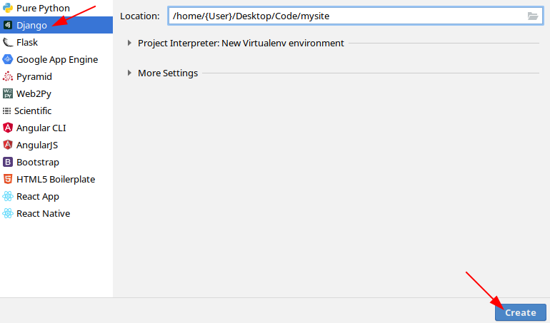
Creating a Django Project

Slide 8
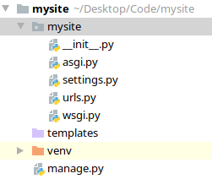
Folder Structure (1)
__init__.py
The directory is a Python package
settings.py
The configuration file for the Django Project
urls.py
Table of Content
manage.py
Tool for executing commands

Slide 9
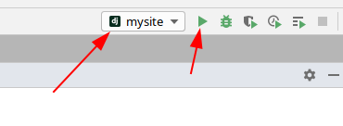
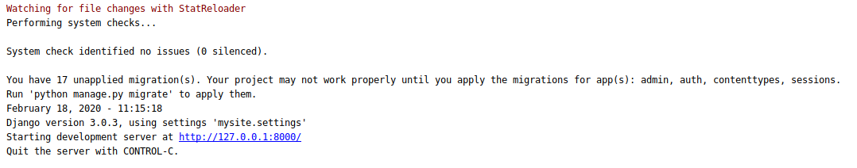
Running a Django Project (1)

Slide 10
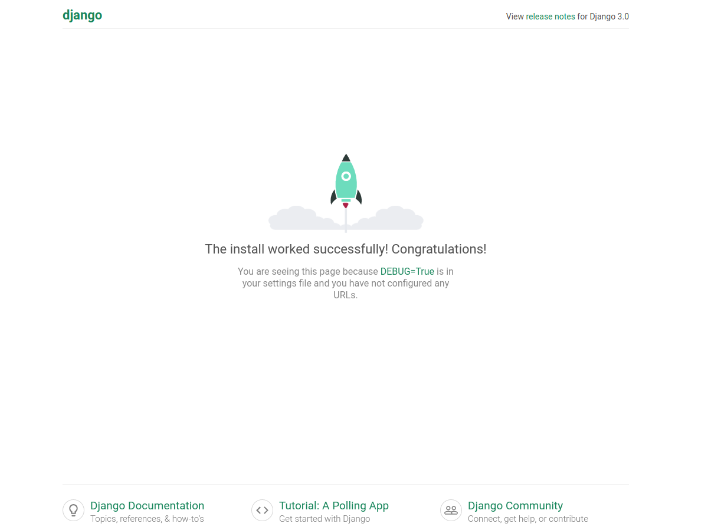
Running a Django Project (2)

Slide 11

Terminal Commands

Slide 12
Terminal Commands
pip install django
python -m django --version
django-admin startproject mysite
python manage.py runserver
django-admin startapp myapp

Slide 13

Django Application
The bread and butter of a Django Project
13

Slide 14
What is a Django Application?
A Python package that is intended for use in a Django project
May use common Django conventions
Describes a Python package that provides some set of features
14

Slide 15
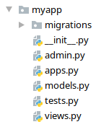
Folder Structure (2)
admin.py
The admin page
models.py
The models of the app
views.py
The views of the app
migrations
Command-line Utility for propagating changes in models
15

Slide 16

Demo
Live Exercise in Class

Slide 17
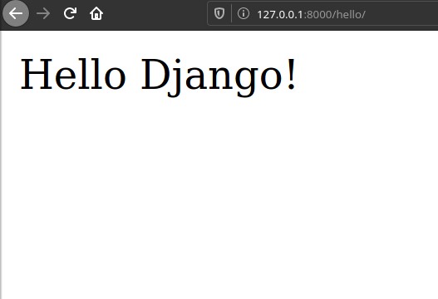
"Hello Django"
17

Slide 18

Summary
Django is a high-level Web Framework
Django applications are set of features for a Django Project
Each Project and Applications has a specific folder structure
We can use terminal commands to manage our projects and apps

Slide 19
Questions?
Notes:
19

Slide 20












SoftUni Diamond Partners

Slide 21




SoftUni Organizational Partners

Slide 22

License
This course (slides, examples, demos, exercises, homework, documents, videos and other assets) is copyrighted content
Unauthorized copy, reproduction or use is illegal
© SoftUni – https://softuni.org
© Software University – https://softuni.bg
Notes:
22

Slide 23
Trainings @ Software University (SoftUni)
Software University – High-Quality Education, Profession and Job for Software Developers
softuni.bg, softuni.org
Software University Foundation
softuni.foundation
Software University @ Facebook
facebook.com/SoftwareUniversity
Software University Forums
forum.softuni.bg
23
Notes:
23

