Slide 1
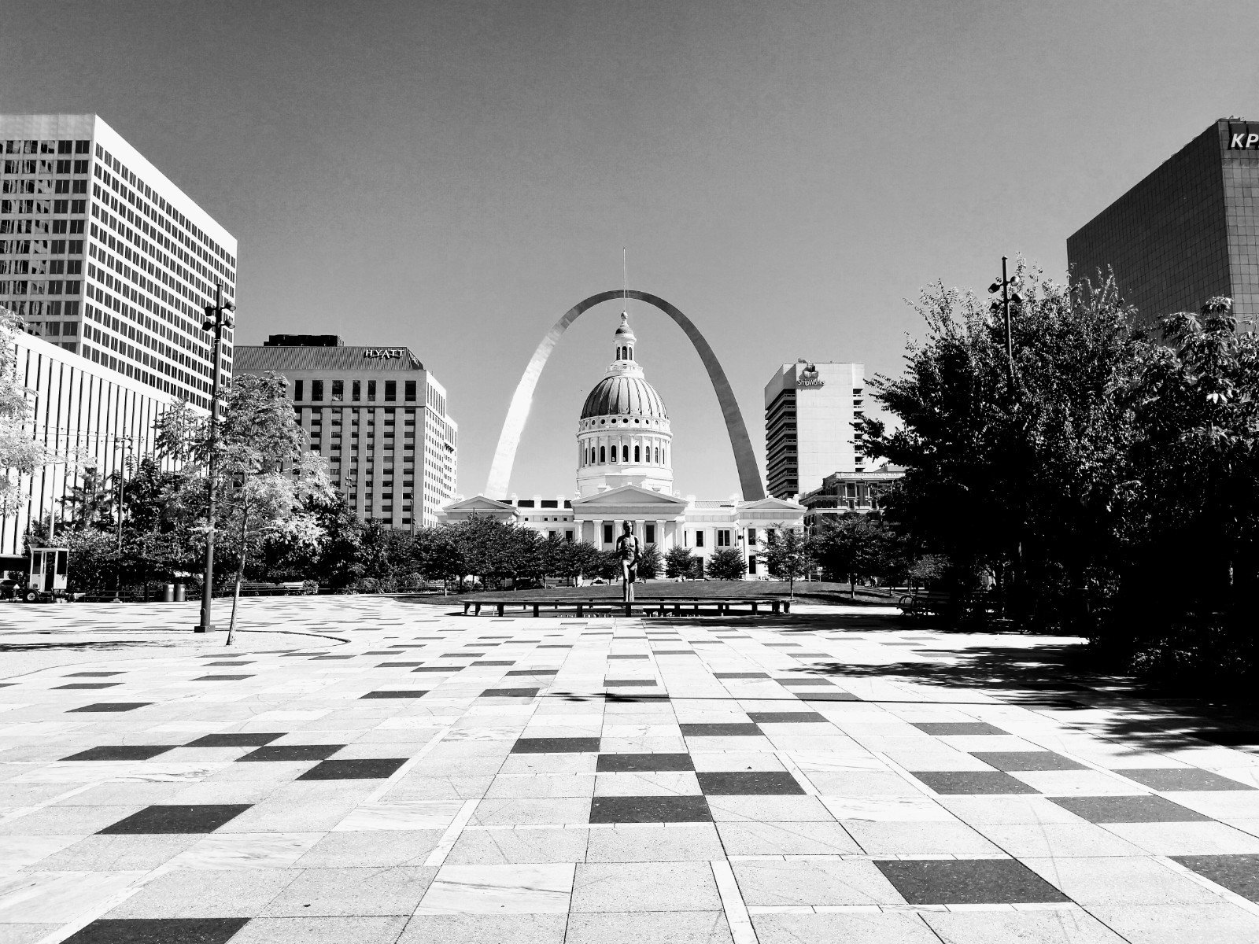
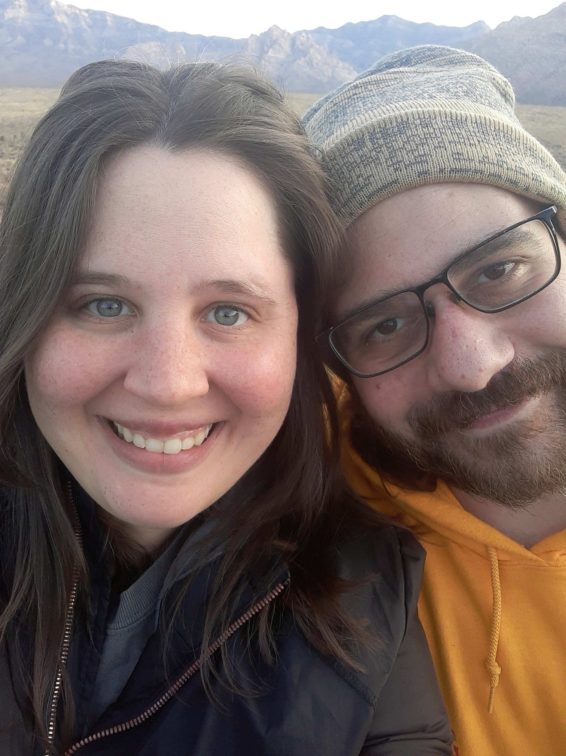
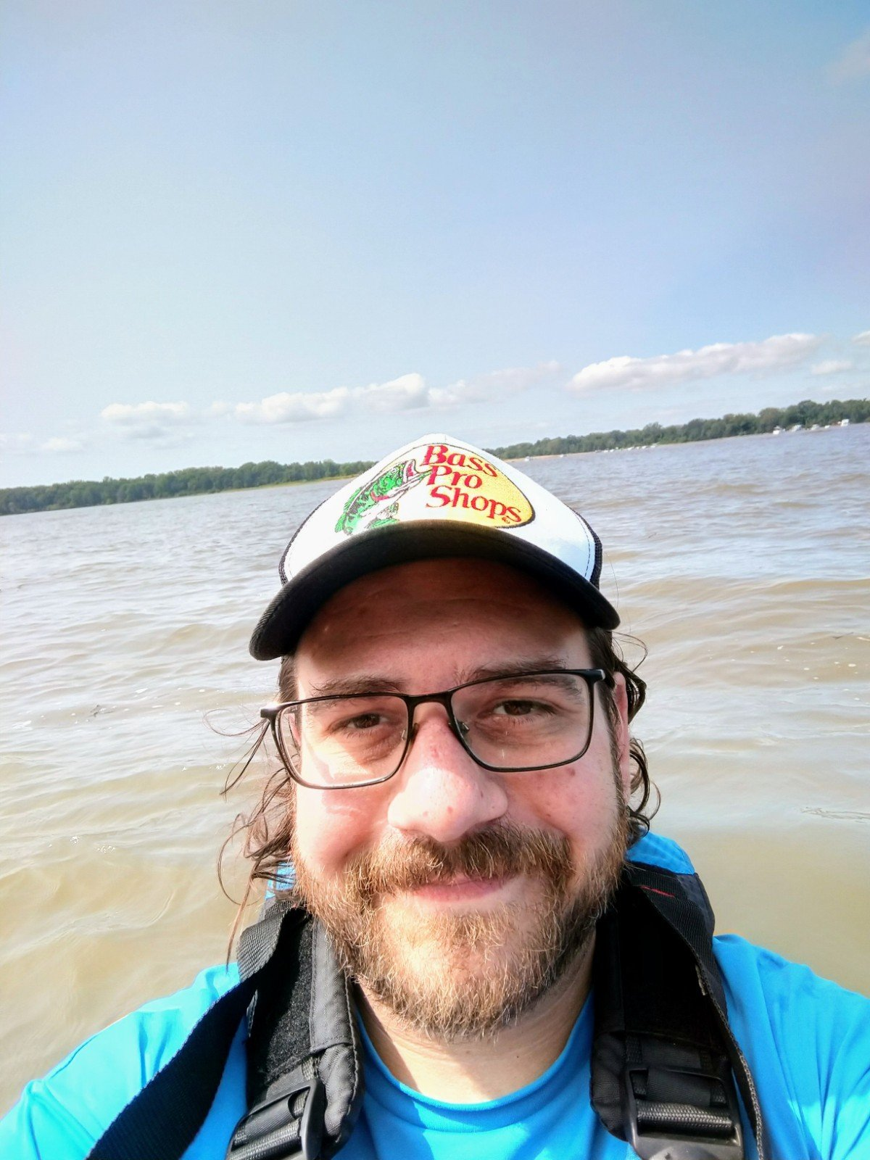
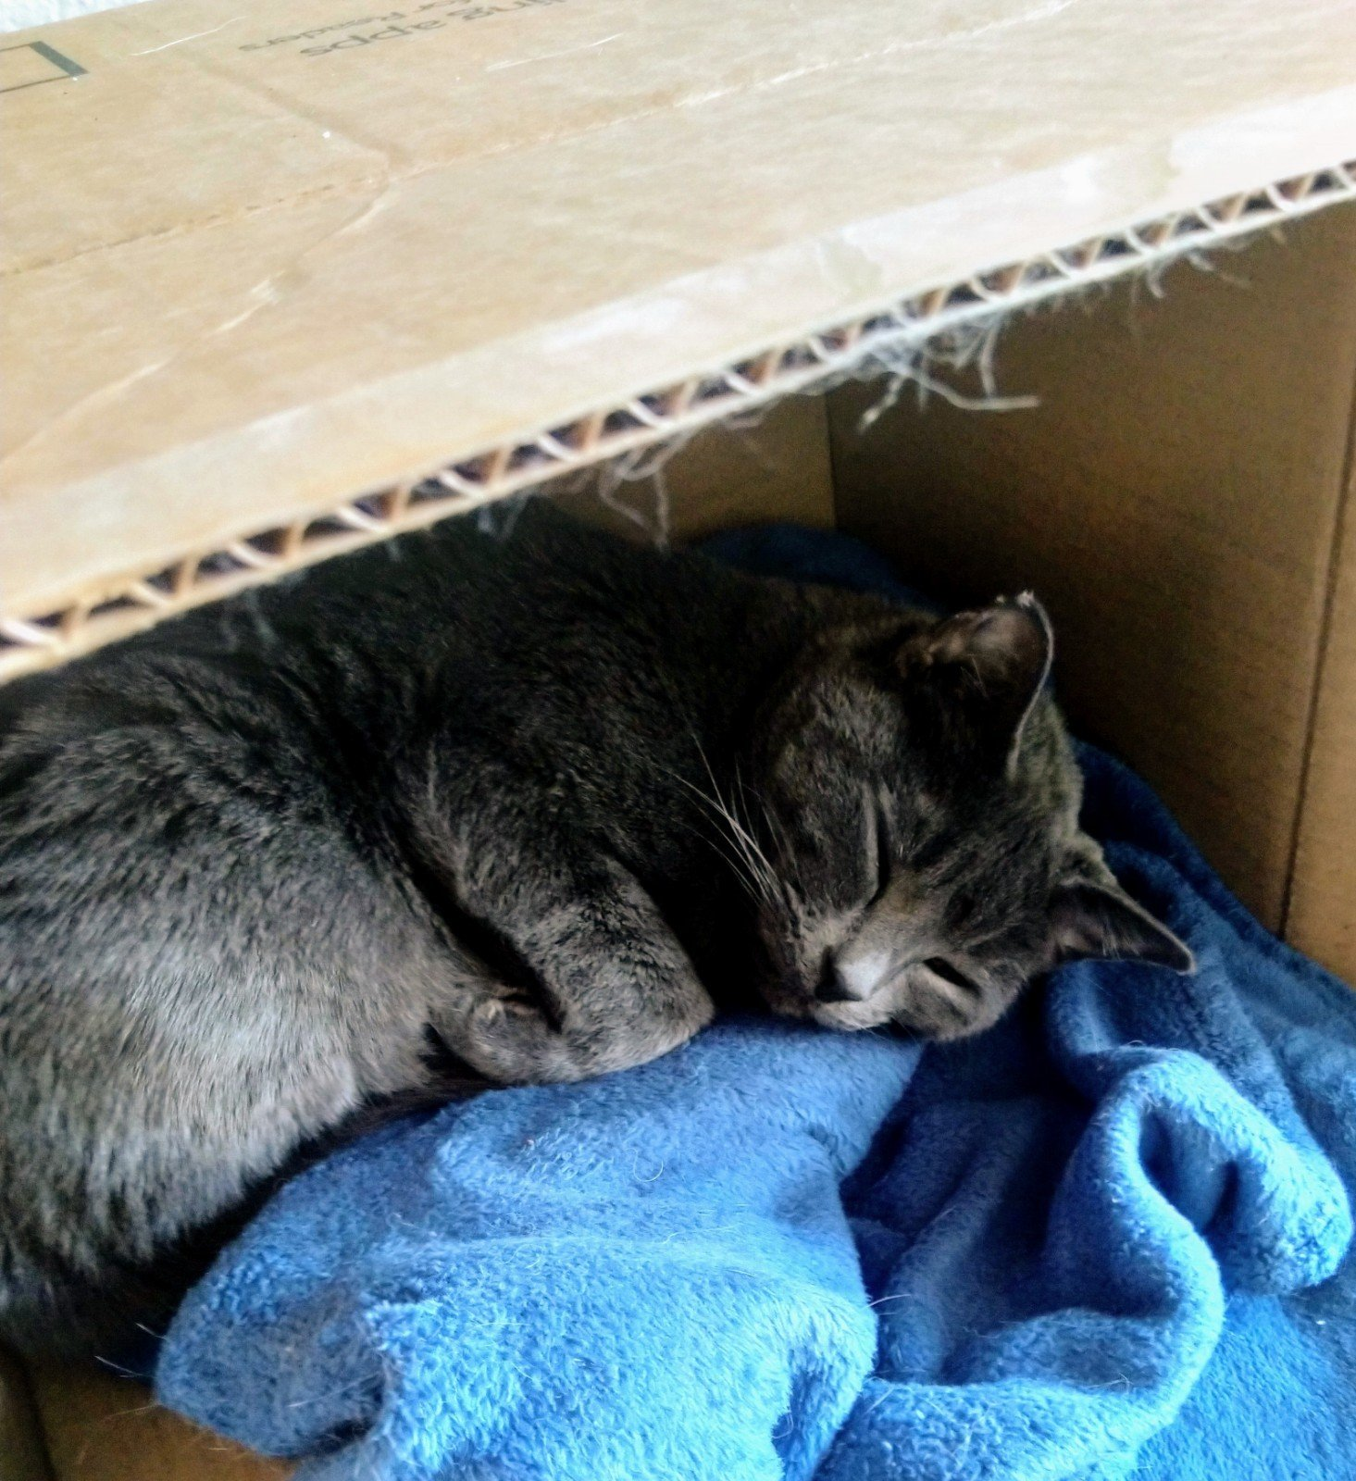
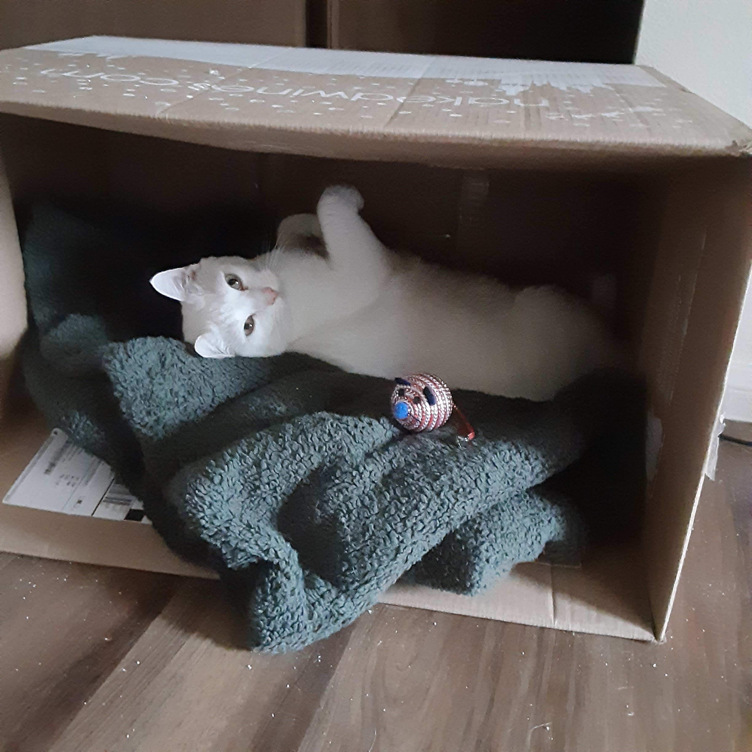
Jonathan Riezman
About Me: I am a Chemistry major with a Physics minor planning to graduate next Spring. I am back in school after a 10 year hiatus during which I worked mostly as a delivery driver and then in wholesale distribution. I have also worked as an assistant in a machine shop, an automotive roadside assistance technician, and a kayak guide. I enjoy working with my hands.
My Life: This summer I got engaged to my girlfriend of four years. We have two cats and no children yet. I was born and raised in St. Louis County but I have lived in Portland, OR and Las Vegas, NV.
Things I Enjoy: I love the outdoors, especially bicycling and kayaking. I also enjoy photography, music, cooking, and open source software. My fiancé and I enjoy hiking together. We like to travel as well: our most recent trip was camping in Illinois and Wisconsin.

