Slide 1
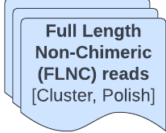
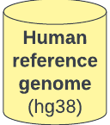



workflow
Mapped reads
Collapsed and filtered reads
Corrected (gff and fasta)
Merged annotation

