Slide 1
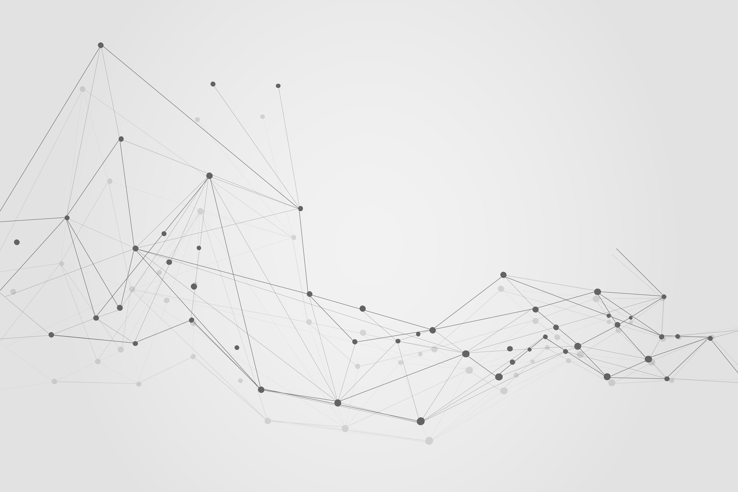


Social Networking Graph
Using JAVA

Slide 2
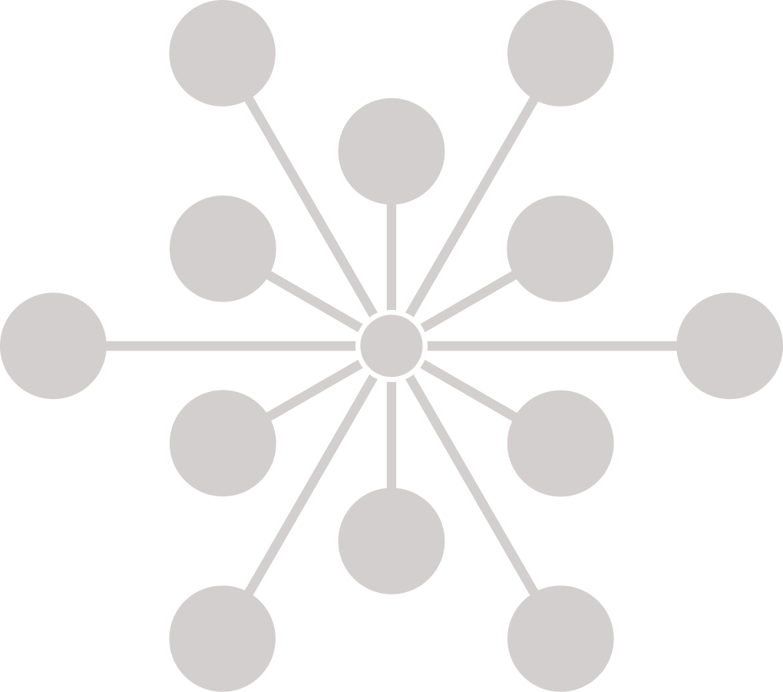




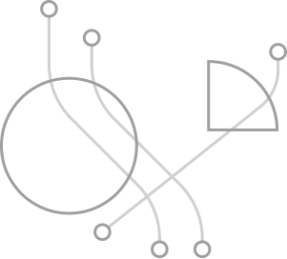
Table Of Contents
Functions
&
Database
Scalability
Limitations
Introduction

Slide 3
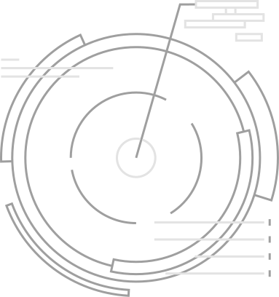
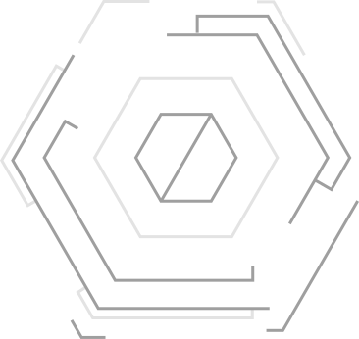
Introduction
A social networking graph is a mathematical representation of the relationships between people, groups, or other entities in a social network.
Graph algorithms can be used to analyze user data and provide personalized recommendations for social networking platforms. For example, recommendations for friends, groups, or content can be based on the user's interests, activity, and network connections.
Graph algorithms can also be used to improve the user experience of social networking platforms. For example, by identifying and removing fake accounts or spam, or by optimizing the network structure to reduce the spread of misinformation or hate speech.

Slide 4
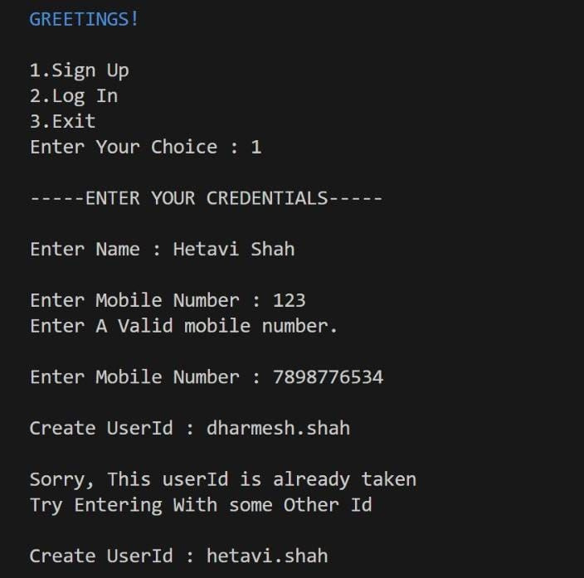
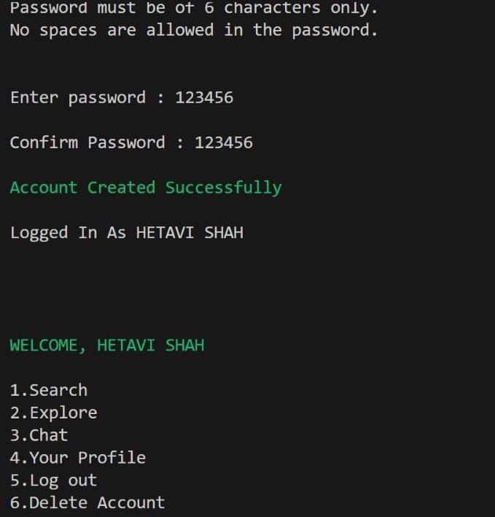

Slide 5
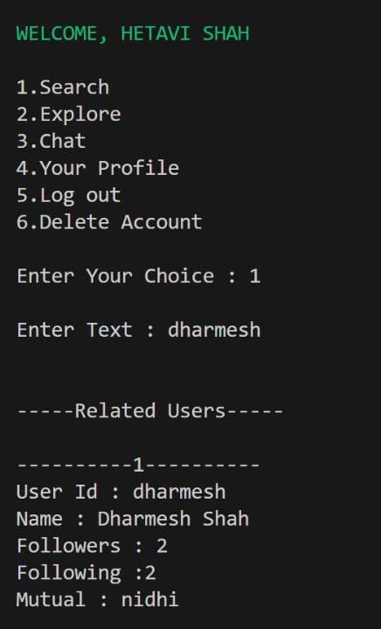
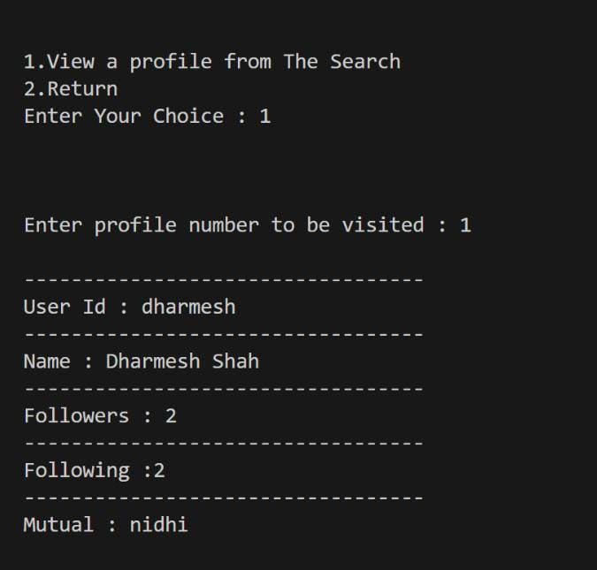
1.Search

Slide 6
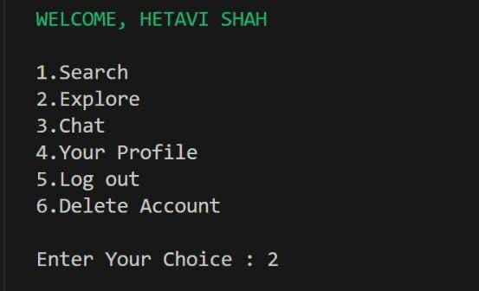
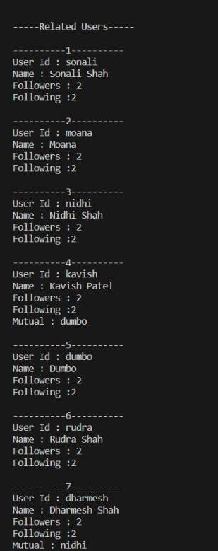
2.Explore

Slide 7
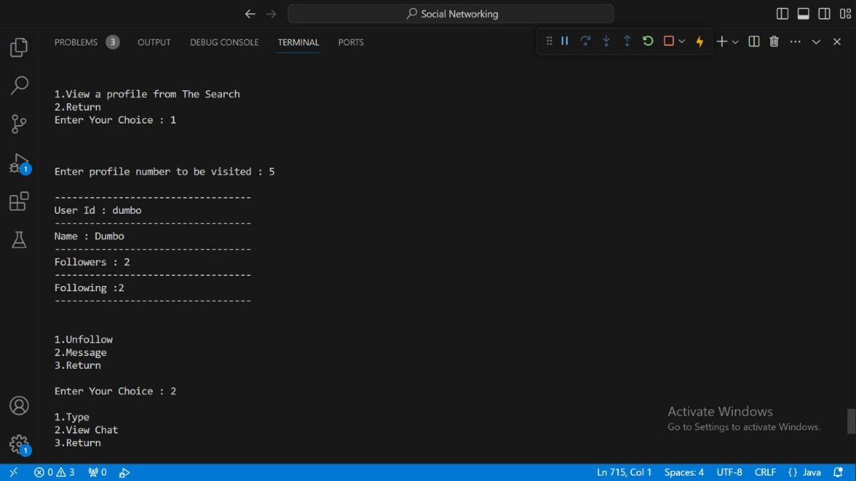
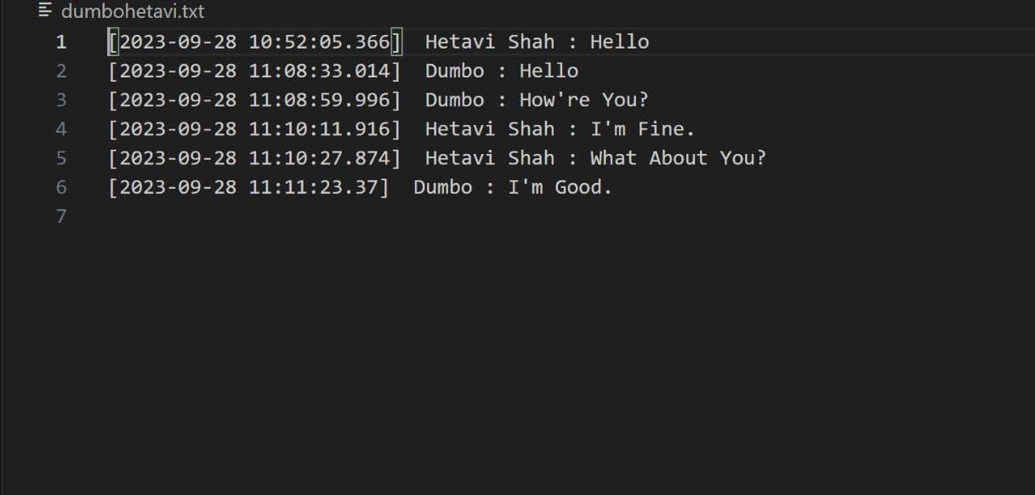
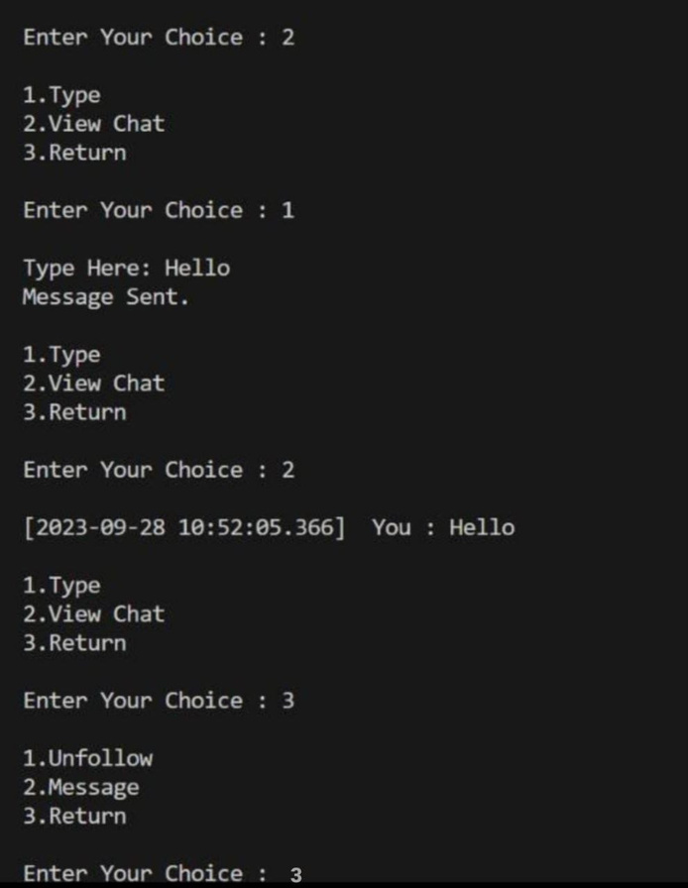
3.Chat

Slide 8
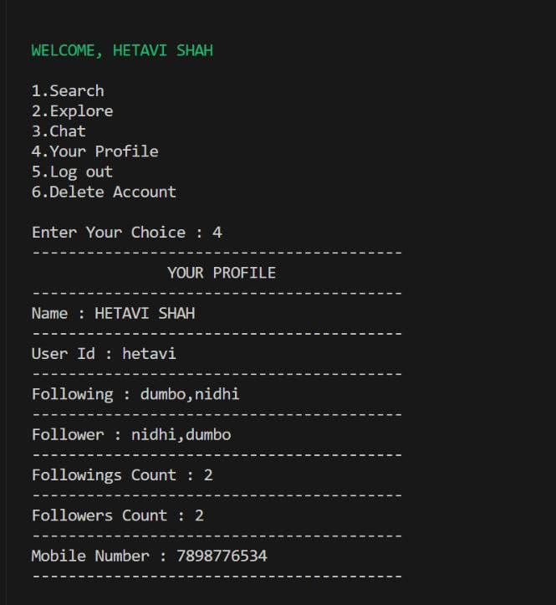
4.Your Profile

Slide 9
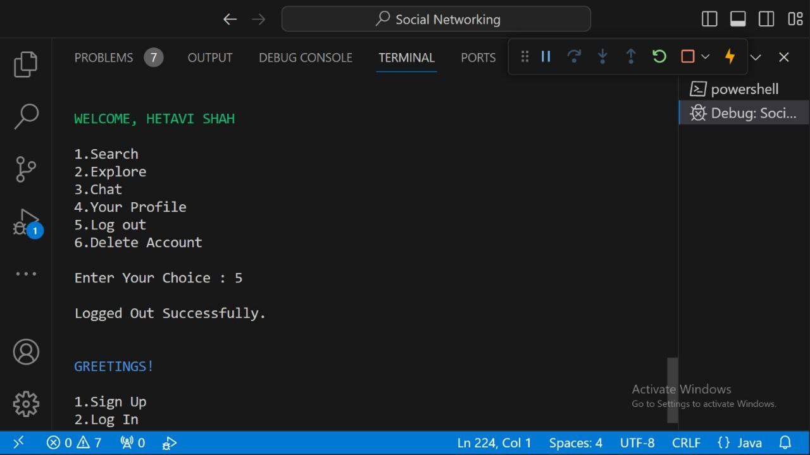
5.Log out

Slide 10
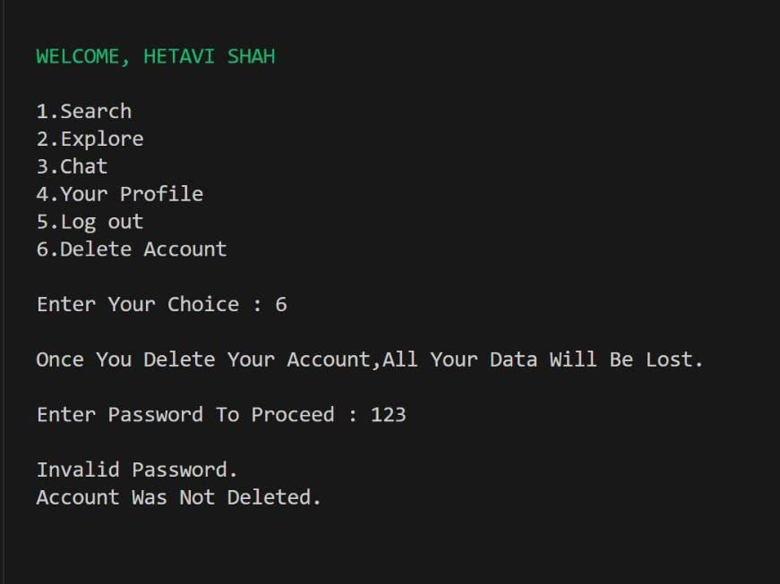
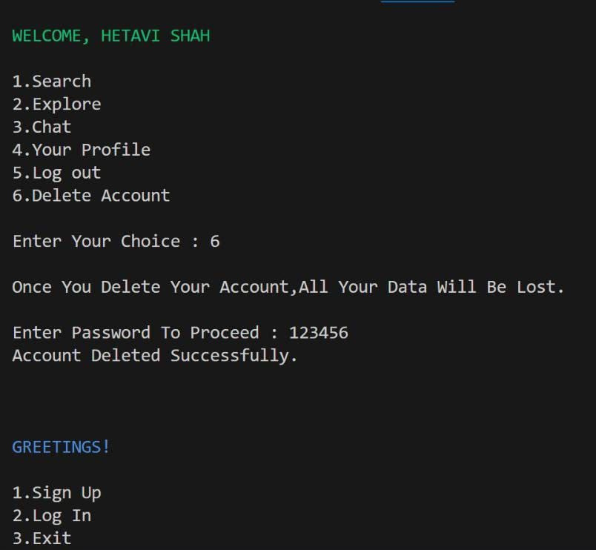
6.Delete Account

Slide 11
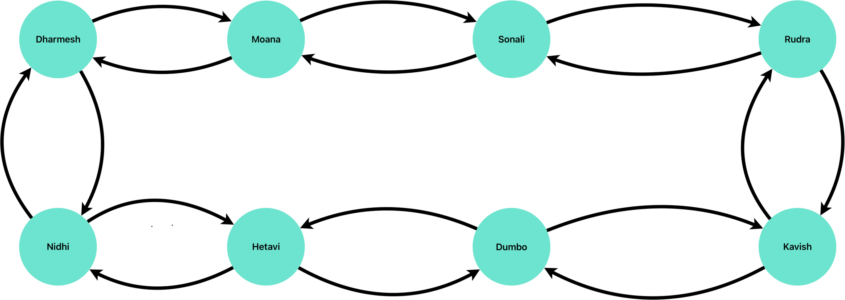
Graph Database

Slide 12
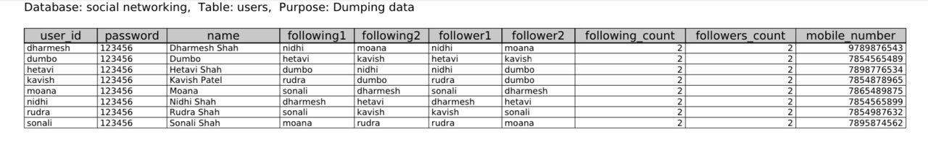
Relational Database

Slide 13
Limitations
No Cybersecurity.
One User Can Follow Utmost 2 Profiles.
One User Can Have Utmost 2 Followers.
No Community Post Section Provided.
Data Like Videos And Audio’s can’t be Shared.
Account Type Is Public By Default ,No Option For Private Account.
No GUI available.
Message Once Sent Cannot Be Deleted.

Slide 14
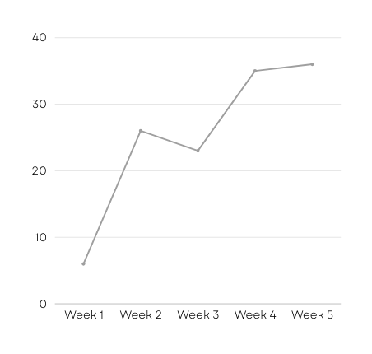
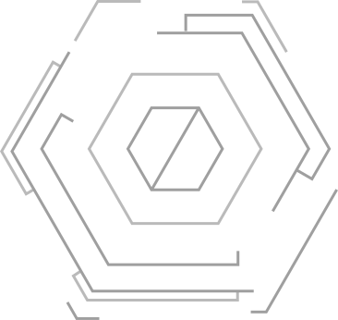
Scalability
Can Add More Functions Like :
Add More Followers And Also Follow More Profiles.
A Community Post Section
An Option For Private Account.
Add GUI.
Add Cybersecurity.
A Place To Share Audio and Videos .
Wi-Fi Calling.

Slide 15
THANK YOU

