Slide 1
Project Title
Sr. # | Registration# | Name
1 | L1F22BSSE0286 | NABEEL IJAZ
2 | L1F22BSSE02 | EHSAN SHAHID
3 | L1S23BSSE100 | UMER AKRAM
4 | L1S23BSSE | USAMA

Slide 2
Project Team Introduction
Member Name | Roles
Nabeel Ijaz | Backend Development
Umer Akram | Web Development
Usama | Database Design and Testing
Ehsan Shahid | Mobile App Development

Slide 3
Introduction and Background of the Project
Problem Rationale:
Pet owners in Pakistan face significant challenges managing pet-related activities due to fragmented and unverified sources.
Current reliance on scattered Facebook groups, WhatsApp chats, and unconnected websites leads to incomplete information, lack of trust, and inefficiency.
Key issues include: difficulty selling or adopting pets safely, arranging temporary shelter, purchasing products, and tracking vaccination schedules.
Project Understanding & Evolution:
PetLink is a cross-platform web and mobile application designed to serve as a centralized digital solution for all pet-related needs.
It aims to improve pet welfare, enhance trust and transparency in pet trading, and provide convenience to users.
Evolution: The project started with identifying core user problems through surveys. This led to prioritizing features like health record management, automated reminders, and a verified marketplace, which evolved from a simple listing system to a comprehensive platform with integrated e-commerce, AI chatbot, and location services.

Slide 4
Introduction and Background of the Project
Key Stakeholders and Roles:
Product Owner: Supervisor.
Scrum Master: Nabeel Ijaz (Manages sprint execution and removes impediments).
Development Team: Nabeel, Ehsan, Umar, Usama
End Users: Pet Owners, Adopters, Sellers, Shelter Service Providers.
Platform Admin: Manages platform content, resolves disputes, and manages product listings and mange users.

Slide 5
Agile Framework Setup
List your important/top epics and how are the stories mapped with them and ranked in the product backlog.
Identify the main user stories your project aims to capture and implement in current sprint.
Mention
Selected user stories and acceptance criteria met
Sprint goals

Slide 6
Sprint Planning & Sprint Backlog
Exhibit your
Kanban Board
Burndown Chart
Progress Tracking
Briefly highlight any changes and deviation from original plan.
Show revised plan/tracking chart as well

Slide 7
Functional Requirements
Model your Functional Requirements in the form of
High level system architecture (Describe how the design changed as you worked)

Slide 8
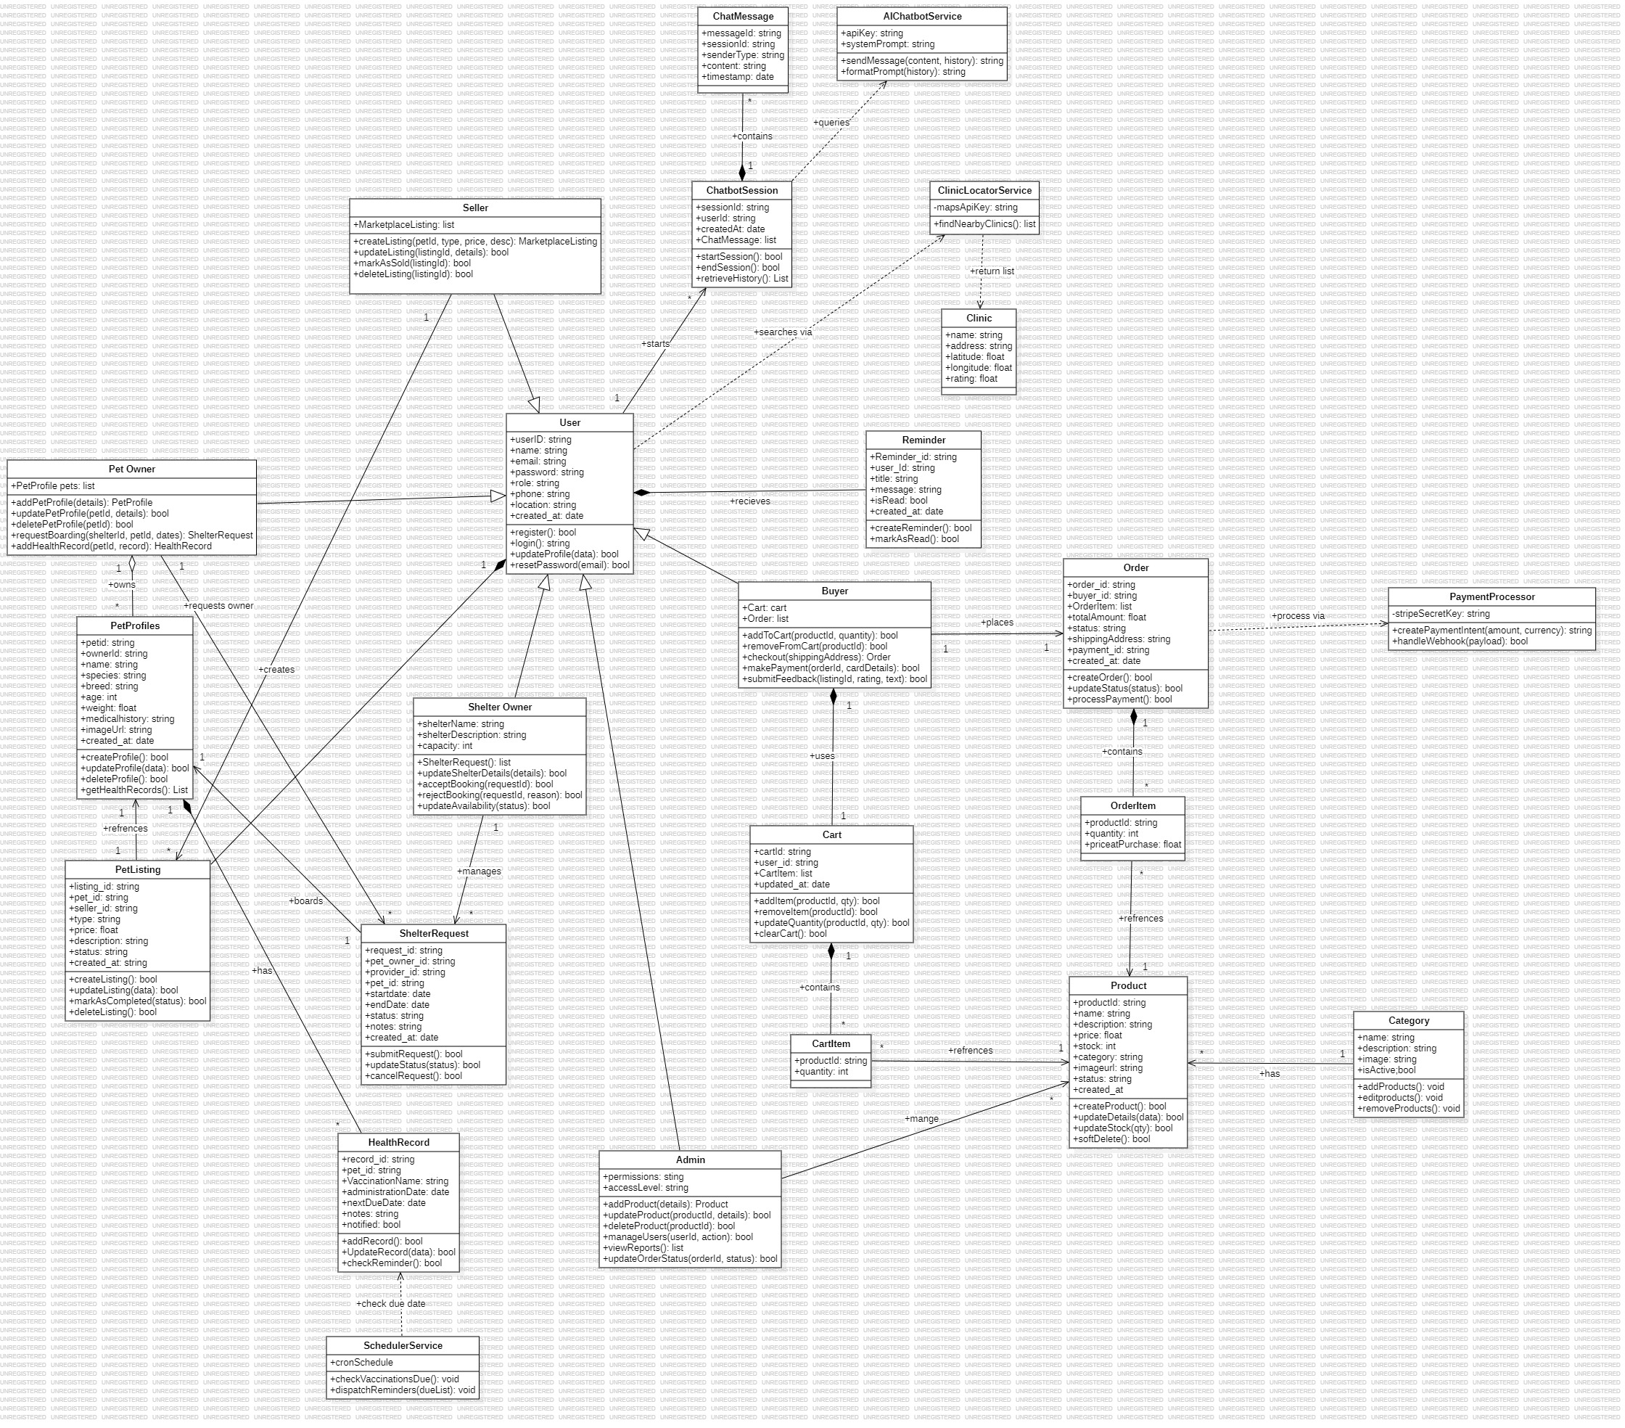
Class Diagrams

Slide 9
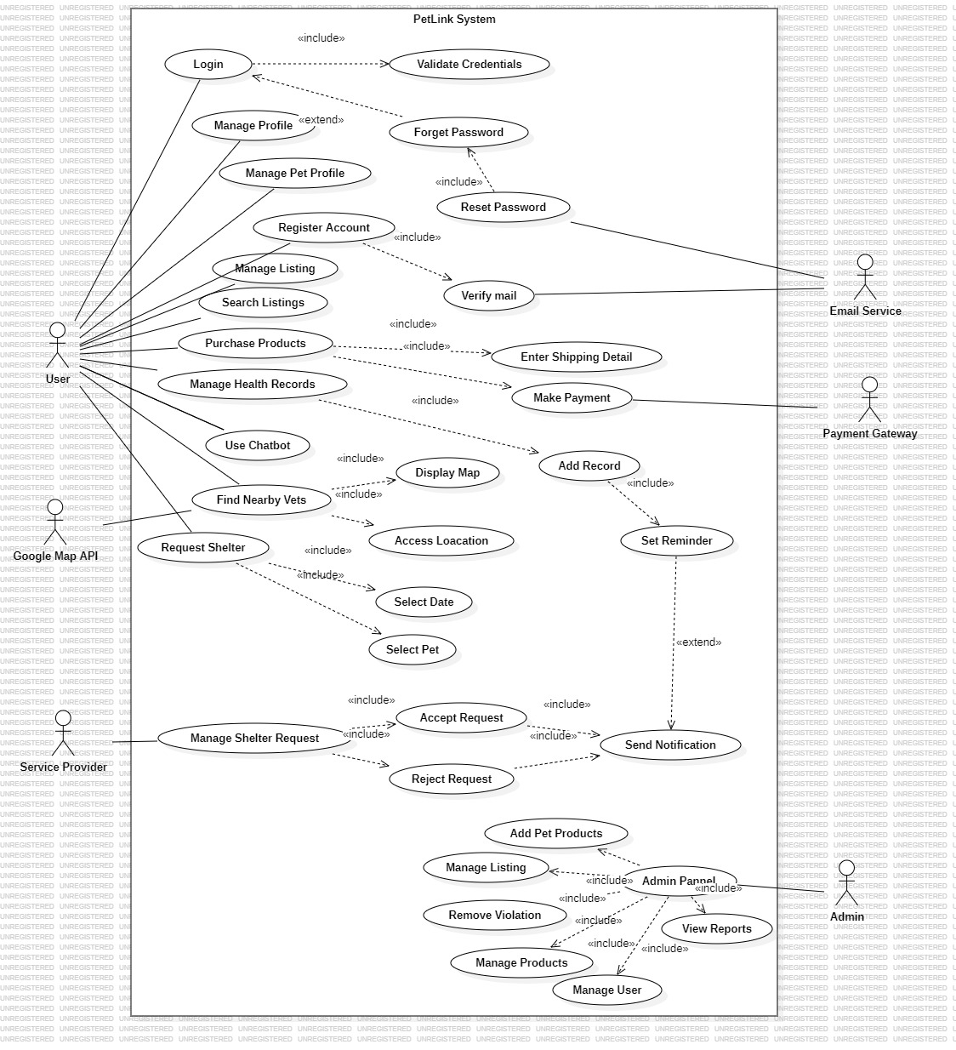
Use-Case Diagrams

Slide 10
Sequence Diagram

Slide 11
Sequence Diagram

Slide 12
Sequence Diagram

Slide 13
Sequence Diagram

Slide 14
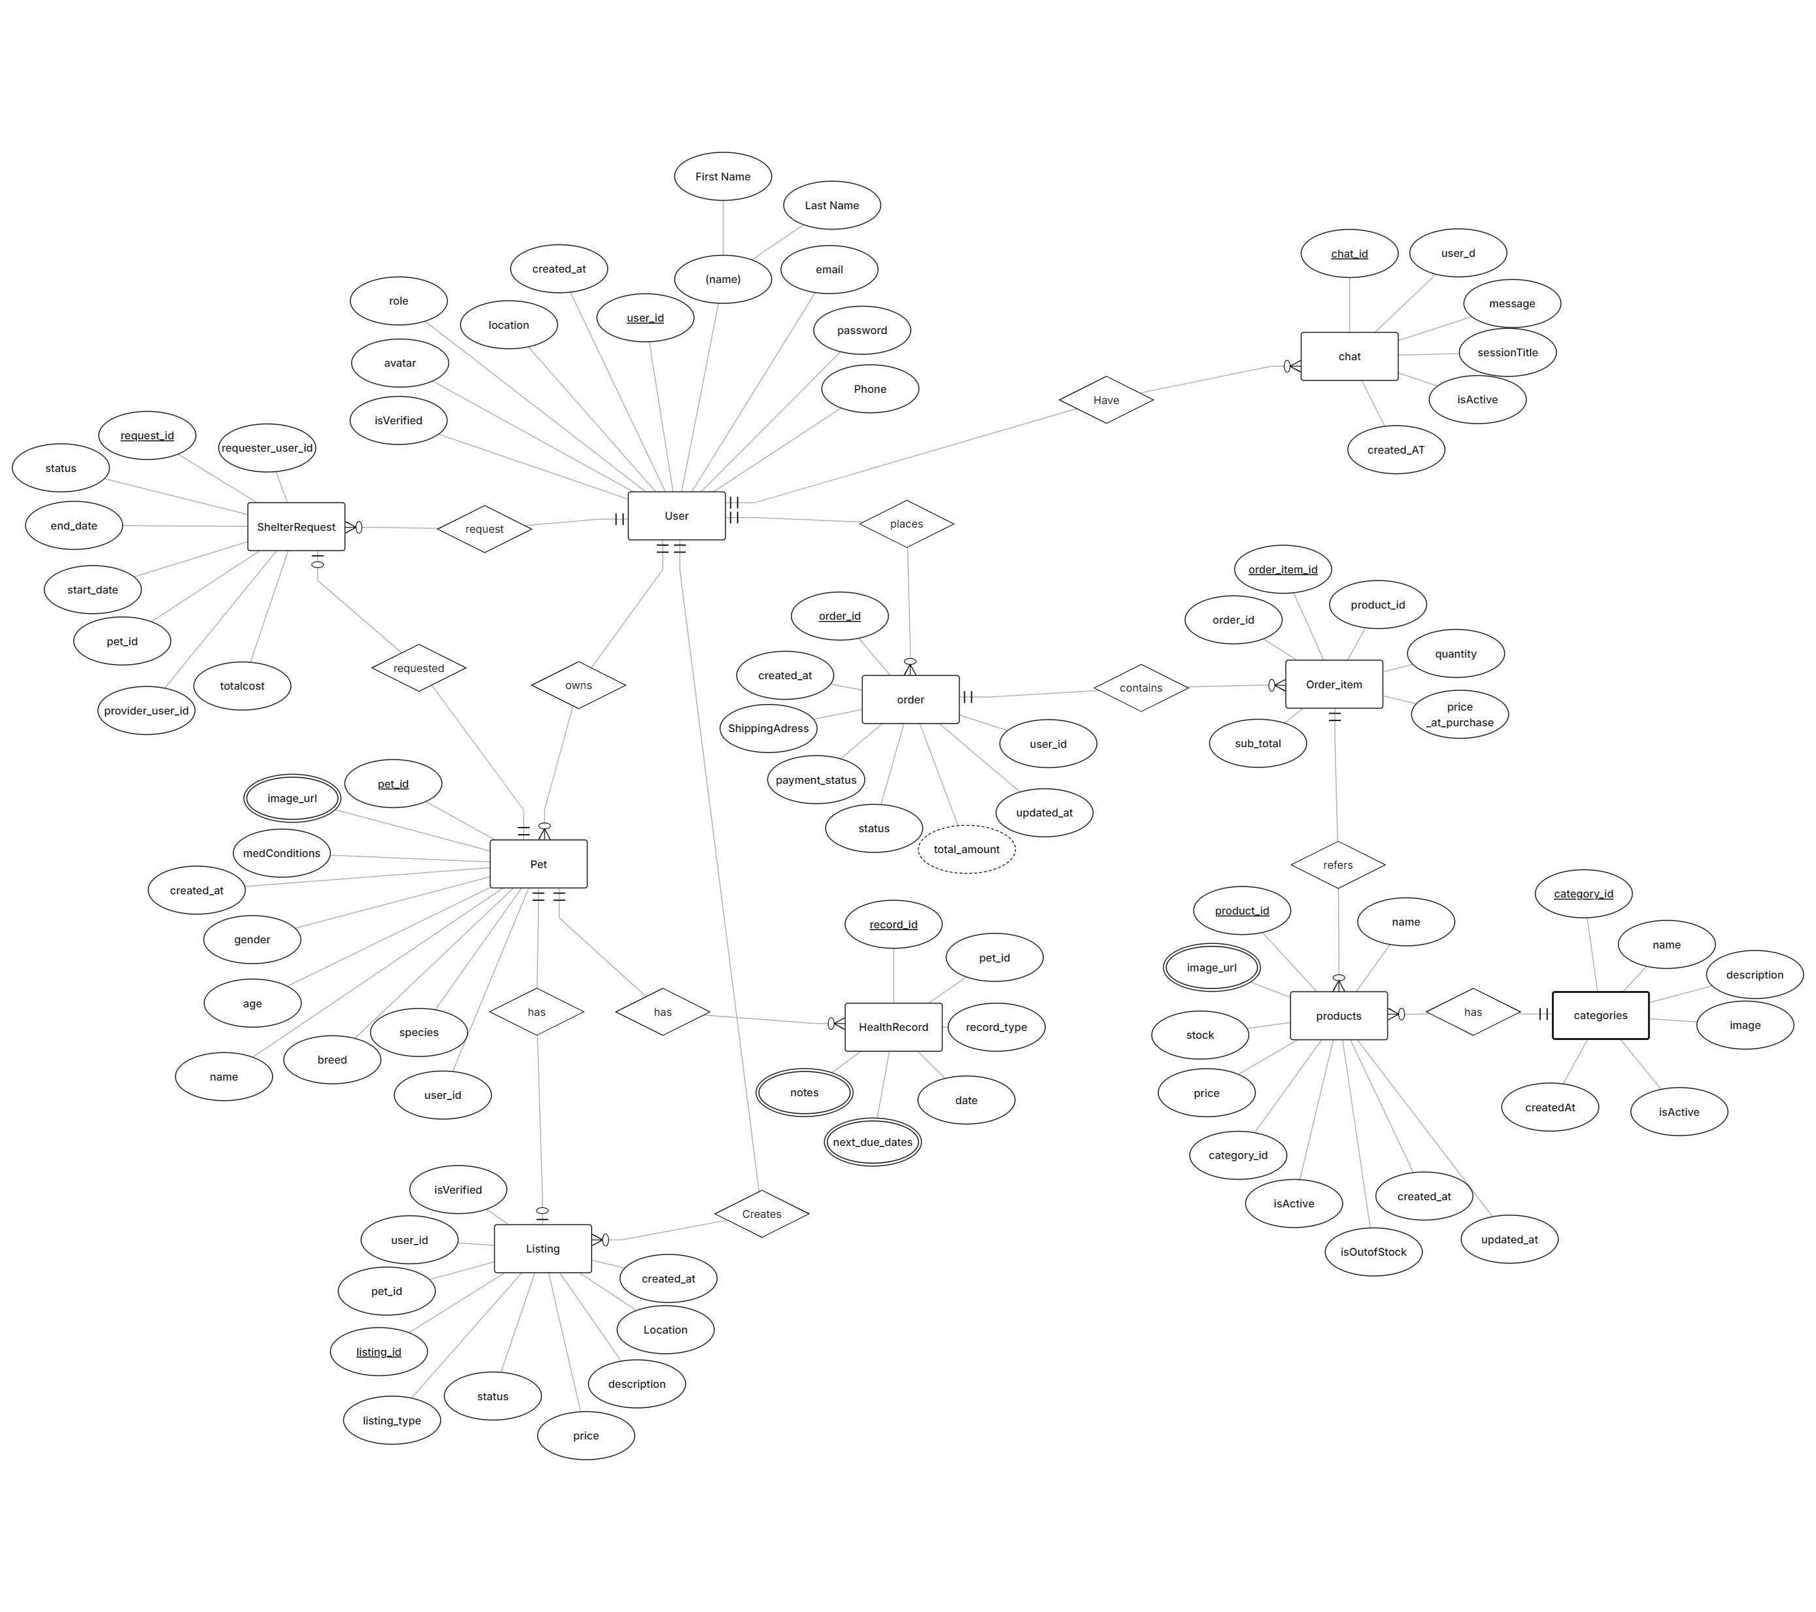
ER Model

Slide 15
Prototypes
UI/UX mockups/flow of remaining modules
API designs

Slide 16
Prototypes
Flow of modules

Slide 17
Prototypes
API designs
Endpoint | Method | Input | Output
/api/auth/register | POST | {name, email, password, role} | User registration confirmation
/api/auth/login | POST | {email, password} | Authentication token + user details
/api/auth/profile | PUT | userId, name, phone, address | Updated user profile
/api/pets | POST | ownerId, name, species, breed, ageMonths, weightKg, imageUrl | Pet profile creation confirmation
/api/pets | GET | ownerId | List of owned pet profiles
/api/listings | POST | petId, sellerId, type, price, description | Marketplace listing creation confirmation
/api/listings | GET | type, category, search, location | List of matching active listings
/api/listings/{id}/status | PUT | listingId, status | Updated listing details
/api/shelters/bookings | POST | petOwnerId, providerId, petId, startDate, endDate | Booking request confirmation
/api/shelters/bookings/pending | GET | providerId | Pending boarding requests

Slide 18
Prototypes
API designs
Endpoint | Method | Input | Output
/api/shelters/bookings/{id}/status | PATCH | bookingId, status | Updated booking status
/api/products | GET | category, search | List of matching shop products
/api/admin/products | POST | name, description, price, stock, category, imageUrls | Product creation confirmation
/api/admin/products/{id}/stock | PATCH | productId, stock | Updated product inventory
/api/orders/checkout | POST | cartId, shippingAddress | Stripe Payment Intent clientSecret + orderId
/api/orders/confirm-payment | POST | orderId | Payment confirmation status
/api/chatbot/message | POST | message, sessionId | AI reply message
/api/clinics/nearby | GET | latitude, longitude | List of nearby veterinary clinics
/api/notifications | GET | userId | List of active notifications
/api/logout | POST | userId | Logout confirmation

Slide 19
Revised Plans & Risk Analysis
Identify risks encountered and mitigation plans.
Show Project Enhancements & Revised Project Plan

Slide 20
Non-Functional/ Quality Attributes
Measurable Attributes and Testing:
Reliability: 99% uptime; daily database backups.
Testing: Simulate server failure to check recovery time; verify backup restoration.
Performance: API response <500ms for 95% of requests; app loads initial view in under 3 seconds.
Testing: Load testing with tools like JMeter to simulate 50 concurrent users.
Security: User passwords hashed (bcrypt); JWT for session management; HTTPS encryption.
Testing: Test for input attempt unauthorized API access; verify JWT expiry.
Usability: Consistent interface across web and mobile; intuitive navigation.
Testing: Conduct user acceptance testing (UAT) with target users to ensure ease of use.
Maintainability: Modular codebase with consistent naming and documentation.
Testing: Code review processes to ensure adherence to standards.

Slide 21
Conclusion
Explicitly mention your progress and future targets

Slide 22
Thanks Slides
Q&A Session

