Slide 1

TCP EXTENSION
SELECTIVE ACKNOWLEDGEMENT (SACK)
RFC 2018
DUPLICATE SACK (D-SACK)
RFC 2883
Pallavi Mahajan
CIS 856
Computer & Information Sciences
University of Delaware

Slide 2

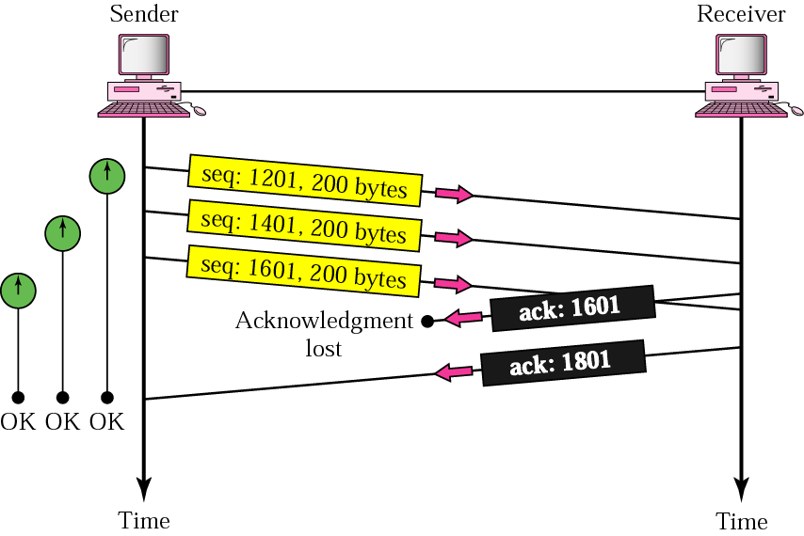
TCP without SACK
Cumulative acks are used.
Out of Order PDU’s are not ACKed.
Receiver sends duplicate acknowledgement.
Sender learns about a single lost packet per RTT.

Slide 3
SACK Advantages
Receiver informs the sender about all the PDUs that have been received successfully.
Sender retransmits only the PDUs that have not been Acked.
Implemented using two TCP options.

Slide 4
SACK –Permitted Option
First option: enabling option(2 bytes) sent in a SYN
Indicates SACK option can be used once connection established
  Receiver may return SACK’s
  Sender can process SACK’s
TCP Header
Source Port Address Destination Port Address
Header Length
Sequence Number
Cumulative Acknowledgement Number
Window Size
6
1
Checksum Urgent Pointer
SYN
Kind = 4 Length = 2
Kind = 1 Kind = 1
SACK-Permitted
NOP
NOP

Slide 5
SACK – Permitted and SACK
SENDER
RECEIVER
KIND = 4
SYN = 1
KIND = 4
ACK = 1
SYN = 1
TCP Connection Establishment Phase
ACK = 1
Data Transfer Phase
ACK containing Cumulative Ack (CumAck) and Selective Ack (SACK)

Slide 6
SACK Option
Source Port Address Destination Port Address
Sequence Number
Length of SACK with n blocks ?
Cumulative Acknowledgement Number
HLEN Window Size
Checksum Urgent Pointer
Kind = 1 Kind = 1
Kind = 5
Length ?
Left Edge of First Block
Possible maximum number of Sack's block ?
Right Edge of First Block
Left Edge of last Block
Right Edge of last Block

Slide 7
SACK example
Receiver informs sender of contiguous and isolated blocks of data that have been successfully received and queued.
Sender
Receiver
Receiver’s Buffer
SEQ 100, 200 bytes
100-300
ACK 300
SEQ 300, 200 bytes
SEQ 500, 200 bytes
100-300 500-700
SEQ 700, 200 bytes
ACK 300,SACK 500-700
ACK 300, SACK 500-900
100-300 500--900

Slide 8
SACK Rules
SACK does not change the meaning of ACK field.
SACK cannot be sent unless SACK permitted option has been received.
If SACKs are sent, they should be included in all TCP-PDUs when out-of-order data has been buffered.
First SACK must ack most recently received out-of-order PDU.

Slide 9
SACK Rules
Receiver
  Receiver returns as many distinct SACKs as possible.
  SACK option is filled out by repeating most recently reported SACK blocks.
    There may be some data in receiver’s queue which should be SACKed but is not.

Slide 10
RULES FOR SACK
Sender
  Records the SACK for future reference.
  Maintains a retransmission queue containing unacknowledged PDUs.
  Turns SACK bit on when sender receives a SACK.
  Skips SACK PDUs during retransmission.
  Retransmits the PDUs not SACKed so far and less than the highest SACKed PDU.
  Turns off SACK bit after retransmission time out.

Slide 11
SACK Example
Sender
Receiver
Receiver’s Buffer
SEQ 100, 200 bytes
100-300
ACK 300
SEQ 300, 200 bytes
SEQ 500, 200 bytes
100-300 500-700
ACK 300,SACK 500-700
SEQ 700, 200 bytes
SEQ 900, 200 bytes
ACK 300, SACK 900-1100, 500-700
100-300 500-700 900-1100
SEQ 1100, 200 bytes

Slide 12
Example ….cont
Sender
Receiver
SEQ 1100, 100 bytes
100-300 500-700 900-1100
SEQ 300, 200 bytes
ACK 700, SACK 900-1100
100-300 300-500 500-700 900-1100
SEQ 700, 200 bytes
ACK 1100
100-300 300-500 500-700 700-900 900-1100

Slide 13
Reneging
Reneging is a case when the receiver SACK some data and later discards that data. Such discarding is discouraged, but permitted if the receiver runs out of the buffer space.
If Reneging occurs
The first SACK should reflect the newest PDU even if the PDU is going to be discarded.
Except for the newest PDU, all SACK blocks must not Ack any data which is no longer held by receiver.

Slide 14
Reneging Example
Sender
Receiver
SEQ 200, 200 bytes
Receiver’s Buffer
200-400
SEQ 400, 200 bytes
ACK 400
SEQ 600, 200 bytes
SEQ 800, 200 bytes
200-600 800-1000
ACK 600, SACK 800-1000
200-600

Slide 15
Consequences of Reneging
Sender must maintain normal TCP timeouts. A PDU cannot be considered acknowledged until its ACK by cumulative acknowledgement.
PDU’s cannot be removed from the transmit buffer until ACK by the cumulative acknowledgement.

Slide 16
SACK TCP Implementations
Current Implementations :
  Windows XP/2000/ME/98
  Solaris 7 and later
  Free BSD & NetBSD have optional modules

Slide 17
Duplicate SACK (DSACK)
Extension to SACK
When D-SACK is used, the first block of the SACK option should specify the duplicate PDU.
D-SACK block is used to report duplicate contiguous sequence of data received by the receiver in the most recent packet.
Each duplicate is reported at most once.
Allows the sender TCP to determine when a retransmission is not necessary.

Slide 18
Example : Packet replicated by network
Sender
Receiver
SEQ 200, 200 bytes
Receiver’s Buffer
ACK 400
200-400
SEQ 400, 200 bytes
SEQ 600, 200 bytes
200-400 600-800
ACK 400, SACK 600-800
SEQ 800, 200 bytes
200-400 600-800 800-1000
ACK 400, SACK 600-1000
200-400 600-800 800-1000
ACK 400, SACK 800-1000, 600-1000

Slide 19
Example : Losses and sender changes PDU size
Sender
Receiver
SEQ 500, 100 bytes
Receiver's Buffer
500-600
SEQ 600, 100 bytes
ACK 600
SEQ 700, 100 bytes
SEQ 800, 100 bytes
SEQ 900, 100 bytes
SEQ 1000, 100 bytes
SEQ 1100, 100 bytes
500-600 1100-1200
ACK 600, SACK 1100-1200
SEQ 700, 200 bytes
ACK 700, SACK 1100-1200
500-600 600-700 1100-1200
ACK 700, SACK 800-900,1100-1200
500--700 800-900 1100-1200
ACK 900, SACK 800-900,1100-1200
500--900 1100-1200

Slide 20
D-SACK TCP Rules
If D-SACK block reports duplicate PDU from (possibly larger) block of data in the receiver buffer above the cumulative acknowledgement, the second SACK block (the first non D-SACK block) should specify this block.
As only, the first SACK block is considered as
D-SACK block, if multiple sequences are duplicated, only the first is contained in the D-SACK block.

Slide 21
D-SACK TCP & Retransmissions
D-SACK allows TCP to determine when retransmission is not necessary and thereby undo congestion control measures.
D-SACK allows TCP to determine if the network is duplicating packets.
D-SACK does not allow a sender to determine if both the original and retransmitted PDU are received, or the original is lost and the retransmitted PDU is duplicated by the network.

Slide 22
SACK & D-SACK Interaction
No difference between SACK & D-SACK, except that first SACK block is used to report a duplicate PDU in D-SACK.
No separate negotiation/options for D-SACK.
D-SACK is compatible with current implementations of SACK option in TCP.

Slide 23
References
ftp://ftp.rfc-editor.org/in-notes/rfc2018.txt
ftp://ftp.rfc-editor.org/in-notes/rfc2883.txt
Professor Amer’s Slide
http://www.cse.nd.edu/~surendar/teach/spr03/cse598N/Lectures/Lecture13.pdf

