Slide 1
Keda in depth Kubernetes Event-Driven Autoscaler
Sabyasachi Nayak

Slide 2
Content
HPA
HPA Vs KEDA
KEDA Prerequisite
HPA Real time use cases
KEDA Architecture
KEDA Installation
KEDA using Cron Job
Authentication using KEDA
KEDA Scalers
Tricky Scenarios

Slide 3
HPA
Horizontal Pod Autoscaler (HPA) is a Kubernetes resource that automatically adjusts the number of pod replicas in a deployment, replica set, or stateful set based on observed resource utilization (e.g., CPU or memory) or custom metrics.
HPA queries a custom metrics provider via the Kubernetes API to fetch custom metrics data.
Examples: Prometheus Adapter, Stackdriver Adapter, or KEDA’s Metrics Adapter.
HPA challenges: It requires custom metric servers and adapters for advanced cases. It often falls short during high-traffic or there is a spike in traffic.
KEDA is an open-source tool addresses these challenges , It helps in precise scaling based on diverse external triggers, optimizing resource use and cost efficiency in fluctuating traffic environments.

Slide 4
Prerequisite for KEDA
The Metrics Server is a prerequisite for KEDA (Kubernetes Event-Driven Autoscaler). KEDA relies on Kubernetes' Horizontal Pod Autoscaler (HPA), which uses resource metrics to determine scaling. The Metrics Server provides the necessary metrics, such as CPU and memory utilization, required for HPA and KEDA to function.
Why Metrics Server is Required
KEDA can scale workloads based on both custom external metrics (e.g., message queue length, database query load) and Kubernetes resource metrics (e.g., CPU, memory).
For resource metrics, KEDA leverages the Kubernetes HPA, which depends on the Metrics Server to expose these metrics.
When Metrics Server is Not Strictly Required
If you're only using external metrics provided by KEDA's scalers (e.g., from a message queue like RabbitMQ or Kafka), the Metrics Server is not mandatory. However, for any scaling decisions involving CPU or memory, the Metrics Server is essential.

Slide 5
Keda Realtime Usecases
KEDA is especially useful in event-driven architectures or scenarios where scaling needs are triggered by external systems rather than just CPU or memory usage. Below are scenarios where you would benefit from using KEDA:
1.Scaling Based on External Queue Length
Scenario: Your application processes messages from a message queue (e.g., RabbitMQ, Kafka, AWS SQS).
Need: Scale pods dynamically based on the number of unprocessed messages in the queue.
Why Use KEDA: KEDA monitors the queue length and adjusts the number of pods to ensure timely processing while minimizing idle resources.
2. Scaling Based on Database Metrics
Scenario: A reporting system needs to process rows from a database or execute tasks based on a query count.
Need: Scale workloads dynamically based on database query results (e.g., pending jobs).
Why Use KEDA: Use KEDA’s scalers (e.g., PostgreSQL or MySQL scalers) to query the database and scale pods accordingly.

Slide 6
Keda Realtime Usecases
3. Integration with Cloud Services
Scenario: Your application depends on cloud services like Azure Event Hubs, AWS Kinesis, or Google Pub/Sub.
Need: Autoscale workloads based on events or metrics from these cloud services.
Why Use KEDA: KEDA provides native integration with many cloud event sources, simplifying autoscaling configurations.
4. Scaling Jobs Dynamically
Scenario: You have batch jobs that process data files, perform ETL, or run simulations based on event triggers.
Need: Dynamically create and scale Kubernetes Jobs based on the size of the input dataset or pending tasks.
Why Use KEDA: KEDA’s ScaledJob can launch and scale Kubernetes jobs based on external metrics or triggers.

Slide 7
KEDA Vs HPA
Key Differences Between KEDA and HPA
Feature | KEDA | HPA
Trigger Sources | Event-driven (external triggers): e.g., message queues, databases, cloud metrics (Azure Monitor, AWS CloudWatch), Kafka, custom triggers. | Resource-based (internal Kubernetes metrics): e.g., CPU, memory, or custom Kubernetes metrics.
Scope | Designed for event-driven scaling (external systems triggering scaling events). | Focused on scaling based on application resource usage.
Scaling Mechanism | Can scale workloads directly or act as a custom metrics provider for HPA. | Adjusts replica counts based on Kubernetes metrics or custom metrics provided by Metrics APIs.
Scale to Zero | Supported: Can scale workloads to zero when no events or triggers are present. | Not supported: HPA maintains a minimum of one replica by default.
Metrics Adapter | Bundled with KEDA (for exposing external metrics to Kubernetes). | Relies on Kubernetes Metrics Server or custom metrics adapters.
Configuration Complexity | Simple for event-driven scenarios. | Simple for resource-based scaling but requires extra setup for custom metrics.
Performance and Use Cases | Handles high variability in workloads (event spikes). | Works well with steady, predictable scaling needs like CPU/memory utilization.
Custom Metrics Support | Extensive: Integrates directly with external systems or custom scalers. | Limited: Needs additional configuration to use external/custom metrics via APIs.

Slide 8
How KEDA works
The main components of KEDA include:
Agent, Metrics, and Admission webhooks.
1. Agent
The KEDA agent runs within the Kubernetes cluster. It is responsible for monitoring the configured event sources continuously and determining when scaling actions are necessary.
How it does ?
The agent collects metrics from these event sources at regular intervals.
The collected metrics are evaluated against the scaling policies defined by the user.
When the evaluation determines that scaling is necessary, the agent communicates with the Kubernetes control plane to adjust the number of replicas of the targeted deployment. This ensures that the application has enough resources to handle the current workload.

Slide 9
How KEDA works
2. Metrics Adapter
KEDA includes a custom metrics server/adapter that exposes the metrics collected from event sources to Kubernetes’ Horizontal Pod Autoscaler (HPA).
Each event source has a corresponding metric provider that translates the raw data from the event source into metrics that KEDA can use.
Common types of metrics include queue length, request rate, latency, and database operation counts.
Users define thresholds and policies that specify when scaling should occur. For example, a policy might dictate that if the number of messages in a queue exceeds 1000, the application should scale up by adding more replicas.

Slide 10
How KEDA works
3. Admission Webhooks
The webhooks enforce configuration rules, ensuring that only valid scaling policies are applied. This prevents misconfigurations that could lead to instability or inefficiency in the cluster.
They allow for dynamic updates to scaling configurations without requiring application restarts or manual interventions. This means scaling policies can be adjusted on-the-fly based on changing workload patterns.

Slide 11

Understanding KEDA’s Architecture
KEDA extends the standard autoscaling functionality of Kubernetes by allowing event-driven triggers from outside the cluster.
How it does ?

Slide 12
Understanding KEDA’s Architecture
KEDA Components and Internals:
KEDA Operator
Scaled Object
ScaledJob
External Scalers
Metrics Adapter
Trigger Authentication
HPA

Slide 13
KEDA’s Architecture In depth
1. KEDA Controller (Operator)
Ensures the creation and management of HPAs based on the scaling criteria defined in the custom resources.
Watches custom resources like ScaledObject and ScaledJob.
Handles communication with external systems via Scalers.

Slide 14
KEDA’s Architecture In depth
2.ScaledJob
Role: A CRD similar to ScaledObject but tailored for batch jobs instead of deployments.
Attributes:
Triggers: External event sources that determine when jobs should be started.
Concurrency limits, polling intervals, retry mechanisms.
3. External Scalers
Role: Components that interact with external systems to retrieve metrics or events.
Functionality:
Connect to external systems (e.g., Prometheus, Kafka, AWS SQS, Azure Monitor).
Fetch relevant metrics or event counts.
Provide these metrics to the controller for scaling decisions.

Slide 15
KEDA’s Architecture In depth
4. Metrics Server
Role: An internal component of KEDA that acts as an adapter to expose external metrics to Kubernetes.
Functionality:
Translates external event data or metrics into a Kubernetes-compatible format.
Integrates with Kubernetes Metrics API to allow HPAs to use these metrics.
Why is it needed?
5. Trigger Authentication
Role: Defines how KEDA connects to external systems securely.
Attributes:
Specifies secrets or configurations needed for external scalers (e.g., API keys, connection strings).

Slide 16
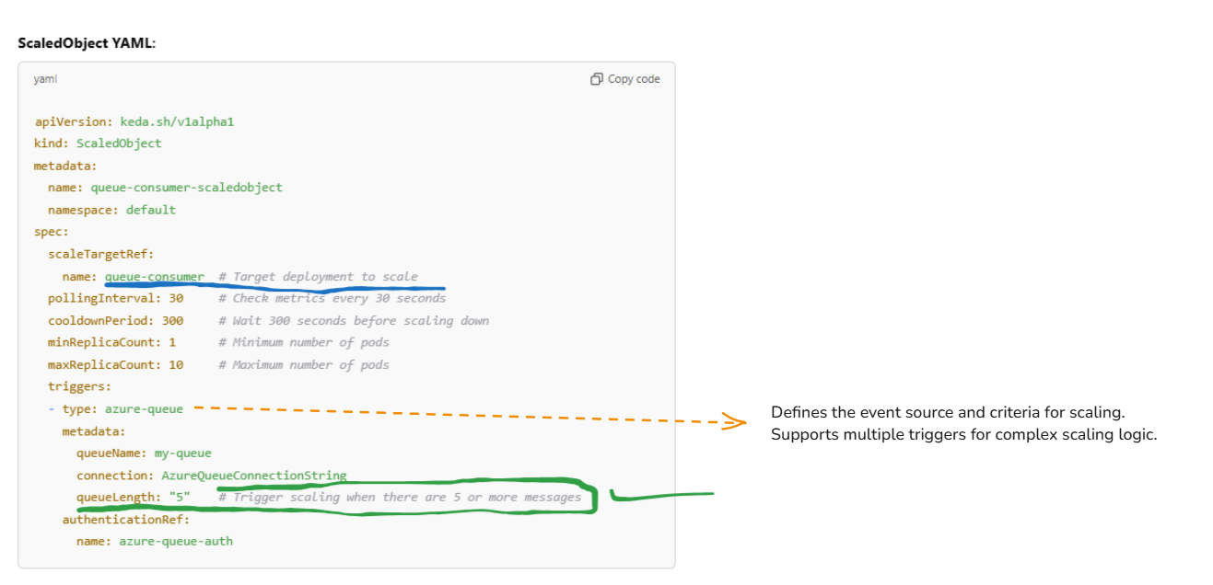
Scaled Object in Depth
Detail

Slide 17
Scaled Object in Depth
Key Fields Explained
scaleTargetRef: This section identifies the Kubernetes resource that will be scaled.
name: The name of the target Kubernetes workload to scale (nginx-deployment).
kind: The type of workload (Deployment).
apiVersion: The API version of the workload (apps/v1).
minReplicaCount:
Ensures there is always at least 1 replica running, even when no scaling conditions are met.
maxReplicaCount:
Caps the scaling to a maximum of 10 replicas, regardless of trigger conditions.
cooldownPeriod:
The time (in seconds) to wait after a scaling action (either scale-up or scale-down) before considering another scaling event.
Here, it is set to 30 seconds. For example:
If the replicas scale up to 10 due to the cron trigger, KEDA will wait 30 seconds before evaluating scaling down again.
triggers:
Defines the event source and criteria for scaling..

Slide 18
Scaled Object Vs Scaled Job Attributes
Common Attributes
Attribute | Description
minReplicaCount | Minimum number of replicas (ScaledObject) or Jobs (ScaledJob).
maxReplicaCount | Maximum number of replicas (ScaledObject) or Jobs (ScaledJob).
cooldownPeriod | Time (in seconds) to wait before re-evaluating scaling actions.
pollingInterval | How often the triggers are polled for scaling decisions.
triggers | Defines the conditions (e.g., Cron, Prometheus, RabbitMQ, etc.) for scaling.

Slide 19
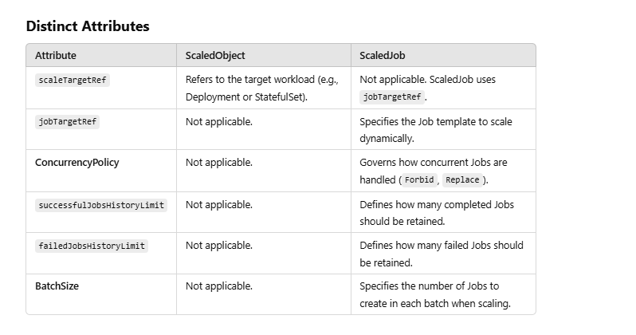
Scaled Object Vs Scaled Job Attributes

Slide 20



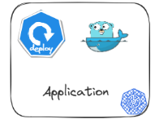




E2E flow of KEDA With HPA
admission webhook
Metrics adapter
Scaler Plugin
Validate
Configure metrics adapter
to expose necessary metrics
Custom metrics API
New
Scaled Object
Notification
Fetch
Metrics based on polling interval from Scaled object
Spawns Scaler plugin
as per scaled object
Operator
K8 Controller
External Trigger
Source

Slide 21

E2E flow of KEDA Without HPA
admission webhook
Metrics adapter
Scaler Plugin
Validate
Configure metrics adapter
to expose necessary metrics
Custom metrics API
Fetch
Metrics based on polling interval from Scaled object
New
Scaled Object
Notification
Spawns Scaler plugin
as per scaled object
Operator
External Trigger
Source

Slide 22
E2E Flow in detail
Admission Webhook:
Validates and mutates the ScaledObject.
Accepts it into the API server.
Operator Action:
Detects the new ScaledObject and initializes the appropriate scaler.
Configures the Metrics Adapter for integration with HPA (if required).
3. Monitoring the Event Source
The initialized scaler monitors the external event source according to the polling interval defined
in the ScaledObject.
4. Triggering Scaling Decisions
HPA-Driven Scaling:
The scaler sends metrics to the Metrics Adapter, which makes them available to the Horizontal Pod Autoscaler (HPA).
KEDA-Driven Scaling (e.g., Scale to/from Zero):
The operator directly decides whether to scale up or down (e.g., starting pods from zero replicas when a trigger condition is met).
It modifies the target workload's replica count accordingly.

Slide 23
Why the Metrics Adapter is Necessary
Why the Metrics Adapter is Necessary:
Kubernetes itself doesn’t natively support custom metrics like queue lengths, database sizes, etc. The Metrics Adapter is the bridge between KEDA (which handles event-driven scaling) and the Kubernetes HPA, enabling scaling based on event-driven conditions that are external to Kubernetes.
It acts as a translator between the custom event-based metrics and the standard HPA metric format, making it possible for the HPA to scale based on custom, user-defined metrics that KEDA makes available.

Slide 24
Tricky Scenarios
How does KEDA handle race conditions when scaling workloads based on multiple triggers?
How does KEDA use same scaler with different metrics
How KEDA integrates with external systems and troubleshoot common issues?
You are using KEDA with RabbitMQ, and the event source authentication fails. How would you resolve it?
Your KEDA setup is not scaling pods when the queue size exceeds the threshold. How would you troubleshoot?
What happens if a ScaledObject is deleted while scaling activity is in progress?
What happens if a KEDA scaler fails to retrieve metrics from an external event source?
How would you secure external systems that KEDA interacts with (e.g., message queues)?

Slide 25
Multiple Triggers for same target
For multiple triggers:
Each scaler works independently and reports its recommended number of replicas.
KEDA combines these recommendations in a deterministic way, selecting the highest desired number of replicas across all scalers for the target workload.
KEDA's operator runs with leader election enabled by default. This ensures that only one instance of the operator (if running in a High Availability setup) makes scaling decisions at a time, avoiding conflicts that might arise from concurrent processing of triggers.\
KEDA leverages Kubernetes' HPA for scaling decisions. The HPA itself is designed to handle multiple metric inputs, selecting the highest desired replica count to scale the workload.
This built-in HPA mechanism prevents race conditions by enforcing a single scaling policy.
Ref: https://keda.sh/docs/2.16/reference/faq/#using-multiple-triggers-for-the-same-scale-target

Slide 26
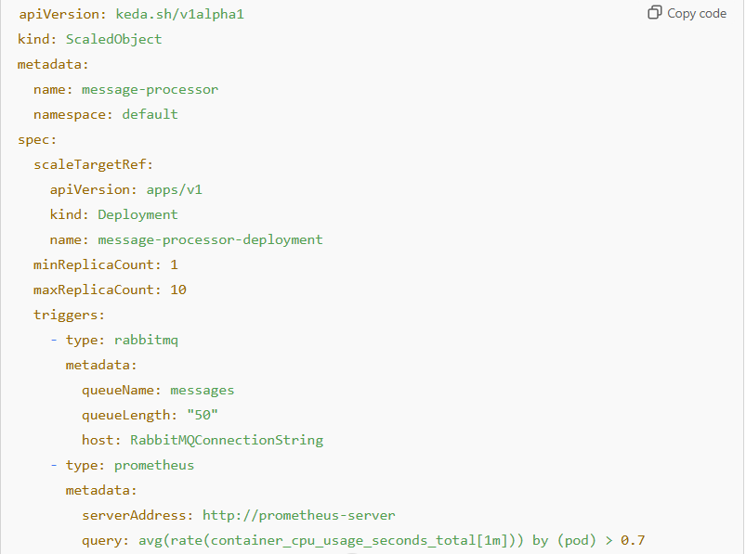
Example
Execution Steps:
Scaler 1 (RabbitMQ):
RabbitMQ queue length is evaluated, and it reports 120 messages.
Recommended replicas = ⌈12050⌉=3\lceil \frac{120}{50} \rceil = 3⌈50120​⌉=3.
Scaler 2 (Prometheus):
Prometheus query shows CPU usage averaging 90%.
Recommended replicas = 5 (based on custom scaling logic).
KEDA Aggregation:
KEDA takes the maximum of the recommended replicas from both scalers:
Max(3, 5) = 5.
Scaling Decision:
KEDA instructs the Horizontal Pod Autoscaler (HPA) to scale the deployment to 5 replicas.

Slide 27
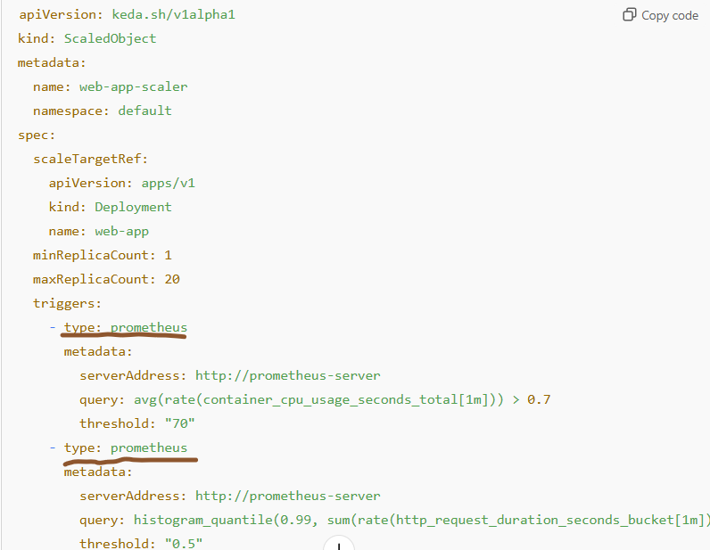
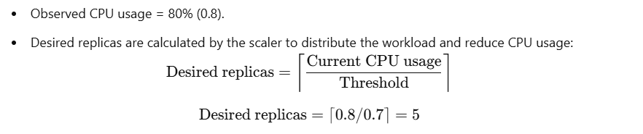
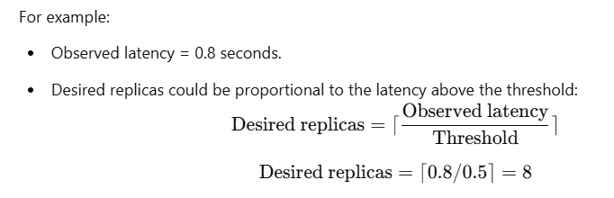
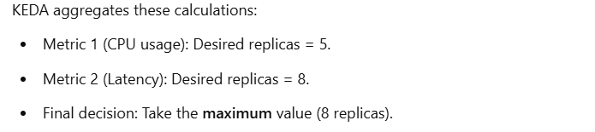
KEDA use same scaler with different metrics

