Slide 1
IMDb Dataset
Turlassov Abylaikhan, Zholaman Temirlan, Aitkali Dinmukhamed

Slide 2
Dataset overview
Contains information about movies/TV shows from 1927 to 2019 year:
Year
Cast
Rating
Streaming platform
Duration
Genre

Slide 3
Dataset overview
Actors information:
Name
Top 3 professions
Known for
Birth and Death year

Slide 4
Dataset problems
No information after 2019
Lots of missed data
Data is not normalized according to database normalization rules

Slide 5
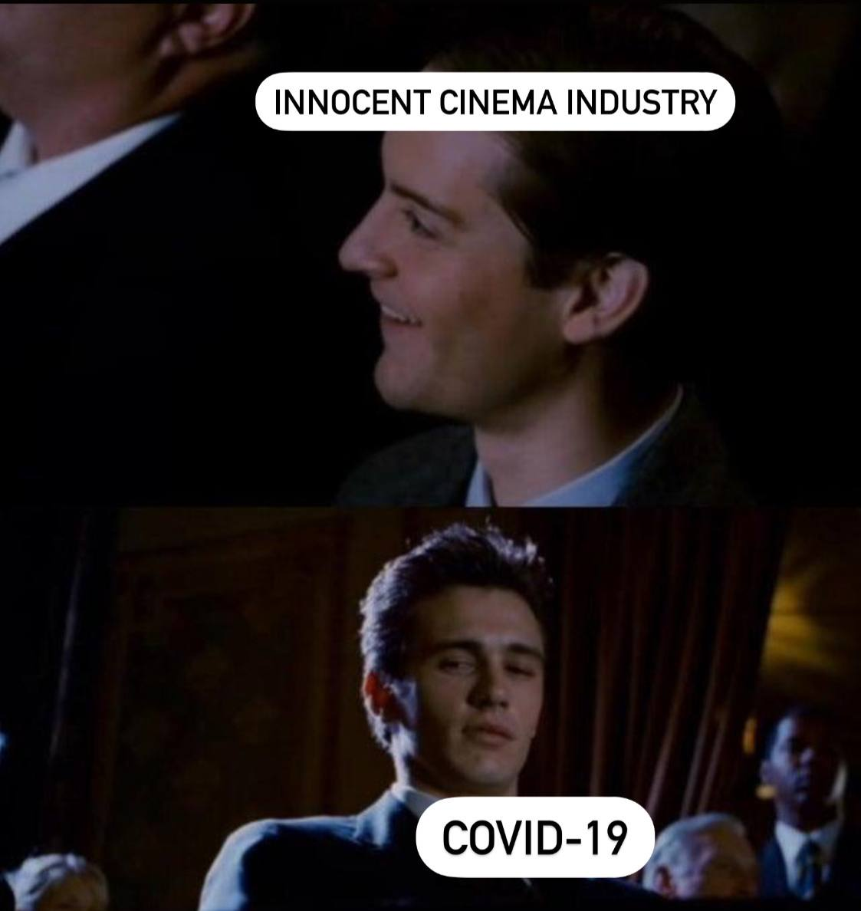
Hypothesis
Hypothesis: “Any global crisis has both financial and genre-wise influence on film industry”
Hypothesis justification: It is known that COVID-19 crisis had a negative and significant impact on the movie industry.

