Slide 1

INVESTIGATION OF CAUSES AND FACTORS SUICIDE AND SUICIDAL ATTEMPTS IN THE REPUBLIC OF KAZAKHSTAN
Adilbek Aituarov
Merey Tursyn
Sanzhar Samatuly

Slide 2
Why this is important?
Kazakhstan holds a leading position in the number of suicides.
In 2014: 8 place in the world, 3 place in Central Asia
Topic is not covered properly
If suicidal behavior is suicide, then demonstrative blackmail behavior refers to an emotional disorder and does not go into the statistics on suicides in any way and is not taken into account anywhere.
Finding patterns can help reduce the number of suicidal cases

Slide 3
Research hypothesis
financial condition
labor activity
mental illness
Relationships
physical health
Basic segmentation: region, sex, age

Slide 4

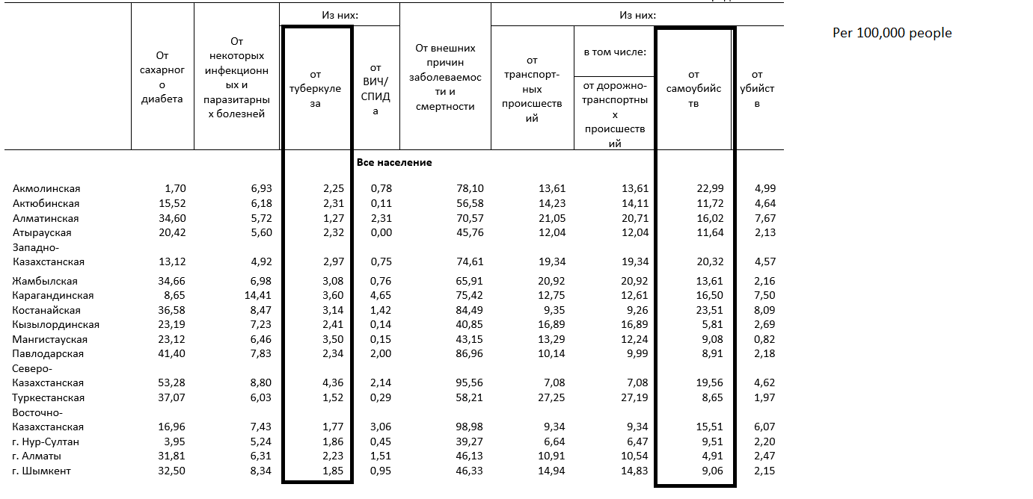
Observation groups: 1) people who committed suicide 2) died from tuberculosis

Slide 5
Segments description, main table
Year (2019-2021)
Sex
Region
Urban, Countryside

Slide 6
Additional data sources
Kazakhstan population over years (https://stat.gov.kz/official/industry/61/statistic/6)
Volume of services provided in the field of health and social services in the Republic of Kazakhstan – amount of people who asked for medical help, surgeries, psychological help (https://stat.gov.kz/official/industry/63/statistic/5)

Slide 7
Data sources
https://www.who.int/ - World Health Organization
https://stat.gov.kz/ - Agency for Strategic planning and reforms of the Republic of Kazakhstan Bureau of National statistics
https://data.egov.kz/ - Egov open data
https://www.unicef.org/ - United Nations International Children's Emergency Fund
https://www.kaggle.com/datasets/szamil/who-suicide-statistics

