Slide 1


Default of credit card clients
T5 Bootcamp project
By/ Meaad Almutairi

Slide 2

Content
Introduction
Project goal
Data process
Modeling
Conclusion

Slide 3
Introudcation
Defaults of credit cards are one of the most serious issues facing many businesses and financial institutions. Identifying the probability of default in a timely and efficient manner is critical to saving banks from any crisis, particularly in the payments sector.

Slide 4

Project goal
To classify – credible or not credible clients.

Slide 5
Data process
1
Reading Dataset.
2
Cleaning the data.
3
Analysis Data.
4
Split Data.
Building model and evaluate.
5

Slide 6
Modeling
Using three machine learning algorithms to apply models and learning from a train dataset. Decision Tree Classifier (DTC) , Naive Bayes and Support Vector Machine Classifier (SVM) . SVM gives higher accuracy than DTC.
Accuracy score is : 72%
Accuracy score is: 78%
Accuracy score is: 69%

Slide 7
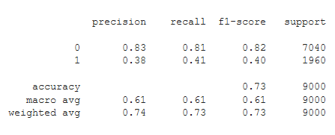
Modeling
Decision Tree Classifier (DTC) :

Slide 8
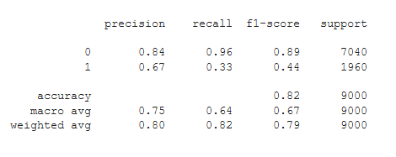
Modeling
and Support Vector Machine Classifier (SVM):

Slide 9
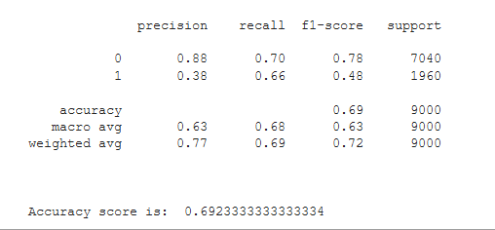
Modeling
Naive Bayes:

Slide 10

.
Conclustion

Slide 11
THANK YOU

