Slide 1
WomenTechWomenYes
Signups in New York
Project 1

Slide 2
Overview
This is the analysis for (WTWY), to help their street teams to gain more signups for the gala that will take place on the first of June.
As we are Data scientist team, we conducted an EDA on MTA data set to get insights on the data for client’s purpose.

Slide 3
Work Stages:
Data Cleaning
Data Processing

Slide 4
Data Cleaning:
Strip White Spaces.
Assure there is no NaN values.
Extract the actual from entries and exits values.
Replace the negative values by zero.
Set a limit for the entries and exits values.
Parse Date & Time columns to timestamp.

Slide 5
Data Processing
Extract Top crowded ten stations and do the following:
Top five crowded station by number of exits
Look for the most crowded day.
Look for the most crowded time.
Look for the most turnstile.
Look for the stations near the LAGUARDIA and JFK airports:
After extracting the most crowded stations the airport stations weren’t part of them.

Slide 6
Data Processing
Top 10 crowded Stations
Top 5 crowded stations
Most crowded Days
Most crowded Times
Most crowded Turnstiles

Slide 7
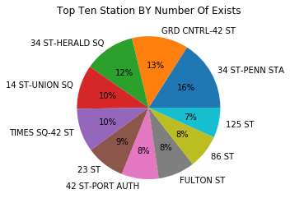
Top Ten Stations by # of Exits

Slide 8
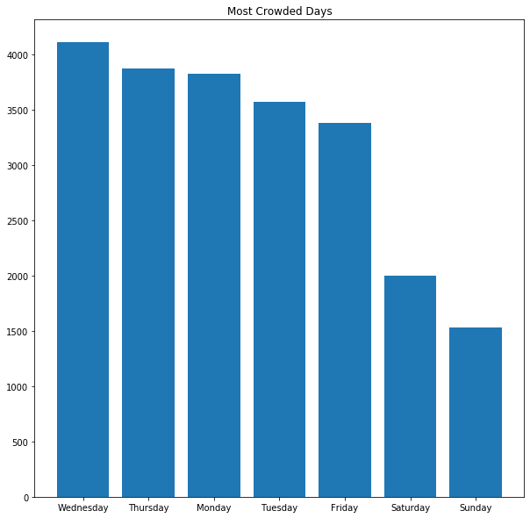
Crowded days in the week

Slide 9
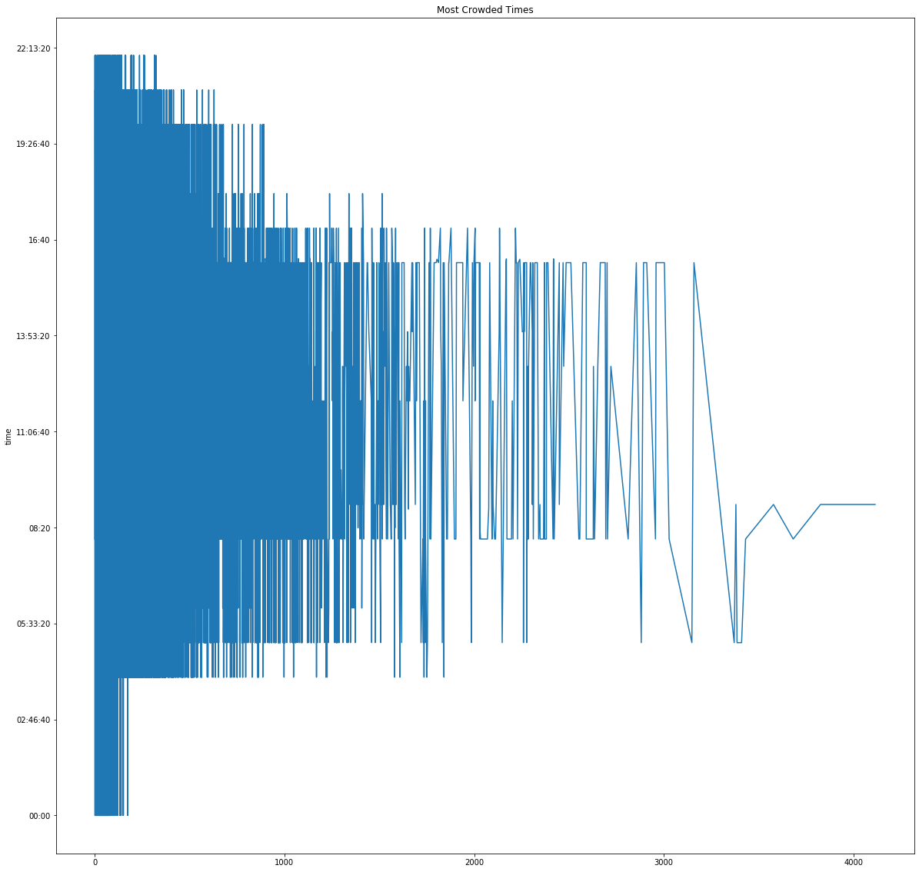
Crowded time in the week

Slide 10
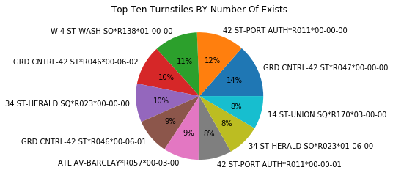
Top Turnstiles by # of Exits

Slide 11
Conclusion
Stations:
34-ST_PENN STA, GRD CNTRL, 34- ST HERALED, 14 ST_UNION, TIMES SW-42 ST
Day:
Wednesday
Time:
8:20

Slide 12
Team members:
Meaad Alrashood.
Njoud alGifari.
Tarfah Alsabi.
Dalya Abuhaimed.
Lama Alsuwayan.

