Slide 1
Removal of Moiré Pattern Noise in Images
107327002
鄭宇程

Slide 2
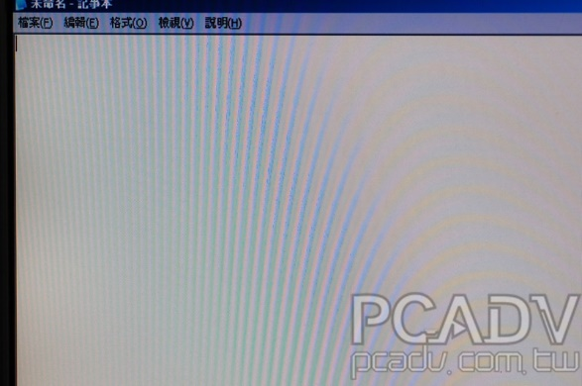
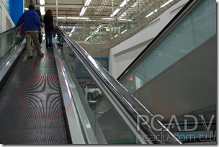
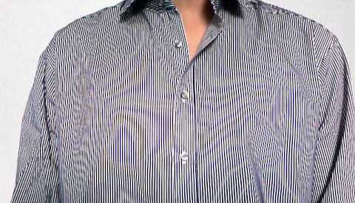

Slide 3
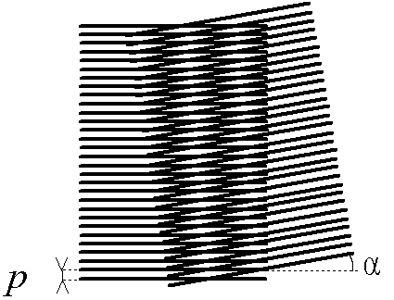
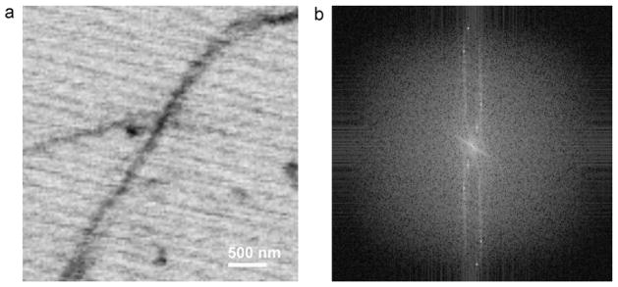
Introduction

Slide 4
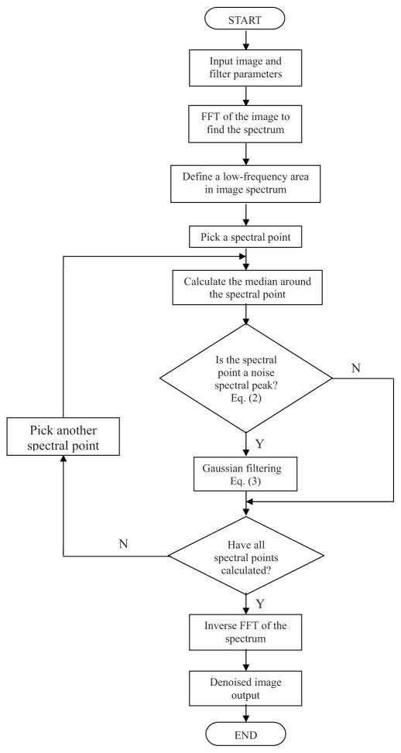
Flowchart

Slide 5
Schemes
Paper search (2~3weeks)
Choose the methods (3~4 weeks)
Project execution (3~6 weeks)
Complete report (1~2weeks)

Slide 6
References
Z. Wei, J. Wang, H. Nichol, S. Wiebe, and D. Chapmana, “A median-Gaussian
filtering framework for Moiré pattern noise removal from X-ray microscopy image,”
Micron, vol. 43, pp. 170-6, 2011.

