Slide 1



DATA ANALYTICS PROJECT
Customer Shopping
Behavior Analysis
End-to-End Analytics: Python · SQL · Power BI
3,900 transactions · 18 features · 4 product categories
Python SQL Power BI
3,900
18
4
3
Purchases
Features
Categories
Tools Used

Slide 2
PROJECT OVERVIEW
🎯 Project Goal
3,900
Analyze customer shopping behavior using transactional retail data to uncover insights into spending patterns, customer segments, product preferences, and subscription behavior — enabling data-driven strategic decisions.
Total Purchases
$59.76
Avg Purchase Amount
01
Data Collection
3,900 purchase records · across 4 categories
02
Python EDA
Cleaning, feature · engineering & prep
3.75
03
SQL Analysis
10 business queries · in PostgreSQL
Avg Review Rating
04
Power BI Dashboard
Interactive visual · reporting

Slide 3
DATASET SUMMARY
3,900 rows · 18 columns · Retail transaction data
👤 Demographics
🛍️ Purchase Details
📊 Shopping Behavior
Age
Item Purchased
Discount Applied
Gender
Category
Prev. Purchases
Location
Purchase Amount (USD)
Frequency
Subscription Status
Season · Size · Color
Review Rating · Shipping Type
⚠️ Missing Data: 37 null values in Review Rating column — imputed using median rating per product category

Slide 4





PYTHON — Exploratory Data Analysis
1
2
3
4
5
Data Loading
Initial Exploration
Missing Data
Feature Engineering
Database Integration
Imported dataset using pandas
(3,900 rows, 18 columns)
df.info() & .describe()
for structure & stats
37 nulls in Review Rating
Imputed via category median
Created age_group &
purchase_frequency_days
Loaded clean DataFrame
into PostgreSQL
✅ Also verified: discount_applied & promo_code_used were redundant → dropped promo_code_used

Slide 5
🐍 Python Code — Jupyter Notebook
[2] Data Loading
[10] Feature Engineering — Age Group
import pandas as pd df = pd.read_csv(r"...customer_shopping_behavior.csv") df.head()
# Create age_group bins labels = ['Young Adult', 'Adult',
'Middle-aged', 'Senior'] df['age_group'] = pd.qcut(df['age'],
q=
4, labels=labels)
[5] Missing Data Check
[12] Feature Engineering — Frequency Days
df.isnull().sum() # Review Rating → 37 nulls df['Review Rating'] = df.groupby('Category')\
[
'Review Rating'].transform(
lambda x: x.fillna(x.median()))
frequency_mapping = { 'Fortnightly': 14, 'Weekly': 7,
'Monthly': 30, 'Quarterly': 90,
'Annually': 365 } df['purchase_frequency_days'] =
df
['frequency_of_purchases'].map(frequency_mapping)
[8] Column Standardization
[15–20] Redundancy Check + DB Load
df.columns = df.columns.str.lower() df.columns = df.columns.str.replace(' ', '_') df = df.rename(columns={
'purchase_amount_(usd)'
: 'purchase_amount'})
# Verify columns are identical → drop (df['discount_applied'] == df['promo_code_used']).all() # → True df = df.drop('promo_code_used', axis=1) # Load to PostgreSQL engine = create_engine(f"postgresql+psycopg2://...", ) df.to_sql('customer', engine, if_exists='replace')
✅ Clean DataFrame: 3,900 rows · 19 cols (after feature engineering) · Loaded into PostgreSQL table 'customer'

Slide 6
SQL — Business Transactions Analysis
10 structured business queries executed in PostgreSQL
01
Revenue by Gender
06
Discount-Dependent Products
Male: $157,890 | Female: $75,191
Hat 50% · Sneakers 49.7% · Coat 49.1%
02
High-Spending Discount Users
07
Customer Segmentation
839 customers spent above average using discounts
Loyal: 3,116 | Returning: 701 | New: 83
03
Top 5 Products by Rating
08
Top 3 Products per Category
Gloves 3.86 · Sandals 3.84 · Boots 3.82
Jewelry, Blouse, Sandals, Jacket lead each cat.
04
Shipping Type Comparison
09
Repeat Buyers & Subscriptions
Express: $60.48 | Standard: $58.46 avg
Non-sub repeat: 2,518 | Sub repeat: 958
05
Subscribers vs Non-Subscribers
10
Revenue by Age Group
Sub avg: $59.49 | Non-sub avg: $59.87
Young Adult $62K → Senior $55K (all close)

Slide 7
🗄️ SQL Code — PostgreSQL Business Queries
Q1 — Revenue by Gender
Q3 — Top 5 Products by Rating
SELECT gender, SUM(purchase_amount) AS revenue FROM customer GROUP BY gender; -- Female: 75,191 | Male: 157,890
SELECT item_purchased, ROUND(AVG(review_rating),2) AS "Average Product Rating" FROM customer GROUP BY item_purchased ORDER BY 2 DESC LIMIT 5;
Q5 — Subscribers vs Non-Subscribers
Q7 — Customer Segmentation
SELECT subscription_status, COUNT(*) AS total_customers, ROUND(AVG(purchase_amount),2) AS avg_spend, SUM(purchase_amount) AS total_revenue FROM customer GROUP BY subscription_status;
SELECT customer_segment, COUNT(*) AS "Number of Customers" FROM (
SELECT
*, CASE WHEN previous_purchases > 10 THEN 'Loyal' WHEN previous_purchases > 5 THEN 'Returning' ELSE 'New' END AS customer_segment FROM customer) sub GROUP BY 1;
Q8 — Top 3 Products per Category
SELECT item_rank, category, item_purchased, total_orders FROM (
SELECT
category, item_purchased, COUNT(*) AS total_orders, RANK() OVER ( PARTITION BY category ORDER BY COUNT(*) DESC) AS item_rank FROM customer GROUP BY 1,2) ranked WHERE item_rank <= 3 ORDER BY category;
Q6 — Discount-Dependent Products
SELECT item_purchased, ROUND( COUNT(CASE WHEN discount_applied='Yes' THEN 1 END) * 100.0 / COUNT(*), 2) AS discount_rate FROM customer GROUP BY item_purchased ORDER BY discount_rate DESC LIMIT 5;

Slide 8
KEY FINDINGS — Revenue & Customer Segments
$157,890
$75,191
3,116
80%
Male Revenue
Female Revenue
Loyal Customers
Loyalty Rate

Slide 9
KEY FINDINGS — Products & Discounts
Standard Shipping
Express Shipping
$58.46 avg spend
$60.48 avg spend

Slide 10
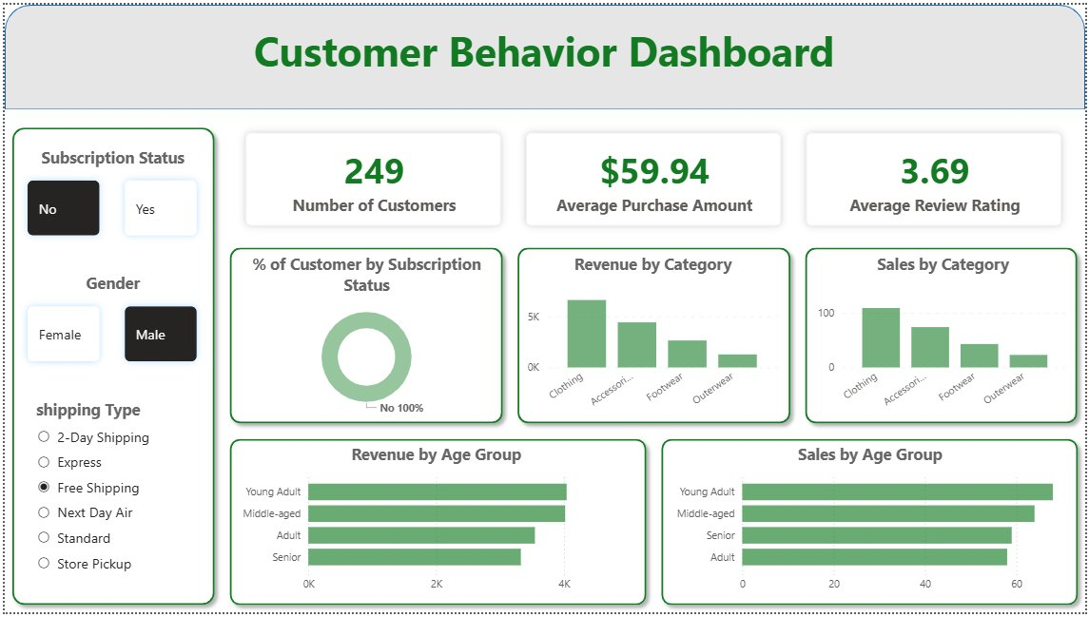
POWER BI — Interactive Dashboard
🔲
Subscription Filter
Toggle Yes/No to compare subscriber behavior
👤
Gender Filter
Male vs Female revenue breakdown
🚚
Shipping Type Filter
All 6 shipping methods selectable
📊
Revenue by Category
Clothing leads with highest revenue
📈
Revenue by Age Group
Young Adults contribute most
249 Filtered Customers
$59.94 Avg Purchase (Filtered)
3.69 Avg Rating (Filtered)
Snapshot: Male · No Subscription · Free Shipping filter active

Slide 11





BUSINESS RECOMMENDATIONS
Data-driven strategies to drive growth
Boost Subscriptions
Customer Loyalty Programs
Review Discount Policy
Only 27% of customers are subscribers yet revenue per subscriber is competitive. Promote exclusive perks — early access, free shipping, member discounts — to convert the 73% non-subscriber base.
80% of customers are already 'Loyal'. Introduce tiered reward programs (Bronze/Silver/Gold) to recognise and retain these buyers — and push 701 Returning customers into Loyal status.
Hat (50%), Sneakers (49.7%) and Coat (49%) show near-50% discount rates. Audit margin impact and consider capping discounts or replacing them with loyalty point incentives.
Product Positioning
Targeted Marketing
Highlight top-rated products (Gloves 3.86, Sandals 3.84, Boots 3.82) in marketing campaigns. Feature best-sellers per category: Jewelry, Blouse, Sandals, Jacket.
Young Adults contribute the highest revenue ($62K). Focus digital campaigns on this segment. Express shipping users spend $2 more on average — upsell premium delivery at checkout.

Slide 12
Project Complete
Thank You!
3,900
Purchases Analyzed
10
Tools & Technologies Used
SQL Queries Run
Python (pandas)
PostgreSQL / SQL
5
Power BI
GitHub (Version Control)
Recommendations
Customer Shopping Behavior Analysis — End-to-End Data Analytics Project

