Slide 1
SAP AI Tools
Summary of AI-Gentic Workshop Hands-On
Step-by-step instructions
Joule Studio · Document AI · AI Launchpad
Joule Studio
Document AI
AI Launchpad

Slide 2
SAP Joule Studio
Hands-On Workshop
20 hands-on steps

Slide 3
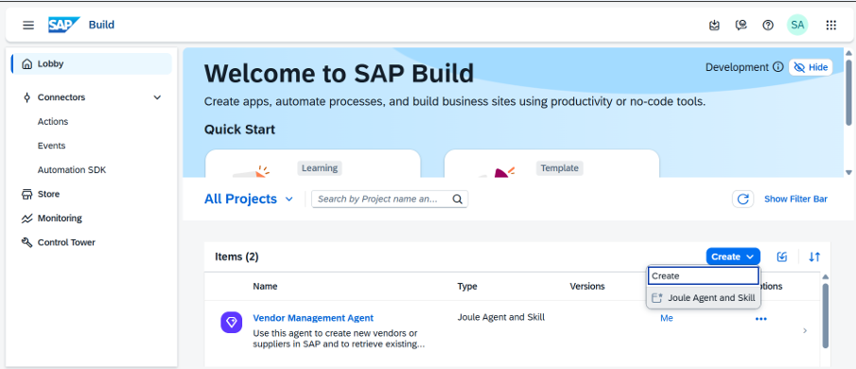
Create New Project
Step 1 of 20
[ Screenshot: New Project button ]
Action
Navigate to SAP Joule Studio and click on
+ New Project to begin creating your project.
What to expect
You will be directed to a project creation
wizard. This is your starting point for building
Joule-powered AI skills and agents.
Ensure you have the correct SAP BTP
subaccount and permissions.
SAP AI Tools Workshop · Joule Studio

Slide 4
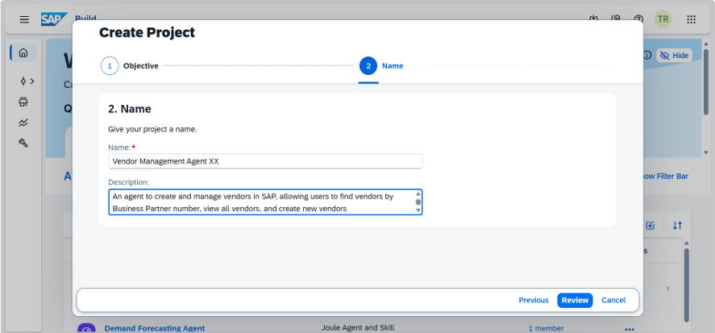
Enter Project Name And Description
Step 2 of 20
[ Screenshot: Project name & description form ]
Fill in Details
Enter a meaningful project name and a brief description that explains the purpose of your Joule project.
Name: Vendor Management Agent Name
Description: An agent to create and manage vendors in SAP, allowing users to find vendors by Business Partner, view all vendors, and create new vendors
Tips
• Use a clear, descriptive name
• Description helps collaborators understand scope
• Keep names consistent with naming conventions
SAP AI Tools Workshop · Joule Studio

Slide 5
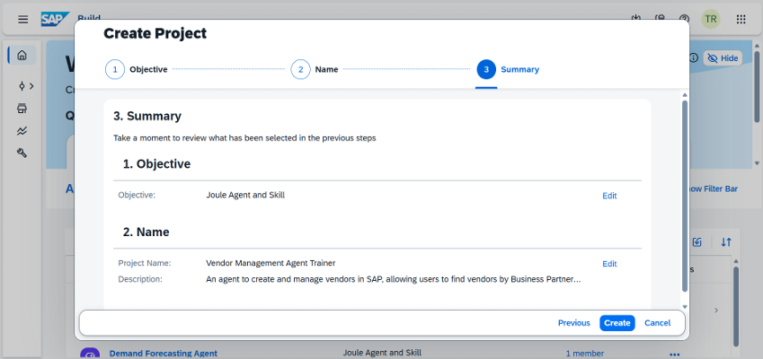
Review and Create Project
Step 3 of 20
[ Screenshot: Review screen ]
Review
Verify all the details you have entered.
Once confirmed, click Create to complete
the project setup.
What happens next
• Project is created in Joule Studio
• You are redirected to the project dashboard
• You can now start adding skills and agents
SAP AI Tools Workshop · Joule Studio

Slide 6
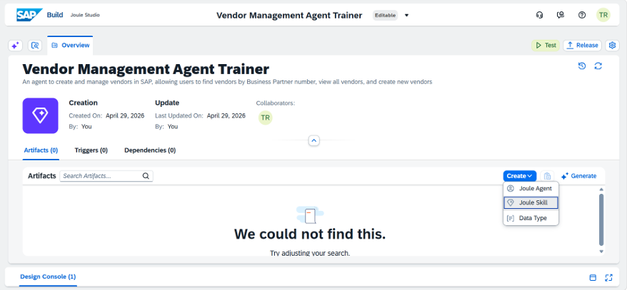
Create Joule Skill To Create Vendor
Step 4 of 20
[ Screenshot: Create Skill button ]
Action
Inside your project, click Create Joule Skill.
About Joule Skills
A Joule Skill is a reusable unit that wraps a business action. It defines inputs, outputs, and the action to execute .In this case, creating a vendor in SAP S/4HANA.
SAP AI Tools Workshop · Joule Studio

Slide 7
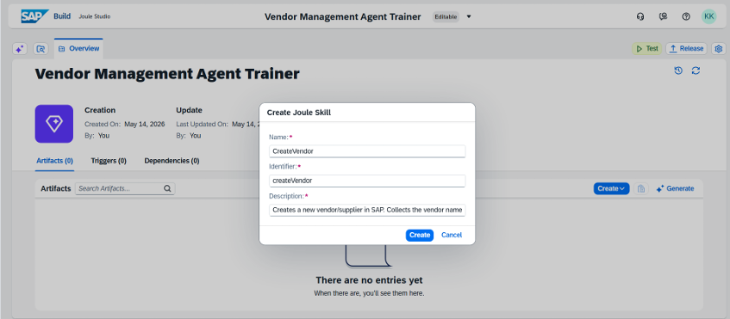
Enter Skill Name and Description
Step 5 of 20
[ Screenshot: Skill name & description ]
Skill Name
CreateVendor
Description
Creates a new vendor/supplier in SAP.
Collects the vendor name, category, and grouping before creation.
SAP AI Tools Workshop · Joule Studio

Slide 8
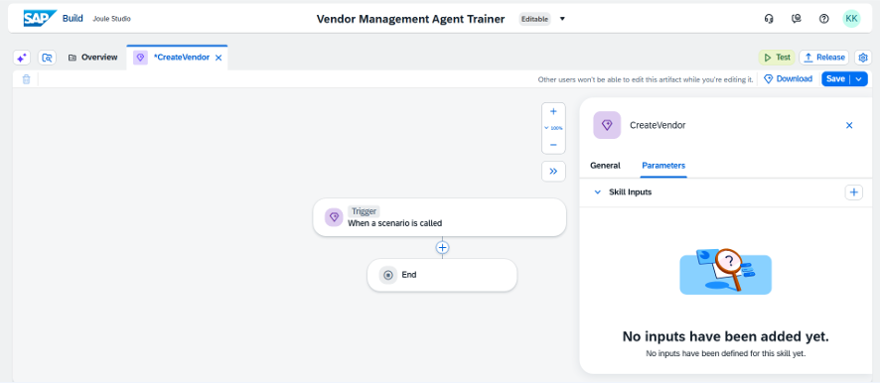
Add Skill Inputs
Step 6 of 20
[ Screenshot: Parameters panel ]
Navigation Steps
1. Click on Trigger
2. Navigate to the Parameters tab
3. Select Skill Inputs which can define the inputs that the skill will accept from the user
SAP AI Tools Workshop · Joule Studio

Slide 9
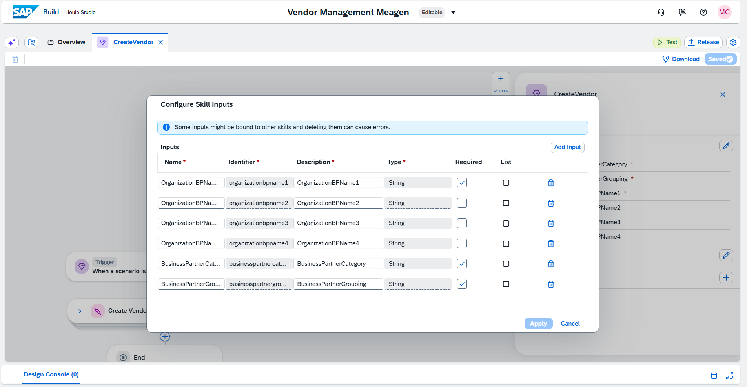
Add Skill Input Fields
Step 7 of 20
Click the + icon and add the following fields with type String, then click Apply:
[ Screenshot: + icon & input fields ]
Field Name Type / Notes
OrganizationBPName1
String — Required
OrganizationBPName2
String — Optional
OrganizationBPName3
String — Optional
OrganizationBPName4
String — Optional
BusinessPartnerCategory
String — Required
BusinessPartnerGrouping
String — Required
SAP AI Tools Workshop · Joule Studio

Slide 10
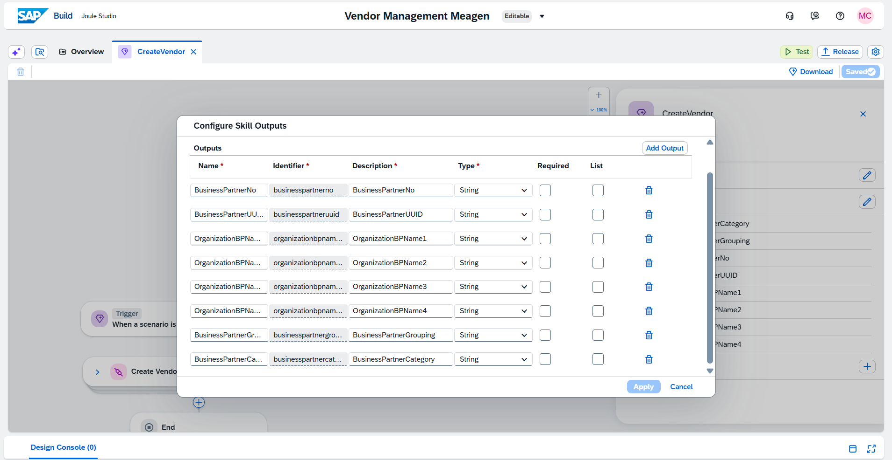
Add Skill Output Fields
Step 8 of 20
Navigate to Skill Outputs and add the following fields (all type String, Optional):
[ Screenshot: Skill Outputs ]
Field Name Type / Notes
BusinessPartnerNo
String — Optional
BusinessPartnerUUID
String — Optional
OrganizationBPName1
String — Optional
OrganizationBPName2
String — Optional
OrganizationBPName3
String — Optional
OrganizationBPName4
String — Optional
BusinessPartnerGrouping
String — Optional
BusinessPartnerCategory
String — Optional
SAP AI Tools Workshop · Joule Studio

Slide 11
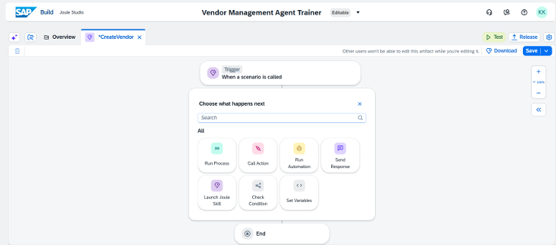
Click + Icon Below Trigger
Step 9 of 20
[ Screenshot: + icon below Trigger ]
Action
Click the + icon directly below the Trigger block.
From the menu that appears, select Call Action.
SAP AI Tools Workshop · Joule Studio

Slide 12
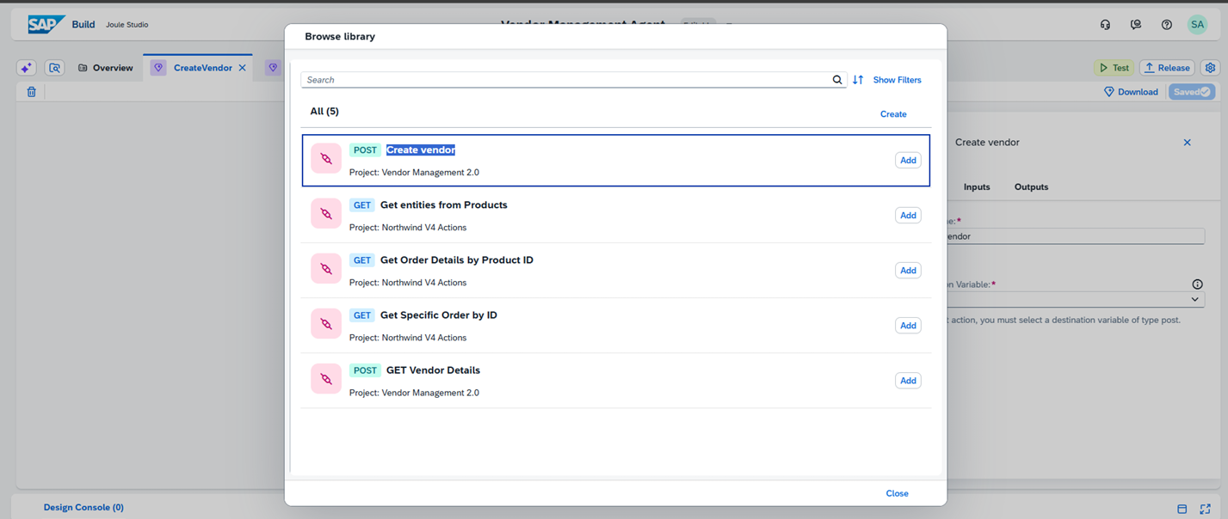
Add Create Vendor Action
Step 10 of 20
[ Screenshot: Call Action — Create Vendor ]
Action
After selecting Call Action, search for or select the Create Vendor action from the action catalogue.
This action maps to the Business Partner POST API in SAP S/4HANA that creates new vendor master records.
SAP AI Tools Workshop · Joule Studio

Slide 13
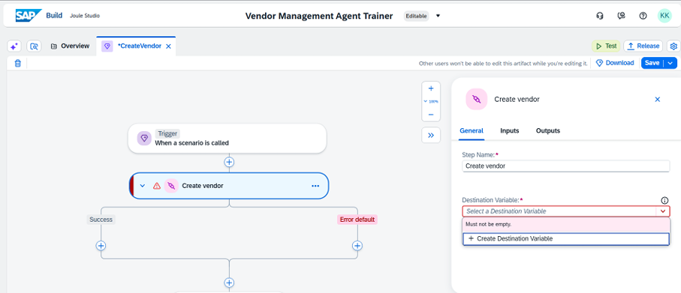
Create a Destination Variable
Step 11 of 20
[ Screenshot: Destination variable screen ]
Action
Click to create a new Destination variable.
This variable will point to the SAP S/4HANA system where the vendor will be created.
SAP AI Tools Workshop · Joule Studio

Slide 14
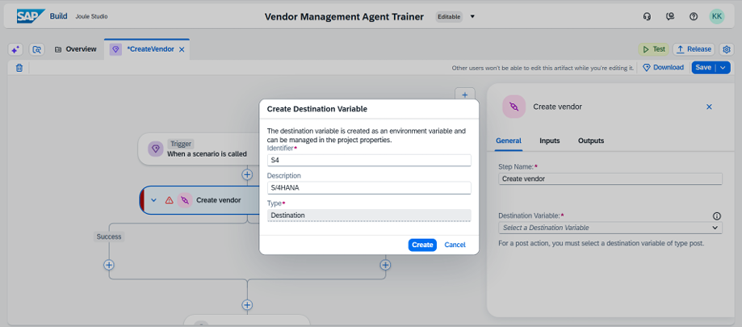
Enter Destination Details
Step 12 of 20
[ Screenshot: Destination details form ]
Identifier
S4
Description
S/4HANA
Note
This destination name (S4) will be used to route API calls to your SAP S/4HANA system. Ensure it matches the BTP destination.
SAP AI Tools Workshop · Joule Studio

Slide 15
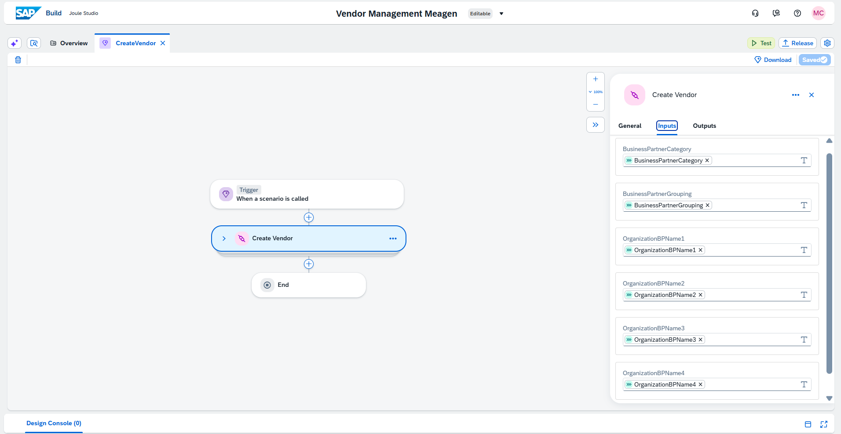
Navigate to Inputs — Map Fields
Step 13 of 20
[ Screenshot: Input mapping screen ]
Action
Navigate to the Inputs tab within the Call Action block.
Here you will see the Action Inputs on one side and Skill Inputs on the other.
Map each Skill Input field to its corresponding Action Input field
• BusinessPartnerCategory → BusinessPartnerCategory
• BusinessPartnerGrouping → BusinessPartnerGrouping
• OrganizationBPName1 → OrganizationBPName1
• (repeat for all remaining fields)
SAP AI Tools Workshop · Joule Studio

Slide 16
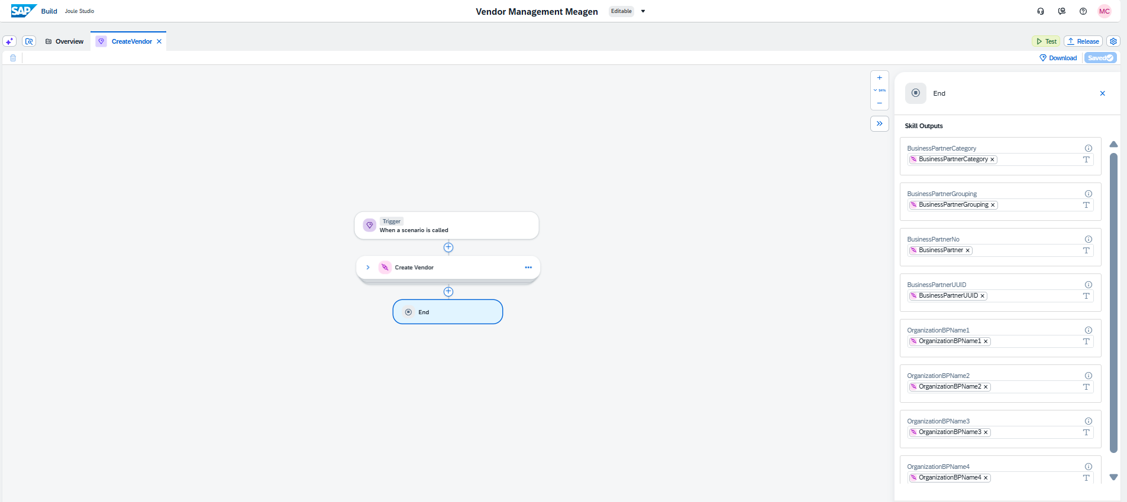
Map Action Outputs to Skill Outputs
Step 14 of 20
[ Screenshot: Output mapping ]
Action
Click the End
Map Action Outputs to the corresponding Skill Output fields:
• BusinessPartnerCategory → BusinessPartnerCategory
• BusinessPartnerGrouping → BusinessPartnerGrouping
• BusinessPartnerNo → BusinessPartner
• BusinessPartnerUUID → BusinessPartnerUUID
• OrganizationBPName1 → OrganizationBPName1
• (repeat for all remaining fields)
Final step
Click Save once all mappings are done.
SAP AI Tools Workshop · Joule Studio

Slide 17
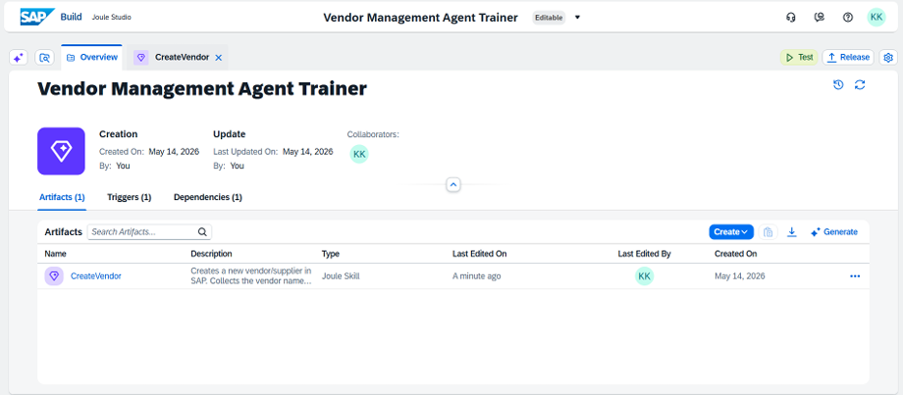
Navigate to Overview
Step 15 of 20
[ Screenshot: Joule icon — Overview ]
Action
Return to the main project Overview screen, where you can see all skills and agents.
Click the Joule icon in the top left corner of the screen, located next to the Overview label.
From here you will generate the Vendor Management Agent using a prompt.
SAP AI Tools Workshop · Joule Studio

Slide 18
Generate Vendor Management Agent
Step 16 of 20
Use the following prompt in the Joule agent creation dialog:
Create a new Joule agent called Vendor Management Agent This agent manages vendor data in SAP S/4HANA using skill: Skill: CreateVendor: Creates a new vendor by collecting OrganizationBPName1, BusinessPartnerCategory, and BusinessPartnerGrouping from the user, then calling the Create Supplier POST API Set the expertise to: SAP Vendor Management Specialist responsible for creating vendor records using Business Partner API in SAP S/4HANA Set the instructions to: Always confirm with the user before creating a vendor. Ask for missing required fields one at a time. Display vendor details in a structured format. Handle errors gracefully and inform the user clearly if an operation fails.
SAP AI Tools Workshop · Joule Studio

Slide 19
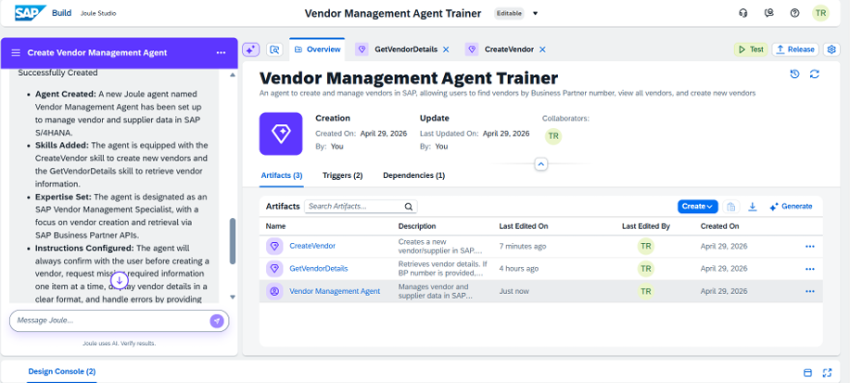
Vendor Management Agent Generated by Joule
Step 17 of 20
[ Screenshot: Generated Vendor Management Agent ]
SAP AI Tools Workshop · Joule Studio

Slide 20
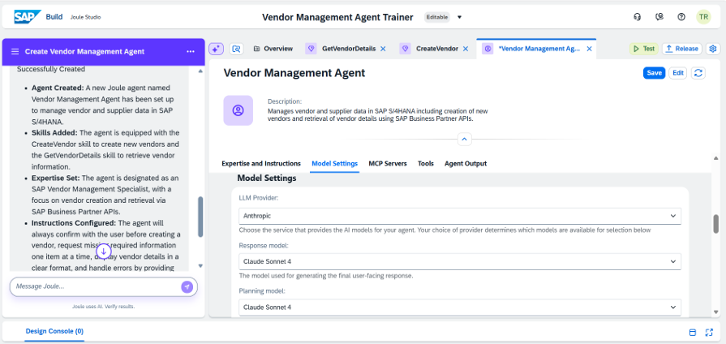
Agent Configuration
Step 18 of 20
[ Screenshot: LLM configuration panel ]
LLM Provider
Change the LLM provider to Claude
Model Selection
Select Claude Sonnet 4 as both the Response and Planning model
Thinking Steps
Set Maximum Number of Thinking Steps to 80
Save
Click Save after configuring all settings.
SAP AI Tools Workshop · Joule Studio

Slide 21
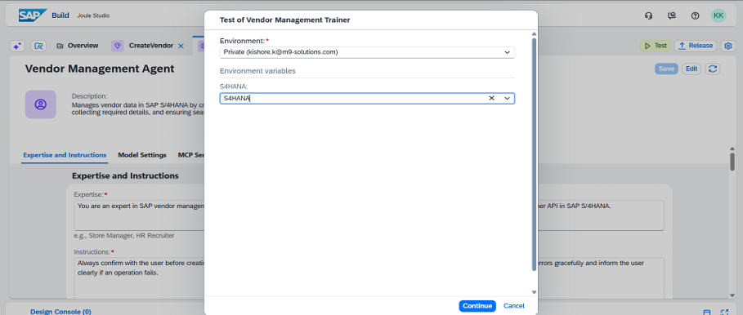
Test Your Agent
Step 19 of 20
[ Screenshot: Test button ]
Action
Click the green Test button to open the test panel.
Note: Testing the agent requires a connected SAP S/4HANA environment to be configured.
SAP AI Tools Workshop · Joule Studio

Slide 22
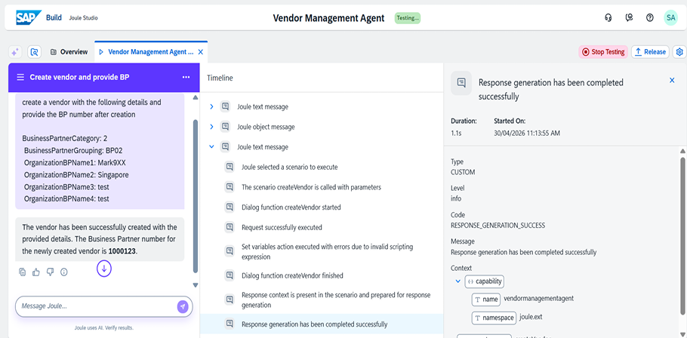
Create a Vendor with Joule
Step 20 of 20
Use the following prompt in the Joule agent test panel:
Expected Result
The agent should:
1. Confirm the details with you before proceeding
2. Call the CreateVendor skill with the provided inputs
3. Return the newly created Business Partner (BP) number
Display vendor details in a structured format
Create a vendor with the following details and provide the BP number after creation
BusinessPartnerCategory: 2
BusinessPartnerGrouping: BP02
OrganizationBPName1: Anyname
OrganizationBPName2: Singapore
OrganizationBPName3: test
OrganizationBPName4: test
SAP AI Tools Workshop · Joule Studio

Slide 23
SAP Document AI
Hands-On Workshop
5 hands-on steps

Slide 24
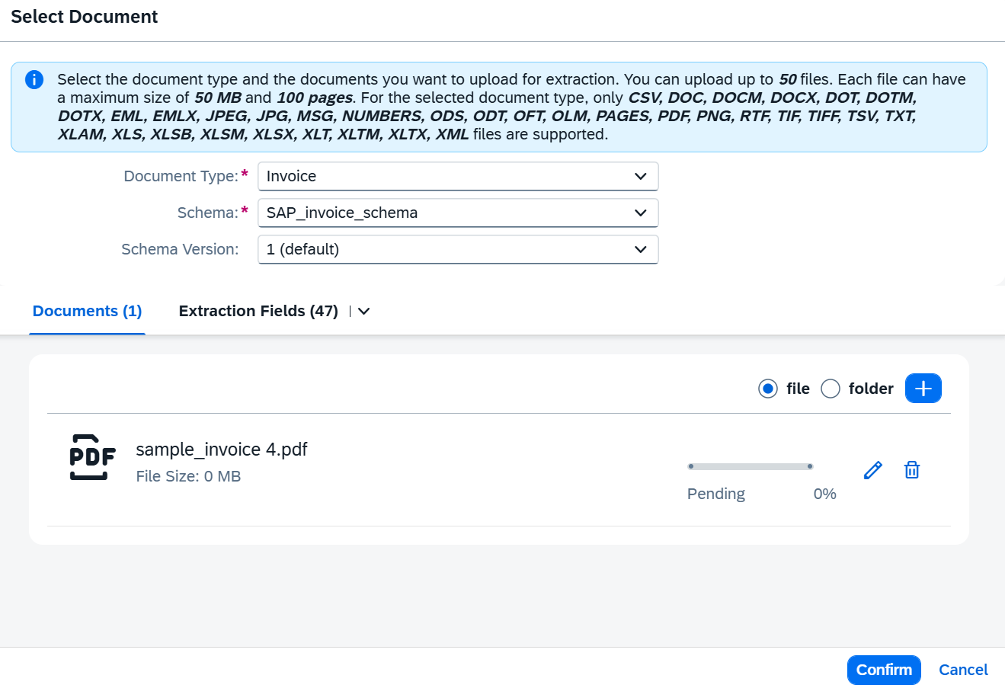
Upload Document
Step 1 of 5
[ Screenshot: Upload document screen ]
Document Type
Invoice
Schema
SAP_invoice_schema
Action
Upload an invoice document. Select the correct Document Type and Schema before uploading.
SAP AI Tools Workshop · Document AI

Slide 25
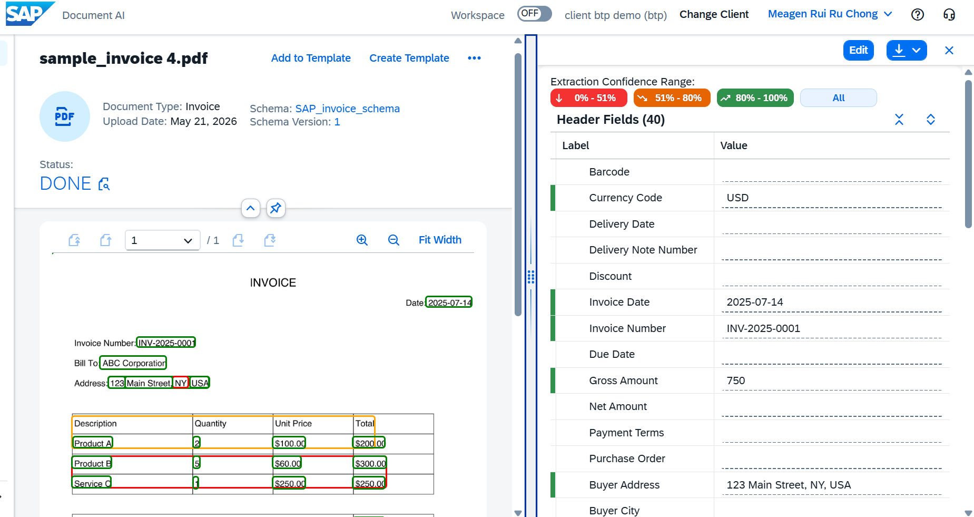
Review Extraction Results
Step 2 of 5
[ Screenshot: Extraction results ]
Confidence Levels Explained:
🟢 Green — High confidence
Field extracted correctly, no review needed.
🟠 Orange — Moderate confidence
Human review recommended before use.
🔴 Red — Low confidence
Extraction likely incorrect, manual correction required.
SAP AI Tools Workshop · Document AI

Slide 26
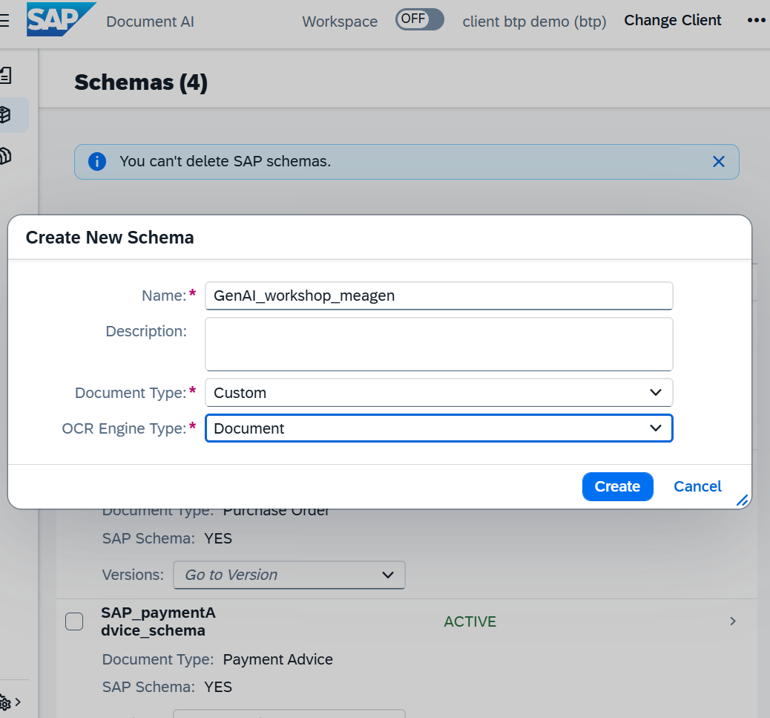
Create a Custom Schema
Step 3 of 5
[ Screenshot: Create schema screen ]
Schema Name
GenAI_workshop_name
Document Type
Custom
OCR Engine Type
Document
Purpose
A custom schema tells SAP Document AI which fields to extract using the underlying LLM, tailored to your document structure.
SAP AI Tools Workshop · Document AI

Slide 27
Add Header and Line Item Fields
Step 4 of 5
Define the extraction fields, then click Activate:
Header Fields
Line Item Fields
Field Name Type / Notes
Field Name Type / Notes
InvoiceNum
string
Description
string
Receiver
string
Quantity
string
ReceiverAddress
string
PricePerUnit
number
TotalAmount
number
TotalPricePerProduct
number
After adding all fields, click Activate to enable the schema for document extraction.
SAP AI Tools Workshop · Document AI

Slide 28
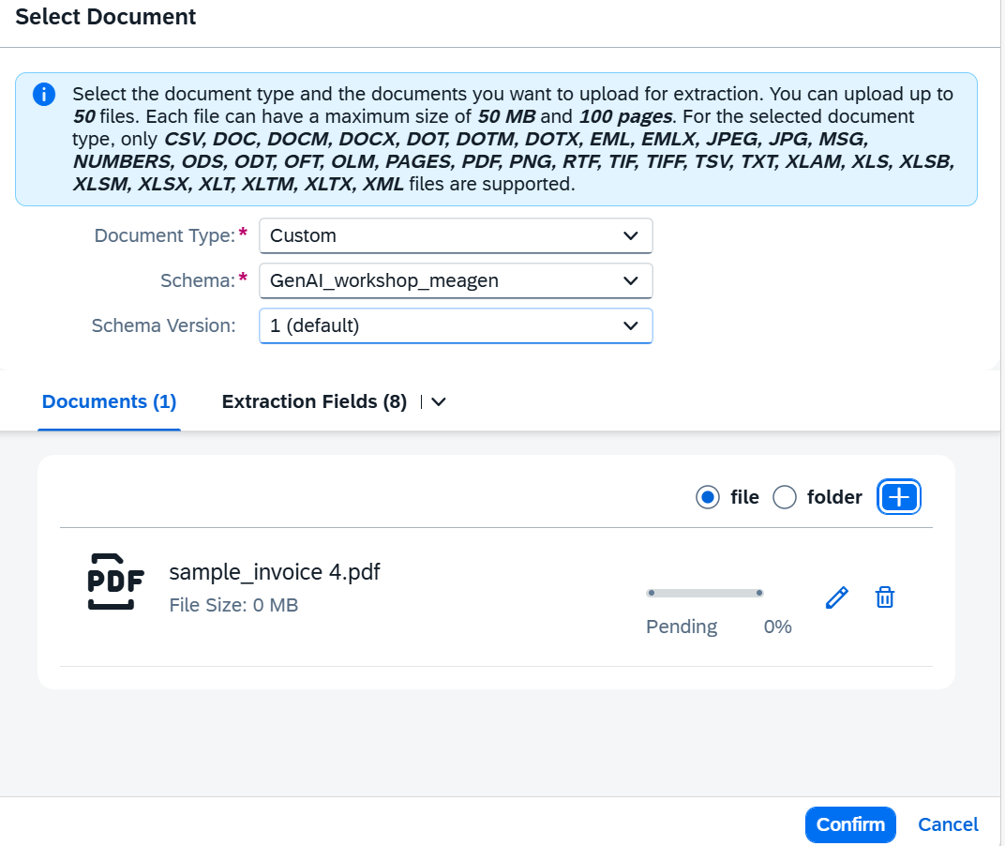
Upload Document with Custom Schema
Step 5 of 5
[ Screenshot: Upload with custom schema ]
Document Type
Custom
Schema
GenAI_Workshop_name
What to expect
SAP Document AI will extract the invoice fields defined in your custom schema. Review the results and check confidence levels for each extracted field.
SAP AI Tools Workshop · Document AI

Slide 29
SAP AI Launchpad
Hands-On Workshop
9 hands-on steps

Slide 30
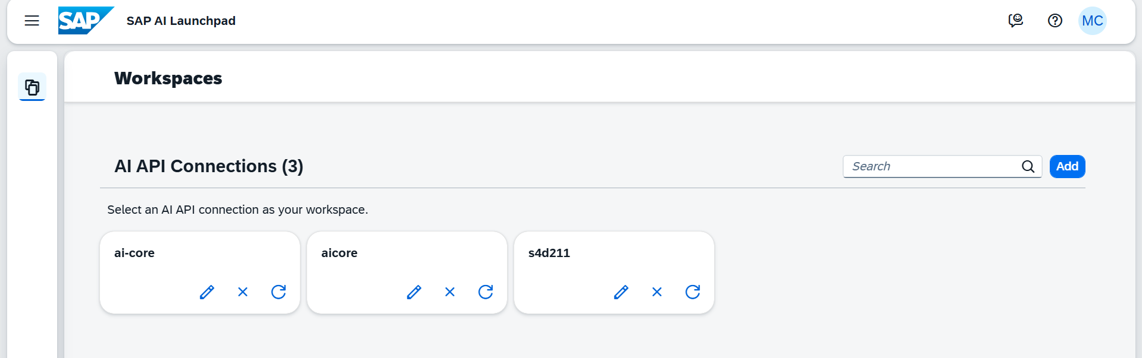
Go to AI Core
Step 1 of 9
[ Screenshot: AI Core workspace ]
Action
Open SAP AI Launchpad and navigate to the AI Core workspace.
“ai-core” is already set up — you do not need to configure the backend connection.
From here you will create an Orchestration configuration and deployment.
SAP AI Tools Workshop · AI Launchpad

Slide 31
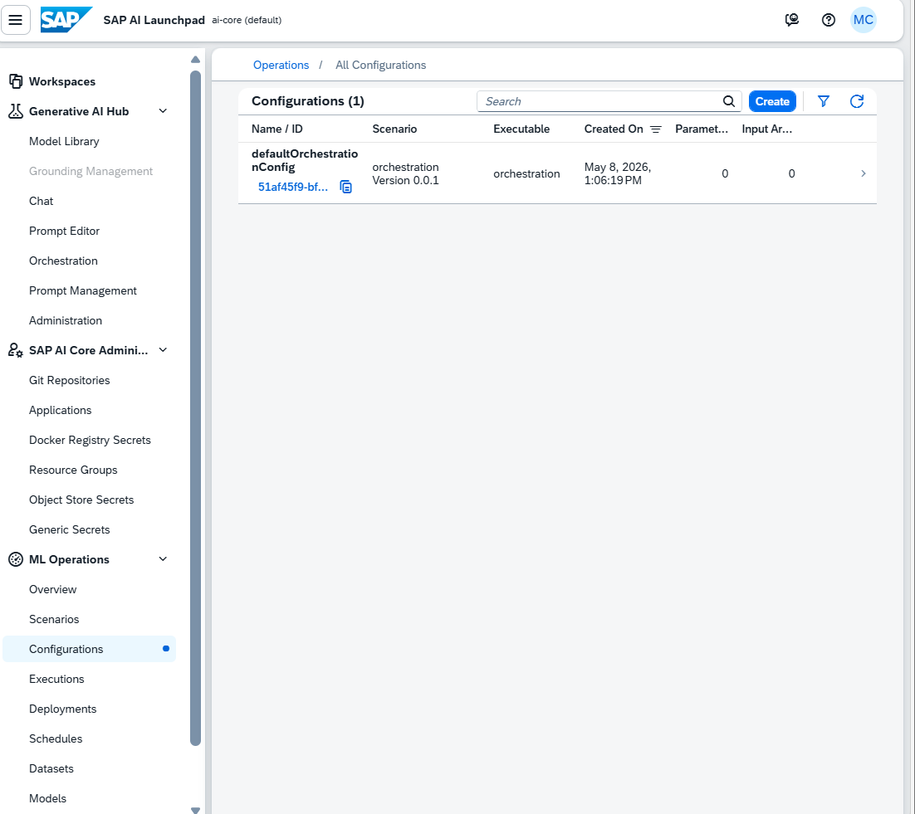
Create Configuration for Orchestration Deployment
Step 2 of 9
[ Screenshot: Configurations section ]
Action
In the AI Core workspace, navigate to the Configurations section from the left-hand menu.
Click Create to start a new configuration.
This configuration will be used to deploy the Orchestration service, which powers the LLM-based scenarios you will test.
SAP AI Tools Workshop · AI Launchpad

Slide 32
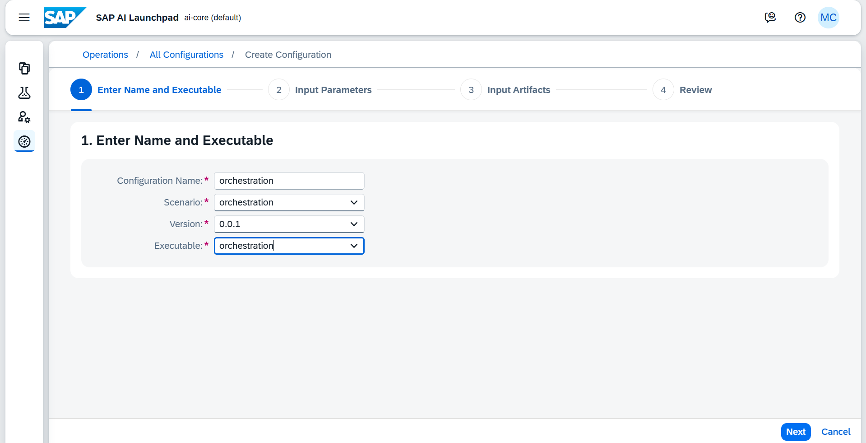
Fill in Deployment Details
Step 3 of 9
[ Screenshot: Configuration form ]
Enter the following configuration details:
Field Name Type / Notes
Name
orchestration
Executable
orchestration
Scenario
orchestration
Version
0.0.1
Click Next after entering each detail and Finally Review and your configuration should be created.
SAP AI Tools Workshop · AI Launchpad

Slide 33
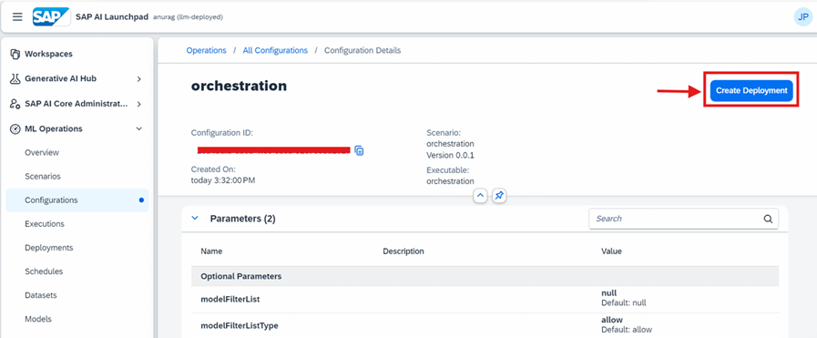
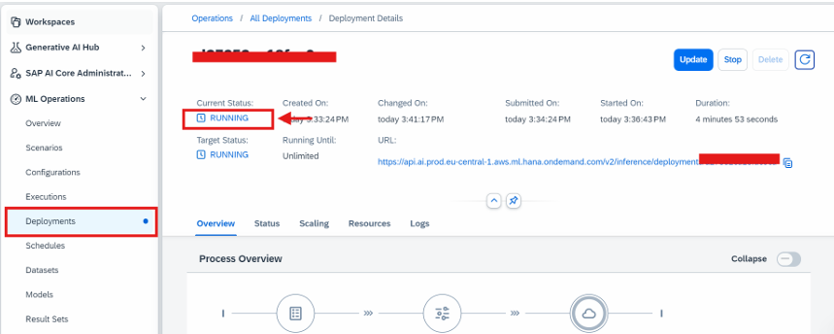
Create Deployment
Step 5 of 9
[ Screenshot: Create Deployment prompt ]
Action
After the configuration is created, you will be prompted to Create a Deployment.
Click Create Deployment.
Continue through the setup wizard by clicking Next at each step.
When you reach the deployment confirmation screen, confirm to start the deployment.
Wait for the deployment status to show Running before proceeding.
SAP AI Tools Workshop · AI Launchpad

Slide 34
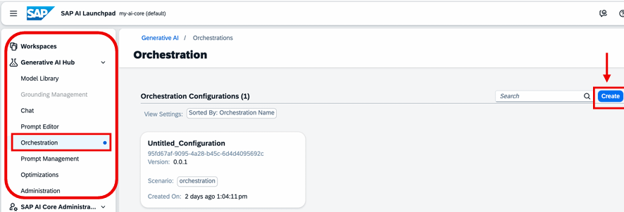
Navigate to Orchestrations
Step 6 of 9
[ Screenshot: Generative AI Hub — Orchestrations ]
Action
From the left-hand menu, navigate to:
Generative AI Hub → Orchestrations
Click CREATE to start building a new orchestration flow.
Orchestrations allow you to chain LLM prompts with structured inputs and system instructions — enabling scenarios like CV summarisation and data masking.
SAP AI Tools Workshop · AI Launchpad

Slide 35
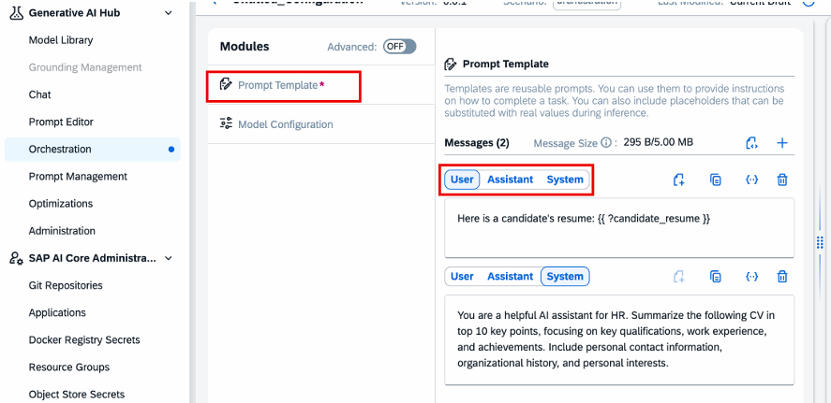
Select Prompt Template Module
Step 7 of 9
[ Screenshot: Modules — Prompt Template ]
Action
In the Modules section of the orchestration editor:
1. Select PROMPT TEMPLATE
2. Locate the message icon with three tabs:
• User
• Assistant
• System
3. Use these tabs to define the user prompt, system instruction, and optional assistant context for each scenario.
SAP AI Tools Workshop · AI Launchpad

Slide 36
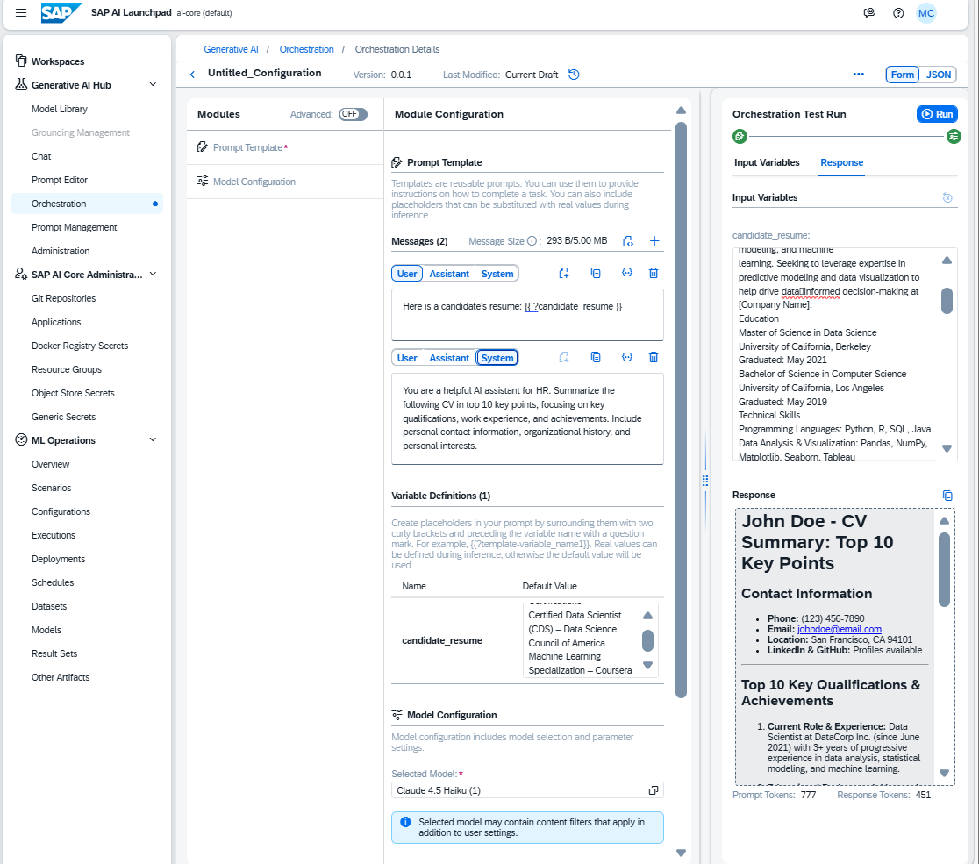
Scenario 1 — Resume Summarisation
Step 8 of 9
Optimise key details from a resume (text only):
USER:
Here is a candidate's resume:
{{ ?candidate_resume }}
System:
You are a helpful AI assistant for HR. Summarize the following CV in top 10 key points, focusing on key qualifications, work experience, and achievements. Include personal contact information, organizational history, and personal interests.
User Input for Resume:
Copy the candidate's CV text from the provided document and paste it in the right panel response tab under the candidate_resume:
SAP AI Tools Workshop · AI Launchpad

Slide 37
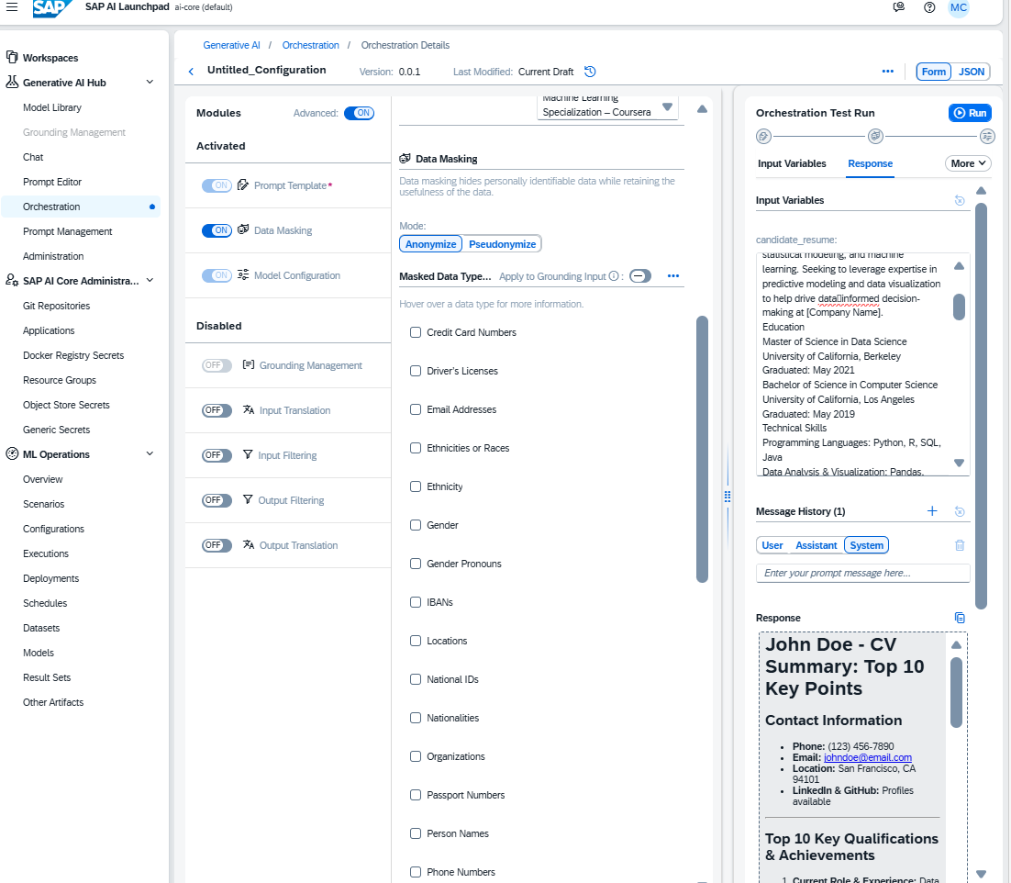
Scenario 2 — Data Masking for Privacy
Step 9 of 9
Apply data masking to protect candidate personal information (DPP compliance):
SYSTEM:
You are a helpful and responsible AI assistant for HR. For maintaining the privacy of the candidate beyond the job position they have applied for, kindly mask the personal details of the candidate to comply with the DPP regulations.
Action
On the advanced setting for Modules and On Data Masking.
Check the boxes for data which needs to be masked like name, gender, phone number, email address etc according to the context.
Use the same {{ ?candidate_resume }} variable as Scenario 1 in the User tab.
SAP AI Tools Workshop · AI Launchpad

Slide 38
Workshop Complete!
You have completed all three hands-on sections
Joule Studio — 20 steps — Build & test a vendor creation agent
Document AI — 5 steps — Extract invoice fields with custom schema
AI Launchpad — 9 steps — Orchestrate HR scenarios with LLM

