Slide 1
SUMMARY
The company should invest in the development of mobile platform (app especially), but keep investing in desktop platform
- the growth in users choosing mobile between November 2021 and November 2022 is significant
- the growth in profit from mobile bookings is also significantly bigger in that period
- it should be considered in investment plans that the desktop is still the main platform to make bookings
2. Region in which the company was the most successful is APAC
Two countries in this region (Australia and South Korea), in which also mobile platform was most popular, should be highlighted as an example
3. The offer of the Travel company could be increased by adding new destinations and removing those less popular.
- the impact of adding new countries to the list of destinations should be measured in the future,
especially for the countries with the highest growth in orders and value

Slide 2
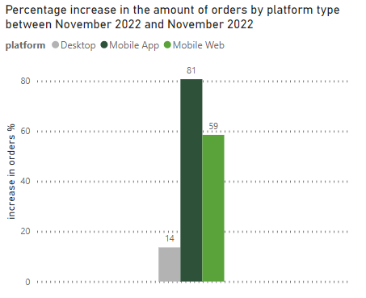
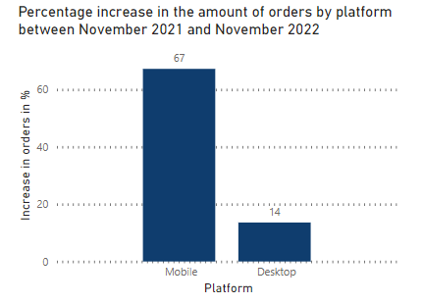
The growth in orders made between Nov 2021 and Nov 2022 by desktop and mobile
In the period of one year (Nov 2021-Nov 2022) we can observe a 67% overall increase in orders made by mobile, while percentage increase of orders made by desktop is low.
The increase is high for mobile web (59%) but it is significantly higher for mobile app option (81%)

Slide 3
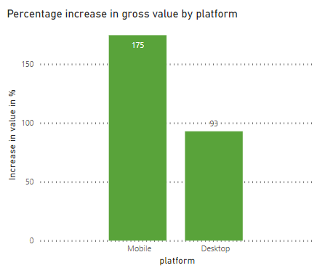
Percentage increase
for value by platform
(November 2021 - November 2022)
The value brought by desktop platform is growing slower than the value brought by mobile platform.
The growth in value by mobile platform is 175 %

Slide 4
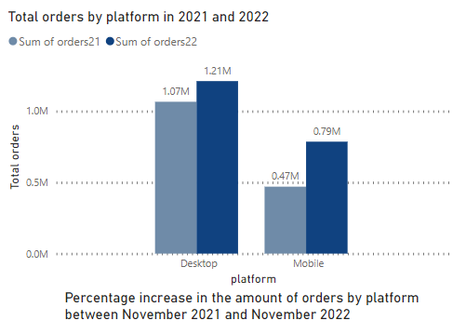
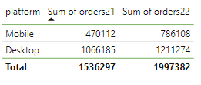
Desktop is still the most popular method of booking.
Difference in amount of bookings made by desktop or mobile platform in one year period (November 2021 November 2022)

Slide 5
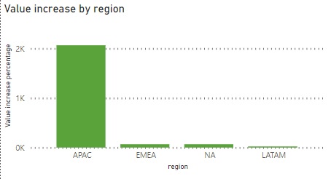
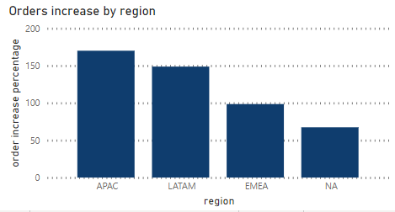
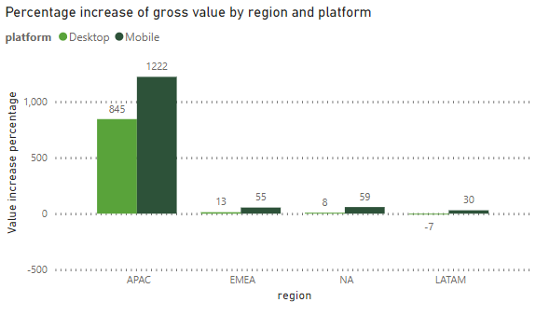
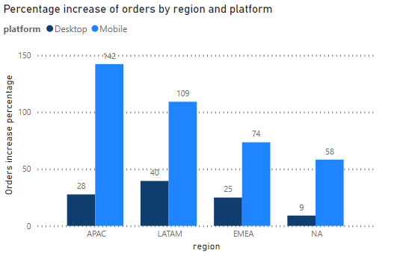
Increase of orders and value by platform and region
Based on the graphs, we will look closer at APAC region as it shows that the biggest growth in value in 2022 brought customers who originate from APAC region. Travelers from APAC region book their travels using mostly mobile platform.

Slide 6
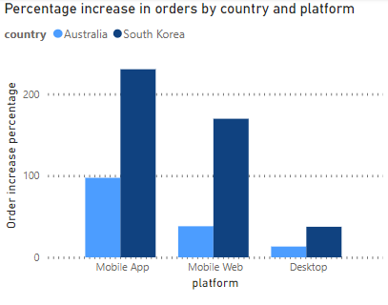
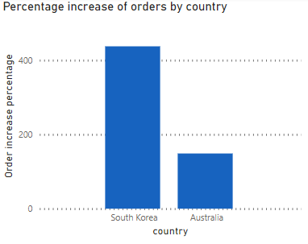
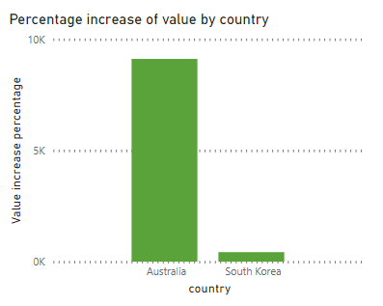
Percentage increase of orders and value by platform and country in APAC region
Closer look at Australia and South Korea.
Within APAC region, the biggest increase in orders has South Korea but Australia brings the biggest increase in value.
The increase in amount of orders made by travellers in South Korea by mobile platforms is big. Over 200%. For mobile app and over 150% for mobile web..
In Australia, the growth is also big but smaller than in South Korea (close to 100% for mobile app and close to 30% for mobile web).

Slide 7
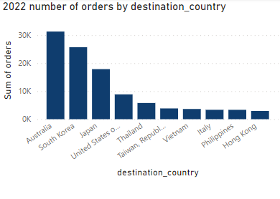
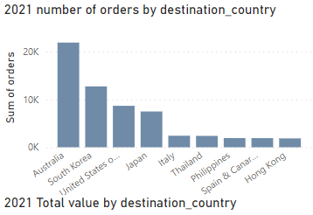
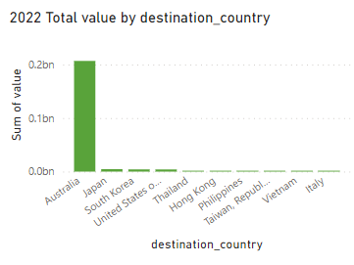
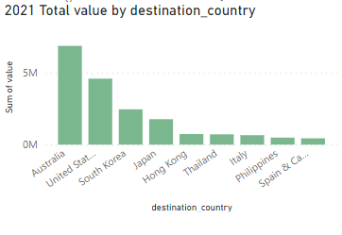
Most popular destinations for travellers from Australia and South Korea in November 2021 and November 2022
There is a visible change in travellers' preferences within a year.
In 2022 there is growth in number of orders in general. The United States are not as popular as in 2021. The biggest value bring booking for Australia. In 2022the difference in value for Australia and other destinations is significant.

Slide 8
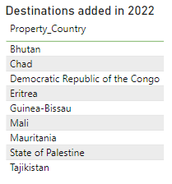
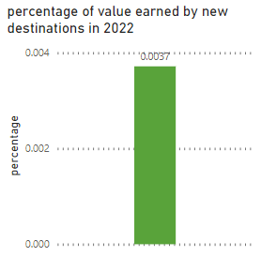
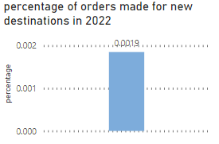
Percentage that value made by countries added to destinations in 2022
made of total orders and total value
Percentage that value made by countries added to destinations in 2022 made of total orders and total value is not yet significant.
Four destinations from 2021 are cancelled in 2022 . It didn’t make a big impact on the growth in amount of orders or growth of value.

