Slide 1



Expansion possibilities in the United States for INTO

Slide 2

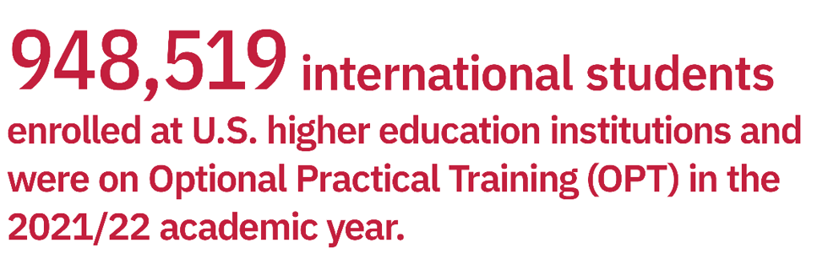

STATISTICS

Slide 3

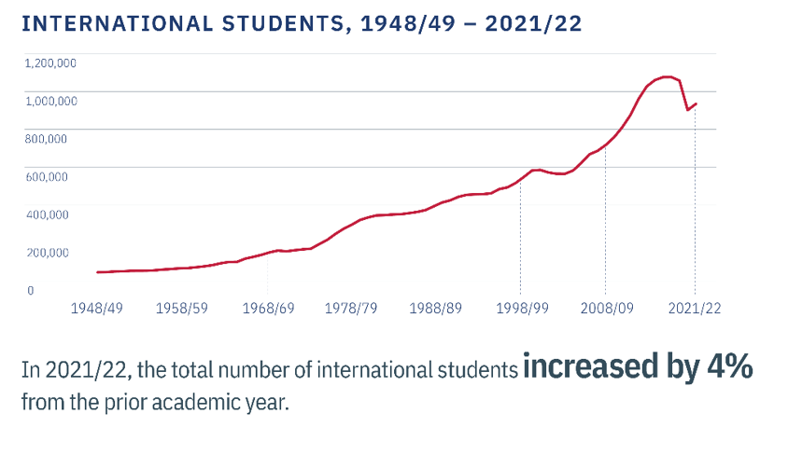
Meet the presenter
Mirjam is the CEO of Contoso, a business that creates a virtual platform for employees to connect with each other all over the world. Mirjam's background as a PhD in communication theory led her to the idea for Contoso, and the building of a successful product for the tech industry.

Slide 4
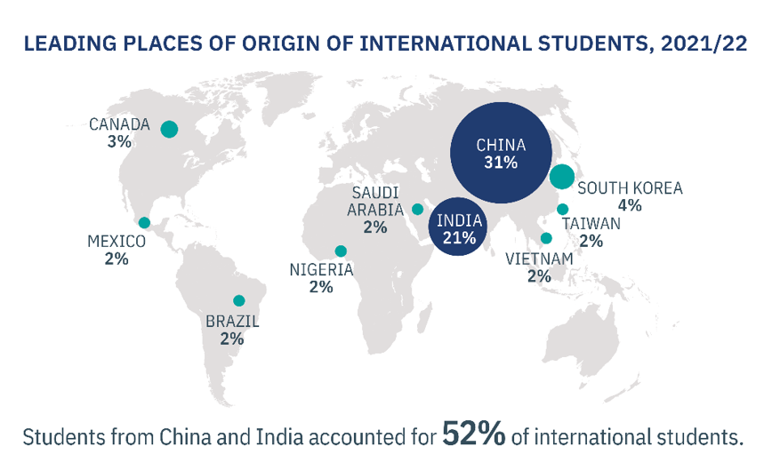

Background
As a high school student, Mirjam’s interest in American Sign Language sparked her desire to study communication, which led to her focus on technology and how it enhances communication.

Slide 5
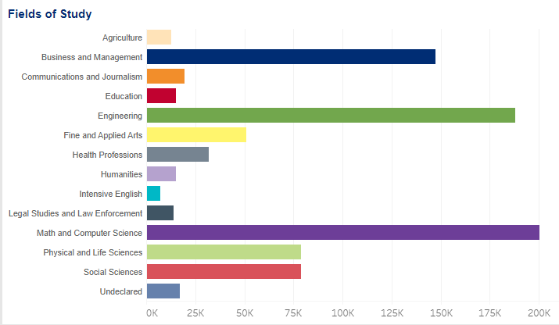
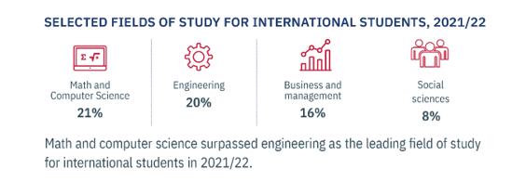
Most Popular Fields of Study
1
2
Do you think technology has helped or hindered our ability to communicate with each other?
3
Share your answers with each other.

Slide 6


STUDENT PROFILE Major contributing factors in a student’s decision to study in US: - Enhancing career opportunities and gaining experience for future employment - 78% considered a period of study abroad as a way to better their career opportunities. -The reputation of academic qualifications and degrees from the U.S. is important for 95% of South Asians and 92% of students from North Africa and the Middle East. - For 77% the specific program or courses in their area of specialization in universities offer is important. -The location of the campus does not seem to be particularly important in candidates’ decision. Only 33% declare differently. -Personal safety and security concerns: 45% of South Asian and 46% of Southeast Asian students found safety important (in comparison to 14% of Europeans)

Slide 7

UNIVERSTITY PROFILE (2022): - Average medium level university is defined by enrolment number between 5000 up to 30000. -Average number of international students in US makes an average of 4.6% to 5% (ACA) -For the universities already in INTO Partnership the max. enrolment varies between 400 and 8000 students.
-Foreign students’ enrolment percentage is smaller or equal than 5. -Average national tuition for foreign students is $22 953 for the US -Most of the public universities has an average admission rate on the 68 % level (the best one’s report 4-5 %) -Most of public institutions with lower cost of tuition offers undergraduate programmes.

Slide 8



TOP 3 universities recommended for INTO Partnership
CALIFORNIA STATE UNIVERSITY - FULLERTON
TEXAS STATE UNIVERSITY
UNIVERSITY OF MISSOURI - COLUMBIA

Slide 9



Thank you
California State university -Fullerton
Texas State University
University of Missouri - Columbia
These universities meet the criteria:
medium public universities (enrolment between 5000-30,000)
Tuition fees on the average national level (no more than $23000)
Admission rate on average national level (what gives guarantee that institution offers fair quality of education)
Undergraduate programming offer
- Small (lower than 5%) percentage of international students what gives a potential for growth.

