Slide 1
Shri Ramdeobaba College Of Engineering and Management, Nagpur Department Of Computer Application Programming in Python Lab(MCP629-1) Project Presentation on “name the color” MCA IV-Semester Shift-I
Student Name:-1) Vaibhav S. Shewale (B3,53)
2) Pournima M. Bambal (B1,14)
Guide Name:- prof. Punam Khandar
Dr. Abhijeet thakare

Slide 2
INDEX
Sr. No.
Title
Page No.
1.
Introduction
4
EE
2.
Explanation
7
3.
Source Code
12
4.
15
Improvement
5.
Conclusion
18
6.
Reference
20

Slide 3
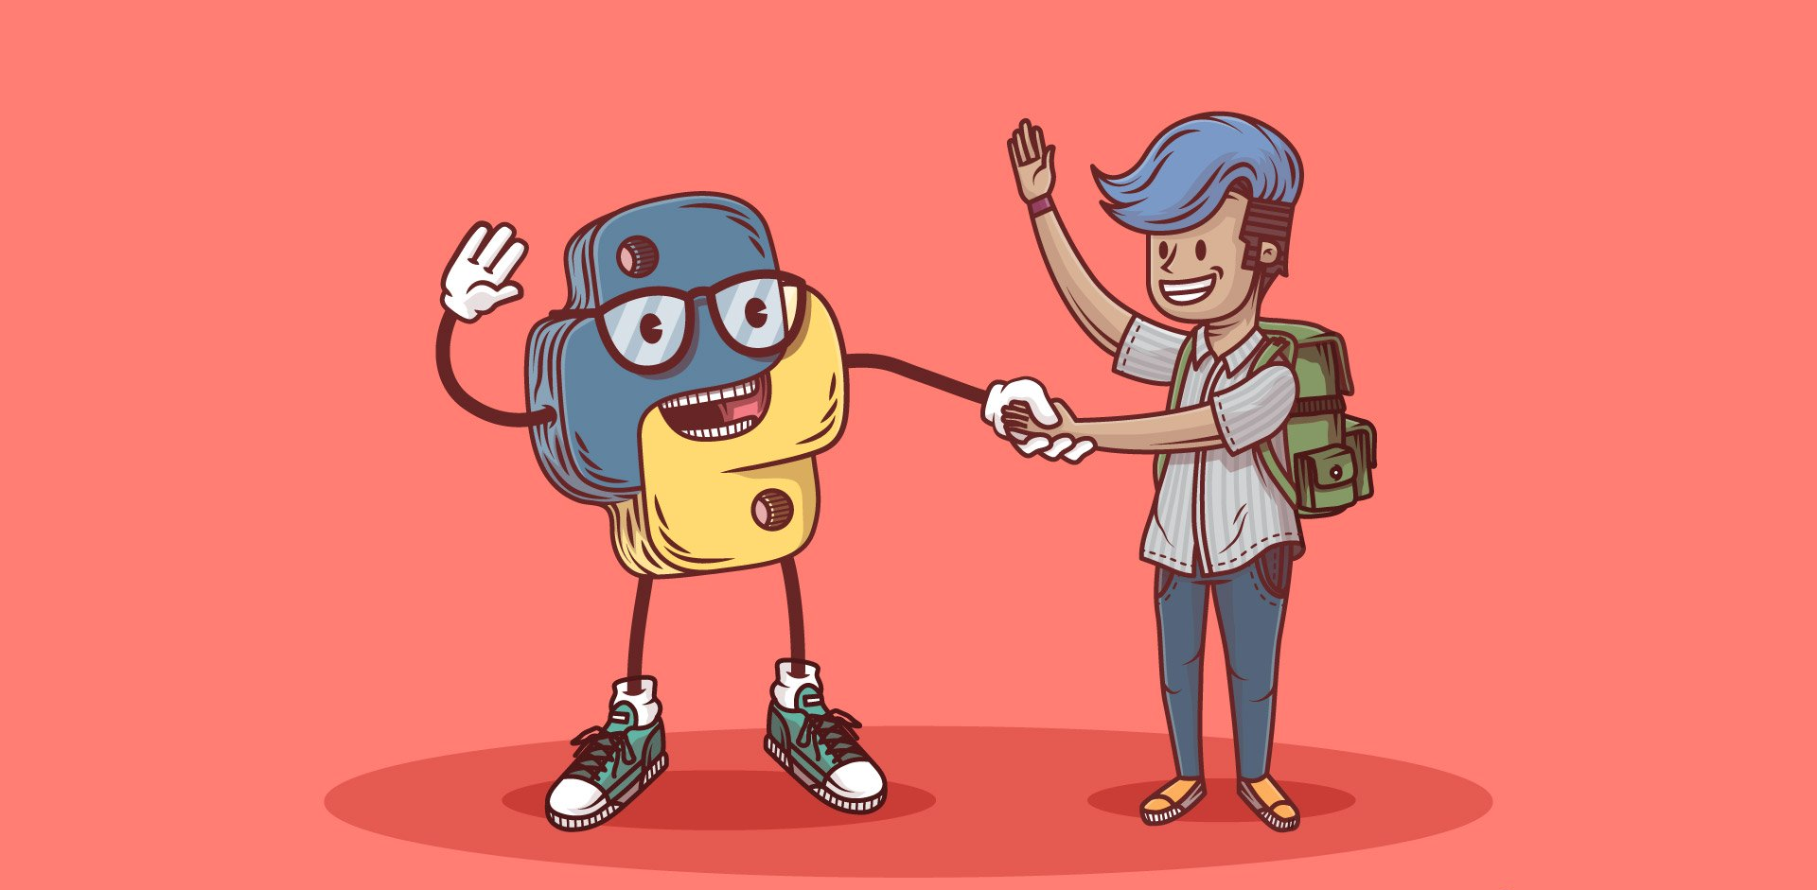

Slide 4
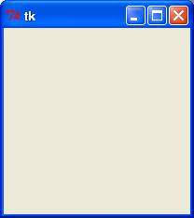
Introduction
The title of project is “Name the Colour” which is developed in Python Version-3.7.7 using spyder 4 .
New syntax features include in python 3.7.7 is :-PEP 563, postponed evalution of type annotations and library modules included are Context variables, Data Classes and importlib.resources. These also include are:- Simple class creation using data classes, Customized aceess to module attributes, and Higher precision timing function. More importantly Python-3.7.7 is fast.
In this game we are using “Tkinter” ,”time” &”random” library . Tkinter is standard GUI library for Python. Python when combined with Tkinter provides a fast and easy way to create GUI applications. Tkinter provides a powerful object-oriented interface to the Tk GUI toolkit.
Using Tkinter library we can create following window.
In this game player has to enter color of the world that appears on the screen and hence the score increase by one, the total time to play this game is 20seconds. Colors Used in this game are Red, Green, Yellow, Orange ,Pink, Black, White, Purple, Brown. Interface will display
Name of different colour in different color. Player has to identify the color and enter the correct color game to win the game.

Slide 5
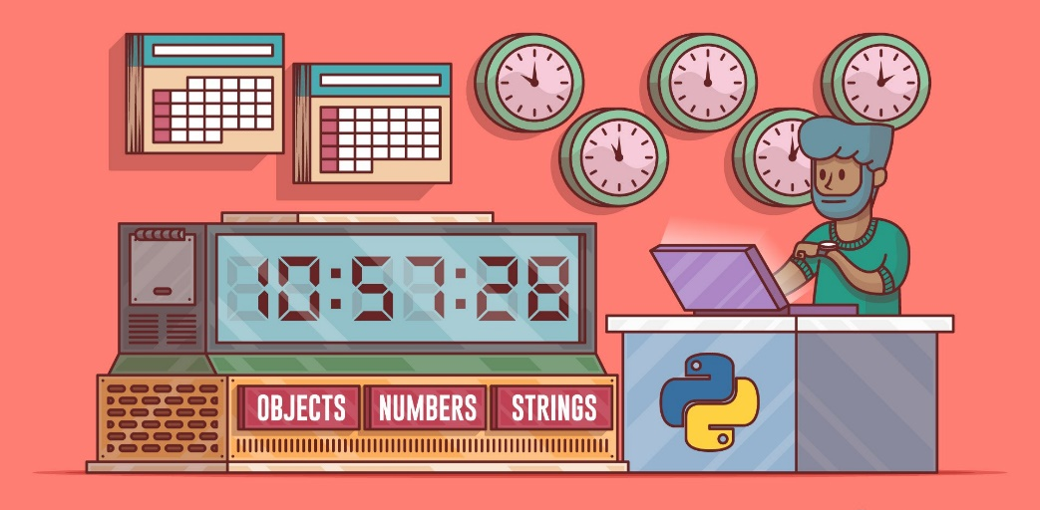
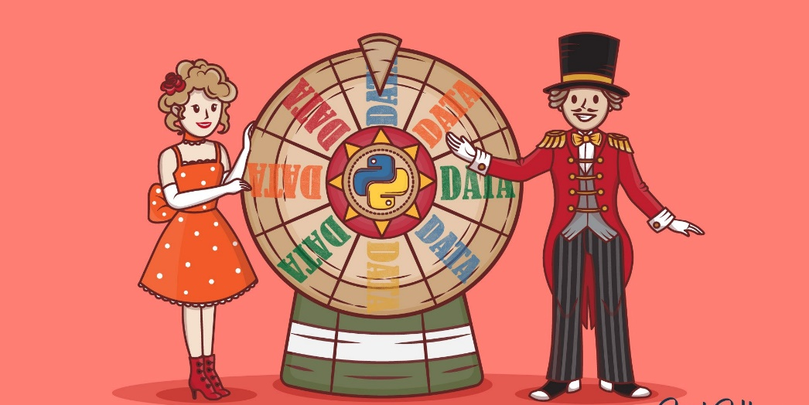
The Python ‘time’ module provides many ways of representing time in code, such as objects, numbers, and strings. It also provides functionality other than representing time, like waiting during code execution and measuring the efficiency of the code. In our code the ‘time’ library is used to create a countdown feature so that the program can get abrupted when the timer hits the zero mark.
‘Random’ used to generate random number or the variables declared by the user. In our program we used the random library to create the randomness in the data that we have provided to it.

Slide 6
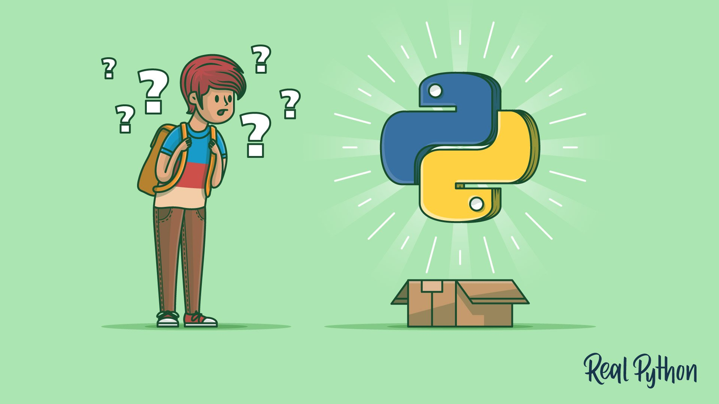

Slide 7
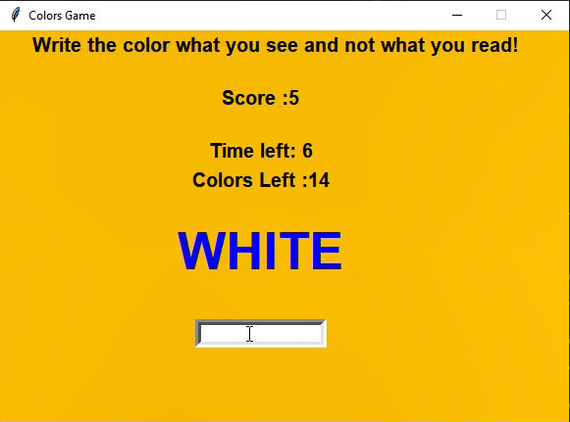
Explanation
Title
1
2
Label
3
score
4
Time decrement
5
Remaining values in dataset
9
Random Library in use
7
TextBox

Slide 8


Title for the application
For the program to indicate what is the program is running it must have some kind of indication, for our tkinter project we used ‘Label’ tag to give the name of the program. (refer arrow:1)
The headline
The headline is given to give some reference or some idea of what will be the below data will be, in our program we have used it to give instruction of what to do.(refer arrow:2)
Increment-decrement value
for our game we needed some value to get increases and decreases as the text have been input the text box, for this we have incremented the value and to balance it out we added a remaining color left to decrement order(refer arrow3,5)

Slide 9



The time library
To use a real time operation in our program we used a ‘time’ library so that we can set a specific time limit for the program. (refer arrorw:4)
The random library
So that data doesn’t come one after the another in a specify order we introduce a random library to disturb the uniformity of the data.
TextBox
to interact with the program we have used a textbox so that the user can input what they can see and interact with our program

Slide 10
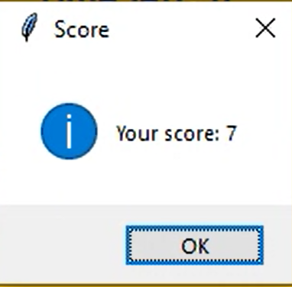
The Alert Box
The alert box is the pop up feature that we added so that when the timer reaches the ‘0’ mark it will pop up with showing how much did they scored

Slide 11
OutPut of the program:

Slide 12
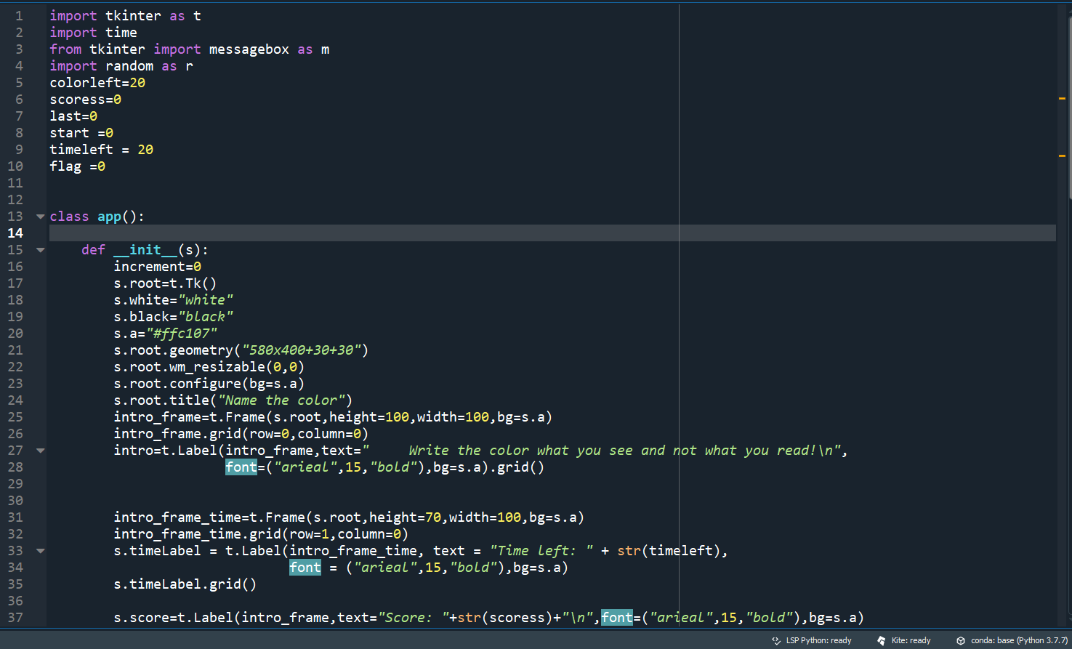
Source Code

Slide 13
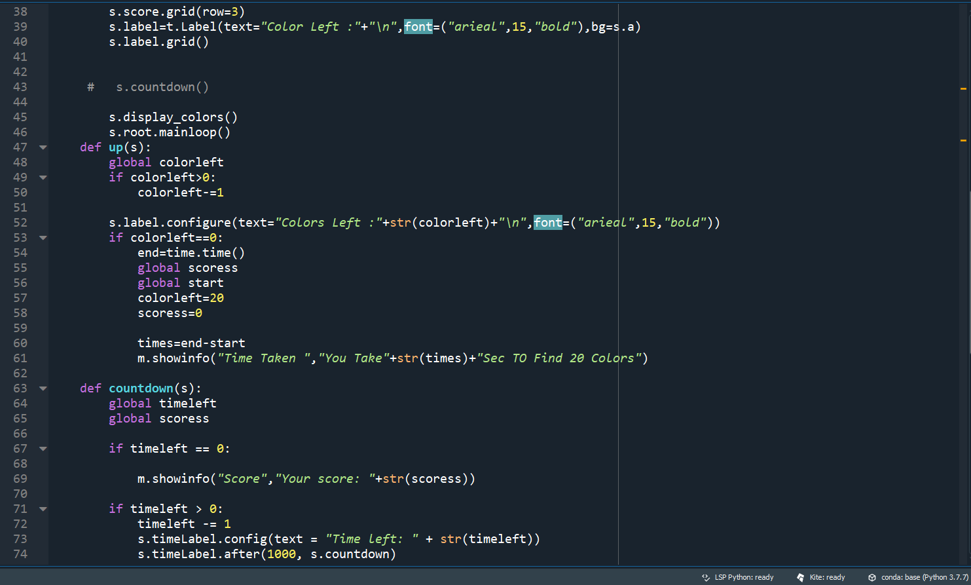

Slide 14
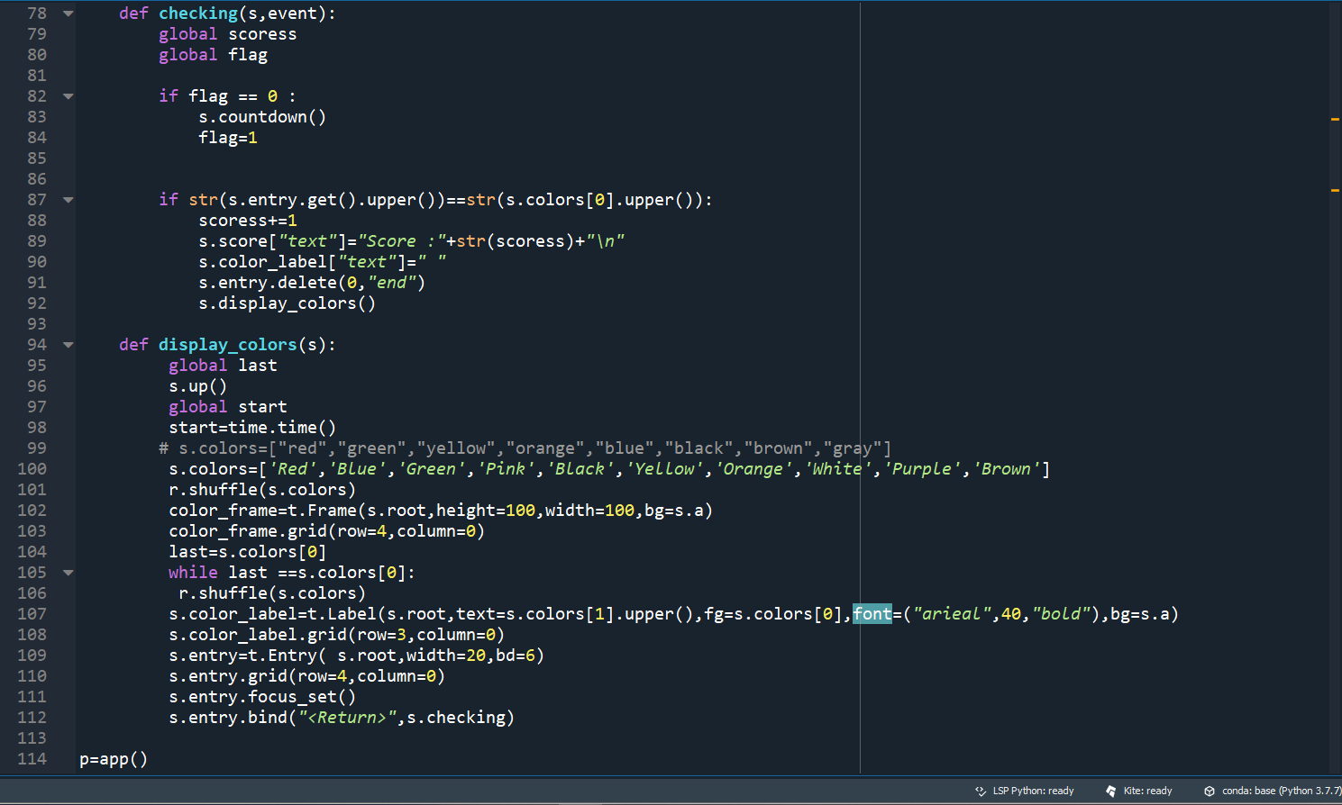

Slide 15
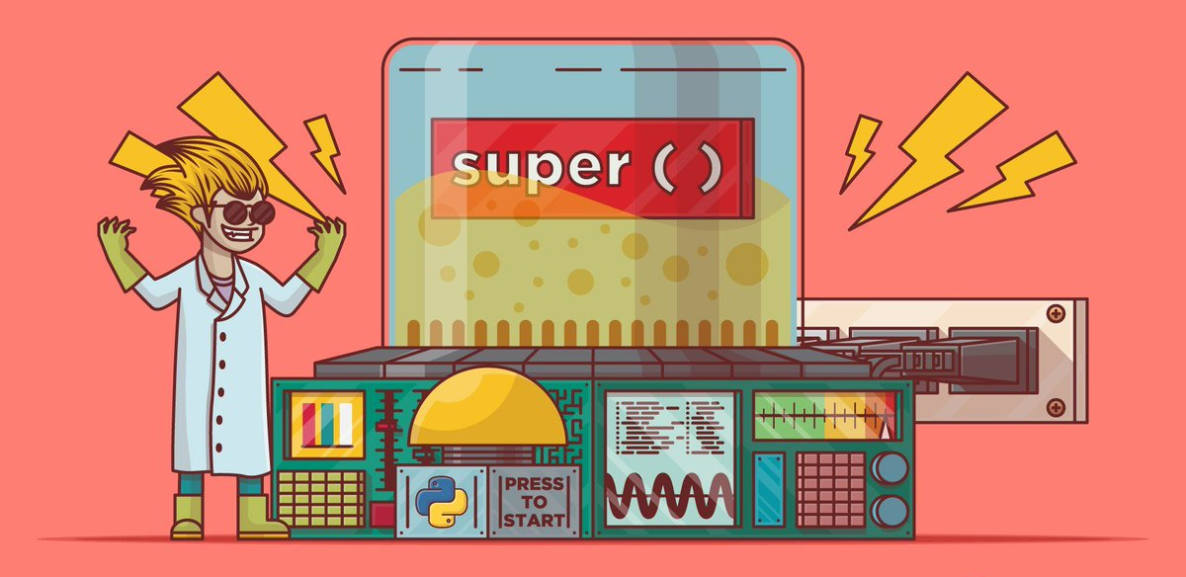

Slide 16
Improvement
In this application we are thinking about three main updation are as follows:
The first one is, adding a menu window. It will have button to start the program. We also gonna add some tune and image to the side of the button to make it more attractive.
The second one is, to add a different difficulty level: that will have a different time speed to it and more color to it to challenge the users brain.
The third and maybe the last one, to create a leader board so that user can track their score by how much time they took to beat it down.

Slide 17
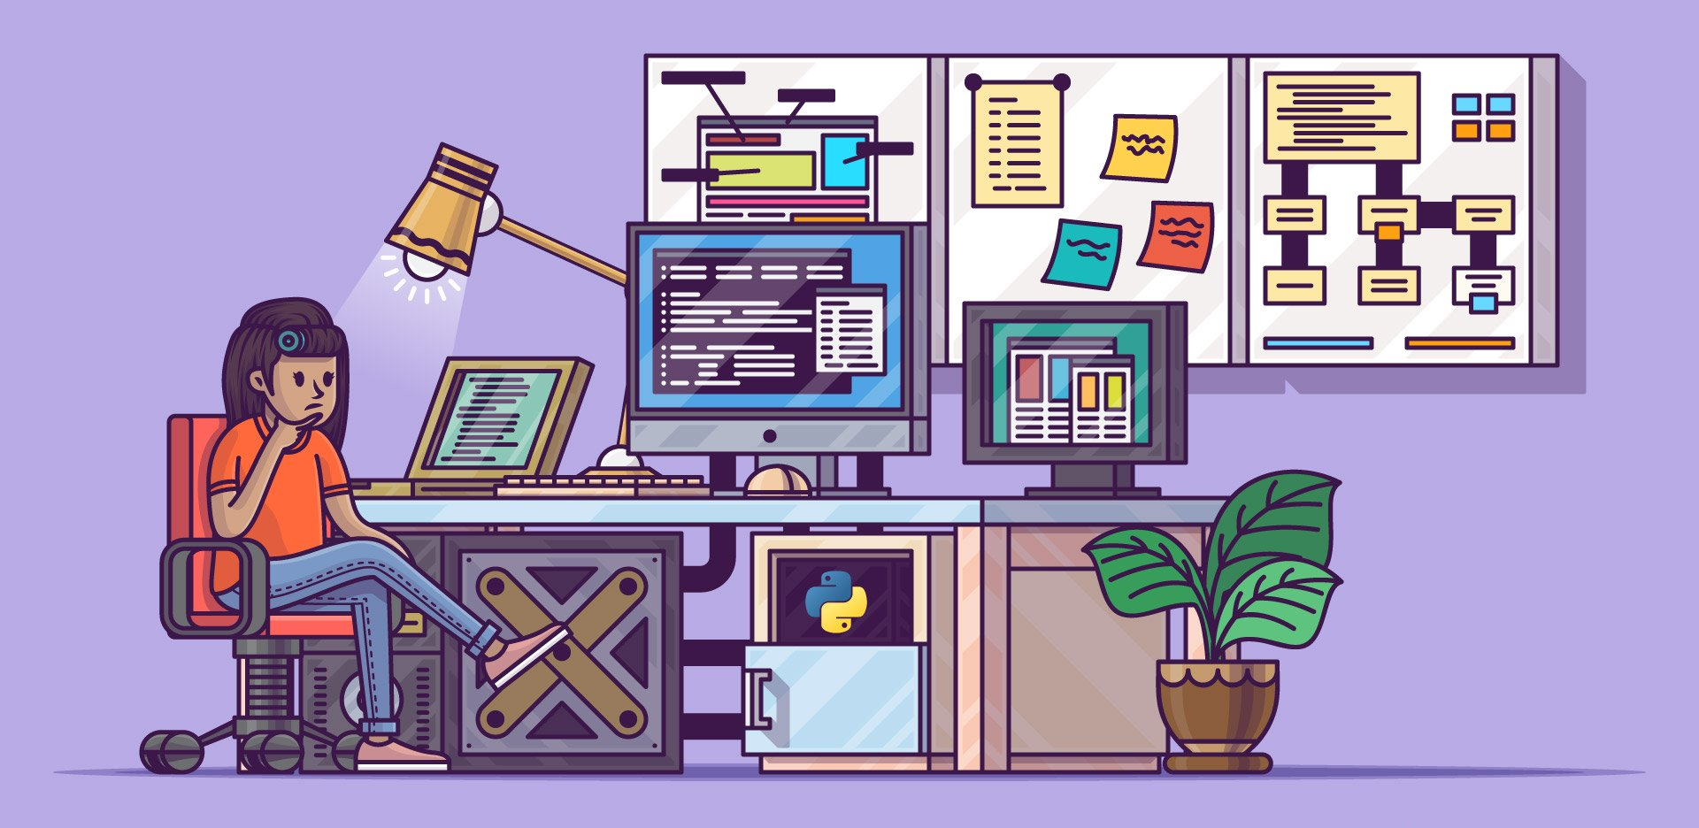

Slide 18
Conclusion
The above explained application is our project named as “Name the Color” which is developed in a python with helped of different library available to use. This application is able to challenge thinking and reaction time of the person and test the limit and also very interactive, this will not only will make the user happy but also increase the reaction and understandability of different color.

Slide 19
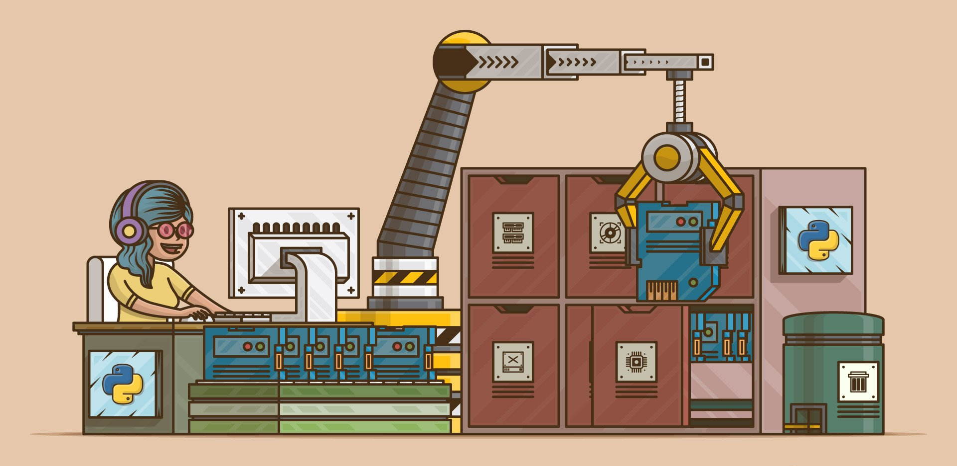

Slide 20
Reference
For making our project we used different places to learn and develop it:
https://www.geeksforgeeks.org/python-gui-tkinter/
https://docs.python.org/3/library/random.html
https://github.com/python-pillow/Pillow/issues/1669
https://www.youtube.com/watch?v=reSF2lfrRVE&t=0s
https://www.youtube.com/playlist?list=PL6lxxT7IdTxGoHfouzEK-dFcwr_QClME_
https://pythonprogramming.altervista.org/tkinter-with-canvas-rectangle/?doing_wp_cron=1586419793.3453390598297119140625
https://stackoverflow.com/questions/39743789/how-do-you-make-a-leaderboard-in-python

Slide 21

Thanks for reading

