Slide 1
Binary search trees
What is a binary search tree?
A binary tree optimized for searching
Ok, what’s a binary tree?
A tree where any node may have at most two child nodes
Ok, what’s a tree?
A data structure with a parent-child relationship between connected nodes

Slide 2
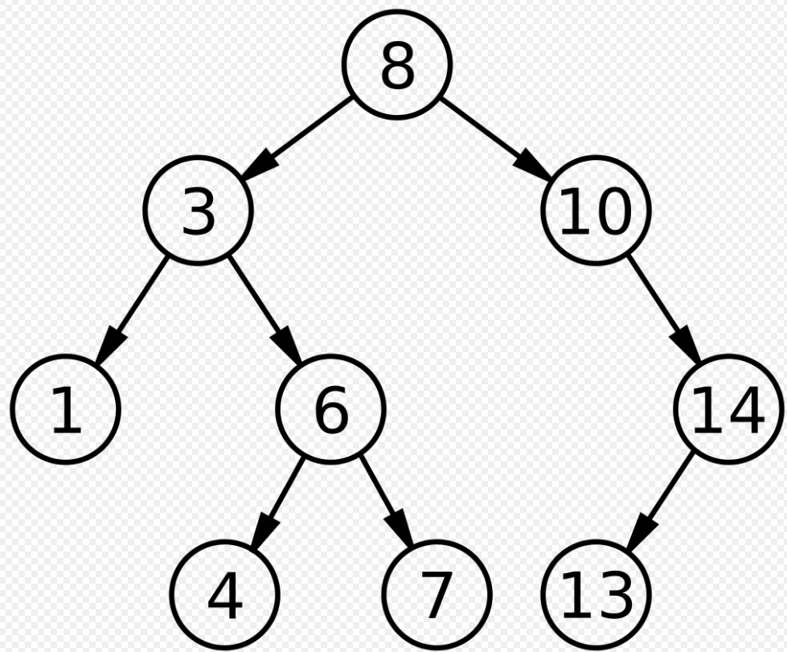

Slide 3
What are the important parts?
A node contains:
  Data
  A left child
  A right child.
The children may be non-existent.
The data needs to be comparable(is this data less than that data), and equatable(is this data equal to that data).
The data in the left child’s sub-tree is all less than the data of the node.
The data in the right child’s sub-tree is all greater than the data of the node.

Slide 4
So how do we use them?
Let’s start with an empty tree:
Root is None
Len is zero

Slide 5
Trivial case add the first item
Every time we insert an item, it will have data, but both of its children will be None.
Every time we insert an item, we increment len.
In this trivial case, we see that root is None, re-set it to Some(Node) with the data

Slide 6
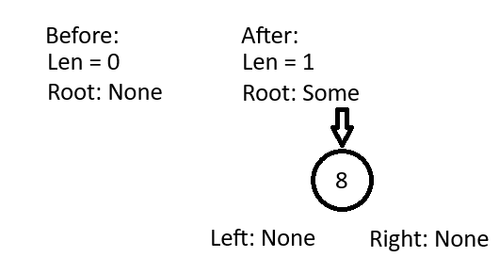
Example

Slide 7
Every other case of insert
Root is Some, so we compare the data we want to insert to the root.
If it’s equal to, we don’t insert duplicates
If it’s less than, we move to the left child
If it’s greater than, we move to the right child
Repeat until we find a child that is None, re-set that child to Some(Node) with the data to insert

Slide 8
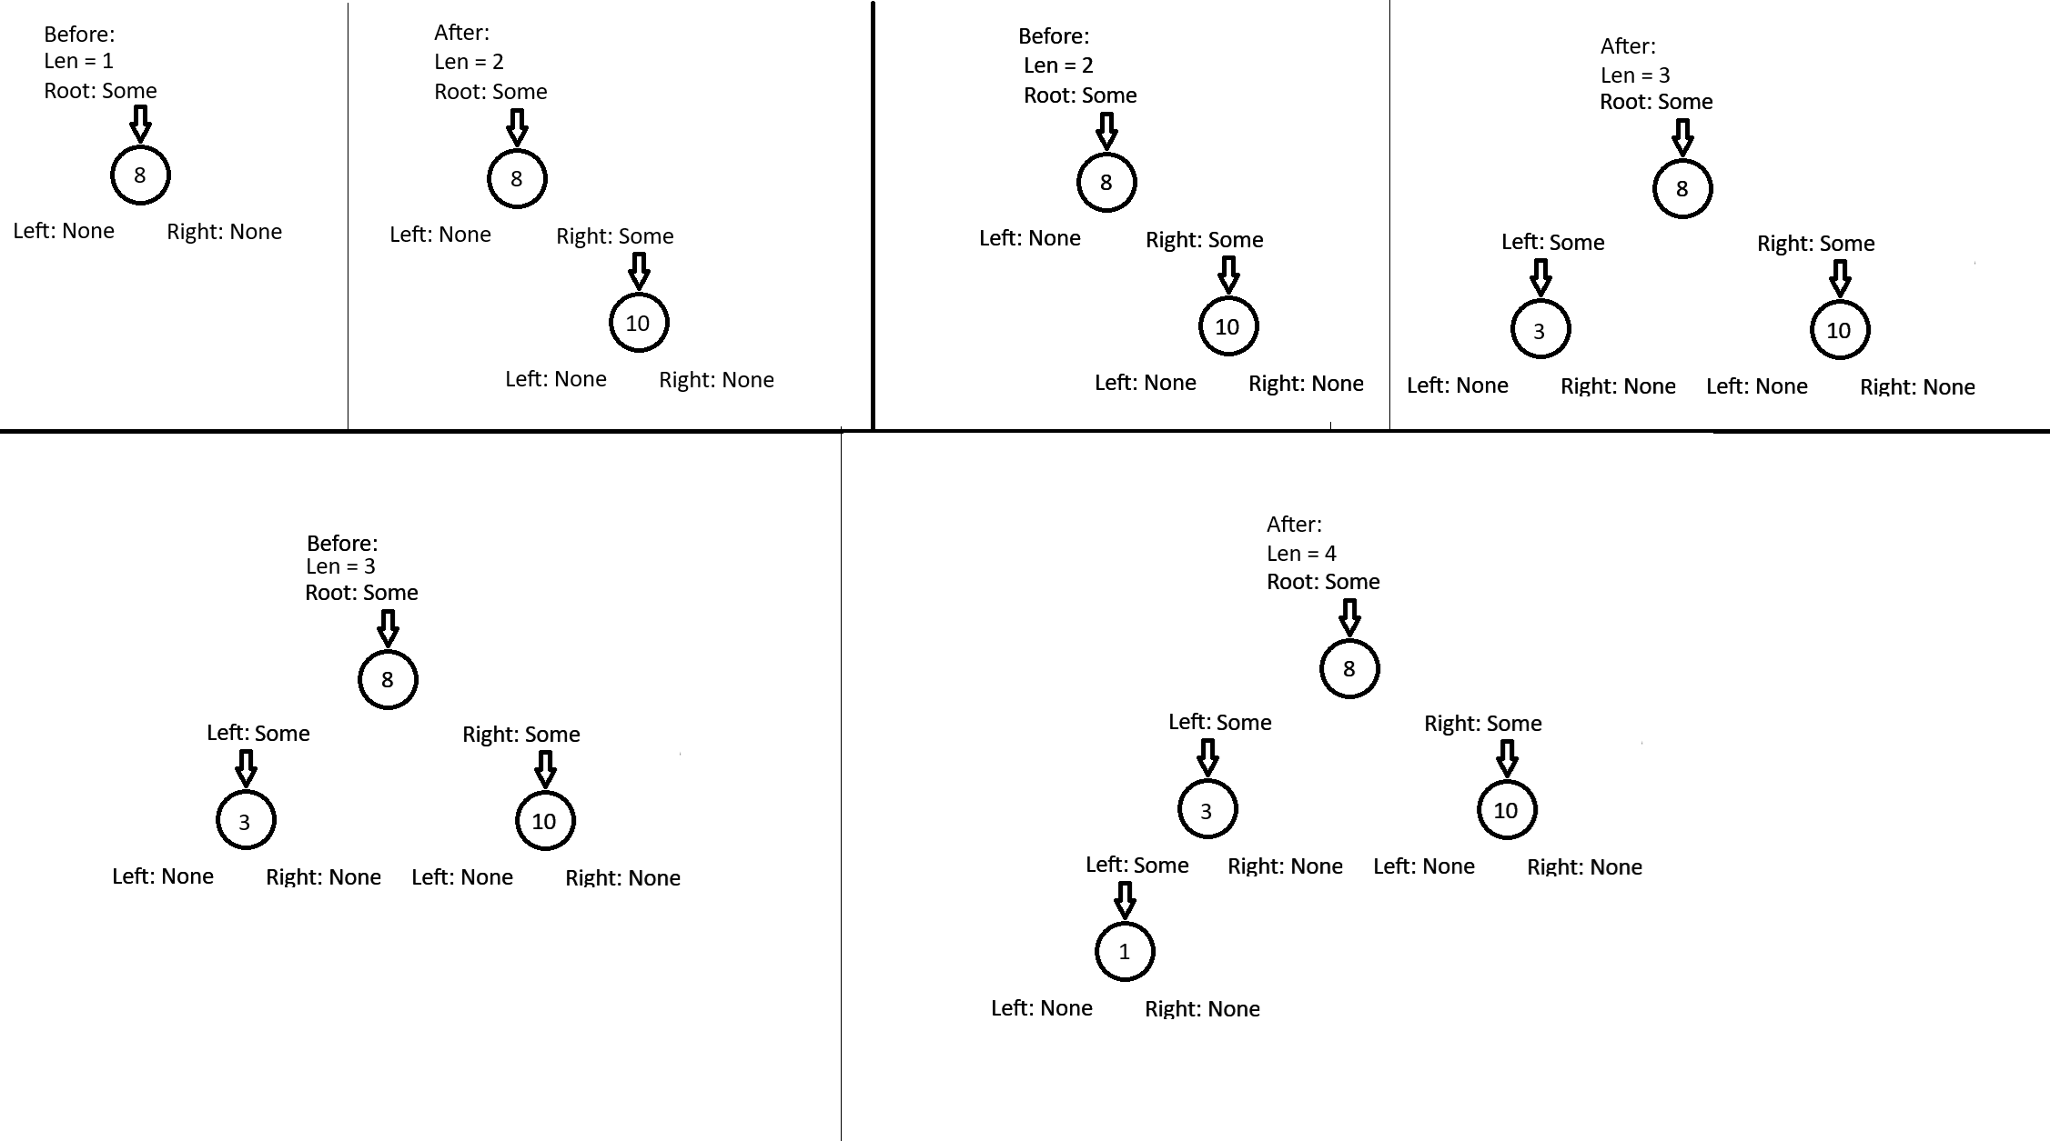
Examples:

Slide 9
Searching/Contains
Recall the insert algorithm for the non-trivial case…
If Root is None, it’s an empty tree and does not contain any value.
If Root is Some, we compare the data we want to insert to the root.
If it’s equal to, we found the item
If it’s less than, we move to the left child
If it’s greater than, we move to the right child
Repeat until we find a child that where the data matches or a child that is None.
  On a match, the tree contains the item
  On None, the tree doesn’t contain the item
Hint: if you write a private search function that returns a mutable reference to the link, you can use that function to find the link to re-set for insertion

Slide 10
Removal
Using the search algorithm, look for a node with matching data.
If you end up at None, do nothing.
Otherwise, the Some is the item for removal
  After removal decrement len

Slide 11
Removal Trivial case(no children)
If the Node for removal’s children are both None:
Set the link to None
Drop the Node

Slide 12
Removal simple case(1 child)
Set the link to the child
Drop the Node for removal

Slide 13
Removal complex case(2 children)
In this case, we have to do something called choosing a successor. The successor is either(and it doesn’t matter which you choose), the largest value in the left sub-tree or the smallest value in the right sub-tree.

Slide 14
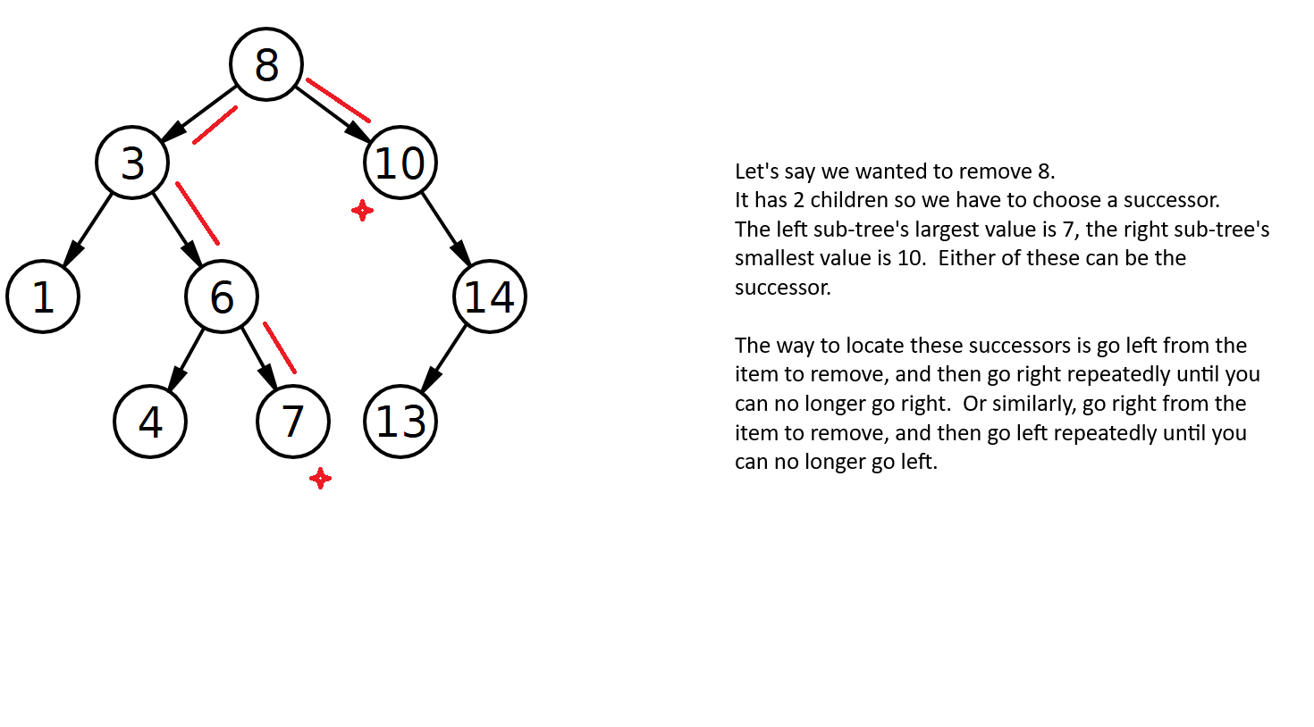
Example:

Slide 15
Removal complex case continued
Once we have chosen a successor, the removal process looks like this:
Replace the data in the Node for removal with the data from the successor
Remove the successor node(guaranteed to not have 2 children)

Slide 16
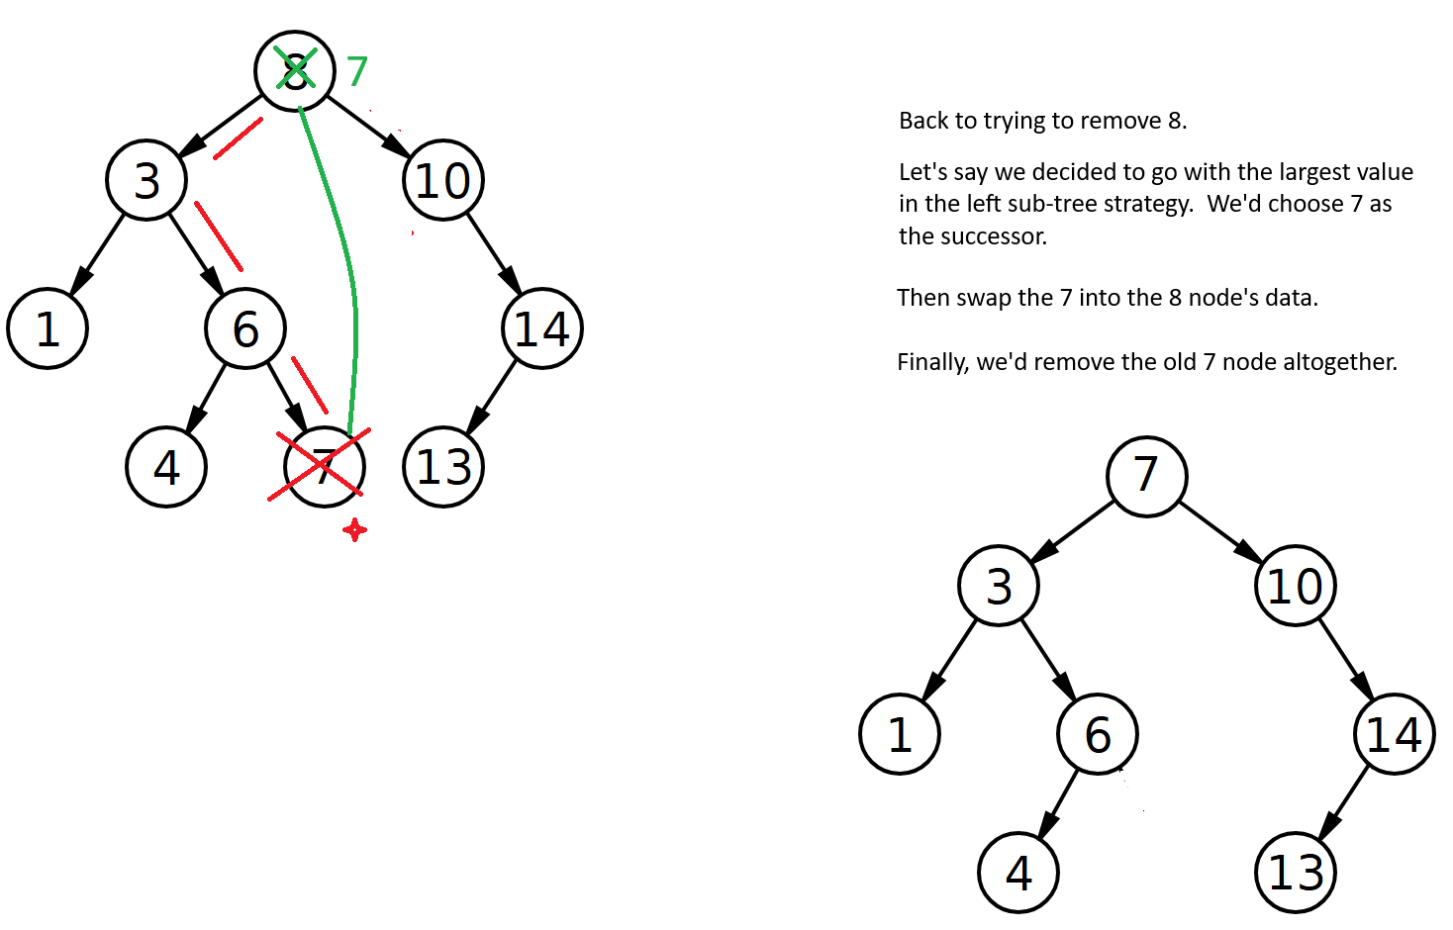
Example

