Slide 1
Product Owner Agent
AI assistant for feedback analysis, prioritization, and user story writing Technical test presentation

Slide 2
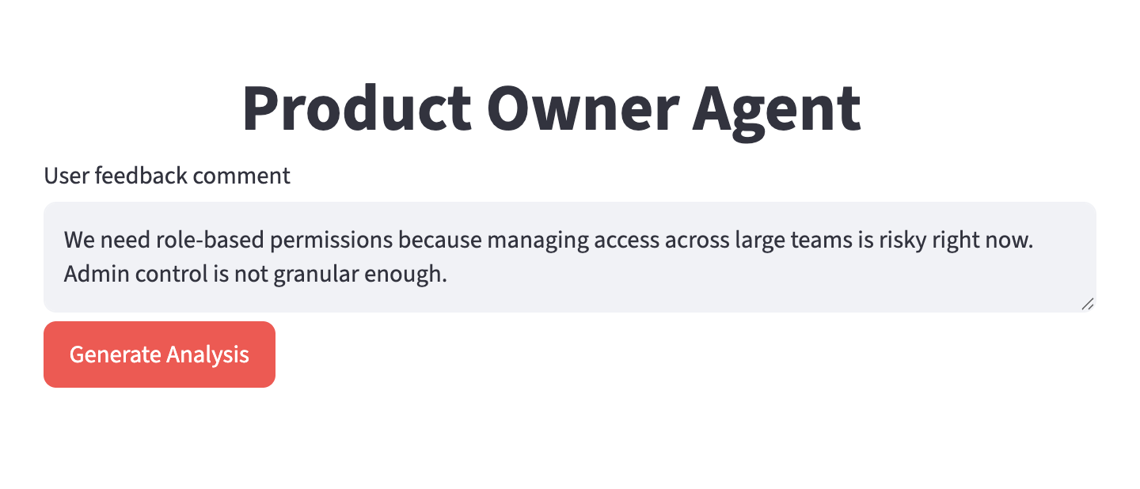
Product Owner Agent
Turns raw customer feedback into backlog-ready decisions.
Notes:
Open with the PO problem: too much feedback, constant prioritization pressure, and a need for faster backlog preparation.

Slide 3
Product Need And Scope
The agent supports three daily Product Owner tasks:
feedback analysis: classify the comment and extract the requested feature
prioritization: estimate impact and urgency, then compute a MoSCoW recommendation
assisted writing: generate a user story, acceptance criteria, and complexity estimate
The output is a structured first analysis for the PO to review.
Notes:
Explain that the agent does not replace the PO. It gives a consistent, explainable starting point.

Slide 4
Demo Plan
Example feedback:
“We need role-based permissions because managing access across large teams is risky right now. Admin control is not granular enough.”
Demo flow:
Run the full pipeline from the UI.
Review extracted feature and feedback type.
Review impact, urgency, score, and MoSCoW category.
Review generated user story, acceptance criteria, and complexity.
Notes:
Spend 8 to 10 minutes in the live demo. This slide is only the roadmap.

Slide 5
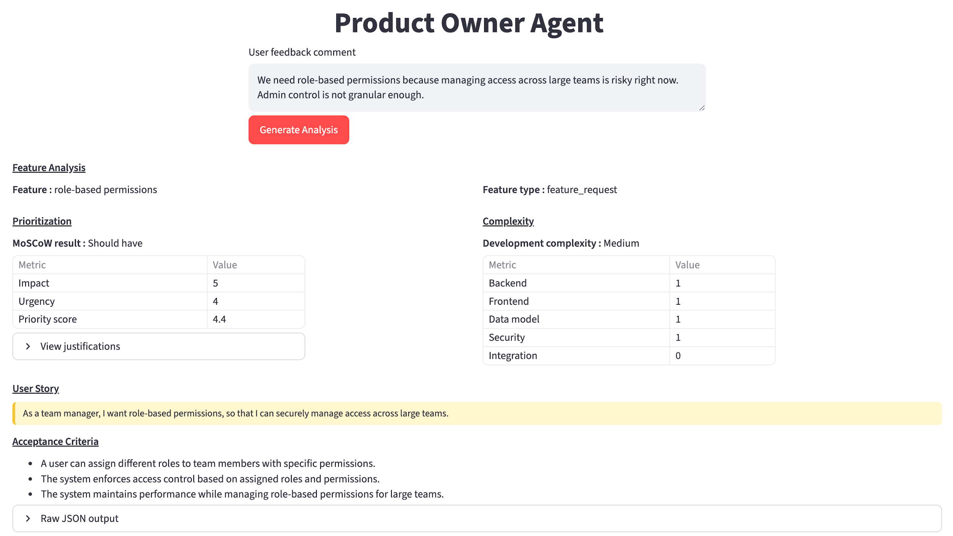
Result Example
Notes:
Use this as a backup or as the transition after the live demo. Point out that the UI groups the PO decision into analysis, prioritization, complexity, story, and criteria.

Slide 6
Architecture
User feedback -> ProductOwnerAgent -> FeatureExtractor -> FeatureEvaluator -> FeatureScorer -> UserStoryWriter -> ProductOwnerOutput
Technical choices:
specialized agents keep each prompt focused
Pydantic schemas constrain model outputs
priority score and complexity are deterministic
Streamlit UI and CLI share the same orchestration layer
Notes:
Mention the key formula: priority score = 0.4 impact + 0.6 urgency. MoSCoW categories are derived from score thresholds.

Slide 7
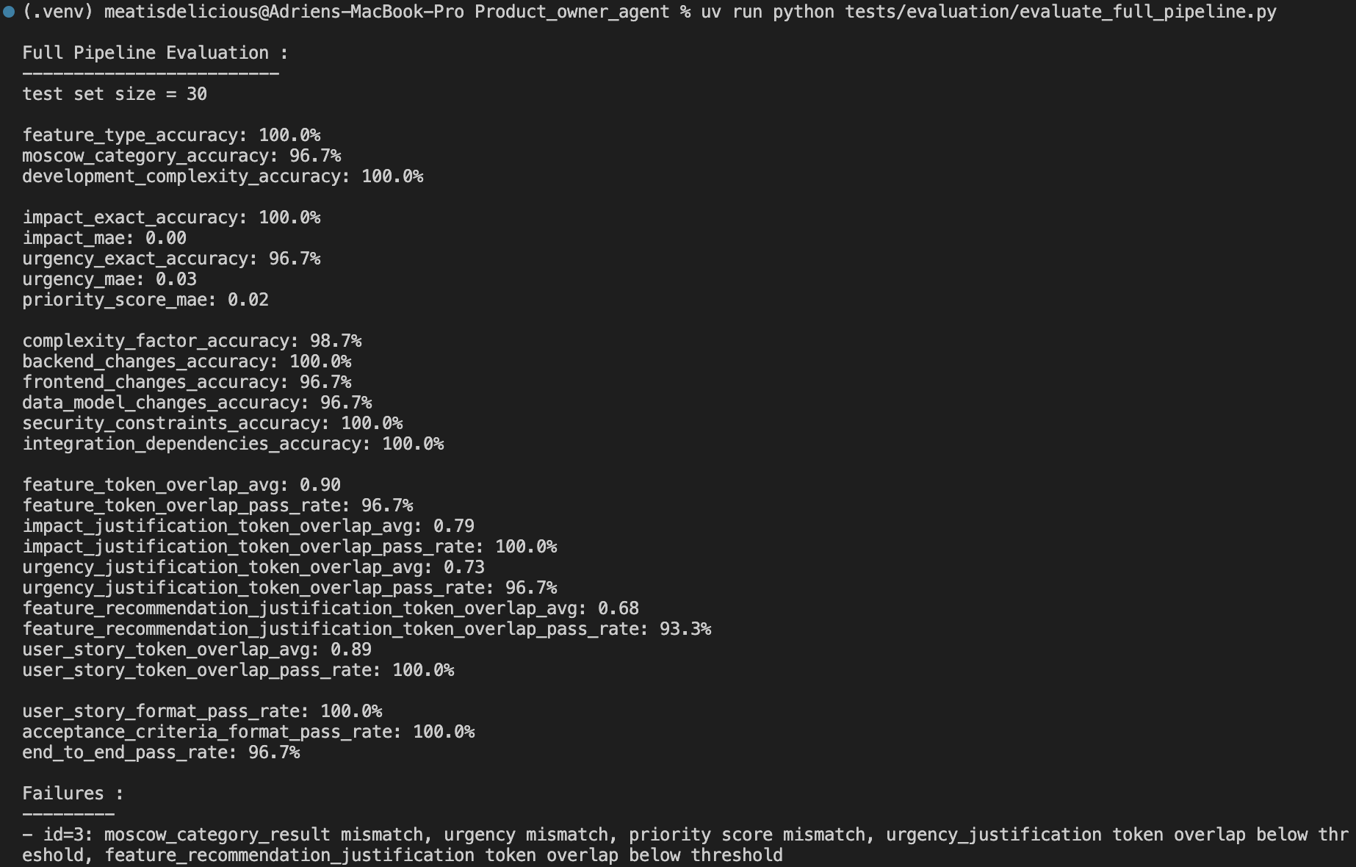
Evaluation And Quality
Quality controls:
dataset-based evaluation checks expected output quality
deterministic calculations reduce variability for business-critical decisions
Notes:
Tie this to the evaluation criteria: technical quality, completeness, business understanding, and user experience.

Slide 8
Challenges And Next Steps
Challenges solved:
ambiguous feedback is normalized into structured fields
subjective prioritization is made reviewable with explicit justifications
generated stories follow a consistent PO-ready format
Next steps:
use real world data
handle edge cases (ambiguous feedback, multiple feature handling…)
connect to Jira, Linear, or ticketing tools
process batches of feedback instead of one comment
Parallelise llm api requests
Notes:
Close with the value: faster triage, clearer prioritization, and better backlog quality.

Slide 9
thank you for your attention
Notes:
Close with the value: faster triage, clearer prioritization, and better backlog quality.

