Slide 1
«Crispino» a wine grape gripper
Group 2 - Francesca Amato, Gian Marco Balia, Mahmoud Magdy Mahmoud Elasmar, Christian Negri Ravera, Carolina Polese, Filippo Salterini

Slide 2
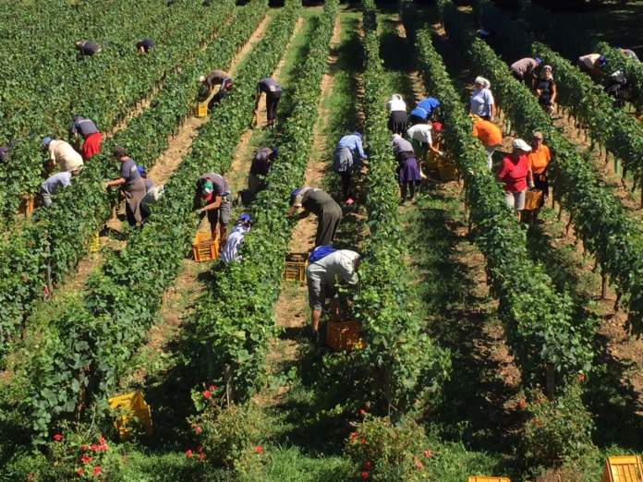
Global challenge
Robotic automation is an important resource that can help reduce risks in jobs decreasing physical and chemical hazards, in line with the principles of D.Lgs. 81/08, which promotes eliminating risks at the source.
1.
¹ https://vigneviniequalita.edagricole.it/attualita-news/vendemmia-abbondante-in-veneto-ma-manca-la-manodopera/

Slide 3
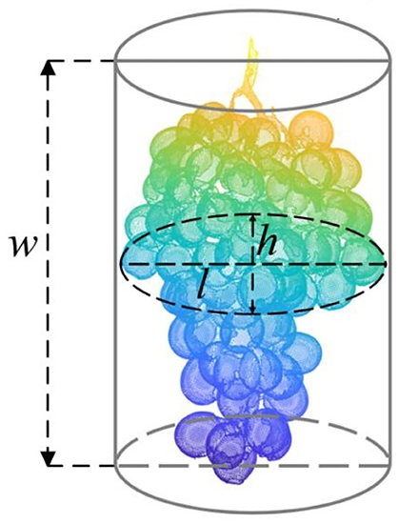
Our target
Our goal is to build a robot designed for cutting and
harvesting grape clusters intended for wine production.
The values we took into consideration for a wine grape cluster are the following :
Diameter h = l = 8-12 cm;
Height w = 12-20 cm;
Weight 12-20 g;
And a general working temperature from 17 °C up to 23°C.
1.
¹ Estimation of Characteristic Parameters of Grape Clusters Based on Point Cloud Data - Wentao Liu,Chenglin Wang,De Yan,Weilin Chenand Lufeng Luo -https://www.frontiersin.org/journals/plant-science/articles/10.3389/fpls.2022.885167/full

Slide 4
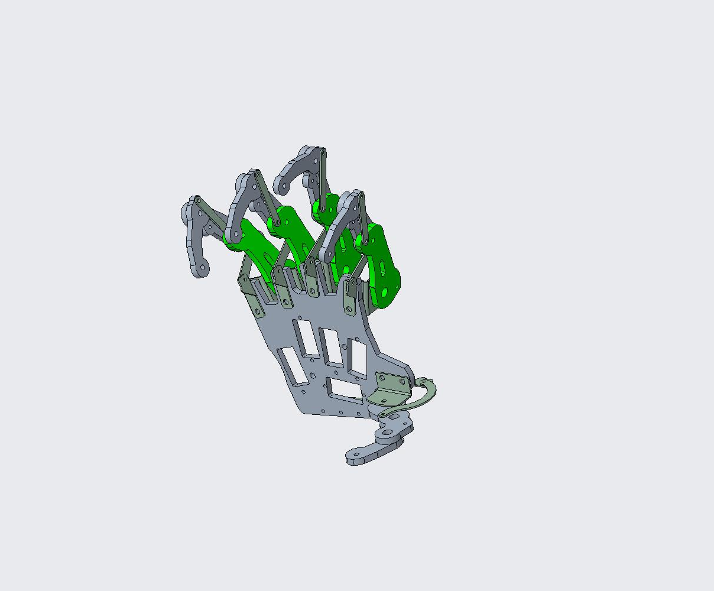
The inspiration
The Crispino end effector is inspired by a robotic hand provided during the lectures and modeled with PTC Creo®. The finger design has been modified, new features have been added, and the actuators have been adjusted. Consequently, the result is a fully functional robotic hand that is tailored for grasping objects with a specific purpose.

Slide 5
The project «Crispino»
Didascalia della foto

Slide 6
Grabbing Mechanism
Fingers bend naturally towards the grapes and gently grip without causing damage. The fingers are coated with a soft silicone material to protect the grapes’ surface.

Slide 7
Scissor Mechanism
The scissor mechanism has two blades: one is serrated and the other is flexible. A piston powers the cutting action, ensuring a clean and efficient cut.
The profile of a blade has an irregular contour designed to grip the branch and cut it with the other blade, which is fixed in place.

Slide 8
Metacarpus Description
The metacarpus has a central role, allowing different components, with extremely different tasks to be properly attach to maximize their performances.

Slide 9
Bill of materials

Slide 10
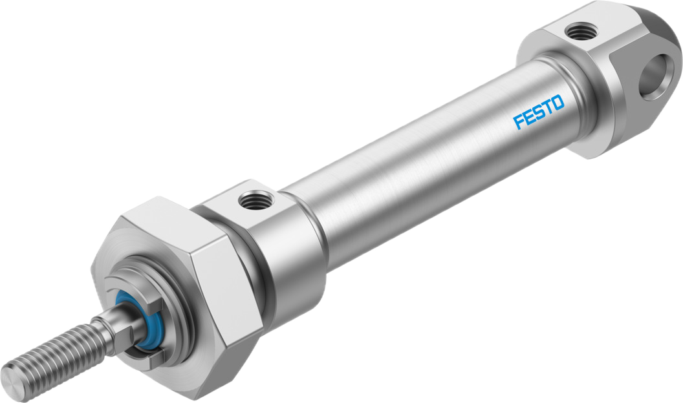
Festo Standard cylinder CRDSNU-12-25-P-A
Distributor | Unit Price
Rubix¹ | €41.14
Farnell Italy | €42.74
MISUMI Italy | €41.78
RS Components Italy | €91.94
¹ https://it.rubix.com/it/cilindro-rotondo-dsnu/p-G1116010692?utm_source=chatgpt.com

Slide 11
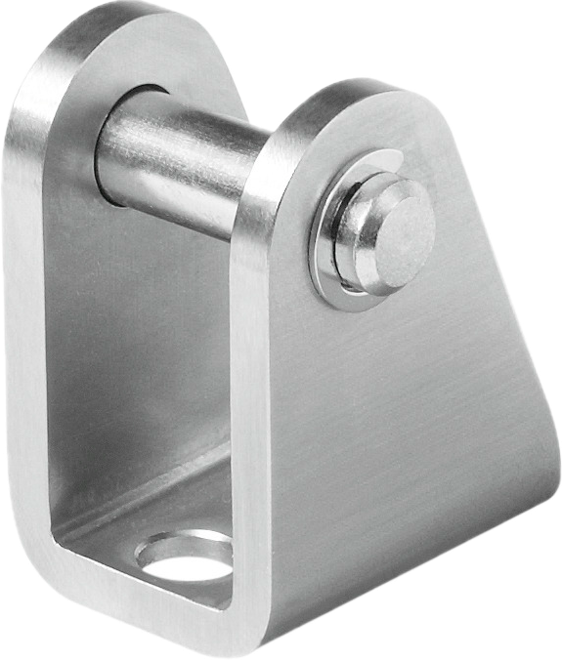
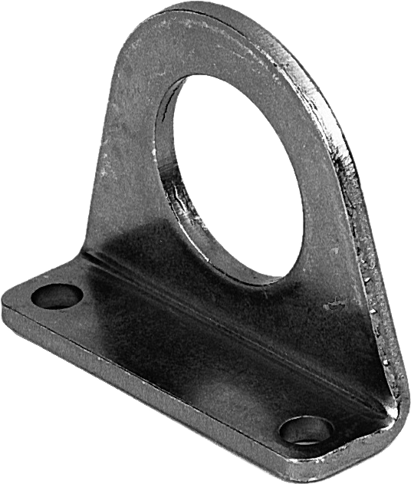
Festo Hinge support CRLBN-12/16
Festo Foot bracket
CRHBN-12/16X1
Distributor | Unit Price
RS Components Italy¹ | €15.18
Distributor | Unit Price
RS Components Italy | €15.62
¹ https://it.rubix.com/it/cilindro-rotondo-dsnu/p-G1116010692?utm_source=chatgpt.com
Notes:
Hinge support CRLBN-12/16:
Size: 12/16 mm
Mounting Position: Optional
Corrosion Resistance Class (CRC): 4 – Extreme corrosion stress
PWIS Conformance: VDMA24364-B1/B2-L
Battery Manufacturing Suitability: Suitable for lithium-ion battery production (Festo severity class F1A, Cu/Zn/Ni restrictions)
Ambient Temperature: –40 °C to +150 °C
Product Weight39 g
RoHS Compliance: EU Directive 2002/95 (RoHS)
Material – Bracket: High-alloy stainless steel
Material – Pin: High-alloy stainless steel
Material – Lock: High-alloy stainless steel
Foot bracket CRHBN-12/16X1:
Size: 12/16 mm
Mounting Position: Optional
Corrosion Resistance Class (CRC): 4 – Extreme corrosion stress
PWIS Conformance: VDMA24364-B1/B2-L
Battery Manufacturing Suitability: Suitable for lithium-ion battery production (Festo severity class F1A, Cu/Zn/Ni restrictions)
Product Weight: 43 g
RoHS Compliance: EU Directive 2002/95 (RoHS)
Material – Bracket: High-alloy stainless steel

Slide 12



Materials & Costs
Stainless steel for the metacarpus and fingers (€18–24) ensures robustness and corrosion resistance.
Tempered steel for the scissors (€12.5–15) provides clean,
long-lasting cuts.
A silicone or TPU coating (€2–3) protects the grapes with its softness.
The total material cost ranges from €32,50 to €42,00
Notes:
The choice of materials was determined by a combination of technical, functional, and economic factors. Specifically, stainless steel was selected for the fingers and the metacarpus because it offers excellent mechanical strength, is corrosion-resistant, and does not easily deform even under varying environmental conditions. These characteristics make it ideal for agricultural applications, where the end effector may be exposed to humidity, dust, and temperature fluctuations. The average cost of the stainless steel used for the metacarpus and fingers is approximately €15–20 per kg, with an estimated usage of around 1.2 kg, bringing the total cost to €18–24.
For the scissor part, tempered stainless steel was chosen because it ensures greater hardness and wear resistance compared to standard steel. This is essential to maintain cutting efficiency over time, especially in the case of repeated harvests. The cost of this material is around €25–30/kg, with an estimated usage of 0.5 kg, amounting to approximately €12.5–15.
The finishes of the fingers and the metacarpus have been made with a coating of soft silicone or TPU (thermoplastic polyurethane). These materials offer excellent elasticity and softness, which are essential to avoid damaging the grape berries during gripping. The food-grade silicone used costs approximately €10–15/kg, with an estimated usage of 200 g per hand, amounting to 2–3 €.

