Slide 1

AI Safety in Mechatronics Systems
Where intelligent algorithms meet physical machines — ensuring autonomous systems operate reliably, predictably, and without harm to humans or equipment.
AI + ROBOTICS + SAFETY ENGINEERING

Slide 2


CORE CONCEPT
The AI Concept: Safe Reinforcement Learning
Safe Reinforcement Learning (Safe RL) trains autonomous agents to maximize performance while satisfying strict safety constraints — preventing dangerous actions during both training and deployment.
Constrained MDP
Extends Markov Decision Processes with safety cost functions
Shielding
Runtime monitors that override unsafe AI decisions
Verification
Formal guarantees on policy behavior before deployment

Slide 3

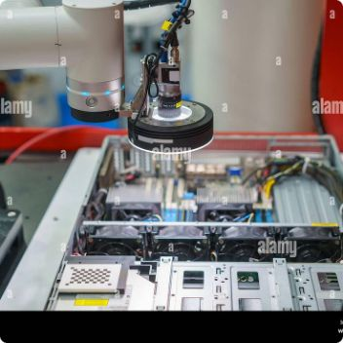
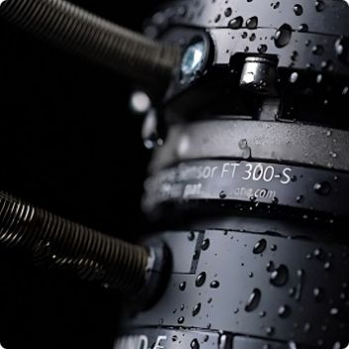
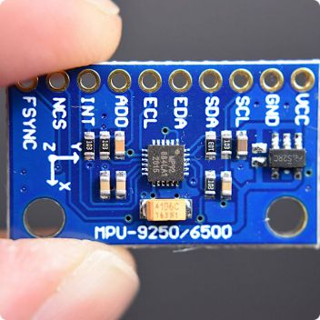
PERCEPTION LAYER
Data & Sensors Feeding the AI
Safe AI decisions depend on rich, real-time sensory input from the physical environment.
LiDAR & Radar
Machine Vision
Force/Torque Sensors
IMU & Encoders
3D spatial mapping and obstacle detection at high speed
Cameras detect anomalies, humans, and part positioning
Measure contact forces to prevent excessive pressure
Track orientation, velocity, and joint positions precisely

Slide 4
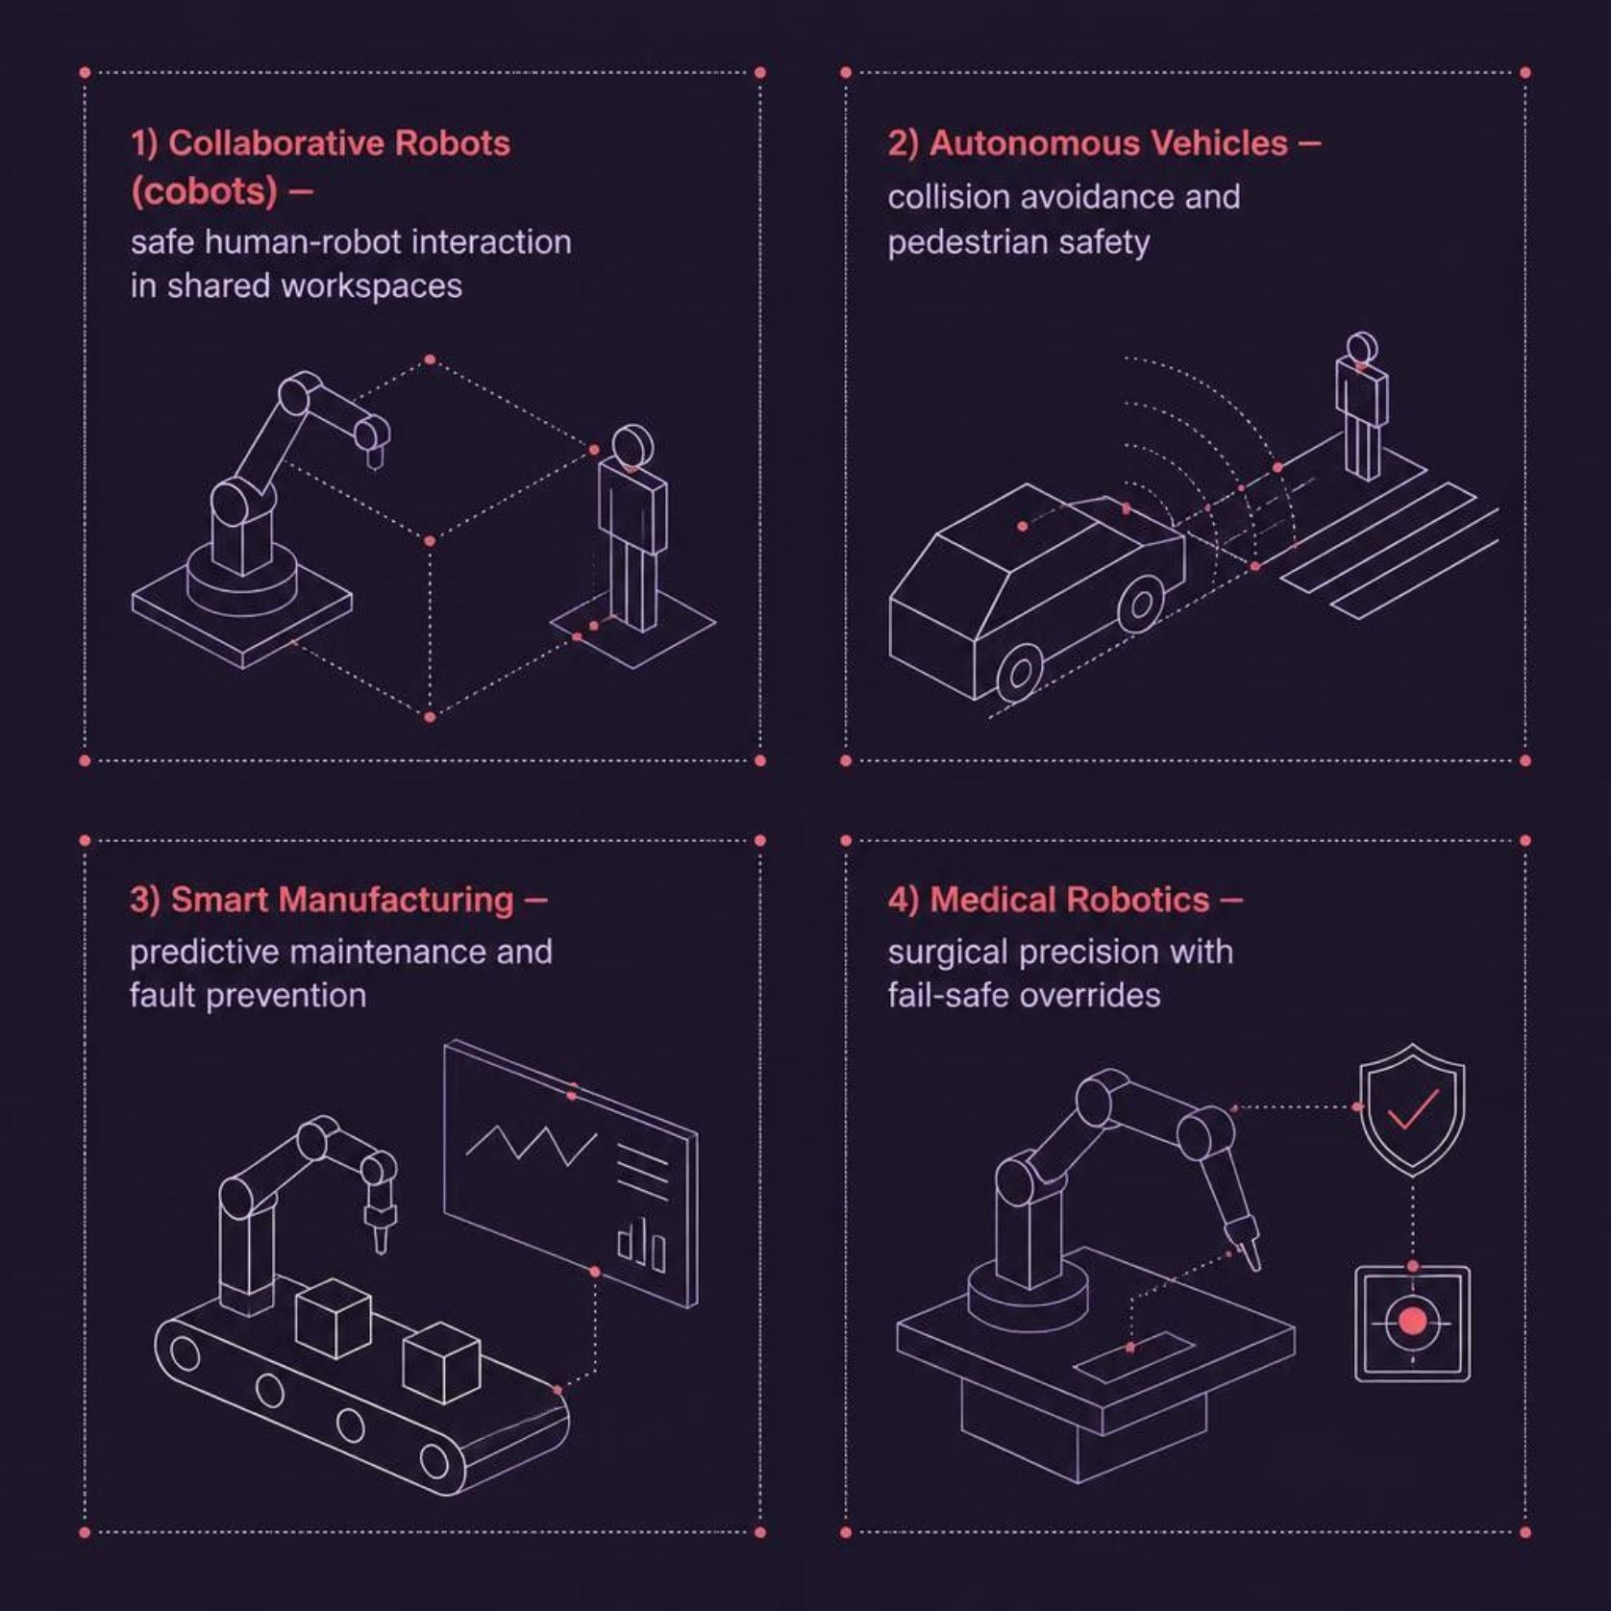
APPLICATION DOMAIN
Where AI Safety Matters in Mechatronics
Why These Domains?
Each application involves direct human-machine interaction or high-consequence physical actions — making AI safety not optional, but foundational.
In collaborative robotics, a single unsafe decision can cause injury within milliseconds. AI safety layers must operate faster than the mechanical response time.

Slide 5

SYSTEM ARCHITECTURE
The AI Safety Pipeline
Input
AI Method
Decision
Action
Every stage includes safety checks — from raw sensor validation through policy verification — ensuring no unsafe command reaches
the actuators.

Slide 6
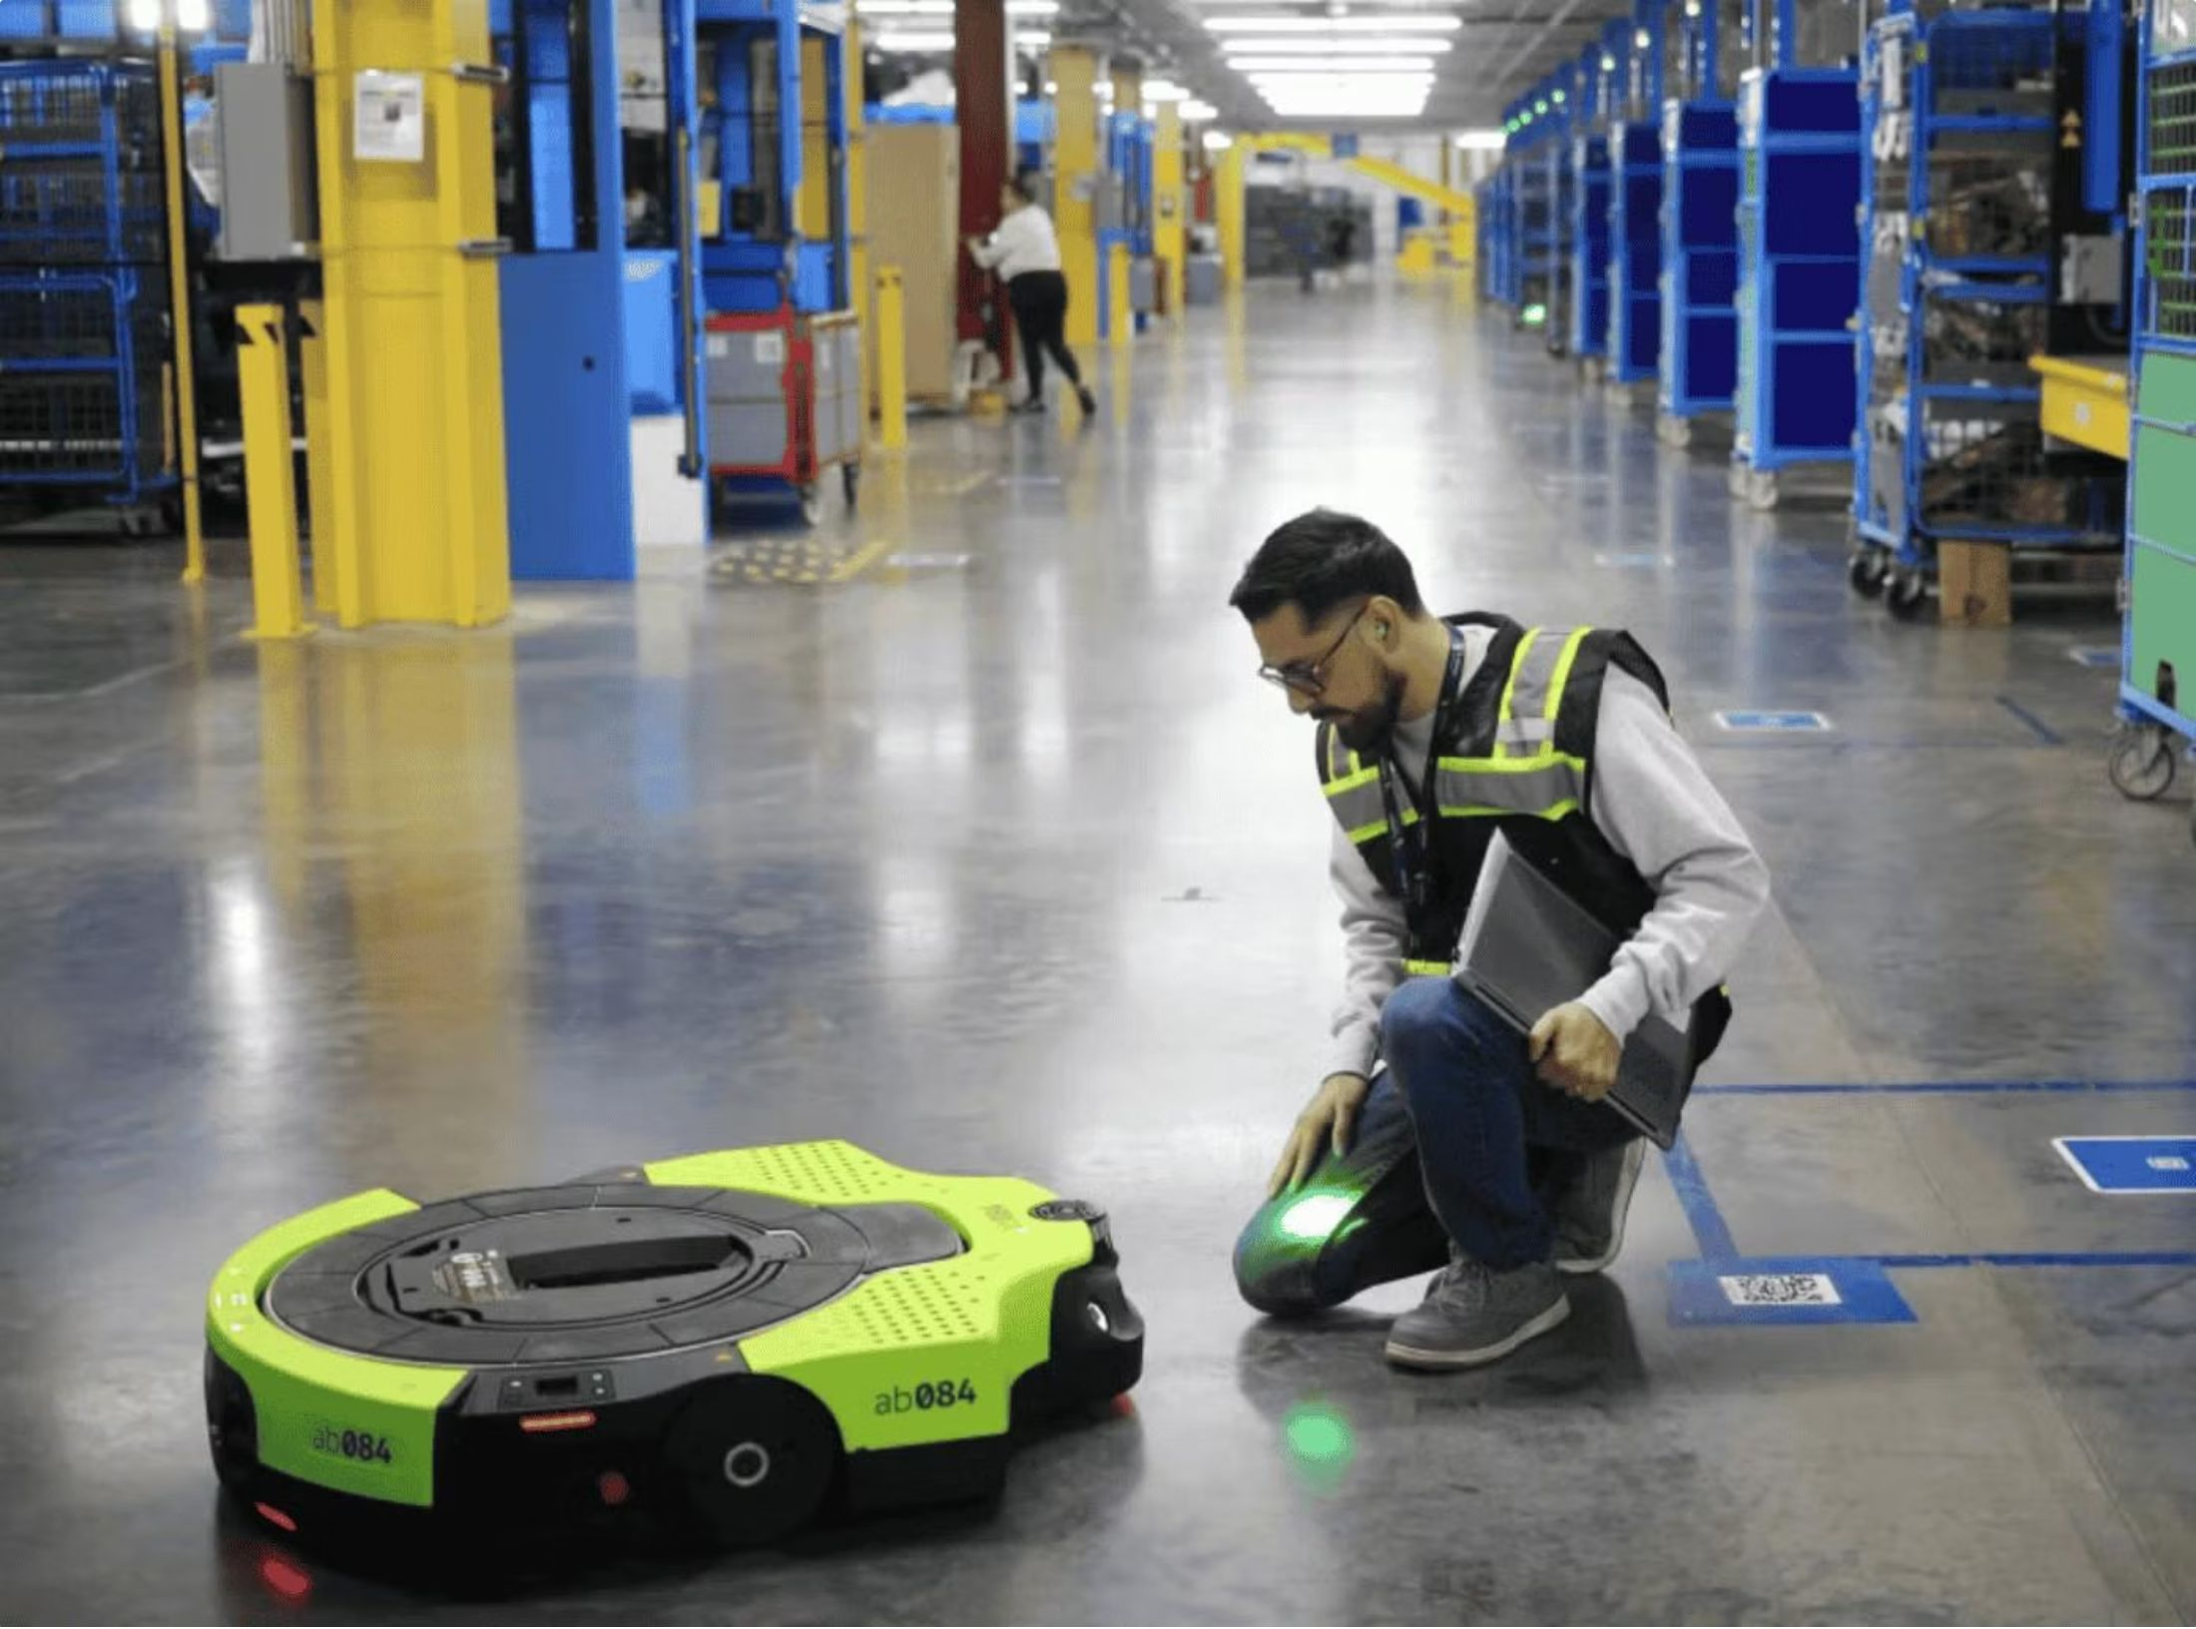
CASE STUDY
UR5e Cobot with Safe RL Collision Avoidance
The Challenge
Universal Robots' UR5e cobot must operate safely near humans without traditional safety cages, requiring real-time collision prediction.
The AI Solution
A Safe RL policy trained with Constrained Policy Optimization (CPO) learns to avoid humans while maintaining task efficiency. A runtime shield enforces hard velocity and force limits.
Results
99.4%
Collision-free operations
40%
Faster task completion

Slide 7





BENEFITS
Advantages of AI-Driven Safety
Proactive Hazard Prevention
AI predicts unsafe states before they occur, shifting from reactive to preventive safety
Real-Time Adaptation
Systems respond to dynamic environments faster than rule-based controllers
Higher Productivity
Safe AI enables closer human-robot collaboration, eliminating costly safety cages
Regulatory Compliance
Formal verification supports ISO 10218 and ISO/TS 15066 certification

Slide 8

CRITICAL VIEW
Challenges & Limitations
Technical Barriers
Systemic Risks
Sim-to-Real Gap — Policies trained in simulation may fail under real-world sensor noise
Adversarial Inputs — Sensor spoofing can deceive AI perception modules
Computational Load — Safe RL inference must meet hard real-time deadlines (<1ms)
Edge Cases — Rare scenarios not seen in training may trigger unsafe behavior
Explainability — Black-box decisions complicate safety certification and debugging
Liability — Legal responsibility for AI-caused incidents remains unresolved

Slide 9
TAKEAWAYS
Conclusion: Safety Is the Foundation
AI safety in mechatronics is not a feature — it is the foundation upon which all autonomous physical systems must be built. Safe RL, sensor fusion, and formal verification together enable machines that are both intelligent and trustworthy.
Design for Safety First
Verify Before Deploy
Embed constraints at the algorithm level, not as an afterthought
Formal methods and simulation testing are non-negotiable
Monitor Continuously
Runtime shielding ensures safety even when the AI is uncertain

