Slide 1
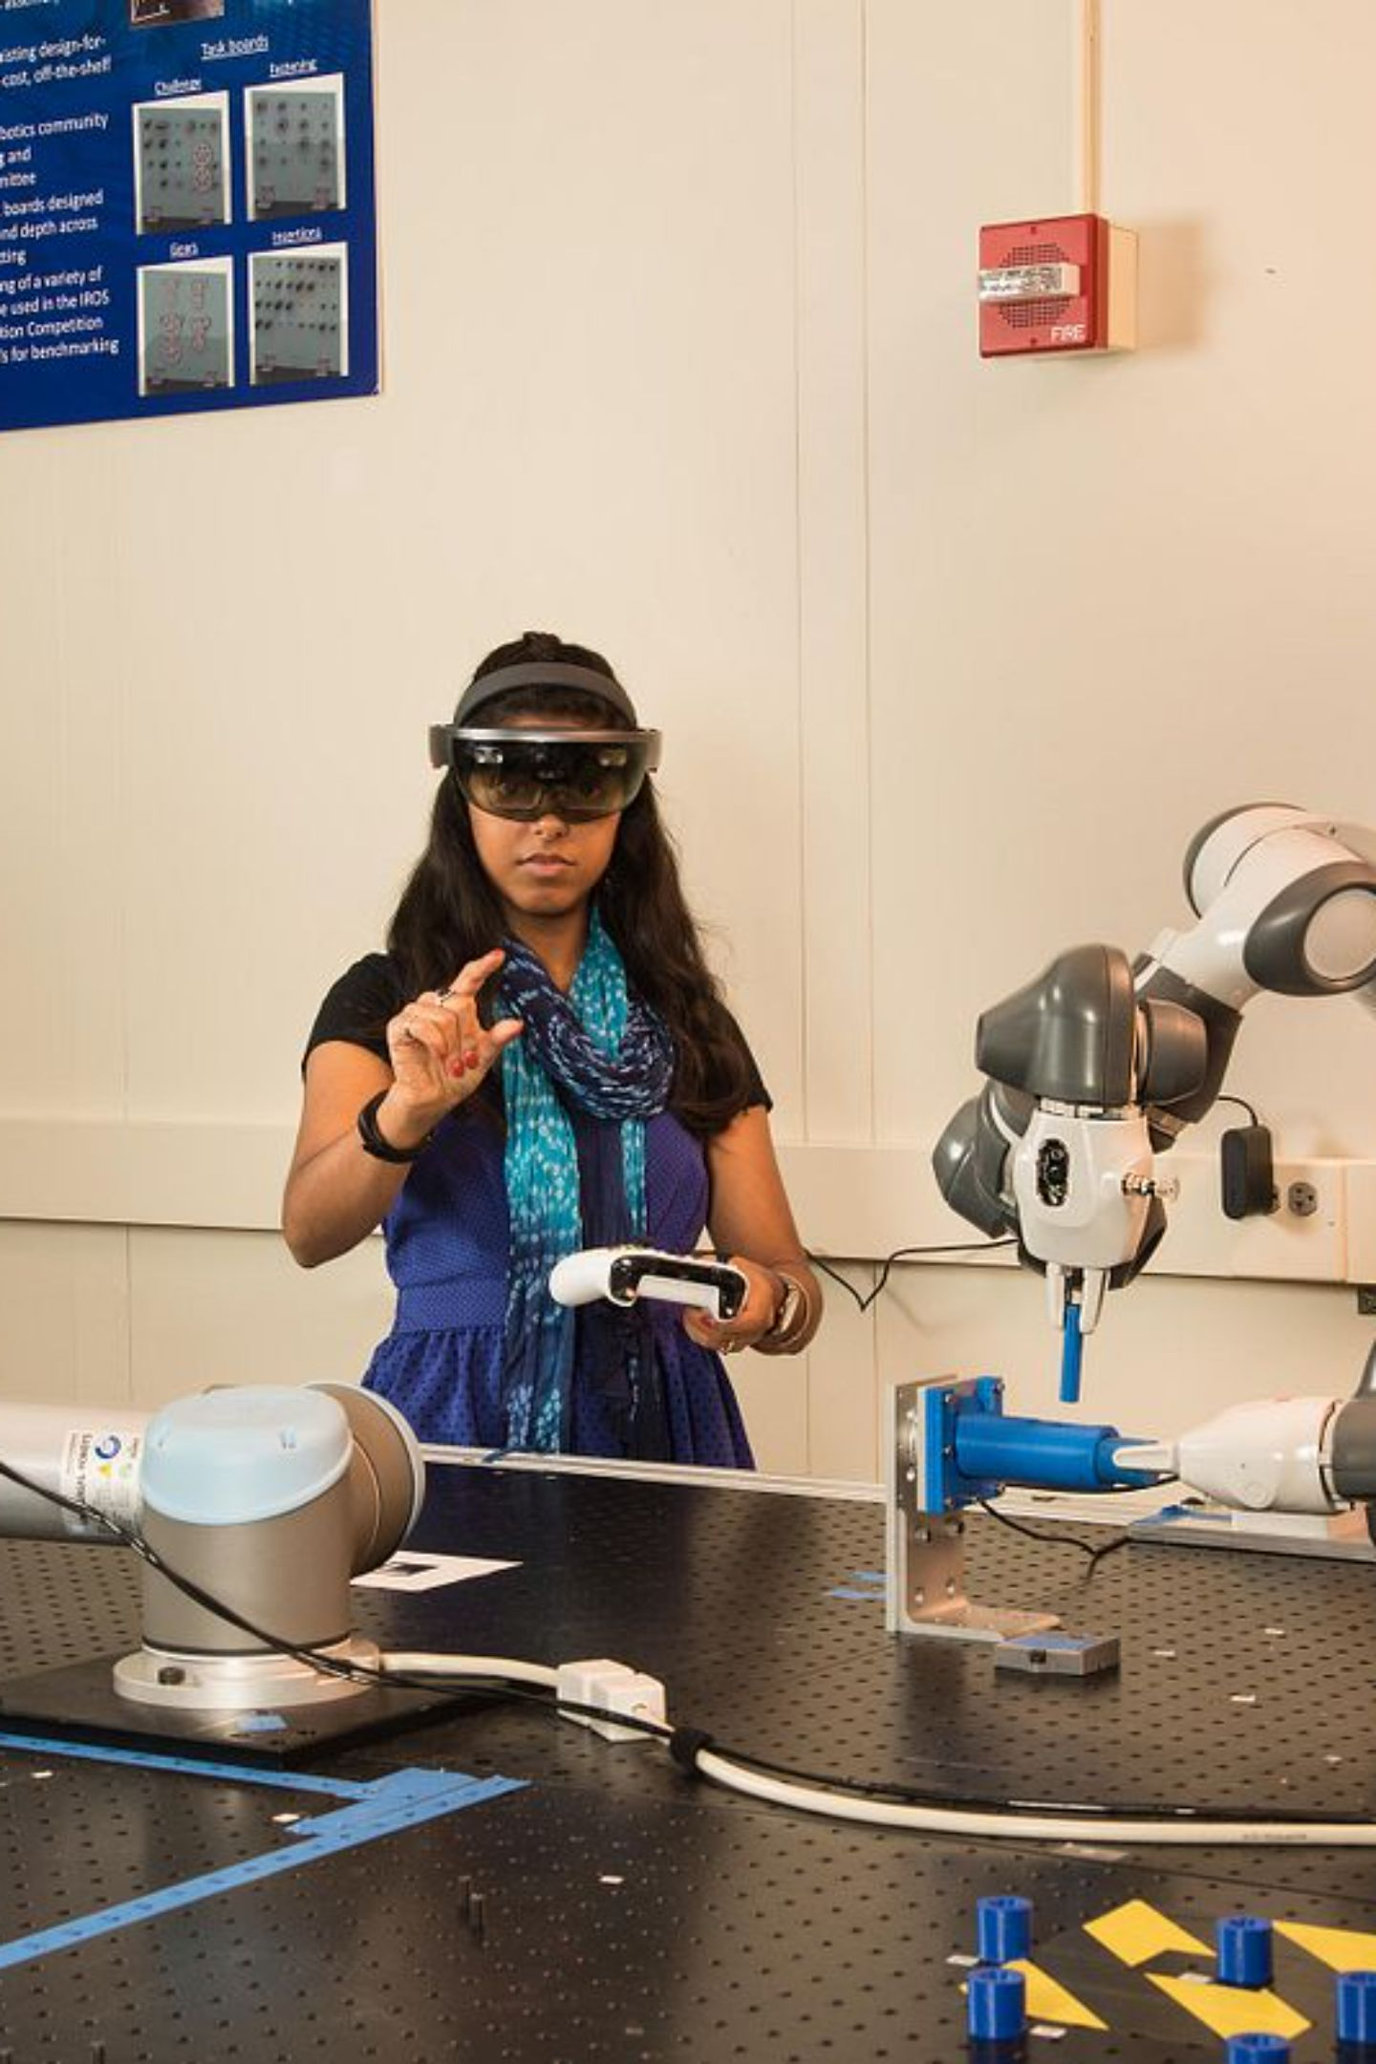
ARTIFICIAL INTELLIGENCE · MECHATRONICS ENGINEERING
Human-Robot Interaction (HRI)
Towards a Collaborative Future: Convergence of Mechatronics & AI

Slide 2
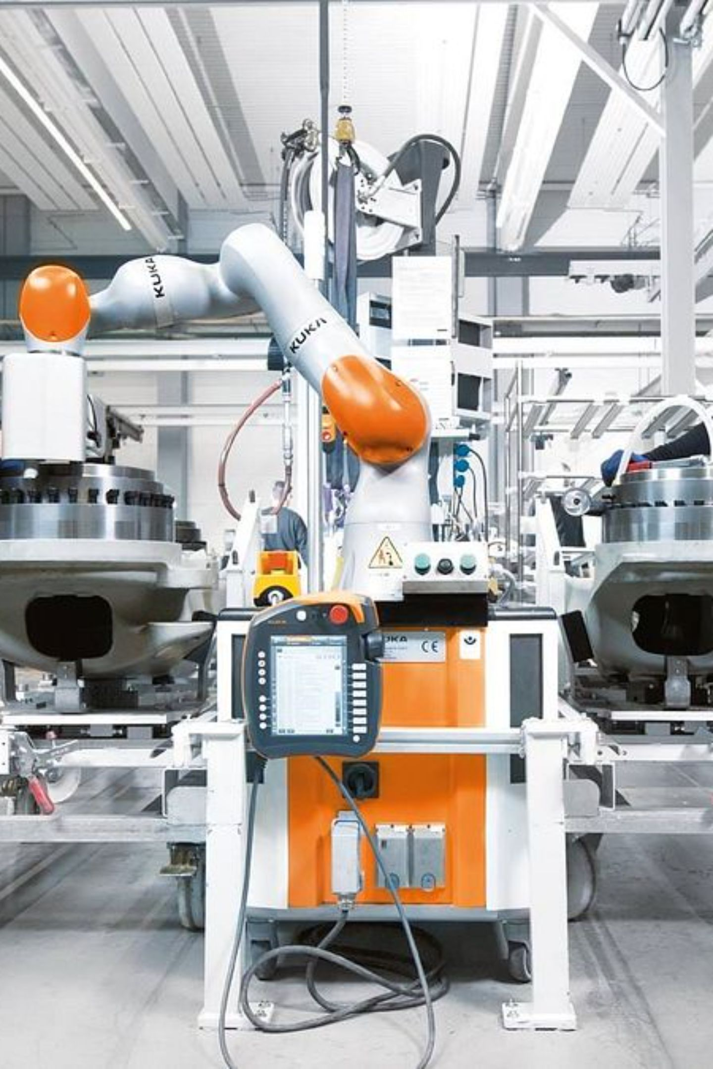
From Isolation to Collaboration
Robotic engineering has moved beyond caged machines. Today, Collaborative Robots (Cobots) share our workspace — and Human-Robot Interaction (HRI) is the discipline making that possible.
The Old Paradigm
The New Paradigm
Robots isolated behind safety cages, performing repetitive tasks with no human awareness.
Cobots work safely alongside engineers, sharing space, tasks, and decisions in real time.
The Ultimate Goal
Integrate human analytical capacity and creativity with machine precision and speed.

Slide 3



AI Technologies Driving HRI
Without these three AI pillars, a cobot is simply a blind, deaf piece of hardware. Together, they enable perception, communication, and adaptation.
Computer Vision
Natural Language Processing
Reinforcement Learning
Recognizes gestures, tracks eye movement, and analyzes facial expressions for precise spatial awareness and safe interaction.
Enables robots to understand human intentions and technical context, responding with fluid communication during shared tasks.
Dynamic algorithms that adapt in real-time to individual user behaviors and anticipate future intentions to maximize efficiency.

Slide 4
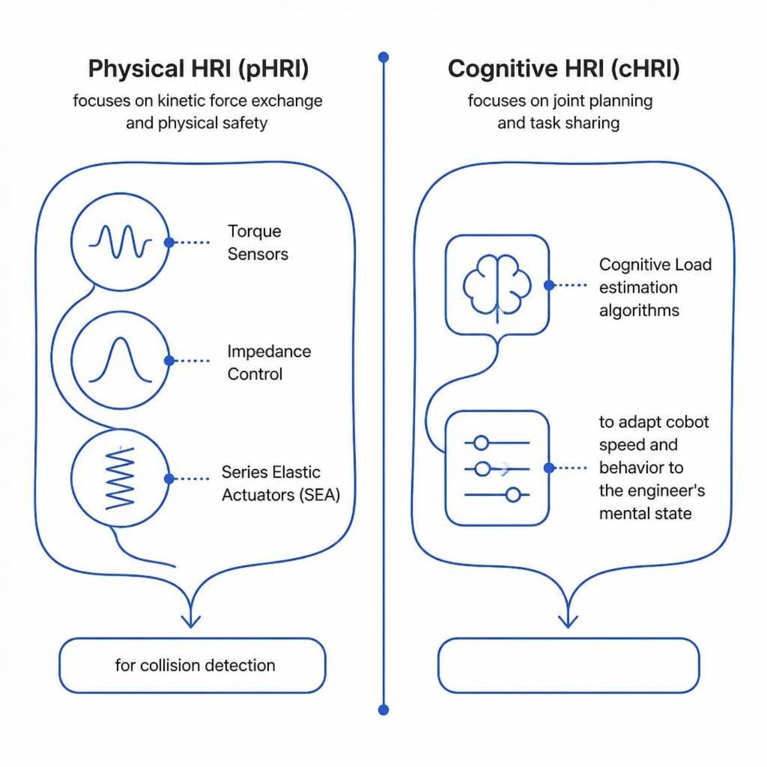
Dimensions of Interaction
HRI operates across two complementary dimensions — one rooted in mechatronics hardware, the other in AI-driven cognition.
Physical HRI (pHRI)
Concerned with the exchange of kinetic force and direct physical safety. Relies on torque sensors, impedance control, and Series Elastic Actuators (SEA) for immediate collision detection.
Cognitive HRI (cHRI)
Concerned with joint planning and dynamic task sharing. Uses intelligent algorithms to estimate the human's cognitive load and automatically adjusts cobot speed and behavior accordingly.

Slide 5
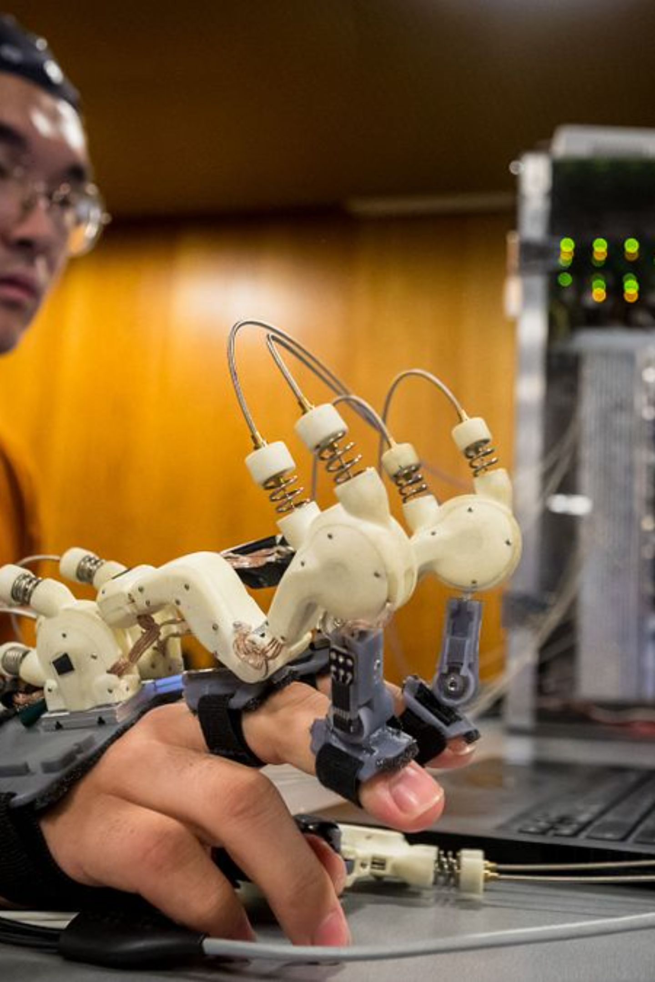


The Future: True Partnership
The next frontier goes beyond physical collaboration. By integrating Brain-Computer Interfaces (BCI) and Emotional AI, future robots will not just be programmed tools — they will be true colleagues that complement our physical and mental capabilities.
Brain-Computer Interfaces (BCI)
Direct neural communication enabling robots to interpret operator intent before physical action is even taken.
Emotional AI
Affective computing that allows robots to sense, interpret, and respond to human emotional states in real time.
Thank you for your attention. Questions are welcome.

