Slide 1
Sentiment Analysis of 2 Files
Data Cleaning
Exploratory Data Analysis
Model Preparation
Model Implementation
Bonus
Cleaned all the tweets and removed stop words
Divided the tweets based on the file
Implemented different features (TF_IDF and Bag of Words)
Implemented 7 models
Bonus Visualization and Using TensorFlow on US_electin_2020 file

Slide 2
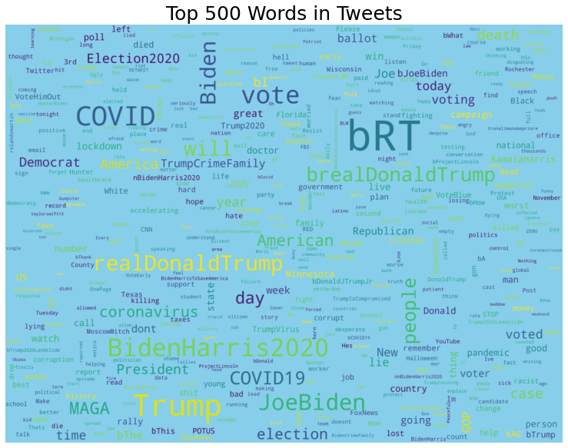
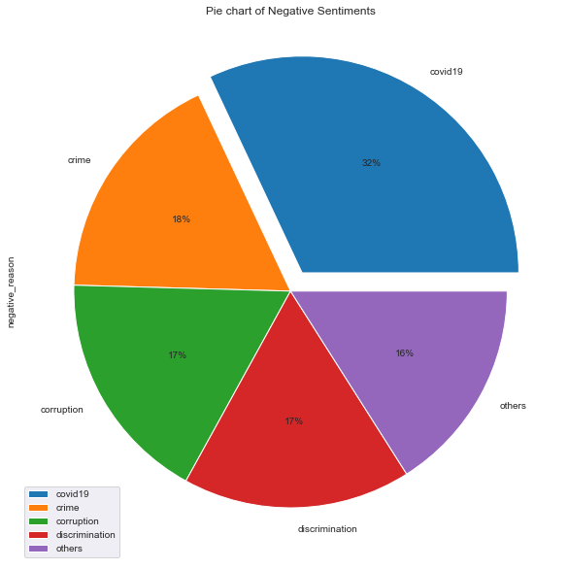
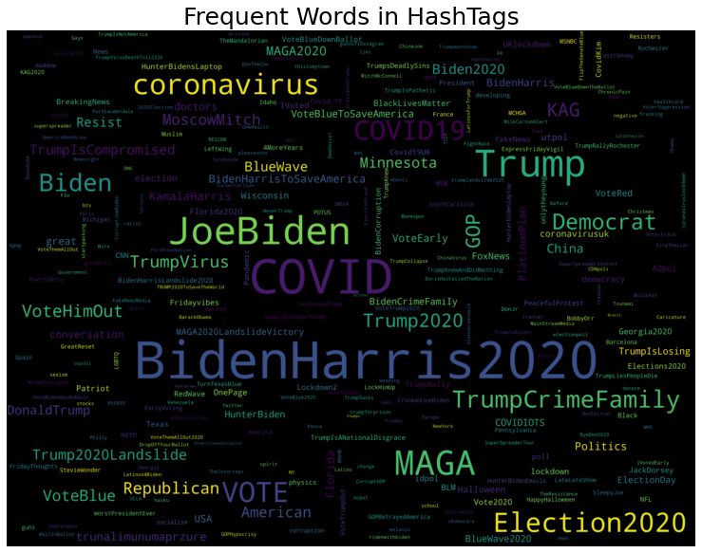
EDA on US Election File
Looking at the tweets and Hashtags data for the US elections we can see that BidenHArris 2020 was one of the popular hashtags and in tweets @realdonaltrump was a popular twitter handle.
Most of the tweets and hashtags were pointed towards Democratic and Republican Parties.
Looking at the Pit Chart we can see that most of the negative sentiments were due to Covid-19. Other reasons like corruption, crime, etc were equally discussed at approx. 16%.

Slide 3
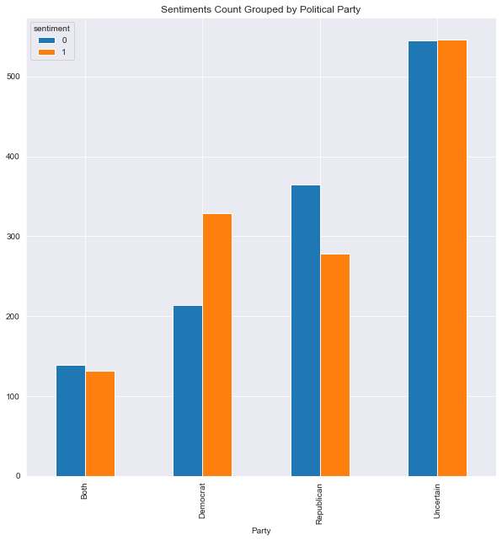
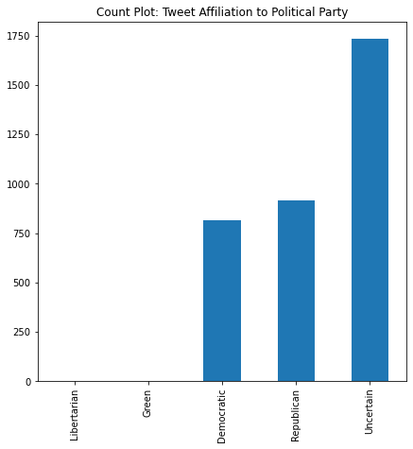
EDA on US Election File
We can see for the graph above that maximum amount of people are uncertain about their political party affiliation. They are also split equally.
For Democrat we can see that more people affiliated have positive sentiment whereas, for Republicans more people have negative sentiment.
Some tweets mentioned both political parties and most of them have negative sentiment however the split difference is low
It can be seen from the graph that maximum amount of tweets were related to the Democratic Party or the Republican Party.
Additionally we can see that 1750 tweets are uncertain about their political affiliations.

Slide 4
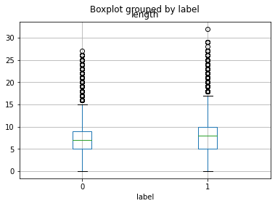
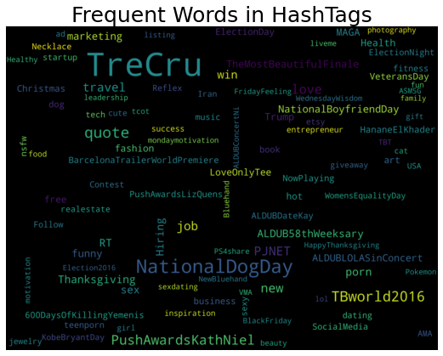
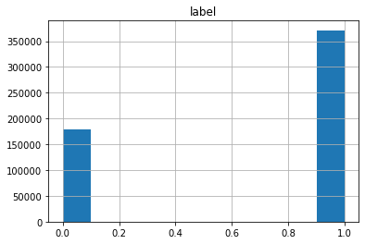
Sentiment_Analysis.csv EDA
Looking at the generic tweet file’s plot we can see that NationalDogday, Job, TreCru were some of the popular words.
Additionally we can see that the mean length of positive and negative tweets is similar, however, +ve tweets are longer.
Also looking at the count plot we can see that we approximately double the positive tweets compared to negative tweets.

Slide 5
Looking at the Accuracy from 7 models on different types of features
Table 1: Showing Accuracy of the models in %
File |  | Sentiment_Analysis.csv |  | US_Election_2020.csv
 | Feature | TF-IDF | Bag of Words | TF-IDF | Bag of Words
Models | Logistic Regression | 96.4 | 95 | 71 | 72
 | KNN | 65 | 89 | 62 | 51
 | Naïve Bayes | 91.4 | 95 | 72 | 73
 | Support Vector Machine | 76 | 96 | 71 | 69.15
 | Decision Tree | 93 | 94 | 64 | 69.9
 | Random Forest | 94 | 95 | 68 | 70
 | XGBoost | 70 | 70 | 57 | 57

