Slide 1
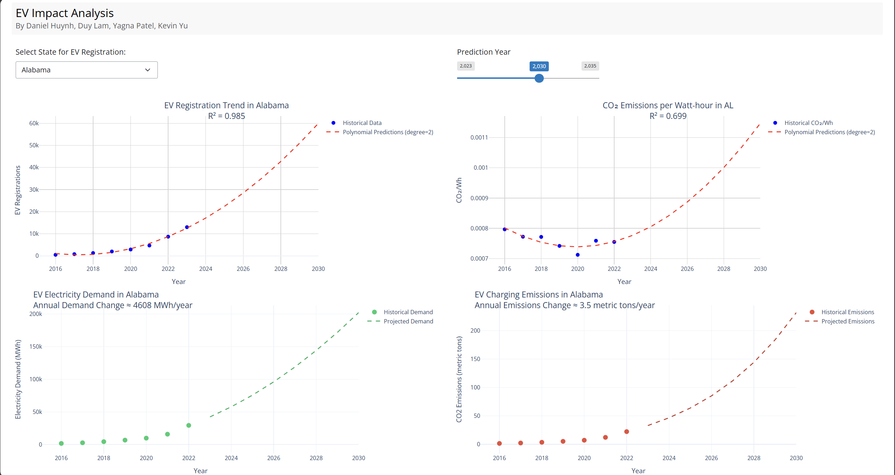
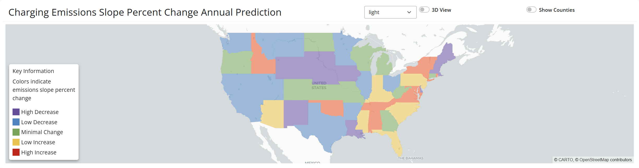
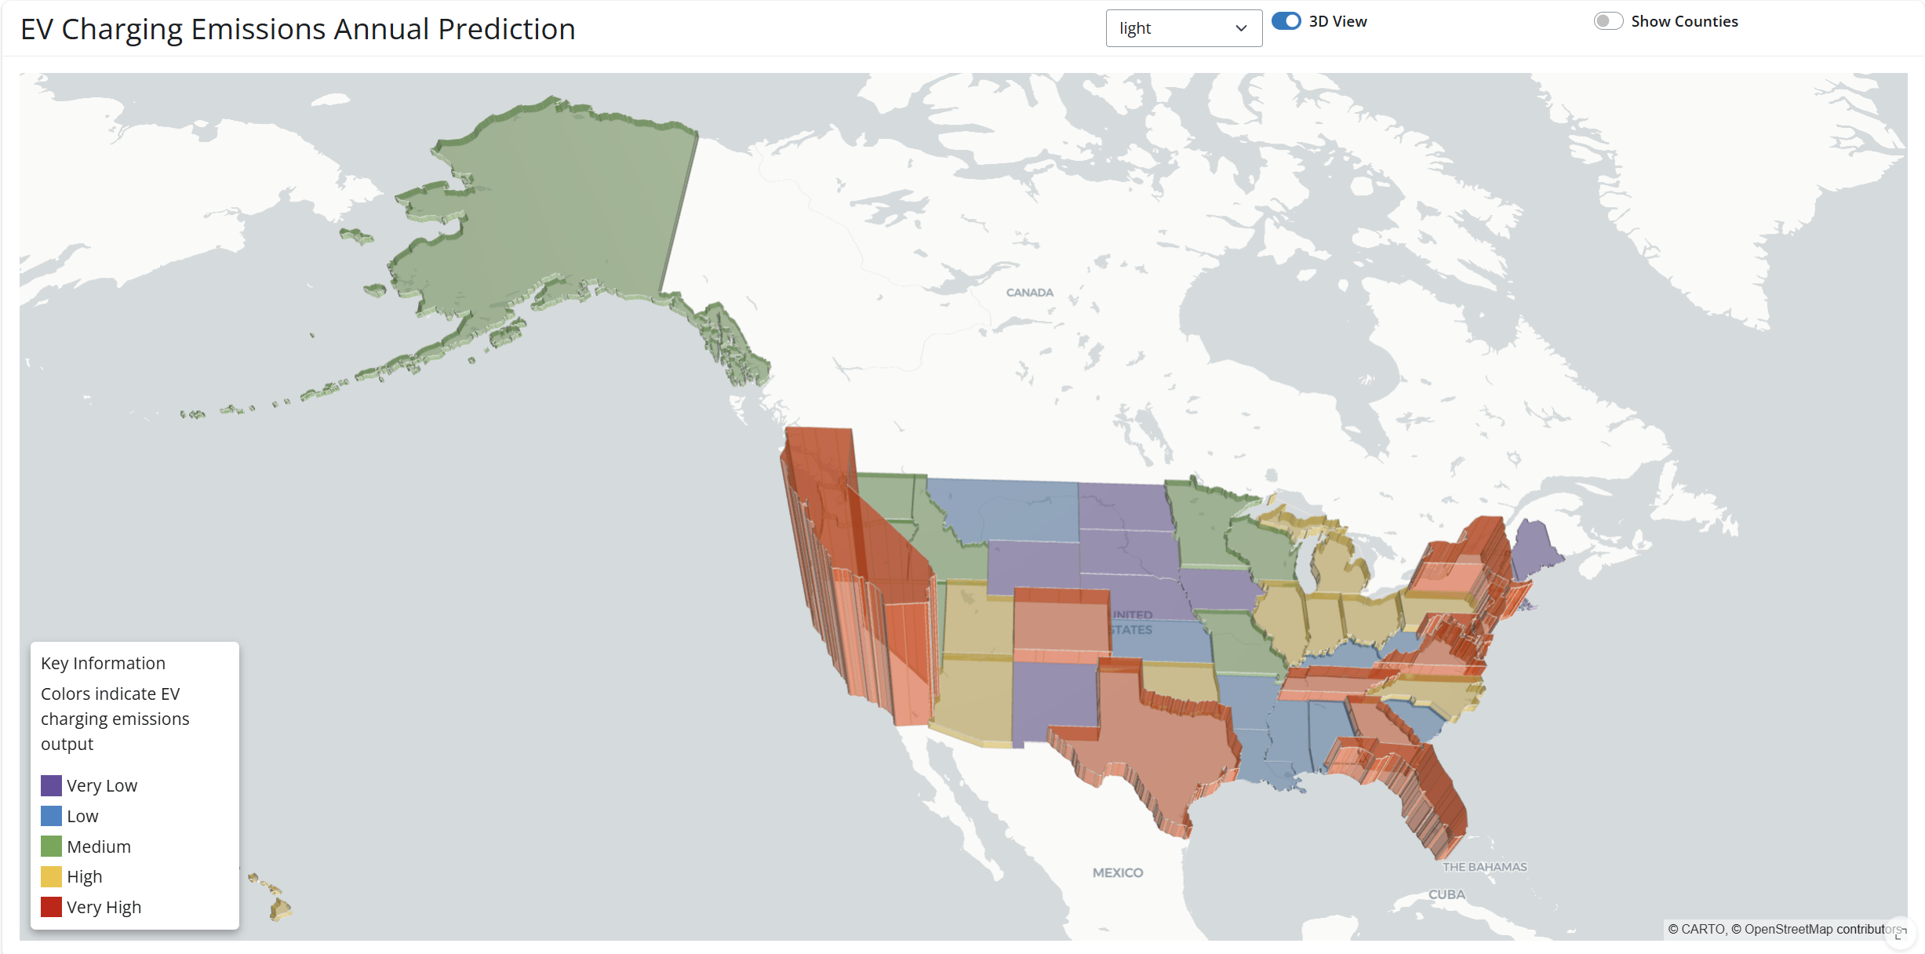
Future EV Demand Impact on Energy and Emissions
Team: [Insert Here] Authors: Daniel Huynh, Duy Lam, Kevin Yu, Yagna Patel
Demonstrations & Results:
Results Summary:
The comprehensive EV impact analysis across the United States reveals a complex relationship between EV adoption and environmental impact. Using Alabama as a case study, data shows exponential growth in EV registrations (R² = 0.985) with projected increases from 15,000 to 55,000 vehicles by 2030, accompanied by rising electricity demand of 4,608 MWh annually.
The national charging emissions analysis demonstrates significant regional variations, with some states showing promising decreases in emissions (purple regions) due to cleaner electrical grids, while others, particularly in coastal areas, face challenges with high emission rates (red regions) despite higher EV adoption.
This pattern is further emphasized in the 3D visualization, where population-dense coastal regions display the highest emissions despite potentially cleaner grids, highlighting a critical need for balanced infrastructure development that combines increased EV adoption with clean energy integration to maximize environmental benefits.
Figure 1.
EV Impact Analysis Results:
In Figure 1. based on the EV Impact Analysis for Alabama as an example, the data shows significant projected growth in electric vehicle adoption through 2030. The EV registration trend demonstrates strong exponential growth
(R² = 0.985), suggesting high forecast reliability. While historical EV numbers were modest, —
(around 10,000-15,000 through 2022), projections indicate a surge to approximately 55,000 registrations by 2030. This growth corresponds with increasing electricity demand, estimated at 4,608 MWh annually. Interestingly, while EV adoption rises, the CO₂ emissions per watt-hour show a U-shaped trend (R² = 0.699), with initial decrease followed by a projected increase post-2022. Total charging emissions are expected to grow by 3.5 metric tons annually, reaching about 200 metric tons by 2030, highlighting the need for cleaner electricity sources to maximize environmental benefits of EV adoption.
Discussions:
Policy Development
  Support creation of effective renewable energy policies
  Identify regions requiring immediate infrastructure investment
Resource Allocation
  Help governments optimize budget allocation for renewable and EV infrastructure
  Prioritize high-impact areas for renewable energy development
  Plan strategic grid and EV charging upgrades based on projected EV demand
Environmental Planning
  Track progress toward carbon neutrality goals
  Identify regions where emissions may increase without intervention
Future Work:
The future research will focus on optimizing regional energy solutions by analyzing weights for different energy types (solar, wind, nuclear, geothermal etc.) to determine the most suitable power sources for specific areas based on geographical and infrastructure factors. This will include developing implementation strategies and location optimization models. Additionally, the study will explore critical resource sustainability by forecasting copper and rare earth metal (cobalt) demands for EV infrastructure, examining supply chains, and predicting production needs. A more granular county-by-county analysis will also be conducted to provide detailed insights into local EV charging impacts and infrastructure requirements, enabling more targeted and efficient clean energy transitions.
Figure 2.
Charging Emissions Slope Percent Change Annual Prediction Results:
In figure 2 the map displays the predicted percentage change (slope) in CO₂ emissions from EV charging across different states. The visualization reveals where EV adoption is actually leading to decreased charging emissions. States shown in purple are experiencing the highest rates of emissions decrease, while indicating that their electrical grid may be becoming cleaner or more efficient. States in green show minimal change in their emission slopes, suggesting stable grid emissions. Concerningly, some states in red show increasing charging emissions slopes, which indicate that their power grid infrastructure isn't keeping pace with EV adoption. Especially, in terms of renewable energy integration. Overall, The map effectively highlights which states are successful in reducing their CO₂ emissions from EV charging and the states that may need to focus more on cleaning up their electricity generation to maximize the environmental benefits of EV adoption.
Introduction
This project investigates the impact of the transition from gasoline-powered vehicles to electric vehicles (EVs) on carbon emissions across the United States. As EV adoption grows, so does the demand for electricity, raising critical questions about energy supply and sustainability. By projecting future EV adoption rates and their associated energy demands, this analysis aims to quantify the resulting changes in carbon emissions at the state level. Our goal is to provide insights that can guide the strategic implementation of renewable energy infrastructure, paving the way for a carbon-neutral future and supporting the nation’s environmental goals.
Figure 3.
Objectives:
The objective of this project is to analyze the impact of electric vehicle (EV) adoption on state-level electricity demand and CO₂ emissions across the United States. The study aims to project EV-related electricity demand and emissions trends, providing a basis for policymakers and energy providers to prepare for the increased energy load and develop emissions mitigation strategies. By forecasting these impacts and identifying regional disparities, the project seeks to support informed decision-making to promote sustainable energy use alongside the growth of EV infrastructure.
EV Charging Emissions Annual Prediction:
Figure 3 is a 3D visualization of predicted annual EV charging emissions output across the US. The West Coast and parts of the Northeast show very high emissions (red), likely due to their larger EV adoption rates and population density. The Midwest region display low emissions (purple/blue), while states like Alaska and parts of the Great Lakes region show medium levels (green). The Mid-Atlantic and some Southern states show high emissions (yellow). The height/elevation emphasizes the contrast between high and low emissions. This suggests that areas with higher EV adoption and urban concentration face greater challenges in managing charging emissions, despite having cleaner energy grids. This map effectively highlights most significant environmental impact EV charging infrastructure is creating.
Methodology:
To assess the impact of increasing EV adoption on electricity demand and carbon emissions, we conducted a state-by-state analysis using historical data on EV registrations, electricity demand, and CO₂ emissions. A polynomial regression model was applied to project future EV adoption rates and the resulting electricity demand across each state.
The analysis then estimated CO₂ emissions from EV charging by calculating emissions per watt-hour in each state, considering the mix of energy sources used in electricity generation. We visualized these trends using projections of annual changes in electricity demand and emissions, categorized by regions and mapped according to expected impact levels. From the regression prediction models, the rate of change for charging emissions was extracted year to year for each state. This approach allows us to pinpoint areas in the future where renewable energy integration is most critical to mitigate emissions associated with EV growth.
Citations:
https://www.eia.gov/environment/emissions/carbon/
https://www.eia.gov/energyexplained/electricity/electricity-in-the-us-generation-capacity-and-sales.php?os=http
https://www.epa.gov/greenvehicles/greenhouse-gas-emissions-typical-passenger-vehicle
https://afdc.energy.gov/vehicle-registration

