Slide 1

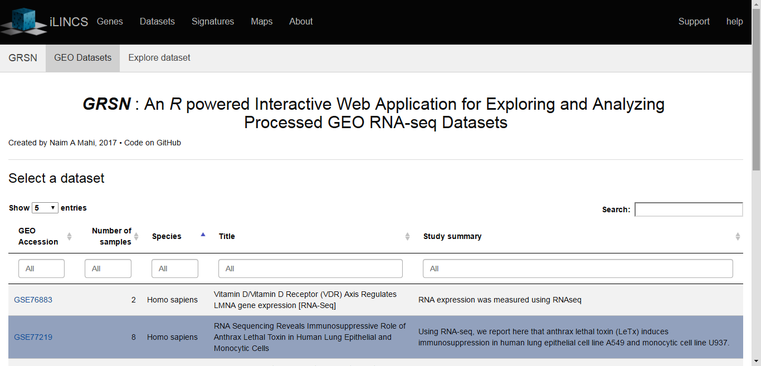
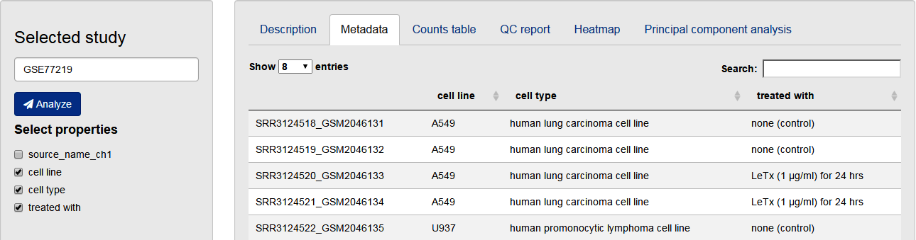
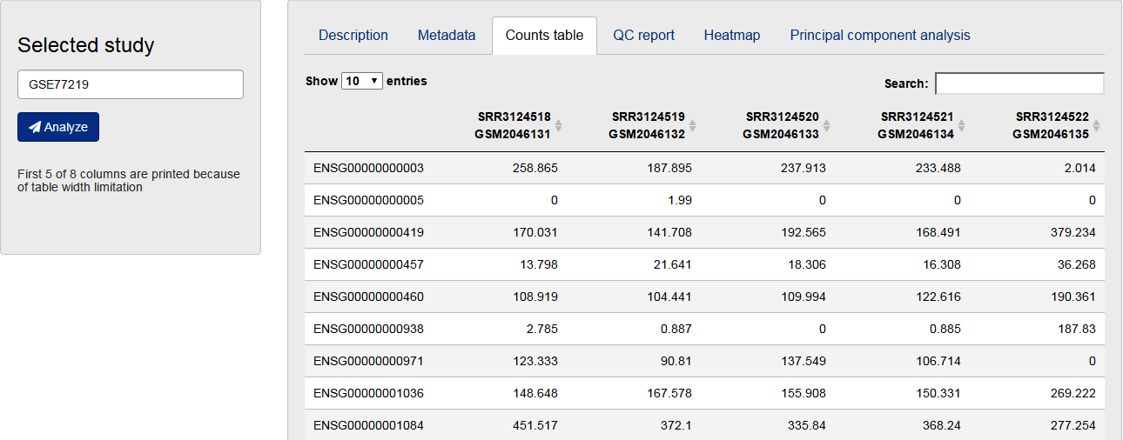
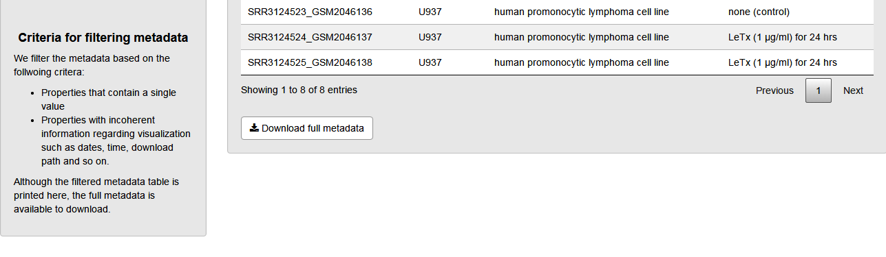
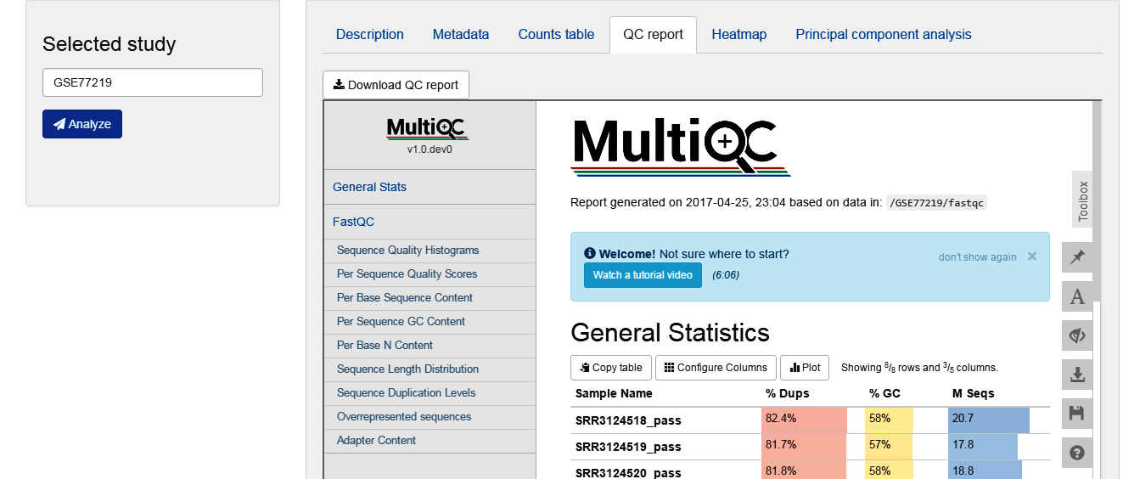
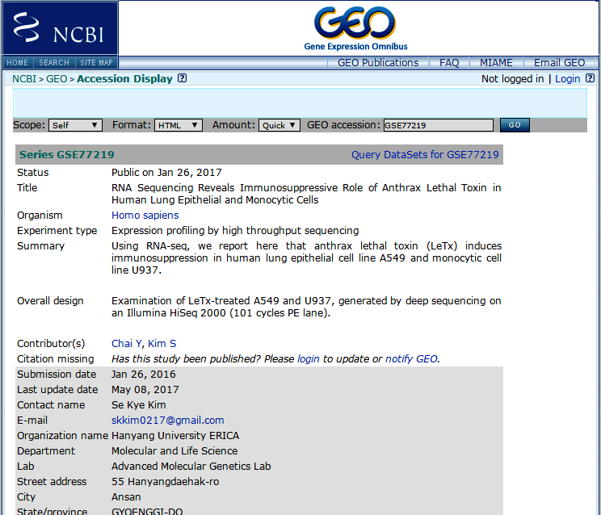
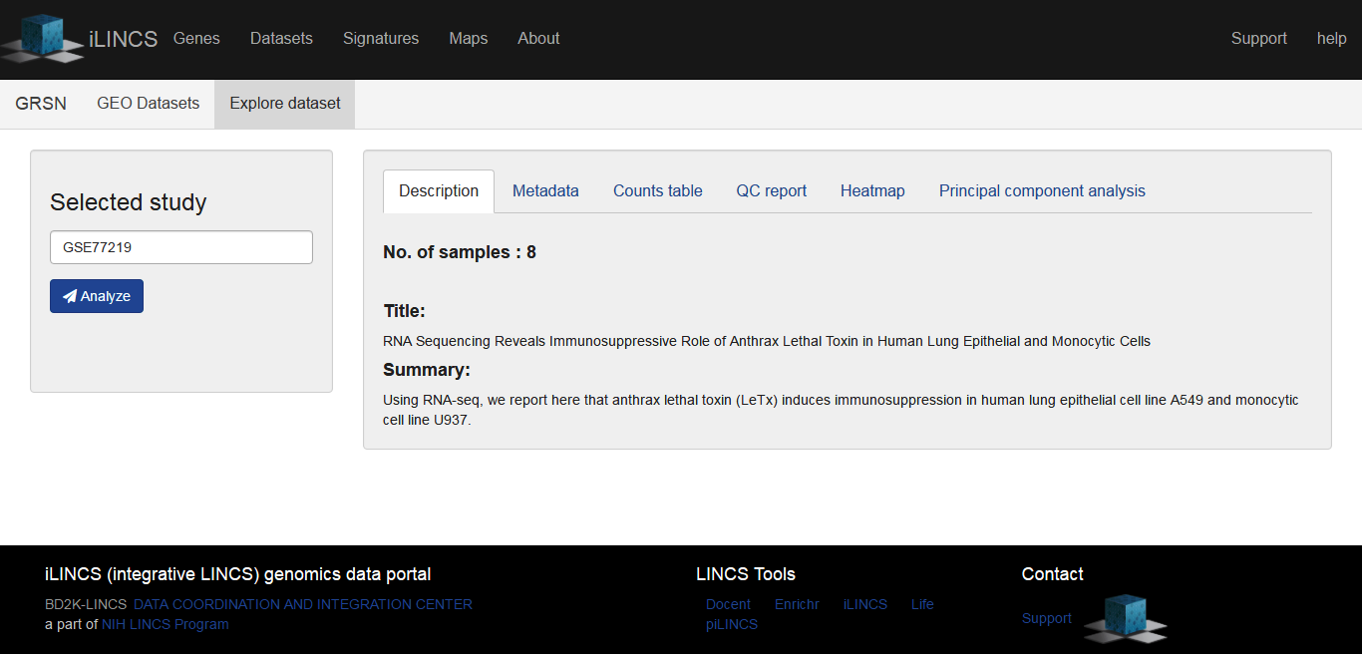
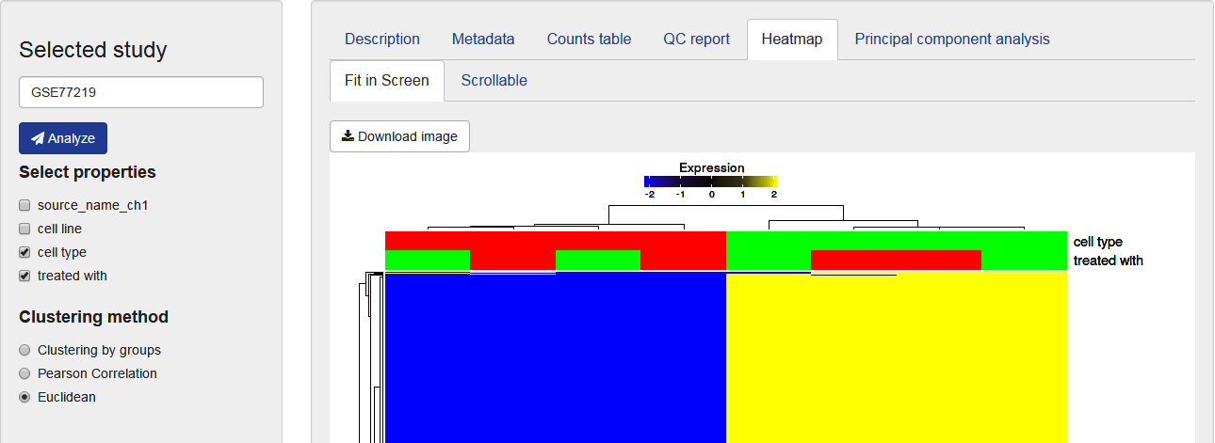
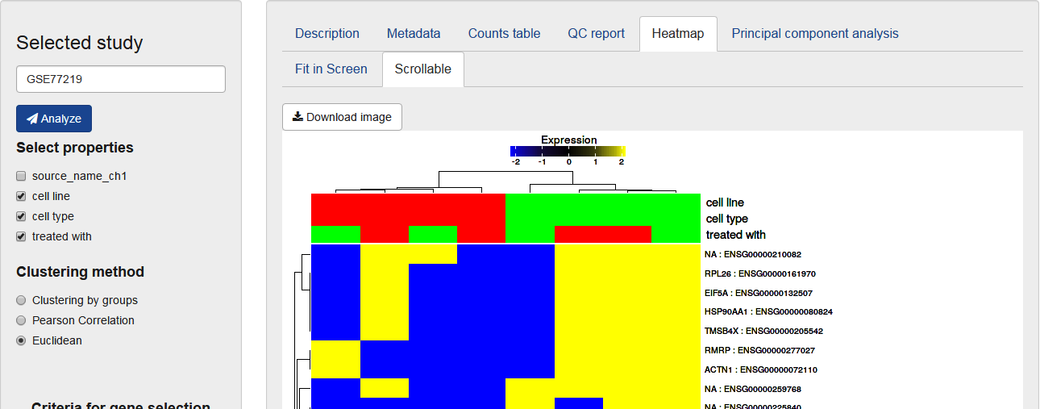
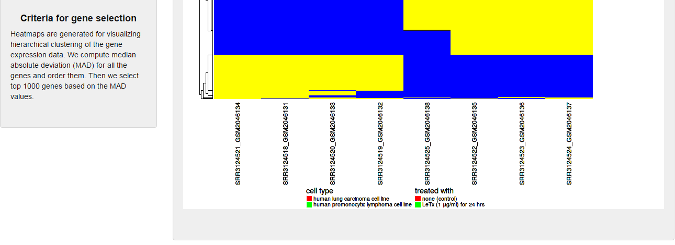
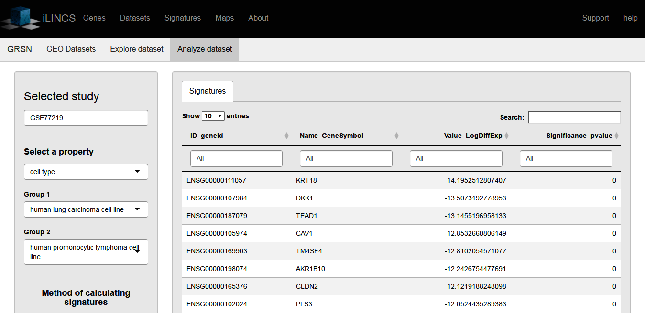
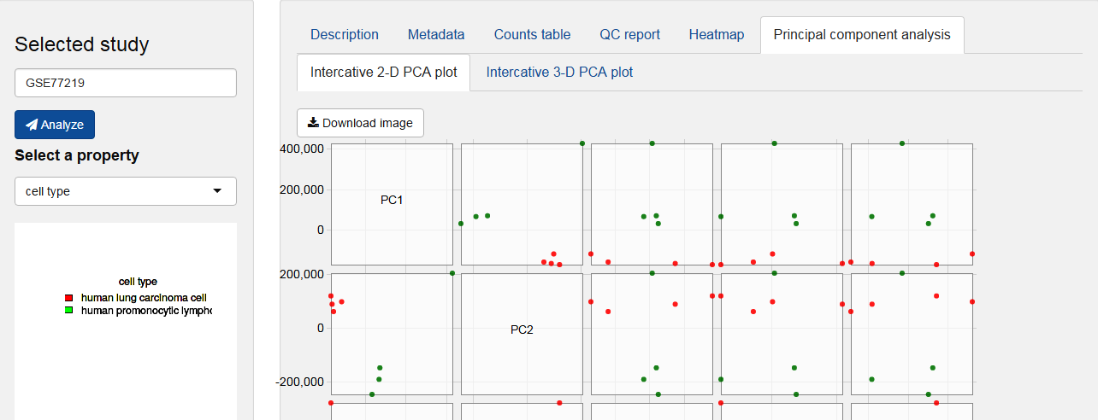
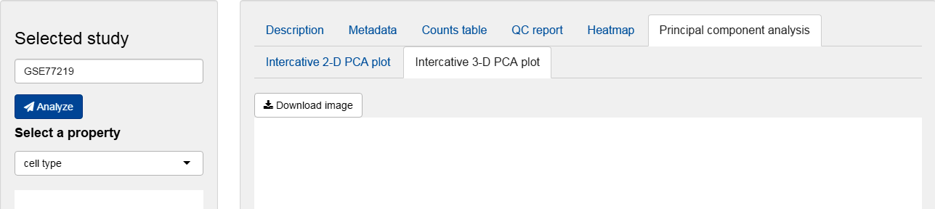
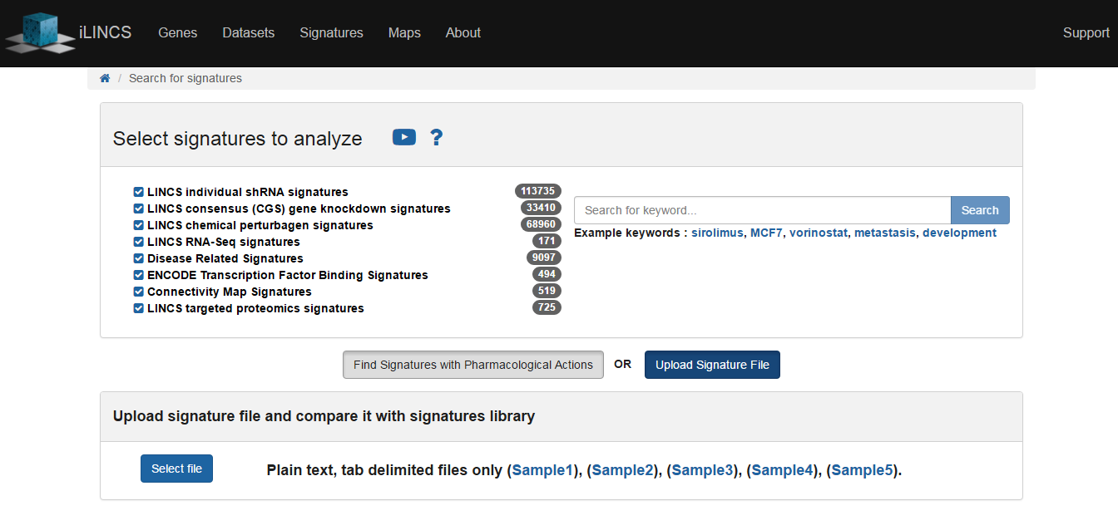
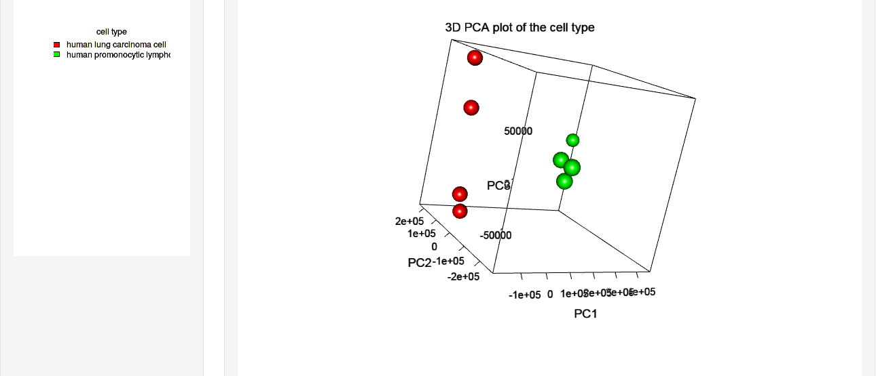
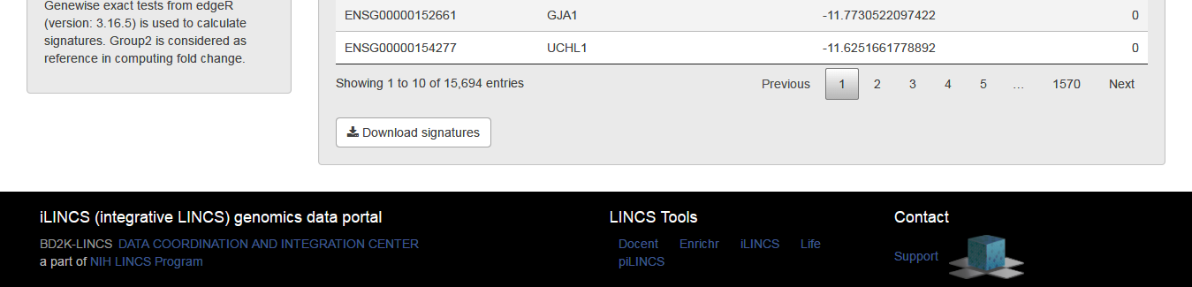




GRSN: An R Powered Interactive Web Application for Exploring and Analyzing Processed GEO RNA-seq Datasets
Naim Al Mahi¹ and Mario Medvedovic¹
¹Laboratory for Statistical Genomics, Division of Biostatistics and Bioinformatics, Department of Environmental Health, University of Cincinnati College of Medicine, 3223 Eden Ave. ML 56, Cincinnati OH 45267-0056, USA
Introduction
GRSN Interactive Workflow
The Gene Expression Omnibus (GEO) is a public repository of gene expression data that hosts more than 40,000 RNA-seq samples and this number is increasing. Most of these samples are deposited in raw sequencing format which needs to be downloaded and processed. With an aim to transform all these datasets in an analysis-ready format, we are currently processing the available RNA-seq samples of human, mouse, and rat from GEO using an R-based automated pipeline. This pipeline simultaneously downloads and processes RNA-seq raw sequencing data available in GEO. We demonstrate the results in a web application, GRSN (GEO RNA-seq Navigator) using the shiny framework. This interactive and intuitive application let a user with little or no computational programming background to explore and analyze processed GEO RNA-seq datasets in a point-and-click manner. GRSN provides the flexibility to analyze and create ilincs (https://www.ilincs.org/) compliant signatures that can be uploaded to ilincs for further in-depth analysis. In addition, GRSN produces publication-ready graphs and allows user to download all the analysis results.
Select dataset
Explore dataset
Pipeline Structure
Downloading stage
GEO
XML query
Collect GEO accession of RNA-seq datasets
aspera
Download SRA files and metadata
Processing stage
Analyze dataset
Input
Steps
Output
Upload signatures to ilincs for further analysis
.sra files
SRA Toolkit
Generate FASTQ files
.fastq files
fastq-dump
.fastq files
FastQC
Pre-alignment QC
HTML report
MultiQC
.fastq files
Trimmomatic
Trim FASTQ
Trimmed .fastq files
Trimmed .fastq files
Salmon
Read mapping
Estimated counts
Acknowledgements
This work has been funded by the NIH grant U54HL127624.

Slide 2
Downloading stage
GEO
XML query
Collect GEO accession of RNA-seq datasets
aspera
Download SRA files and metadata
Processing stage
Docker container
Input
Steps
Output
.sra files
SRA toolkit
Generate FastQ files
.fastq files
fastq-dump
GRIN
.fastq files
FastQC
Pre-alignment QC
QC reports
.fastq files
Salmon
Read mapping
Estimated counts
FastQC and Salmon files
MultiQC
Summarize sample wise QC and Salmon info
Combined QC report

Slide 3
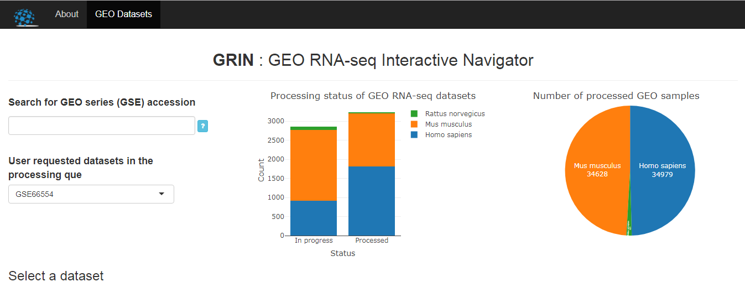
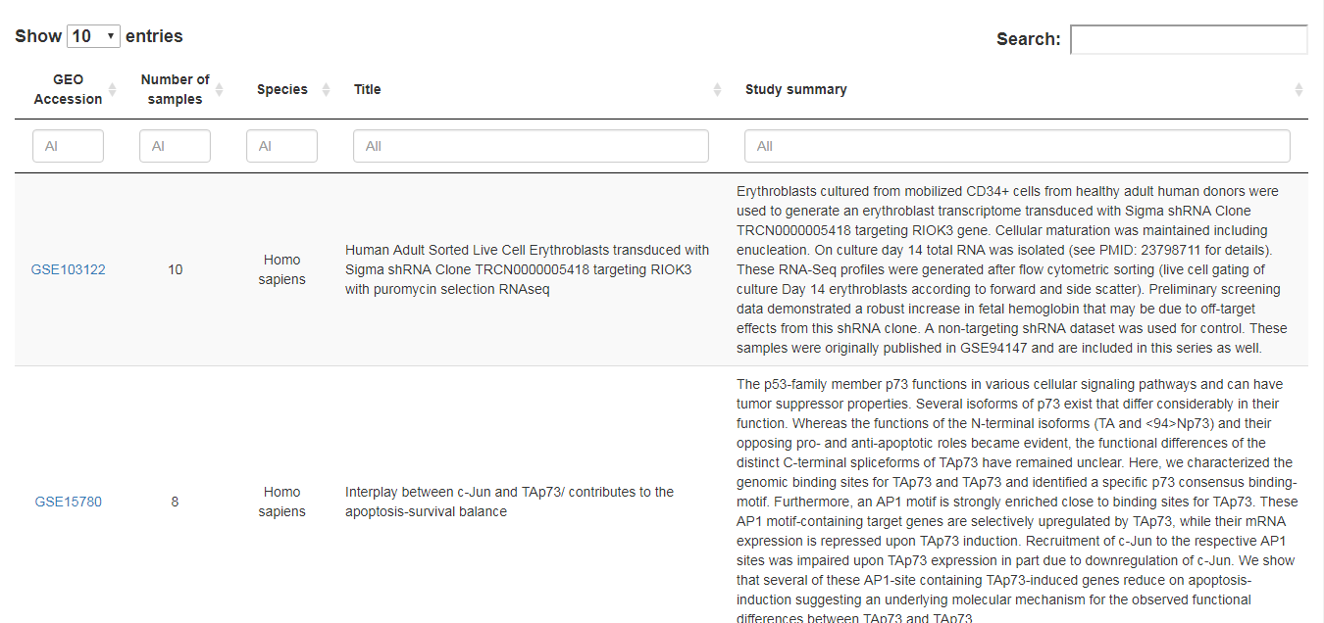
Section 1
Section 2
Section 3
Section 4

