Slide 1
Lab 7
Micah Angle

Slide 2
DownCounter_v1

Slide 3


Slide 4
FSM Design

Slide 5
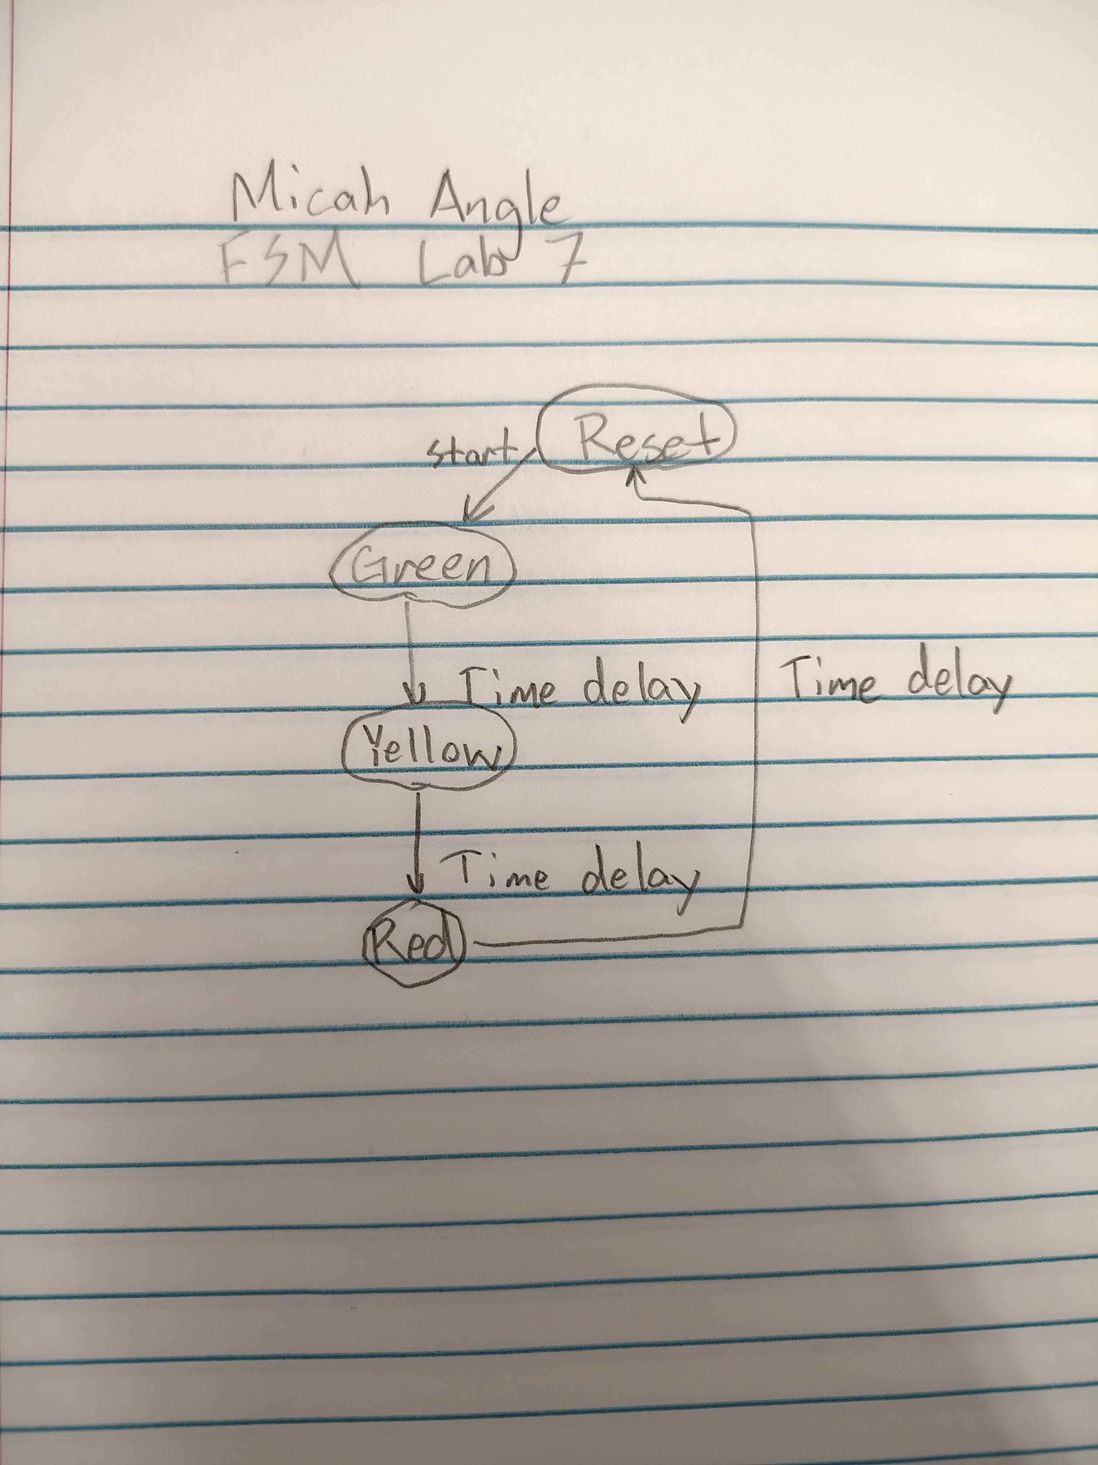

Slide 6
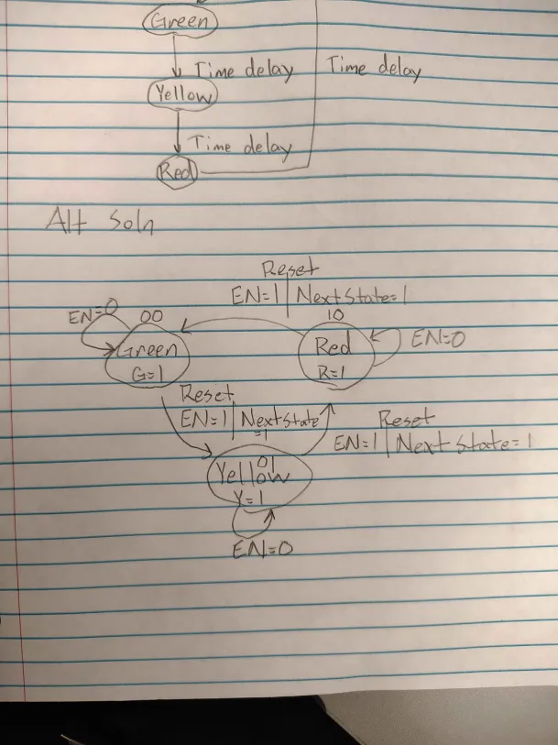
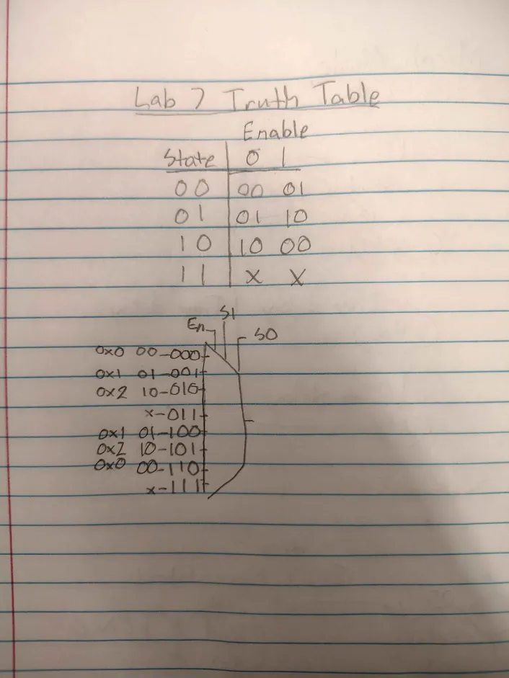

Slide 7
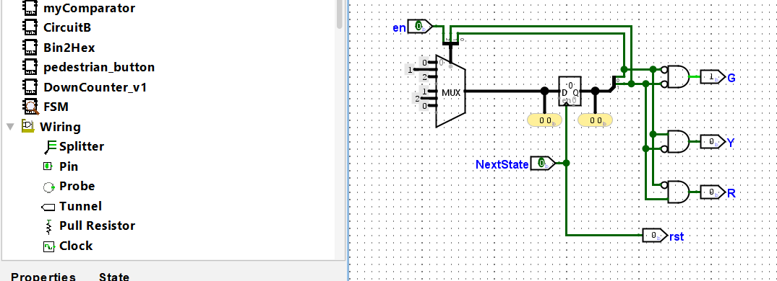
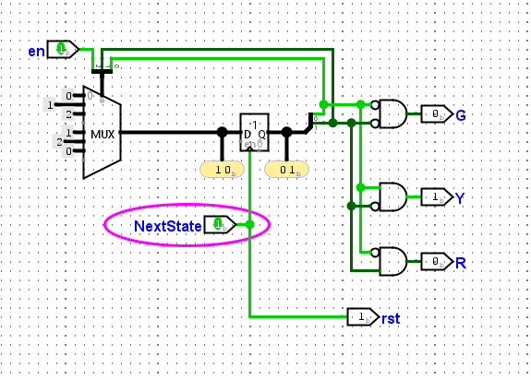
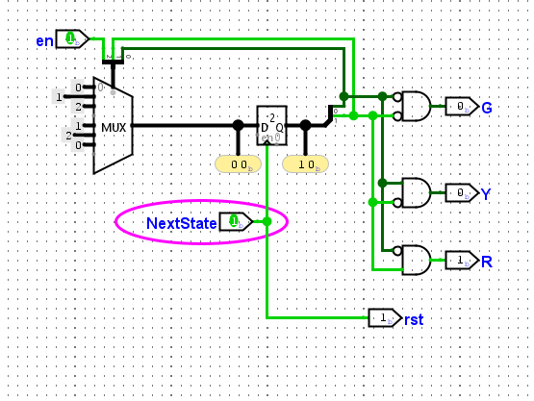

Slide 8
Main Circuit

Slide 9


