Slide 1
Lab 6
Micah Angle

Slide 2
Down Counter

Slide 3
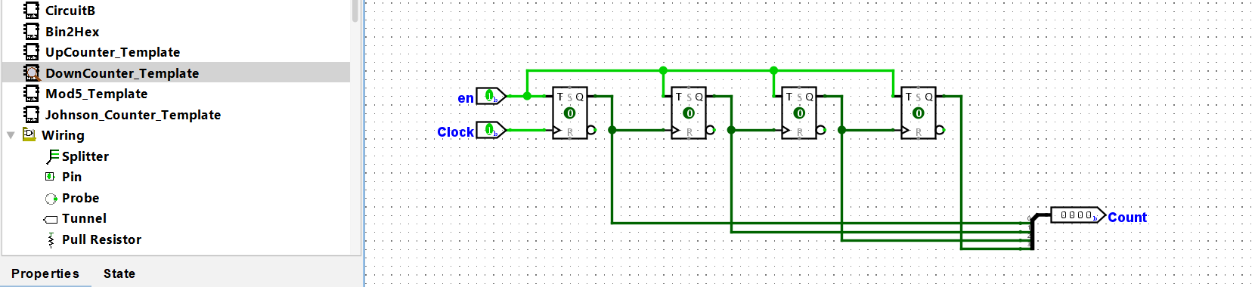

Slide 4
Up Counter w/ Reset

Slide 5
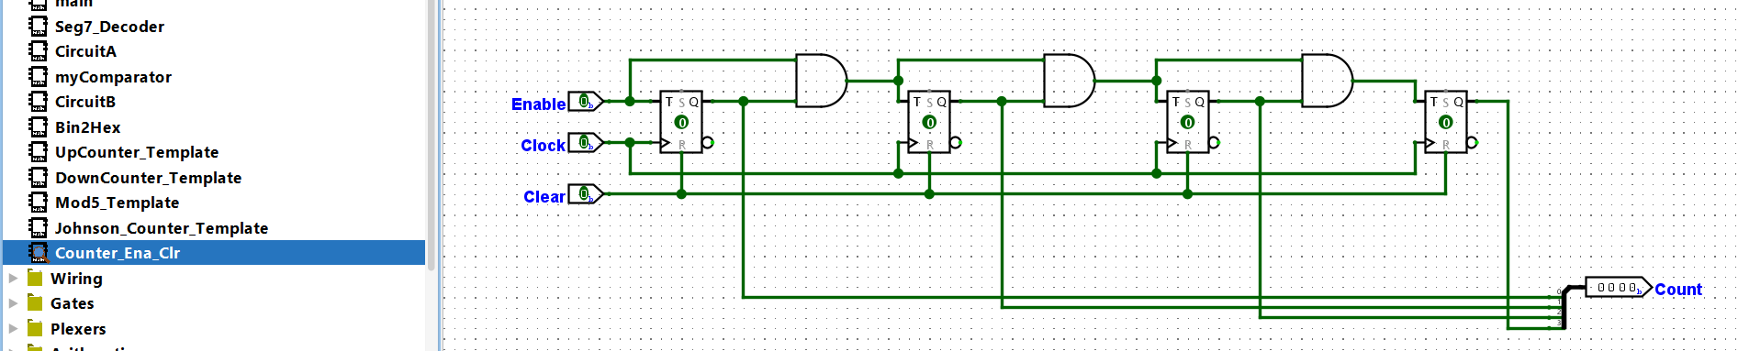

Slide 6
Down Counter w/ Reset

Slide 7
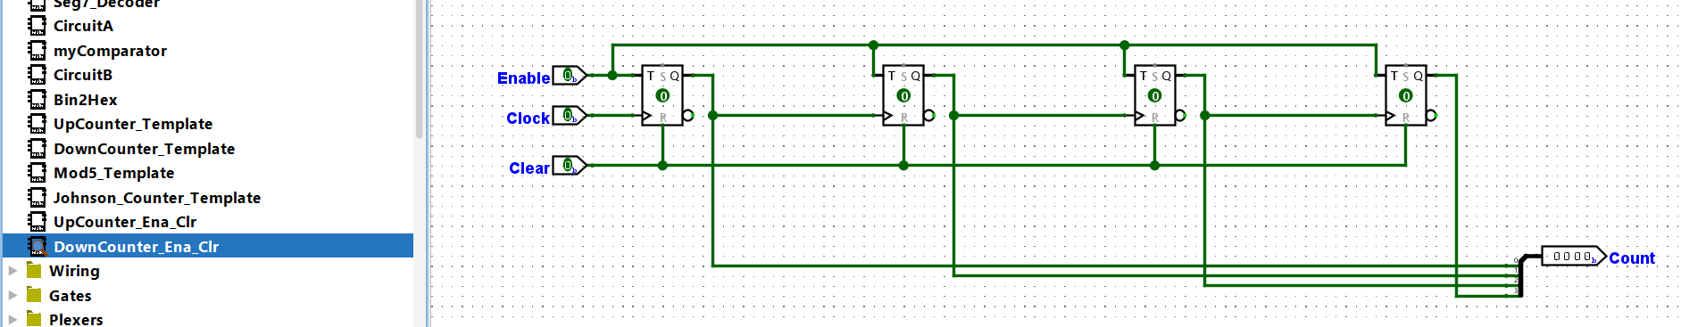
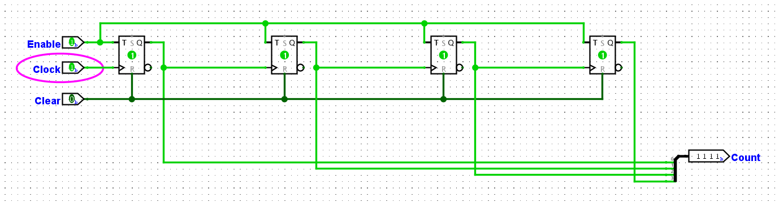
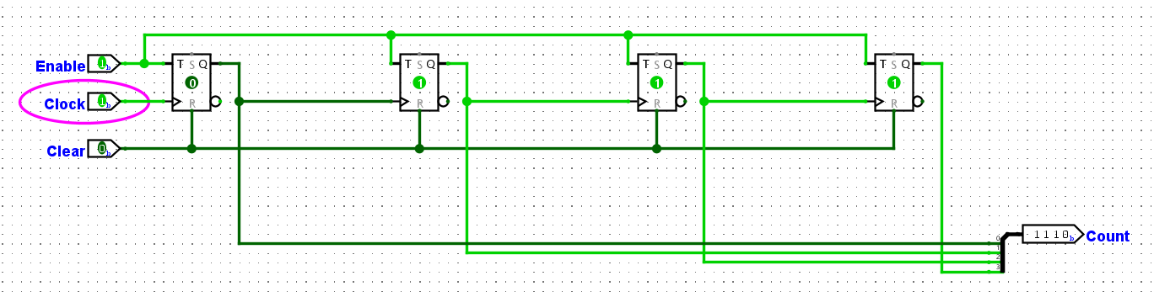
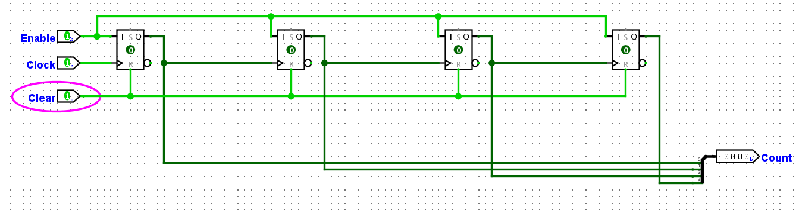

Slide 8
Down Counter from 10 w/ Reset

Slide 9
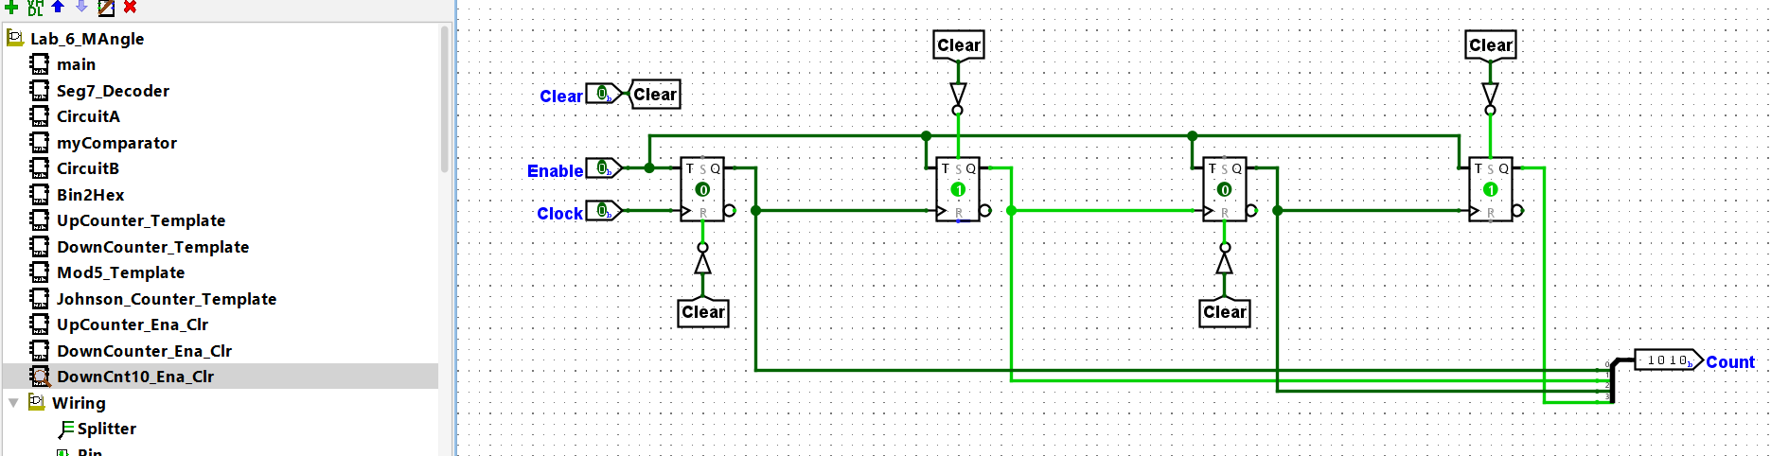

Slide 10
Latch at 0

Slide 11
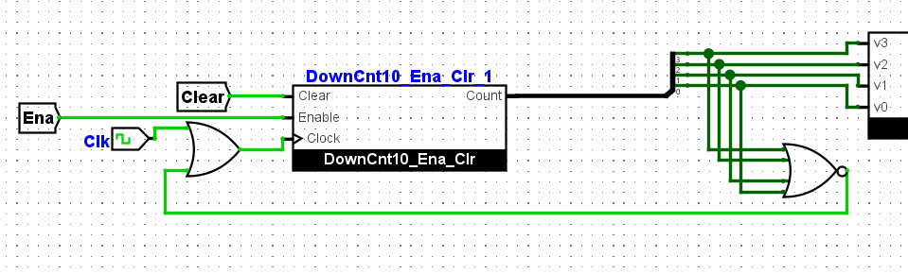

Slide 12
Incorporated into Counter

Slide 13
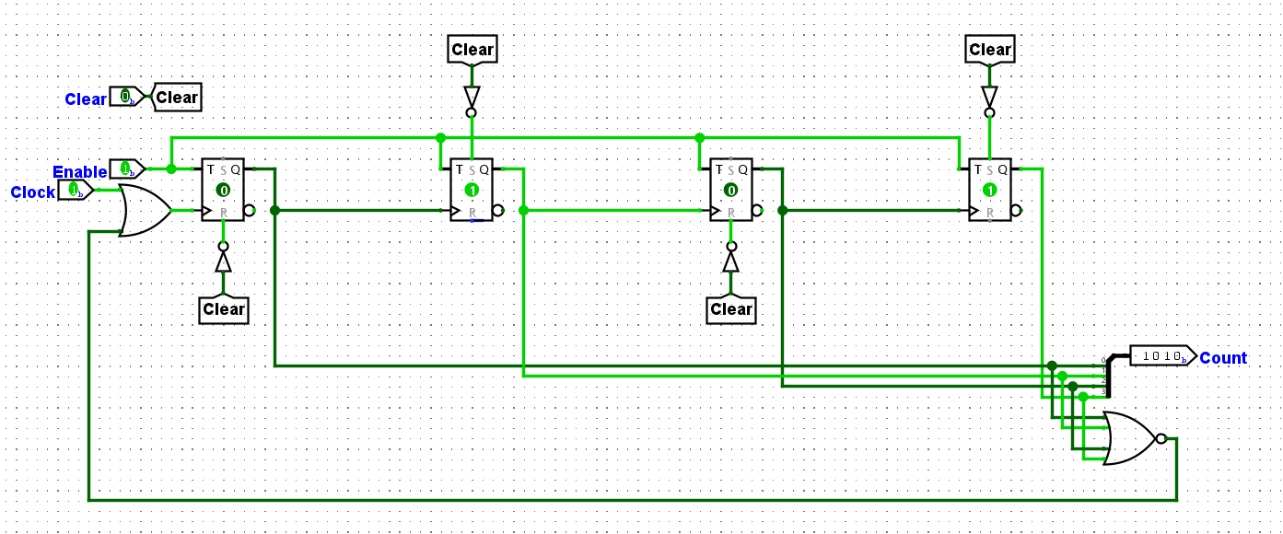

Slide 14
Synchronous Down Counter with 0 Latch and 10 Reset
FPGA had issues counting down from 10 asynchronously and counted starting from 8 despite Logisim counting down from 10. This circuit was designed to test if synchronous timing worked better

Slide 15
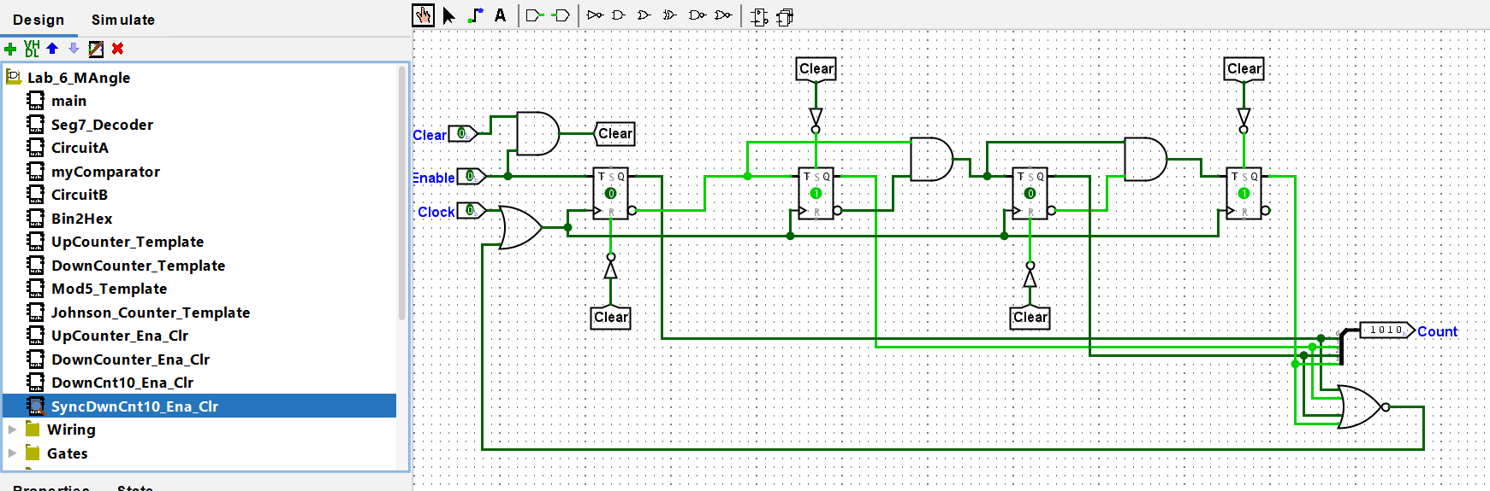

Slide 16
Final Circuit

Slide 17
