Slide 1
Week 4
Team 6328
Software Engineering

Slide 2
Let’s Try it
Create a While loop that prints the numbers from 5 through 10
Create a for loop that begins at 10 and decrements to the number 5
Create a do while loop that starts at value 10 and increments to 16
Create a while loop that is infinite and never quits (We will do this together!)

Slide 3
Enumerations or Enums
Enumerations serve the purpose of representing a group of named constants in a programming language
The main objective of enum is to define our own data types(Enumerated Data Types)
Enum declaration can be done outside a Class or inside a Class but not inside a Method
Enums can be also be described as a separate class and be imported in

Slide 4

Example
Enums are usually made public
Enums usually follow the convention
Enum Name {
Values in the Enum
}
Calling the Enum is as simple as:
EnumColor color1 = EnumColor.RED;

Slide 5
Lets try it
Create a Level Enum with levels Low, Medium, High
Declare a variable l1 with the value of the Enum

Slide 6
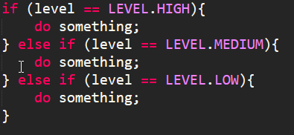
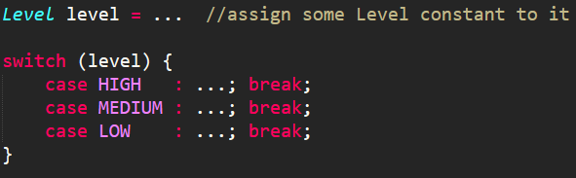
More Enums
Enums can also be called with If/Switch Statements

Slide 7
Things to keep in mind for Enums
An enum class automatically gets a toString() method in the class when compiled.
String levelText = Level.HIGH.toString();
An enum class automatically gets a static valueOf() method in the class when compiled.
Level level = Level.valueOf("HIGH");

Slide 8
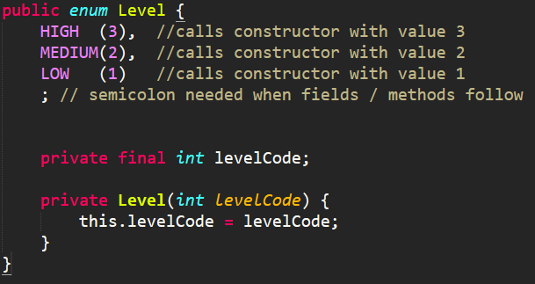
Enum Fields
Enum values can also be assigned a value
These values should be described within the constructor

Slide 9
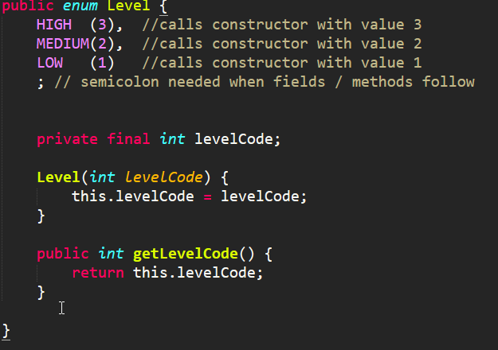

Enum Methods
Enums can also handle methods
levelcode is assigned datatype “int”
getLevelCode() will return the levelcode of the enum value

Slide 10
Lets try some Enums
Create an Enum with values: Giraffe, Monkey, Liger, Wooly Mammoth, Wookie
Assign each enum value a number – this will be the speed of each
Print the speed of the Wookie
Challenge: How w ould you print all values in the Enum and their speeds?

Slide 11
Java Methods
A Java method is a collection of statements that are grouped together to perform an operation.
Many of the methods we have been using: println(), main() … are all methods that the JDK provides us

Slide 12
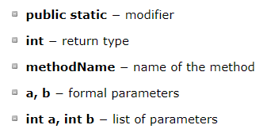


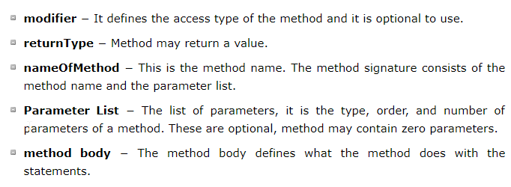
Methods… in general

Slide 13
Let’s try it
Write a method that calculated the minimum of two values
Method should take in two parameters’
Call the method inside the main method

Slide 14
Methods
The void keyword allows us to create methods which do not return a value.
The datatype that defines the method should be the same datatype return by the method
Else you have datatype mismatches

Slide 15
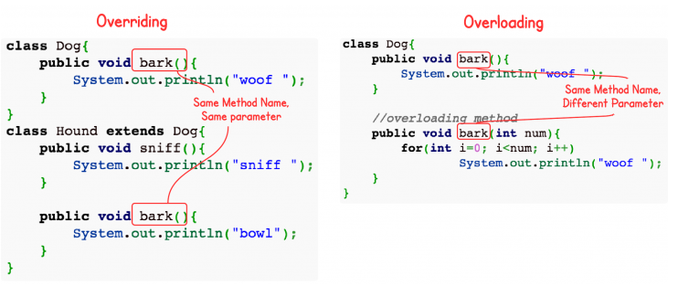
Method Overloading
When a class has two or more methods by the same name but different parameters, it is known as method overloading.
Be careful in the concept, as this is not the same thing as Overriding

Slide 16
Method Overloading
From our previous example of finding the minimum of two numbers…
What happens when the parameters are a double rather than int
Let’s try it…

