Slide 2
Java Methods
A Java method is a collection of statements that are grouped together to perform an operation.
Many of the methods we have been using: println(), main() … are all methods that the JDK provides us

Slide 3
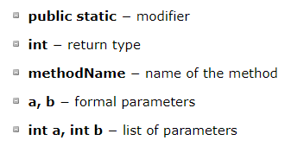


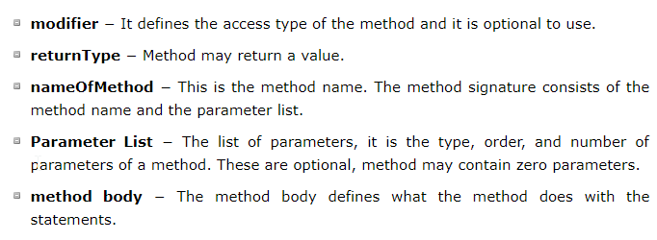
Methods… in general

Slide 4
Let’s try it
Write a method that calculated the minimum of two values
Method should take in two parameters’
Call the method inside the main method

Slide 5
Methods
The void keyword allows us to create methods which do not return a value.
The datatype that defines the method should be the same datatype return by the method
Else you have datatype mismatches

Slide 6
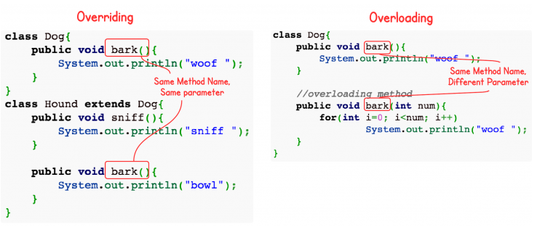
Method Overloading
When a class has two or more methods by the same name but different parameters, it is known as method overloading.
Be careful in the concept, as this is not the same thing as Overriding

Slide 7
Method Overrloading
From our previous example of finding the minimum of two numbers…
What happens when the parameters are a double rather than int
Let’s try it…

