Slide 1
Week 3 – Java Tutorial
Team 6328
Software Engineering

Slide 2
Refresher….
Largest of Three Numbers…
Talk about various instances
If there are 10 numbers, what would happen? (Don’t need to code)
What would happen if they are double’s and int’s?\
…
Concept of Methods
Testing the method with various inputs

Slide 3
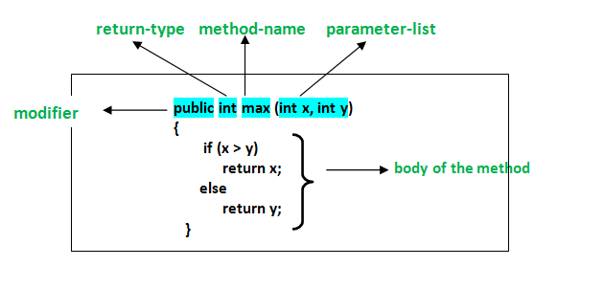
Methods
Collection of statements grouped together
System.out.println(): Calls number of statements under the hood to actually print to the console.

Slide 4
Methods (cont…)
A method name is typically a single word that should be a verb in lowercase or multi-word, that begins with a verb in lowercase followed by adjective, noun…..
After the first word, first letter of each word should be capitalized (Camel-cased)
For example, findSum, computeMax, setX and getX
Remember to call the method in the main method
The method will do nothing if the method is never called
Methods usually should return something or throw an exception
Makes debugging easier
Ensure that the right value is being returned
“void” return type is the exception – this will return nothing

Slide 5
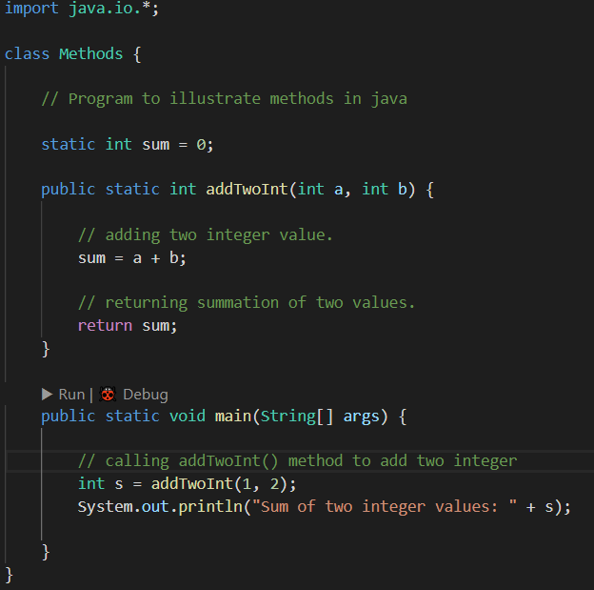
Example…
What would the output be?

Slide 6
Let’s try it…
Find the minimum between two numbers
Create a method called minFunction(int n1, int n2)
Call the minFunction() inside the main method

Slide 7
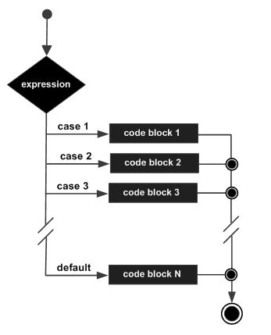
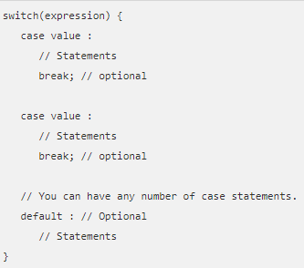
Different kind of if loops – switch statements

Slide 8
Switch Statement rules:
The variable used in a switch statement can only be integers, convertible integers (byte, short, char), strings and Enums.
You can have any number of case statements within a switch. Each case is followed by the value to be compared to and a colon.
The value for a case must be the same data type as the variable in the switch and it must be a constant or a literal.
When the variable being switched on is equal to a case, the statements following that case will execute until a break statement is reached.
When a break statement is reached, the switch terminates, and the flow of control jumps to the next line following the switch statement.
Not every case needs to contain a break. If no break appears, the flow of control will fall through to subsequent cases until a break is reached.
A switch statement can have an optional default case, which must appear at the end of the switch. The default case can be used for performing a task when none of the cases is true. No break is needed in the default case.

Slide 9
Let’s Try it…
I got a a ‘C-’, on my Math Test. Print a statement that tells me how I did on their Math Test.
For example
A – Excellent
A- – Well Done
B+ – Close, but NO!
B – Better Try again!
B- - You Failed!
…

Slide 10
Switching Gears… Different Kinds of loops
While – Repeats a statement or group of statements while a given condition is true,
For – execute a sequence of statements multiple times
do...while – Just like a while loop, but evaluates the condition at the end of the loop.

Slide 11

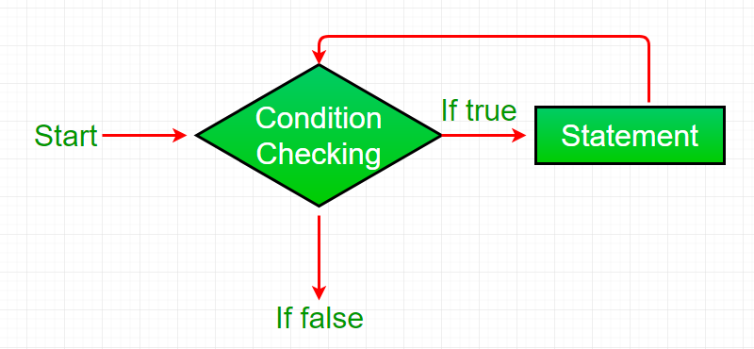
While Loop…

Slide 12
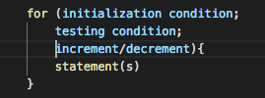
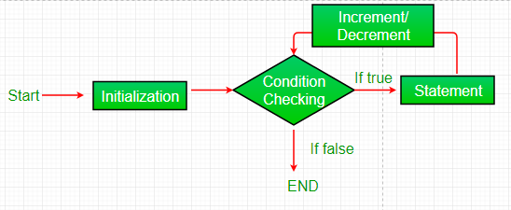
For Loop…

Slide 13

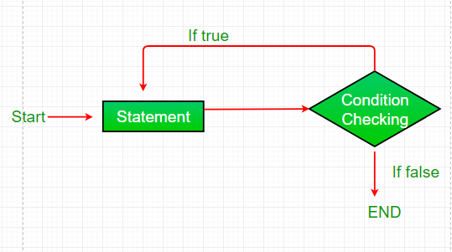
Do…While Loop

Slide 14
Let’s Try it
Create a While loop that prints the numbers from 5 through 10
Create a for loop that begins at 10 and decrements to the number 5
Create a do while loop that starts at value 10 and increments to 16
Create a while loop that is infinite and never quits (We will do this together!)

Slide 15
Homework!
Calculate the area of circle using user input
Tip:
Use import java.util.Scanner;
Use Math.pow(a,b)
a = radius
b = power you want to raise it to
Configuration Change to launch.json
Change “console”: for your class from “internalConsole” to “integratedTerminal”

