Slide 1
Java: Tutorial
Team 6328
Software Engineering

Slide 2
Installation
https://code.visualstudio.com/docs/languages/java
Download the Java extension pack
https://www.oracle.com/technetwork/java/javase/downloads/jdk8-downloads-2133151.html
Download the JDK(based on operating system)
Set your JAVA_HOME variable
Environmental variables → Path → New → Save
i.e: C:\Program Files\Java\jdk1.8.0_172\bin
Start Visual Studio code
Terminal and type java or javac if the commands are being recognized
javac – compile the class
java – run the class

Slide 3
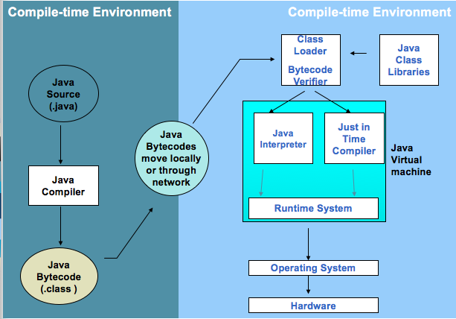
How it all works?

Slide 4
Breaking down JAVA
Each Class is a unit of programming
A class describes objects and parameters in that class
Main – method that indicates to the compiler to run the commands in sequence
File name and Class name needs to match or there will be compiler errors
Java is highly case-sensitive
ROSE is not the same as rose

Slide 5
Our first program…
Inside Main.java
/* *
First Java program, which says "Hello, world!"
*/
public class Main{
public static void main(String[] args) {
System.out.println("Hello, World!");
}
}

Slide 6
Breaking down our Code further
/* ...... */ - Indicate Comments
Important to comment your code so that you can remember what you wrote
Class called ”Main" is defined via the keyword "class" in Lines 4-8. The braces {......} encloses the body of the class.
main() method, which is the entry point for program execution. Again, the braces {......} encloses the body of the method, which contains programming statements.
System.out.println("Hello, world!") is used to print the string "Hello, world!" to the display console.
A string is surrounded by a pair of double quotes and contain texts.

Slide 7
Let’s try it…
Make a program print your how much you love coding!
In the same program, print what you want to learn to do with Java!
Remember to comment you lines ☺!
Try some error cases
Without “;”
Try compiling with the IDE
Try compiling with the command line

Slide 8
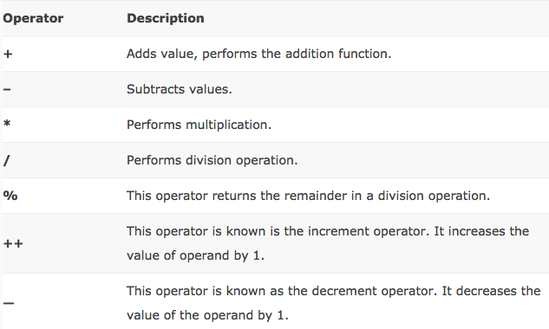
Arithmetic Operators in Java

Slide 9
Try it: PEMDAS
Write a program that does the following
Start with 18
Divide by 6
Multiply by 5
Subtract 14
Divide by 7
Add 10
Remember the PEMDAS rule
Parenthesis, Exponent, Multiply, Divide, Addition, Subtract
Ans: 23

Slide 10
Variables
A variable is a storage location that stores a piece of data for processing. It can change its value over time
A variable has a name that is unique
Each variable in Java is type-casted, meaning the compiler has to know how many bytes of data it should set aside
These types are called primitive types
Declaring a variable takes the form:
data_type variable_name = value;

Slide 11
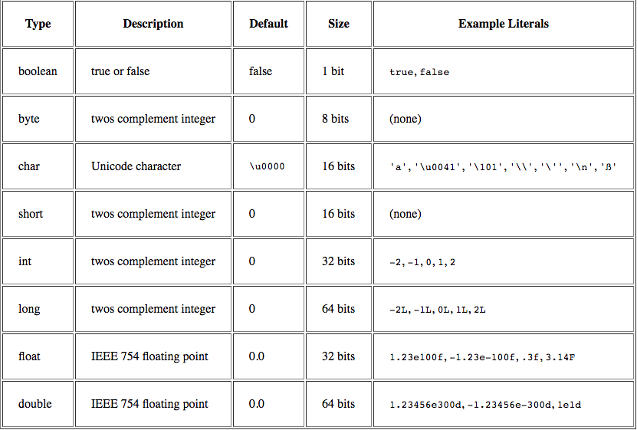
Primitive Types

Slide 12
Refresher
Try to print your favorite Movie and year the movie came out in two different lines using the same print statement
Try using variables to define movie and year of the movie
“/n” signifies a new line in Java

Slide 13
Examples
Char ch = ‘A’;
Int number = 100;
String hello = “Hello”;
Can also combine string and int and other data types using the “+” symbol

Slide 14
Types of Variables
Local variable
These variables are declared inside method of the class. Their scope is limited to the method which means that You can’t change their values and access them outside of the method.
Static (or class) variable
Static variables are also known as class variable because they are associated with the class and common for all the instances of class.
Instance variable
Each instance(objects) of class has its own copy of instance variable. Unlike static variable, instance variables have their own separate copy of instance variable.

Slide 15
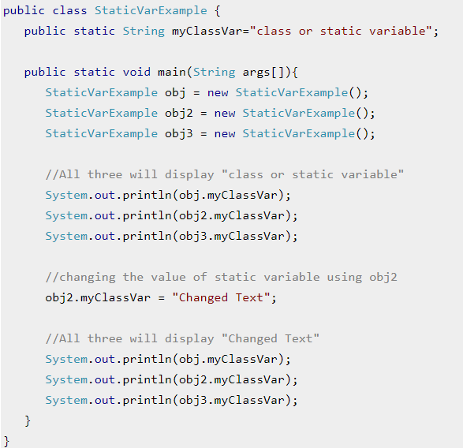
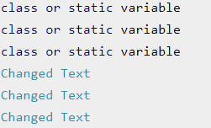
Static Variables
Output:

Slide 16
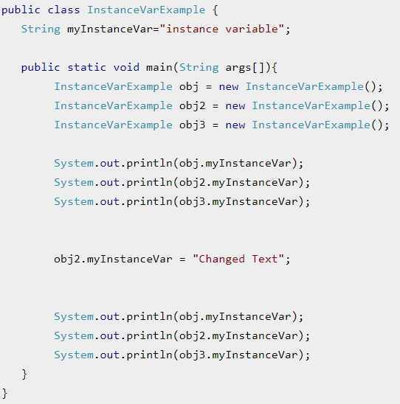
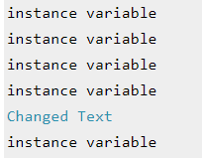
Instance Variables
Output:

Slide 17
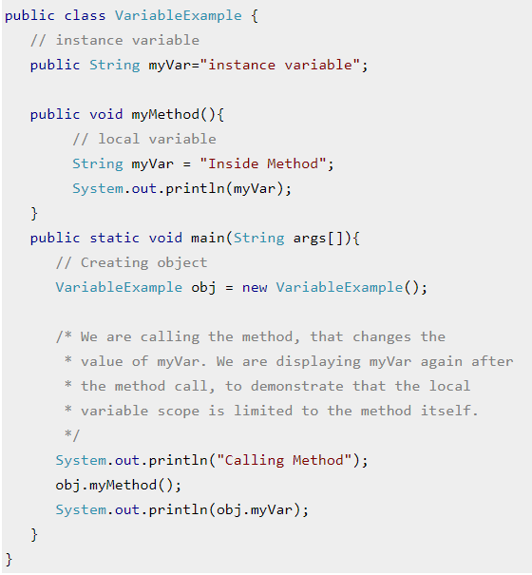

Local Variables
Output:

Slide 18
Let’s Try it
Create all of the primitives (except long and double) with different values. Concatenate them into a string and print it to the screen so it will print: H3110 w0r1d 2.0 true
Create and assign a local variable to a value and then change it?
Make it static
Calculate the Area of a triangle given height of 10.5 and width of 4.99999999999999999999
What happens if you cast these to Long?

Slide 19
Control Flow Statements
There are 4 different kind of control-flow statements
if statement:
if (condition){
Statement(s);
}
nested if statement:
if (condition_1){
Statement1(s);
if (condition_2){
Statement2(s);
}
}
if-else statement
if (condition){
Statement(s);
}
else {
Statement(s);
}
if-else-if statement
if (condition){
Statement(s);
}
else if(condition2){
Statement(s)
}
else {
Statement(s);
}

Slide 20
Let’s try it
Find the largest of three numbers
Using if-else..if
Using nested If

Slide 21
Different Kinds of loops
While – Repeats a statement or group of statements while a given condition is true,
For – execute a sequence of statements multiple times
do...while – Just like a while loop, but evaluates the condition at the end of the loop.

Slide 22

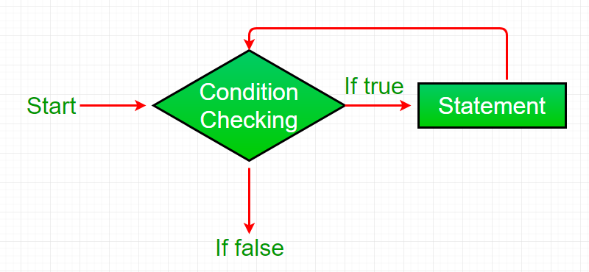
While Loop…

Slide 23
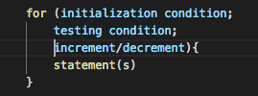
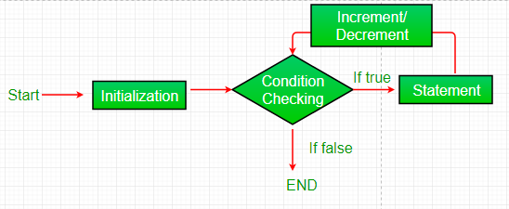
For Loop…

Slide 24

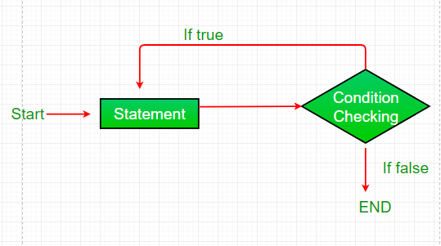
Do…While Loop

Slide 25
Let’s Try it
Create a While loop that prints the numbers from 5 through 10
Create a for loop that begins at 10 and decrements to the number 5
Create a do while loop that starts at value 10 and increments to 16
Create a while loop that is infinite and never quits (We will do this together!)

Slide 26
Homework!
Calculate the area of circle using user input
Tip:
Use import java.util.Scanner;
Use Math.pow(a,b)
a = radius
b = power you want to raise it to
Configuration Change to launch.json
Change “console”: for your class from “internalConsole” to “integratedTerminal”

