Slide 1
Java: Tutorial
Team 6328
Software Engineering

Slide 2
Installation
https://code.visualstudio.com/docs/languages/java
Download the Java extension pack
https://www.oracle.com/technetwork/java/javase/downloads/jdk8-downloads-2133151.html
Download the JDK(based on operating system)
Set your JAVA_HOME variable
Environmental variables → Path → New → Save
i.e: C:\Program Files\Java\jdk1.8.0_172\bin
Start Visual Studio code
Terminal and type java or javac if the commands are being recognized
javac – compile the class
java – run the class

Slide 3
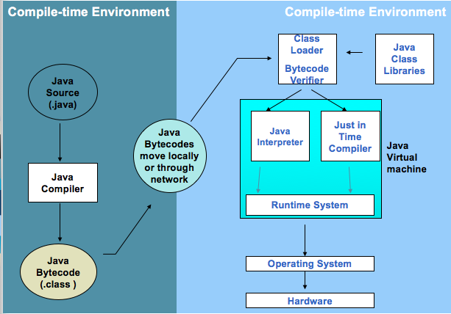
How it all works?

Slide 4
Breaking down JAVA
Each Class is a unit of programming
A class describes objects and parameters in that class
Main – method that indicates to the compiler to run the commands in sequence
File name and Class name needs to match or there will be compiler errors
Java is highly case-sensitive
ROSE is not the same as rose

Slide 5
Our first program…
Inside Main.java
/* *
First Java program, which says "Hello, world!"
*/
public class Main{
public static void main(String[] args) {
System.out.println("Hello, World!");
}
}

Slide 6
Breaking down our Code further
/* ...... */ - Indicate Comments
Important to comment your code so that you can remember what you wrote
Class called ”Main" is defined via the keyword "class" in Lines 4-8. The braces {......} encloses the body of the class.
main() method, which is the entry point for program execution. Again, the braces {......} encloses the body of the method, which contains programming statements.
System.out.println("Hello, world!") is used to print the string "Hello, world!" to the display console.
A string is surrounded by a pair of double quotes and contain texts.

Slide 7
Let’s try it…
Make a program print your how much you love coding!
In the same program, print what you want to learn to do with Java!
Remember to comment you lines ☺!
Try some error cases
Without “;”
Try compiling with the IDE
Try compiling with the command line

Slide 8
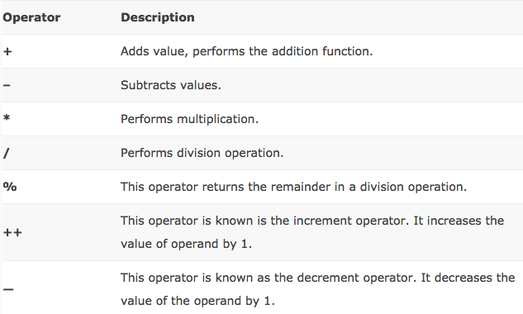
Arithmetic Operators in Java

Slide 9
Try it: PEMDAS
Write a program that does the following
Start with 18
Divide by 6
Multiply by 5
Subtract 14
Divide by 7
Add 10
Remember the PEMDAS rule
Parenthesis, Exponent, Multiply, Divide, Addition, Subtract
Ans: 23

Slide 10
Variables
A variable is a storage location that stores a piece of data for processing. It can change its value over time
A variable has a name that is unique
Each variable in Java is type-casted, meaning the compiler has to know how many bytes of data it should set aside
These types are called primitive types
Declaring a variable takes the form:
data_type variable_name = value;

Slide 11
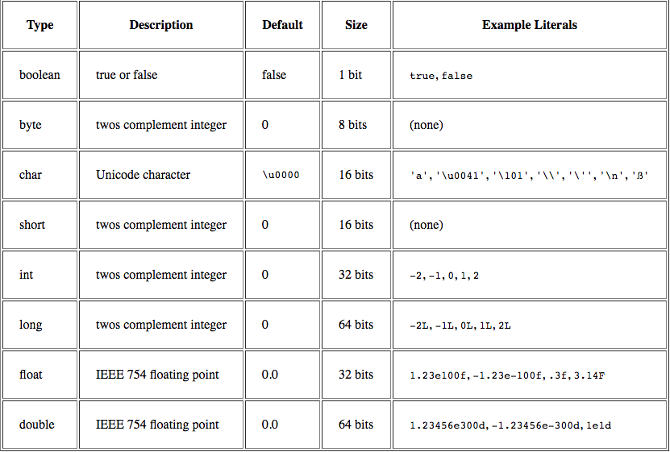
Primitive Types

