Slide 1
Java Tutorial: Week 2
Team 6328
Software Engineering

Slide 2
Refresher
Try to print your favorite Movie and year the movie came out in two different lines using the same print statement
Try using variables to define movie and year of the movie
“/n” signifies a new line in Java

Slide 3
Examples
Char ch = ‘A’;
Int number = 100;
String hello = “Hello”;
Can also combine string and int and other data types using the “+” symbol

Slide 4
Types of Variables
Local variable
These variables are declared inside method of the class. Their scope is limited to the method which means that You can’t change their values and access them outside of the method.
Static (or class) variable
Static variables are also known as class variable because they are associated with the class and common for all the instances of class.
Instance variable
Each instance(objects) of class has its own copy of instance variable. Unlike static variable, instance variables have their own separate copy of instance variable.

Slide 5
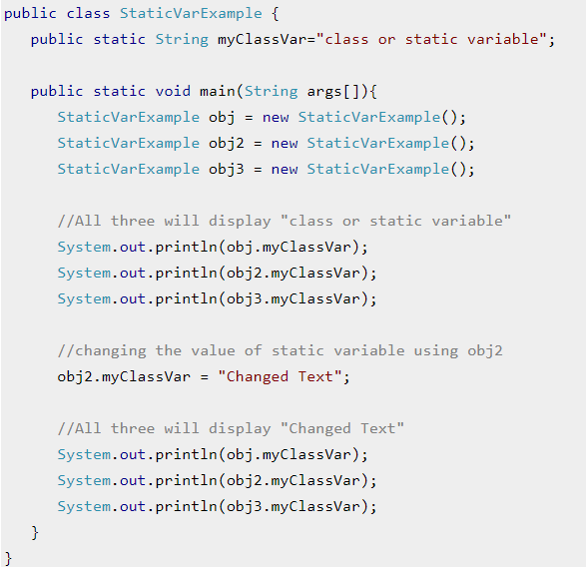
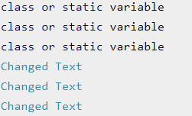
Static Variables
Output:

Slide 6
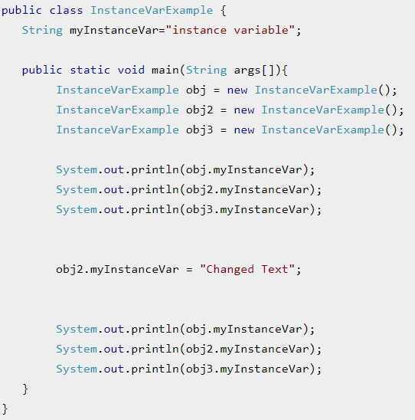
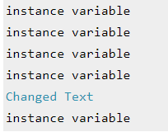
Instance Variables
Output:

Slide 7
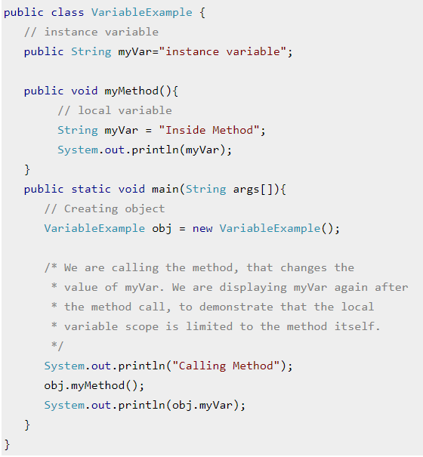

Local Variables
Output:

Slide 8
Let’s Try it
Create all of the primitives (except long and double) with different values. Concatenate them into a string and print it to the screen so it will print: H3110 w0r1d 2.0 true
Create and assign a local variable to a value and then change it?
Make it static
Calculate the Area of a triangle given height of 10.5 and width of 4.99999999999999999999
What happens if you cast these to Long?

Slide 9
Control Flow Statements
There are 4 different kind of control-flow statements
if statement:
if (condition){
Statement(s);
}
nested if statement:
if (condition_1){
Statement1(s);
if (condition_2){
Statement2(s);
}
}
if-else statement
if (condition){
Statement(s);
}
else {
Statement(s);
}
if-else-if statement
if (condition){
Statement(s);
}
else if(condition2){
Statement(s)
}
else {
Statement(s);
}

Slide 10
Let’s try it
Find the largest of three numbers
Using if-else..if
Using nested If

