Slide 1
Week 3 – Java Tutorial
Team 6328
Software Engineering

Slide 2
Different Kinds of loops
While – Repeats a statement or group of statements while a given condition is true,
For – execute a sequence of statements multiple times
do...while – Just like a while loop, but evaluates the condition at the end of the loop.

Slide 3

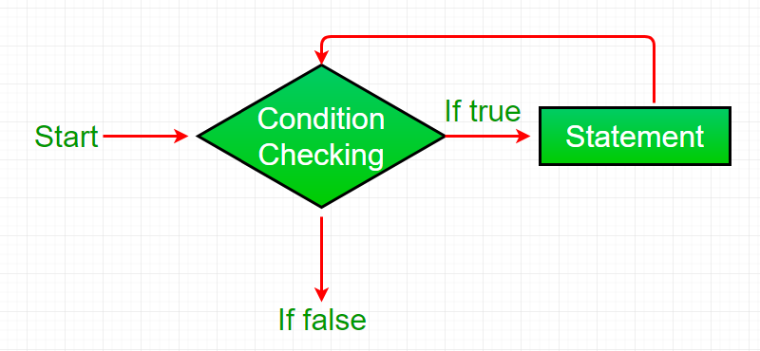
While Loop…

Slide 4
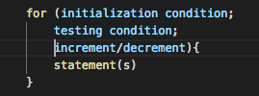
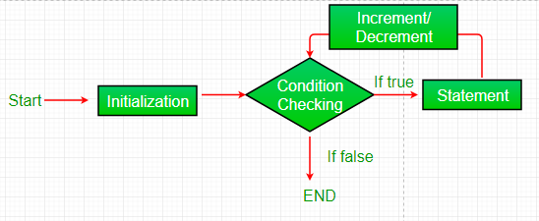
For Loop…

Slide 5

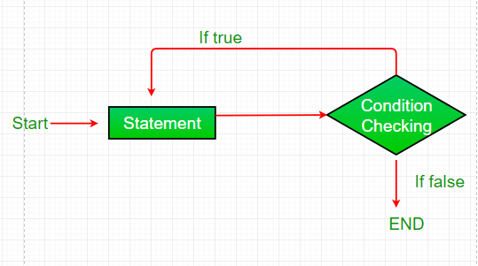
Do…While Loop

Slide 6
Let’s Try it
Create a While loop that prints the numbers from 5 through 10
Create a for loop that begins at 10 and decrements to the number 5
Create a do while loop that starts at value 10 and increments to 16
Create a while loop that is infinite and never quits (We will do this together!)

Slide 7
Homework!
Calculate the area of circle using user input
Tip:
Use import java.util.Scanner;
Use Math.pow(a,b)
a = radius
b = power you want to raise it to
Configuration Change to launch.json
Change “console”: for your class from “internalConsole” to “integratedTerminal”

