Slide 1
Week 5
Team 6328
Software Team

Slide 2
Java Methods
A Java method is a collection of statements that are grouped together to perform an operation.
Many of the methods we have been using: println(), main() … are all methods that the JDK provides us

Slide 3
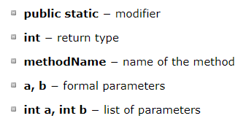


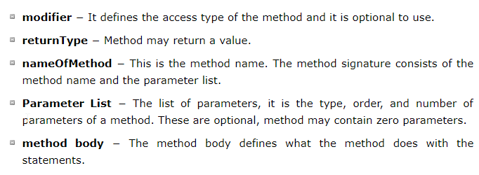
Methods… in general

Slide 4
Let’s try it
Write a method that calculates the minimum of two values
Method should take in two parameters’
Call the method inside the main method

Slide 5
Methods
The void keyword allows us to create methods which do not return a value.
The datatype that defines the method should be the same datatype return by the method
Else you have datatype mismatches

Slide 6
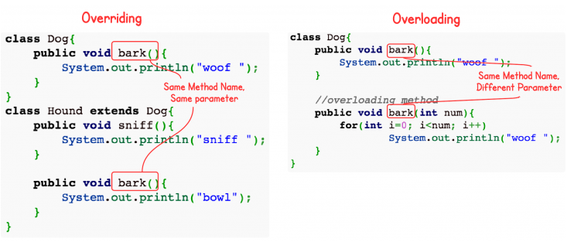
Method Overloading
When a class has two or more methods by the same name but different parameters, it is known as method overloading.
Be careful in the concept, as this is not the same thing as Overriding

Slide 7
Method Overloading
From our previous example of finding the minimum of two numbers…
What happens when the parameters are a double rather than int
Let’s try it…

Slide 8
Mehtod Overriding
Overriding is a feature that allows a subclass or child class to provide a specific implementation of a method that is already provided by one of its super-classes or parent classes.

Slide 9
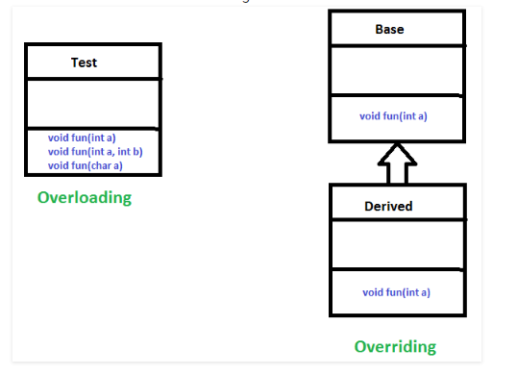
Overriding: Rules…
Final methods can not be overridden
Static methods can not be overridden
Private methods can not be overridden
The overriding method must have same return type

Slide 10
Overriding Methods: Let’s try it…
Write a Base class that has a method called speed
Give a speed
Important: Return the speed
Write an Extend class that inherits the Parent class
This new class should have a new method “<method_name>” that uses the speed
Increment the speed from the Base Class by 10
Print the new speed

Slide 11
Three main concepts of OOP
Encapsultation
Polymorphism
Inheritance

Slide 12
Encapsulation
Access modifier keywords are used for encapsulation in object oriented programming. For example, encapsulation in java is achieved using private, protected and public keywords.

Slide 13

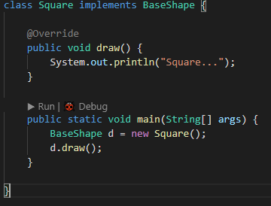
Polymorphism
Compile time polymorphism
Method overloading
Run time Polymorphism
Method Overriding

Slide 14
Inheritance
Inheritance is the object oriented programming concept where an object is based on another object.
Inheritance is the mechanism of code reuse.
The object that is getting inherited is called superclass and the object that inherits the superclass is called subclass.

