Slide 1
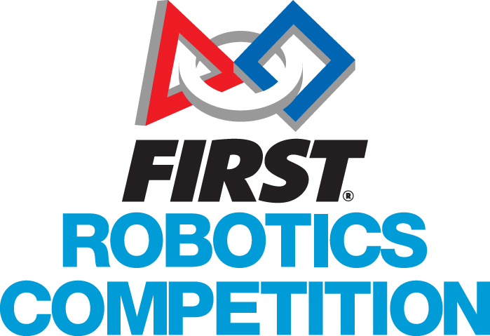
Programming In Python 3
Part 4: Functions & Data Scope

Slide 2
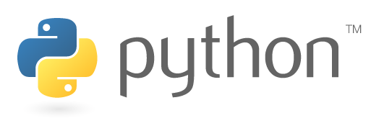
This lesson covers
Review of functions and parameters
Variable scope

Slide 3
Homework!
Read up on JSON
https://www.w3schools.com/js/js_json_intro.asp
https://www.w3schools.com/js/js_json_syntax.asp
https://www.w3schools.com/js/js_json_datatypes.asp
…and using it in Python
https://www.w3schools.com/python/python_json.asp
Now, make your robots dictionary into JSON!

Slide 4
Solution
import json
robots = {
# Dictionary content here
}
json_robots = json.dumps(robots)
print(json_robots)

Slide 5
FuncTions RevIEW
Functions allow for code reuse & better program structure
Inputs: arguments (positional) and keyword arguments (named, with defaults)
Output: return value, which can be a data structure

Slide 6
Variable Scope
Scope is the range within the program where a given variable is valid
In increasing order:
Local variables : inside the function they’re in
Class variables : inside all functions in the class
Global variables : throughout the file
Scope should be as small as it can be
Less confusion
Less need to “protect” data access when more complex concepts like threads are used

Slide 7
Exercise
Write a program that sets a global variable & prints it inside a function
Now make the function set a variable with the same name, then print it
Is the global changed by doing this?
Now have the function print, then set it
Explain what you see
How can a function modify a global?

Slide 8
Web APIs
“Application Programming Interface”
A way of making function calls over the web!
Can provide data
… as header fields
… as body
CRUD maps to web operations
Create → POST
Read → GET
Update → PUT
Delete → DELETE

Slide 9
Python & Web APIs
Requests module

Slide 10
The End
Questions?

