Slide 1
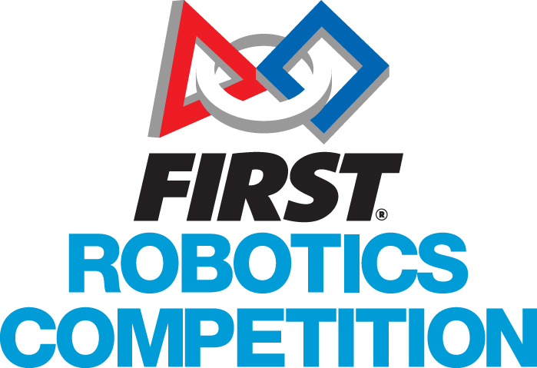
Object Oriented Concepts
A language-agnostic overview

Slide 2
Introduction
Older languages like C are procedural – programs are designed around the execution of a series of procedures (functions).
Most modern languages (such as Java, Python, C++, C#, Swift, etc.) are object-oriented.
What does that mean?
“An object-oriented language enables a system to be modeled as a set of objects that contain data and provide well defined interfaces for interacting with that data.”

Slide 3
Advantages
Criticisms
Promotes modularity and reusability
Natural fit for many real world and conceptual systems
Widely used and understood
Can be complex
Not always as reusable as claimed
Focuses more on data than algorithms (when both are important)

Slide 4
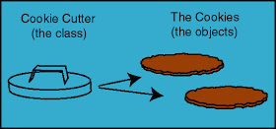
Classes vs objects
The CLASS is the ‘blueprint’ or ‘recipe’ that describes the data and methods that make up an object. It’s a template for making objects of a particular kind.
An OBJECT is an instance of a class. It doesn’t exist until instantiated at run time. There can be many instances of the same class, each with its own copy of the data in the object (though most languages allow for ‘static’ data that is shared across all instances).

Slide 5
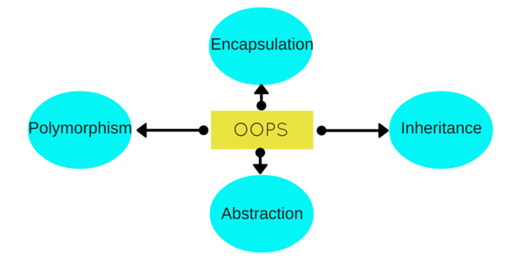
Fundamental object-oriented Principles
There are four basic OO principles – we’ll talk about each
Encapsulation
Abstraction
Inheritance
Polymorphism

Slide 6
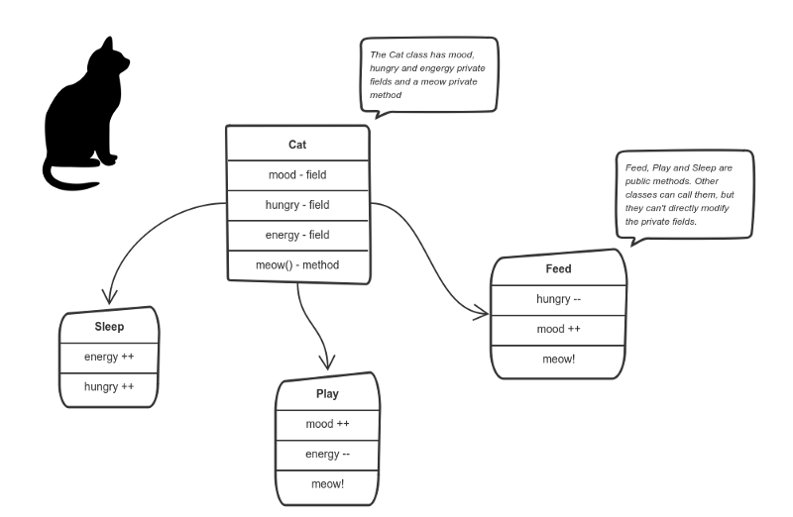
Encapsulation
Each object keeps its internal state private
Other objects can only access the state (data) in the ways the object allows
This provides good control
Example: You can feed the cat. But you can’t directly change how hungry the cat is.

Slide 7
Abstraction
Each object should only expose a high-level mechanism for using it. This is its interface.
This mechanism should hide internal implementation details. It should only reveal operations relevant for the other objects.
An object’s internal implementation can change without affecting the system, as long as the interface remains the same.
This is a natural extension of encapsulation.

Slide 8
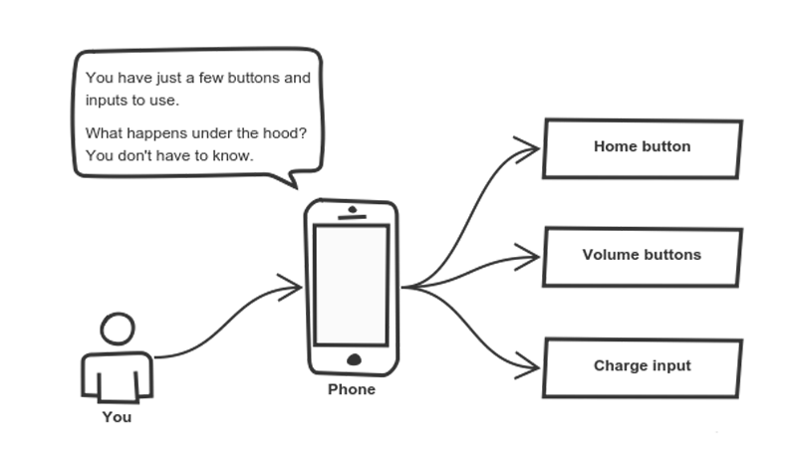
Abstraction
Example: think about your phone…
Cell phones are complex. But using them is simple.

Slide 9
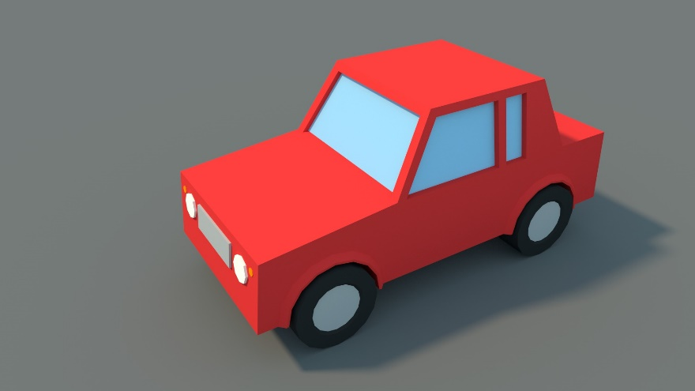
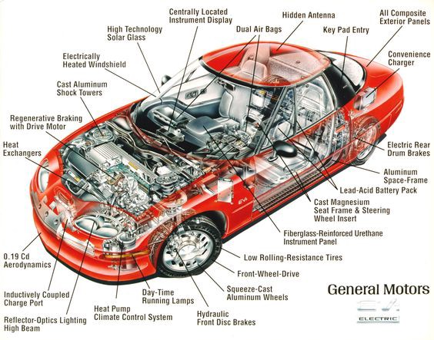
Encapsulation + abstraction
Instead of this:
Lets the user see this:
…and hides the fact that the car implementation shown is electric. It drives the same as the old gas model because the interface is unchanged!

Slide 10
inheritance
A mechanism by which an object acquires some or all features from one or more other objects
The base (or parent or superclass) is extended to form a derived (or child or subclass) class.
The derived class is a base type, but adds more functionality or characteristics

Slide 11
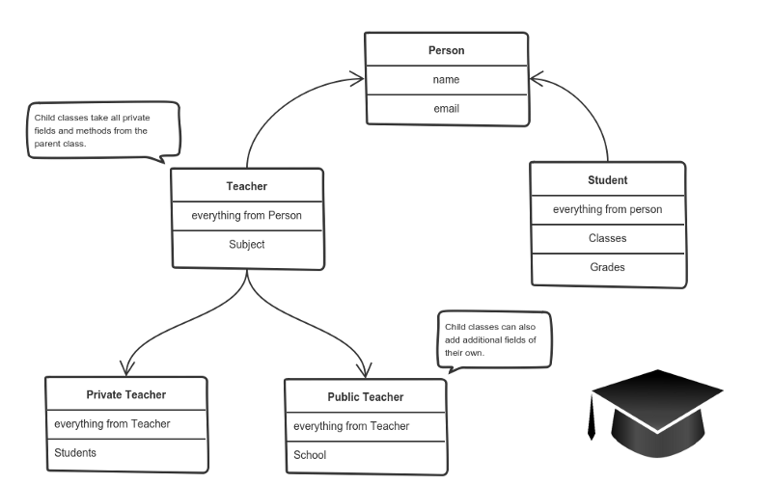
Inheritance

Slide 12
polymorphism
The capability to process objects differently based on their data type or structure.
This can involve overloading and overriding.
Overloading occurs when two or more methods in one class have the same method name but different parameters.
Overriding means having two methods with the same method name and parameters (i.e., method signature). One of the methods is in the parent class and the other is in the child class.

Slide 13
Polymorphism: overloading
Allows a class to provide multiple interfaces that a user can use, accommodating different inputs
Example:
calculateArea(int x, int y)
calculateArea(float x, float y)
Correct method gets used automatically based on input types provided

Slide 14
Polymorphism: OverRiding
Overriding a method gives a way to use a class exactly like its parent so there’s no confusion with mixing types. But each child class keeps its own methods as they are.
This typically happens by defining a (parent) interface to be reused. It outlines a bunch of common methods. Then, each child class implements its own version of these methods.

Slide 15
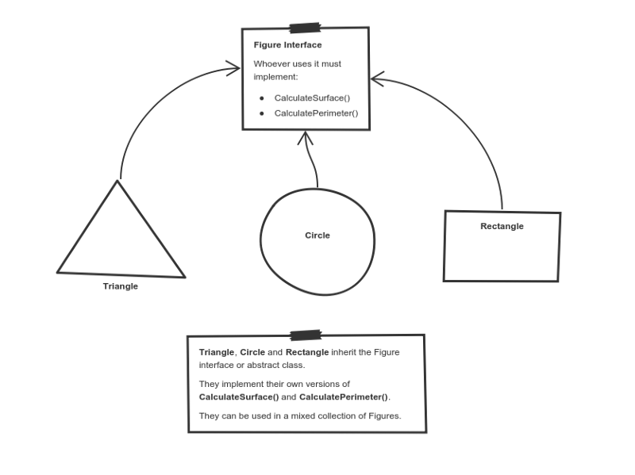
polymorphism

Slide 16
The End
Questions?

