Slide 1

Programming In Python 3
Part 1: Introduction

Slide 2
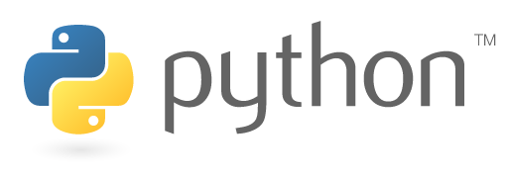
Introduction
Python is widely used for lots of different purposes
It’s pretty easy to learn but very powerful
Many of the concepts transfer to other languages (including Java)
Like every language it has a few quirks!

Slide 3

Why python?
Yes, the main robot code is written in Java
(It’s technically possible to use Python, but few teams do so)
But we use Python too…
Vision processing code on a Raspberry Pi co-processor
Scouting Systems code
Driver Station uses Python to communicate with the OI board Arduino
Attendance System code
“Don’t we use Java on the robot?”

Slide 4
How do we run it?
Python, like Java, is interpreted
The interpreter is a program compiled for a specific platform
Python source code is compiled into bytecode (intermediate instructions) that the interpreter runs using native code.
No separate ‘compile’ step is needed; it happens automatically.
We will use Python 3, the latest revision.
“Do I need to compile my code first?”

Slide 5
“Hello World”, Python edition
print(“Hello World!”)
…it doesn’t get much easier than that!
Notice that there’s no semicolons at the end of lines!
EXERCISE
Fire up your Python 3 interpreter and make sure this works!

Slide 6
Good Things to Know…
Python files are usually saved with a “.py” extension
In Python, blocks of code use indentation instead of curly-braces { }
… this takes some getting used to
Consistent indentation is critical!
Python has a rich set of “batteries included” libraries called modules
Include them via “import” where needed, e.g.
import math
math.floor(4.5)

Slide 7
Strings
string: A sequence of text characters in a program.
Strings start and end with quotation mark " or apostrophe ' characters.
Examples: "hello" "This is a string" "This, too, is a string. It can be very long!"
A string may not span across multiple lines or contain a " character. "This is not a legal String."
"This is not a "legal" String either."
A string can represent characters by preceding them with a backslash.
\t tab character
\n new line character
\" quotation mark character
\\ backslash character
Example: "Hello\tthere\nHow are you?"

Slide 8
String indexing
Characters in a string are numbered with indexes starting at 0:
Example:
name = “Road Runner"
Accessing an individual character of a string:
variableName [ index ]
Example:
print(name, "starts with", name[0])
Output:
Road Runner starts with R

Slide 9
String slicing
Use colon-separated range specifier to retrieve a portion of a string: word[x:y]
Character at x is included, character at y is not
Negative indices are from end of string
Omitted index means “start” or “end”
EXERCISE
word = “Python”
print(word[0:2])
print(word[3:])
print(word[-4:-2])
print(word[-2:])

Slide 10
String methods
len(string)- number of characters in a string (including spaces)
str.lower(string) - lowercase version of a string
str.upper(string) - uppercase version of a string
str.find(string2) - return position of string2 in str
Many more: https://www.w3schools.com/python/python_ref_string.asp

Slide 11
exercise
Store your full name in a string
Print how many characters your name has
Find the index of the first space
Print just your middle name from the string
Can you do it without using your middle name?
Print just your last name, using negative indexing
Bonus: print your name with cASE sWAPPED

Slide 12
Operators
Generally work as you’d expect
Basic math: +, -, *, /, %
Do you think these can operate on strings?
Exponentiation: **
Bitwise OR, AND: |, &
We’ll get into bitwise operations later
What does print(1 | 2) print out?

Slide 13
Logic
Operator | Meaning | Example | Result
== | equals | 1 + 1 == 2 | True
!= | does not equal | 3.2 != 2.5 | True
< | less than | 10 < 5 | False
> | greater than | 10 > 5 | True
<= | less than or equal to | 126 <= 100 | False
>= | greater than or equal to | 5.0 >= 5.0 | True
Logical expressions can be combined with logical operators:
Operator | Example | Result
and | 9 != 6 and 2 < 3 | True
or | 2 == 3 or -1 < 5 | True
not | not 7 > 0 | False

Slide 14
comparisons
Simple if statement:
if condition:
statements
Python has if/elif/else:
if condition:
statements
elif condition:
statements
else:
statements
…but no case or switch statement!

Slide 15
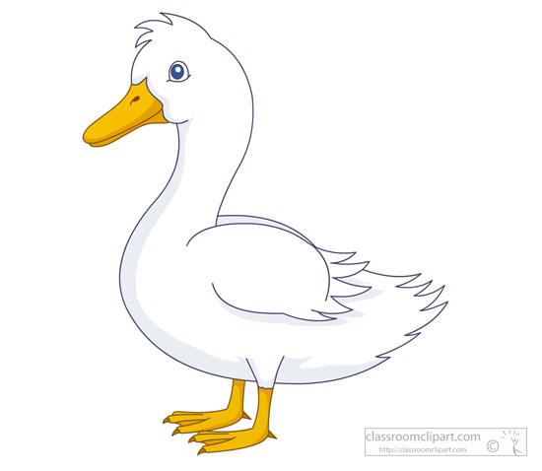
Variables
“If it walks like a duck, and quacks like a duck, it’s a duck!”
Variables do not have specific types – all variables are objects
Can hold integers, floats, strings, object references…
And this can change any time you assign a value
“Best reasonable interpretation” of a variable will be used for a specific purpose
Python uses “duck typing”

Slide 16
exercise
Use at least 3 variables and store a string, an integer, and a floating-point number
Try using each in a conditional
Is a string true or false? Can you make it change?
Which numbers evaluate to true?
What happens if you compare variables holding different types?
Does the behavior seem sensible?

Slide 17
For loop
While loop
Simple:
for x in range(1,5):
print(x)
With “step”:
for x in range(5, 0, -1):
print(x)
while condition:
statements
Example:
number = 1
while number < 200:
print(number)
number = number * 2

Slide 18
Data Structures: lists
List is one of the most basic and versatile
Comma separated items between square brackets
my_list = [ 1, 3, 5, 7, 11 ]
Items in a list do not have to have the same type
list2 = [ 1, 2, ‘shoe’, 4.5 ]
Like strings, lists can be indexed, sliced, etc.

Slide 19
List Operations
Lists have many methods to operate on them
append: add to a list
del: remove specified entry
remove: remove an object
And there are functions that operate on lists
len(), max(), min(), cmp() …
More:
https://www.tutorialspoint.com/python/python_lists.htm
https://www.w3schools.com/python/python_ref_list.asp

Slide 20
exercise
Make a list of 2 items
Use a loop to add items to the list
Delete every other item
Count how many items are in the list
Print the second half of the list using a while loop
Add items in the middle of the list
What operators work on lists?

Slide 21
The End
Questions?

