Slide 1

Feb. 20rd2014 meeting
Suzuki Lab.,
Dept. of Advanced Energy, GSFS
University of Tokyo

Slide 2

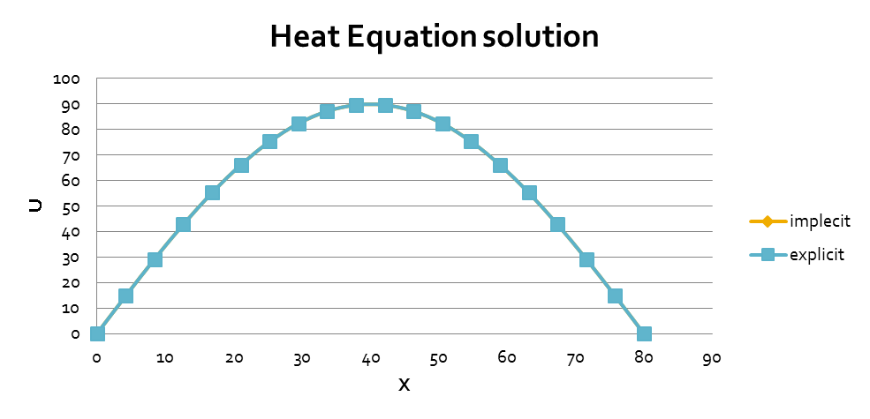
Implicit VS Explicit
1D diffusion equation
Domain of Calculation:
(0,80) in the x axis
I.C:
B.C
u=0 @ x = 0 and 80

Slide 3
Implicit VS Explicit
1D diffusion equation
Time | 600 |  | Time | 600
Implecit |  |  | explicit
x | u |  | x | u
0 | 0 |  | 0 | 0
4.210526 | 14.79082 |  | 4.21053 | 14.7932
8.421053 | 29.17819 |  | 8.42105 | 29.1828
12.63158 | 42.76965 |  | 12.6316 | 42.7764
16.84211 | 55.19447 |  | 16.8421 | 55.2032
21.05263 | 66.11373 |  | 21.0526 | 66.1242
25.26316 | 75.22957 |  | 25.2632 | 75.2415
29.47369 | 82.29335 |  | 29.4737 | 82.3064
33.68421 | 87.11238 |  | 33.6842 | 87.1263
37.89474 | 89.55521 |  | 37.8947 | 89.5695
42.10526 | 89.55521 |  | 42.1053 | 89.5695
46.31579 | 87.11238 |  | 46.3158 | 87.1263
50.52632 | 82.29334 |  | 50.5263 | 82.3064
54.73684 | 75.22956 |  | 54.7368 | 75.2415
58.94737 | 66.11372 |  | 58.9474 | 66.1242
63.1579 | 55.19446 |  | 63.1579 | 55.2032
67.36842 | 42.76964 |  | 67.3684 | 42.7765
71.57895 | 29.17818 |  | 71.5789 | 29.1828
75.78948 | 14.79082 |  | 75.7895 | 14.7932
80 | 0 |  | 80 | 0

Slide 4
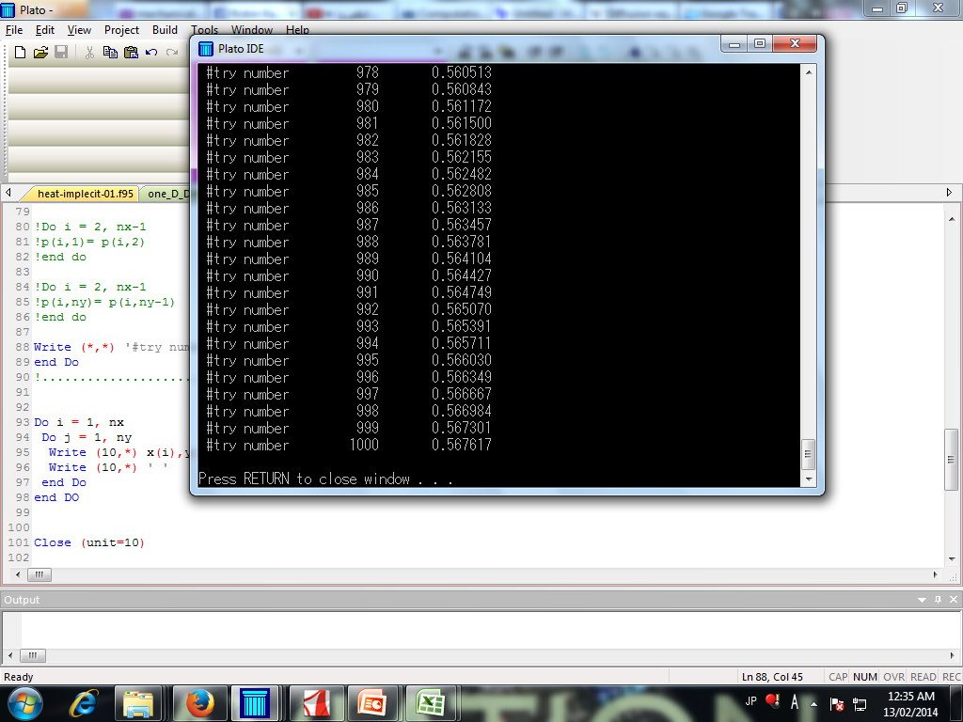
2D poisson equation trace of the results in real time

Slide 5
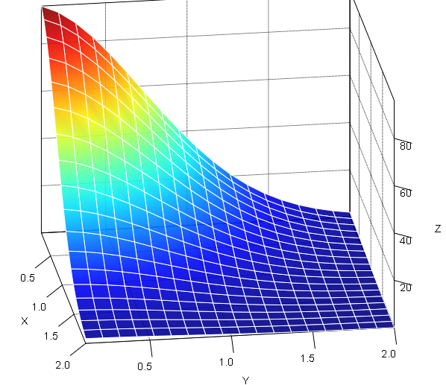


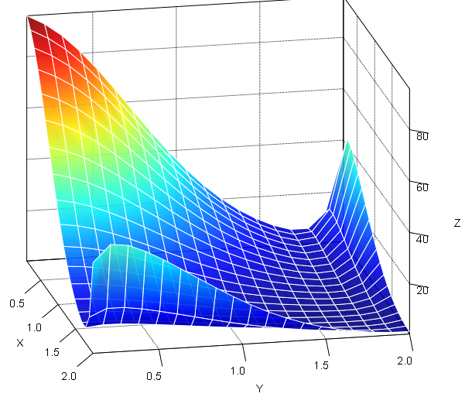

Numerical VS Analytical
2Ｄ diffusion equation
Domain of Calculation:
(0,2) X (0,2)
I.C:
Analytical Solution:
Analytical Result
Numerical Result

Slide 6
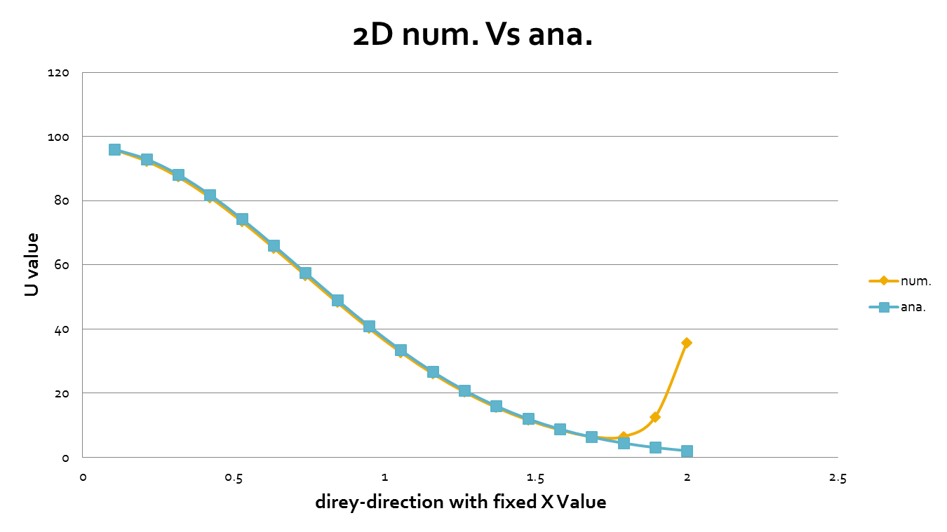
Numerical VS Analytical
2Ｄ diffusion equation

Slide 7
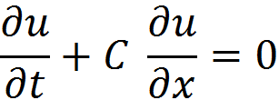
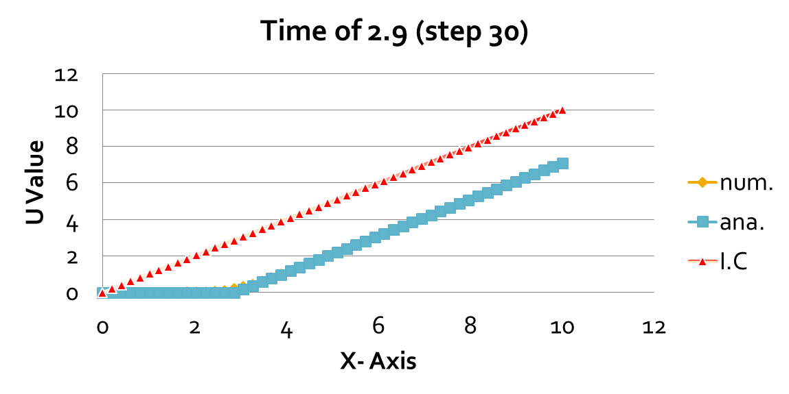
Numerical VS Analytical
1-D linear convection
Governing equation:
c=1

Slide 8
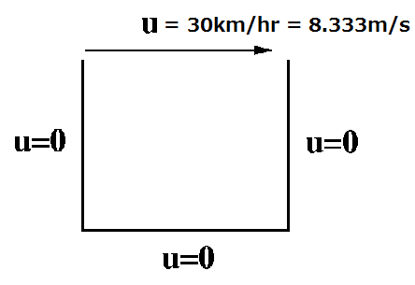


2D-Cavity Flow
Domain of Calculation:
(0,0.01) x (0,0.01) m
I.C:
p = 0 @ Everywhere
u = 0 @ Everywhere
v = 0 @ Everywhere
B.C:
u= 8.333m/s @ y = 2
u, v = 0 @ x = 0 & x = 2 & y = 0
p = 0 @ y = 2
@ y = 0
@ x = 0 & x = 2
2D-Cavity Flow
Test 1: Re= 20
Test 2: Re=
Test 3: Re=

Slide 9
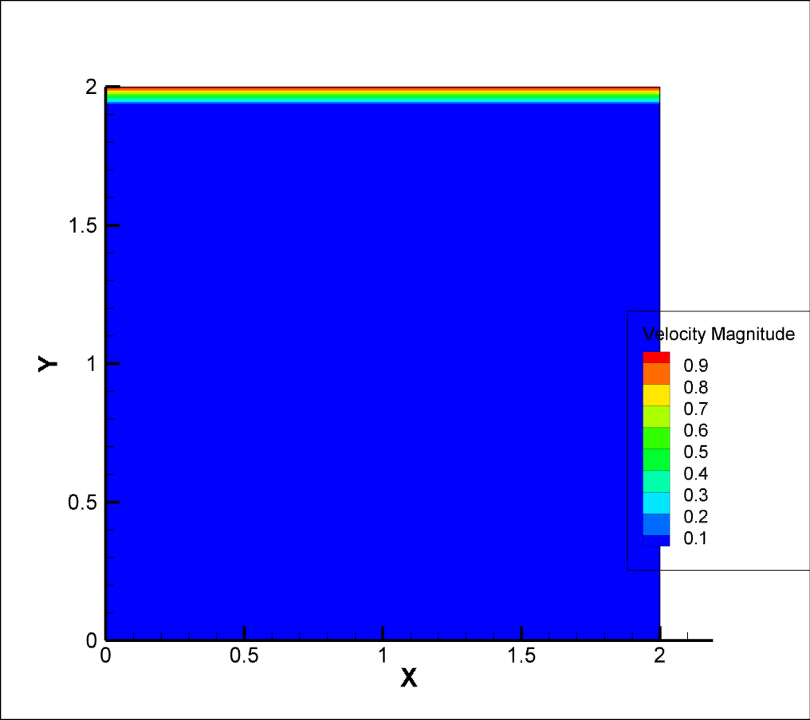
RE = 20, vis = 0.1 , CFL = u*dt/dx = 0.145

Slide 10
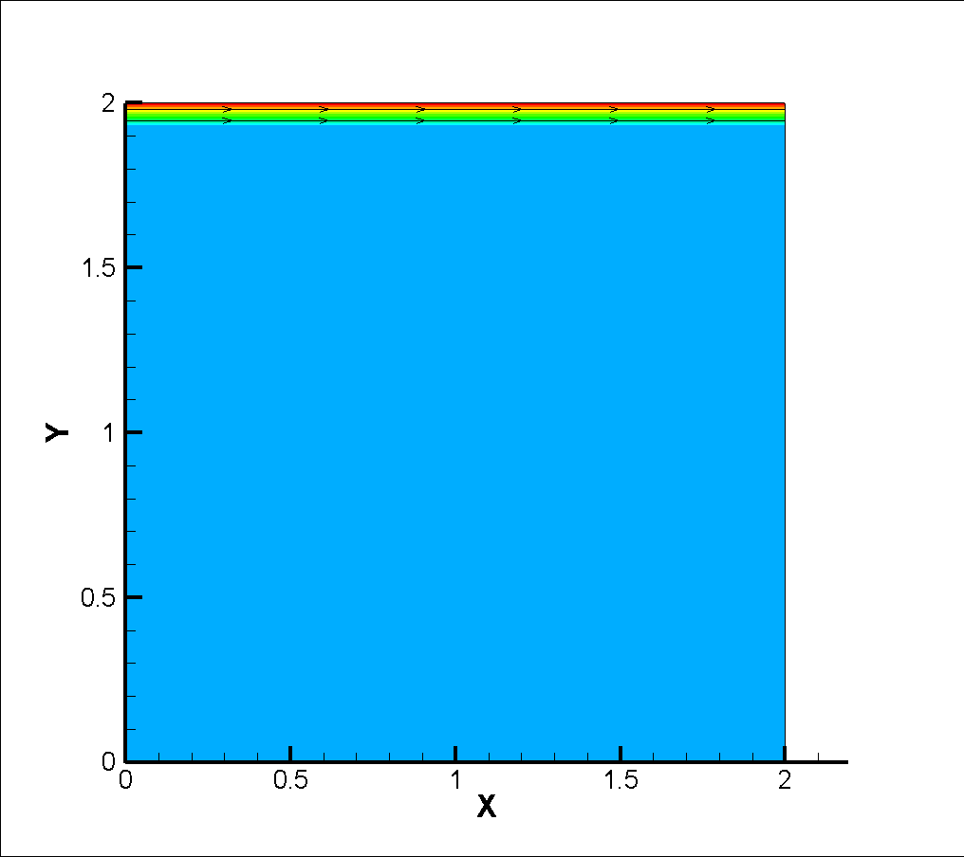
RE = 200, vis = 0.01

Slide 11

RE = 2000, vis = 0.001

Slide 12
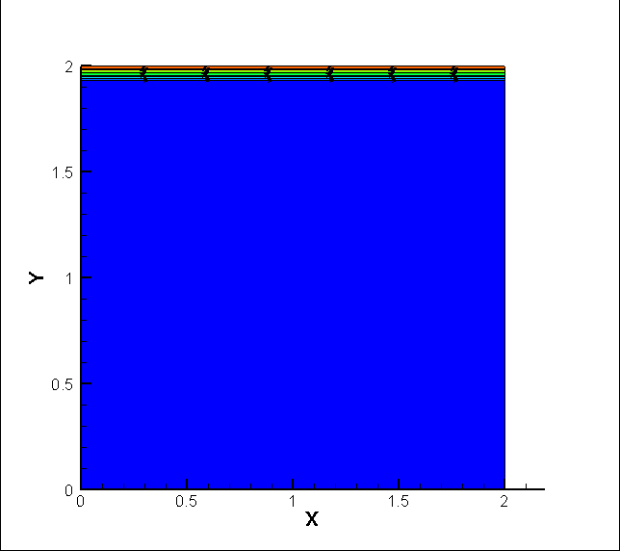
RE = 20000, vis = 0.0001

Slide 13
Thank you

