Slide 1


FUZZY LOGIC METHODS AND BASES OF RULES
Practical session 1. Fuzzy Inference system of pendulum positioning control

Slide 2

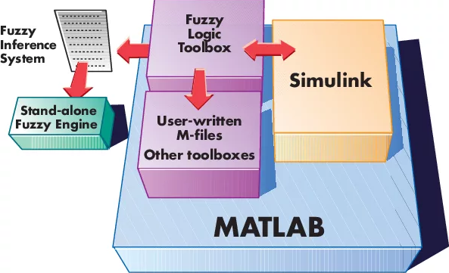

MASTER PLAN
WARM-UP TASK
2. INTRODUCTION TO FUZZY LOGIC TOOLBOX
3. FUZZY INFERENCE SYSTEM OF PENDULUM POSITIONING CONTROL

Slide 3

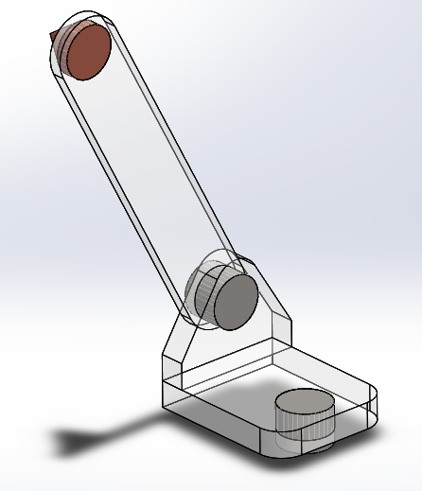
Warm-up task: How to turn the pendulum on exact angle position
using the time-depended signal of the torque
Pendulum with the mass “m” and the rotational inertia “J” driven with the DC motor should be turned on angle “φ0” using time depended signal of voltage “U” or torque “M”. Let the friction force and the gravity force are to be negligibly small.
It is necessary to find the function U=U(t) or M=M(t).
Pendulum
Revolute joint
driven with DC motor
Pivot mount
Pendulum scheme

Slide 4

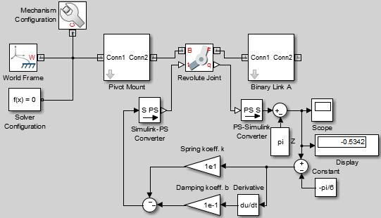
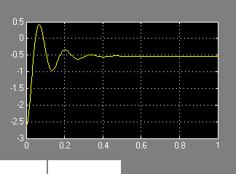
Warm-up task: How to turn the pendulum on exact angle position
using the time-depended signal of the torque
Solution. Let us φ0 = - π/6 ≈ - 0.5236 , then answer is following:
Proportional part
Derivative part
For step-by-step instructions on how to build this model, see the "Model Double Pendulum" tutorial in the SimMechanics documentation.
Damped oscillations

Slide 5
MASTER PLAN
WARM-UP TASK
2. INTRODUCTION TO FUZZY LOGIC TOOLBOX
3. FUZZY INFERENCE SYSTEM OF PENDULUM POSITIONING CONTROL

Slide 6
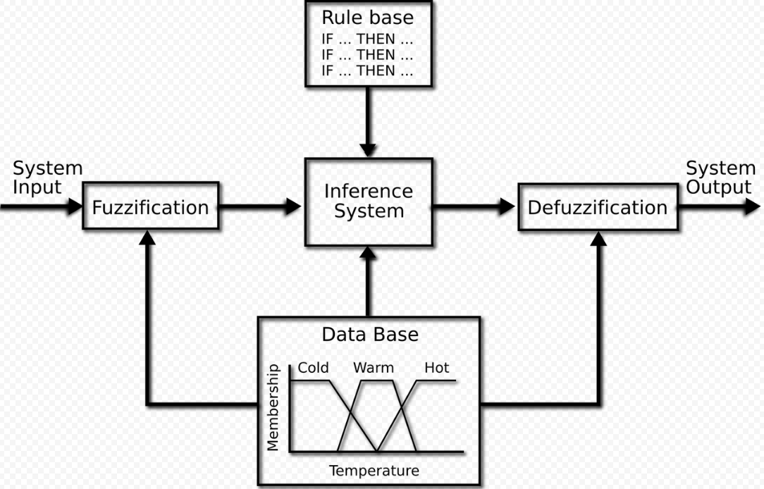
Fuzzy Logic Toolbox
Fuzzy logic inference scheme

Slide 7
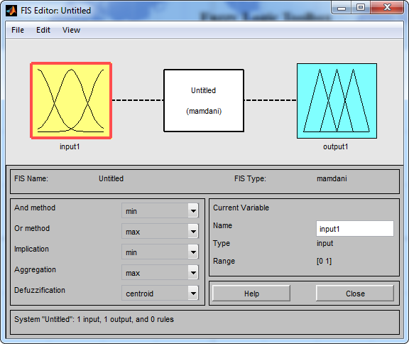
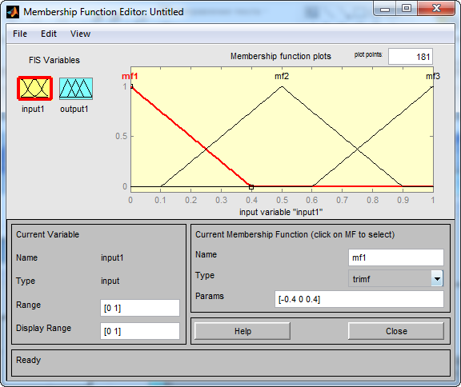
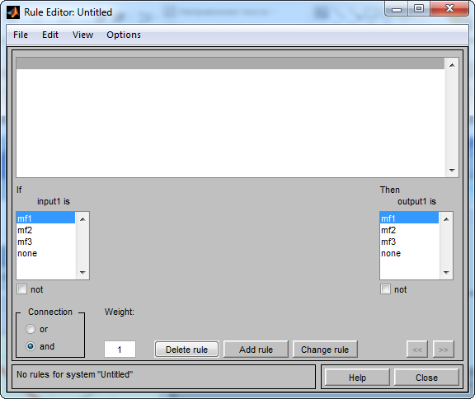
Fuzzy Logic Toolbox
>> fuzzy

Slide 8
MASTER PLAN
WARM-UP TASK
2. INTRODUCTION TO FUZZY LOGIC TOOLBOX
3. FUZZY INFERENCE SYSTEM OF PENDULUM POSITIONING CONTROL

Slide 9
Fuzzy inference system of pendulum positioning control
Pendulum with the mass “m” and the rotational inertia “J” driven with the DC motor should be turned on angle “φ0” using time depended signal of voltage “U” or torque “M”. Let the friction force and the gravity force are to be negligibly small.
It is necessary to find the function U=U(t) or M=M(t).
Solution algorithm.
Create fuzzy rules
Develop a fuzzy inference system in the FIS-editor
Input the “Fuzzy controller” in Simulink program
Tune the values of input and output using “Giant” block to make the program work correctly
Pendulum
Revolute joint
driven with DC motor
Pivot mount

Slide 10
Fuzzy inference system of pendulum positioning control
Create fuzzy rules to connect the values of the position error and the torque
The rules has following form:
If the error is positive then the force is negative
If the error is negative then the force is positive
Pendulum
Revolute joint
driven with DC motor
Pivot mount

Slide 11
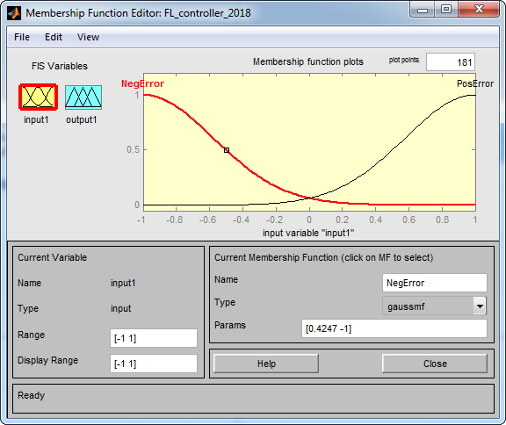
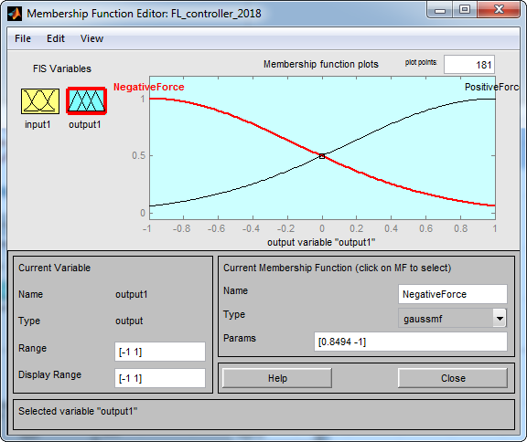
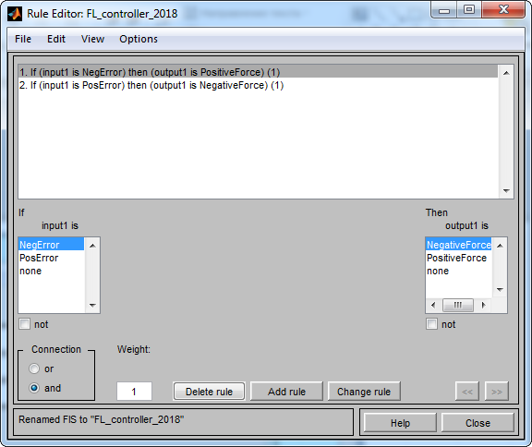
Fuzzy inference system of pendulum positioning control
2. Develop a fuzzy inference system in the FIS-editor in three steps

Slide 12
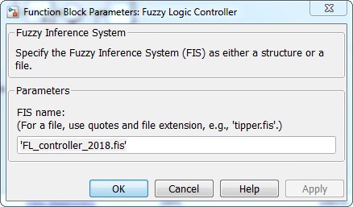
Fuzzy inference system of pendulum positioning control
3. Input the “Fuzzy controller” in Simulink program
First of all, export the results from FIS-editor to fis-file and to Workspace using following commands: File -> Export to Workspace
File -> Export to File -> FL_controller_2018.fis.
Then input the “Fuzzy Logic Controller” in Simulink program

Slide 13
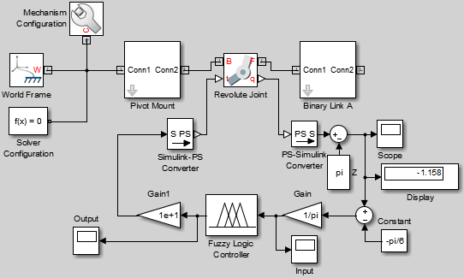
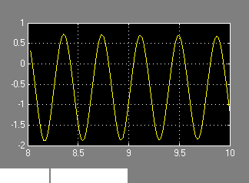
Fuzzy inference system of pendulum positioning control
4. Tune the values of input and output using “Giant” block to make the program work correctly.
And finally, try to stop the pendulum ;)

Slide 14
REFERENCES
https://www.youtube.com/watch?v=N5kwA6CQsAE
https://www.youtube.com/watch?v=FOvNoWMSqzA&t=17s
https://www.youtube.com/watch?v=Te4HGoZpRmY
https://www.youtube.com/watch?v=x6eBUpHpj6g
https://www.youtube.com/watch?v=woCdjbsjbPg
https://www.youtube.com/watch?v=cNZPRsrwumQ

