Slide 1
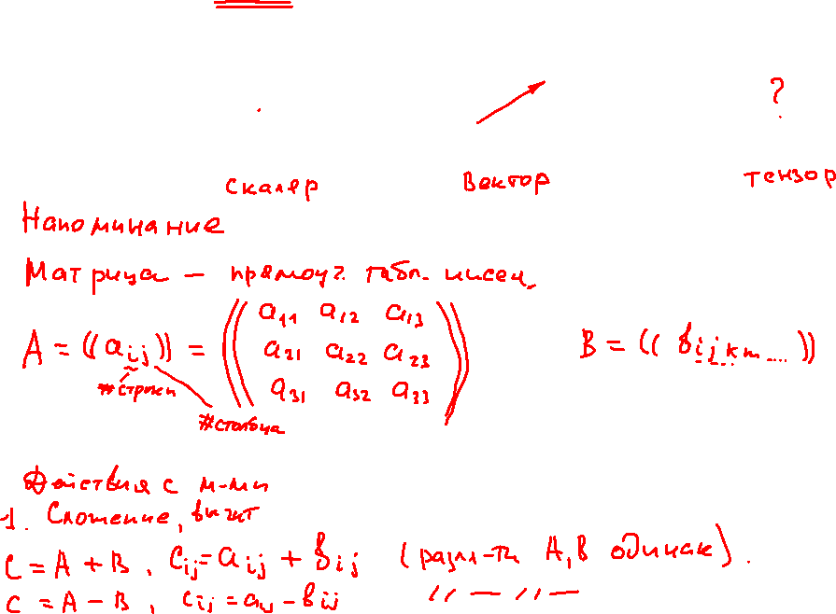
An Introduction to Tensor Calculus. Part 1: Scalars, Vectors and Tensors.

Slide 2
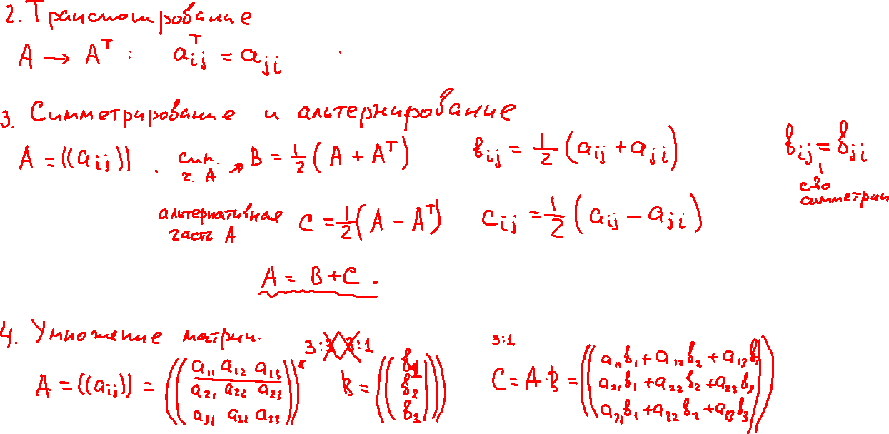
An Introduction to Tensor Calculus. Part 1: Scalars, Vectors and Tensors.

Slide 3
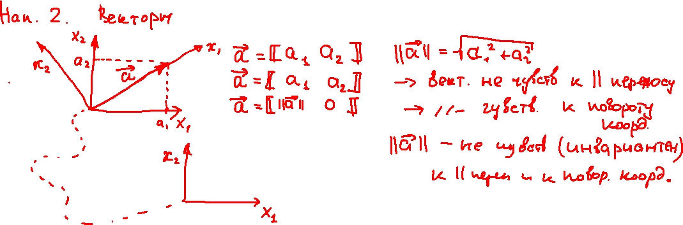
An Introduction to Tensor Calculus. Part 1: Scalars, Vectors and Tensors.

Slide 4
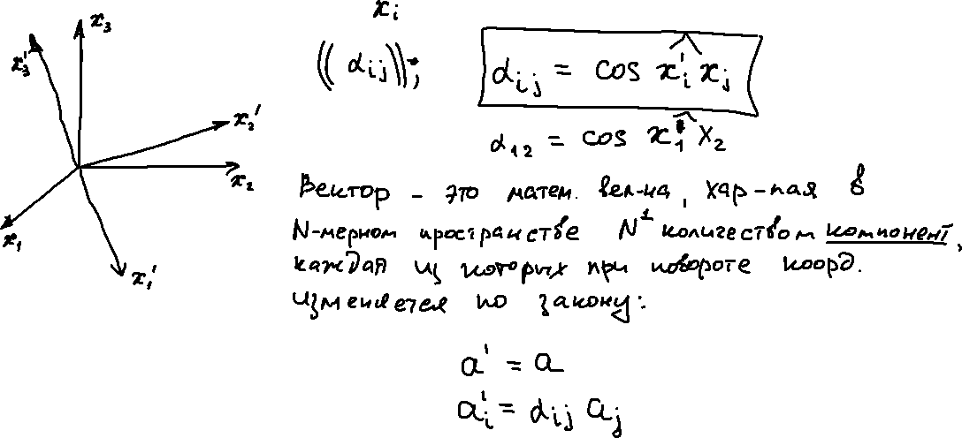
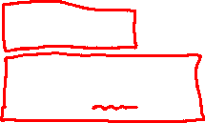
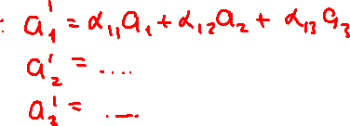
An Introduction to Tensor Calculus. Part 1: Scalars, Vectors and Tensors.

Slide 5
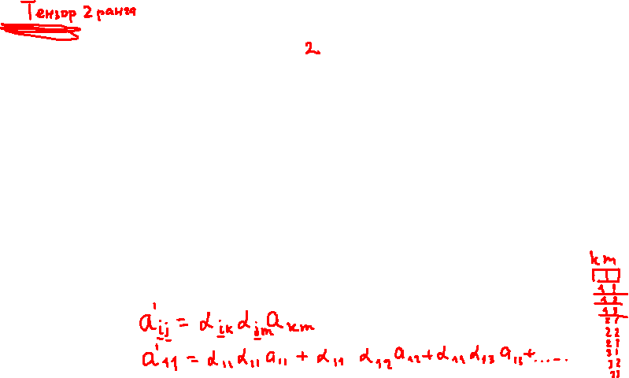
An Introduction to Tensor Calculus. Part 1: Scalars, Vectors and Tensors.

Slide 6
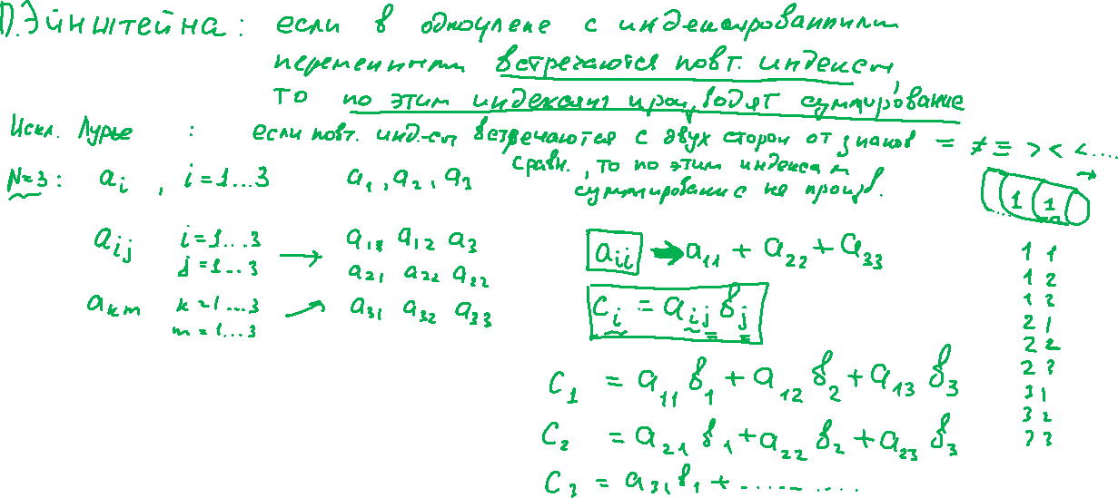
An Introduction to Tensor Calculus. Part 1: Scalars, Vectors and Tensors.

Slide 7
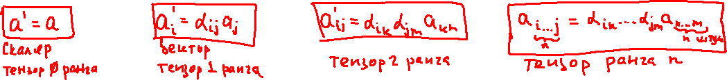
An Introduction to Tensor Calculus. Part 1: Scalars, Vectors and Tensors.

Slide 8
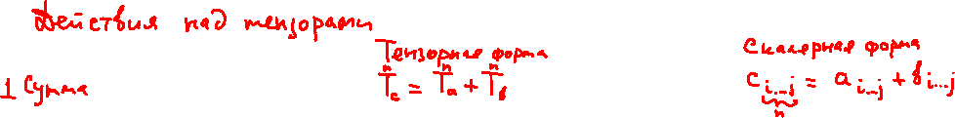
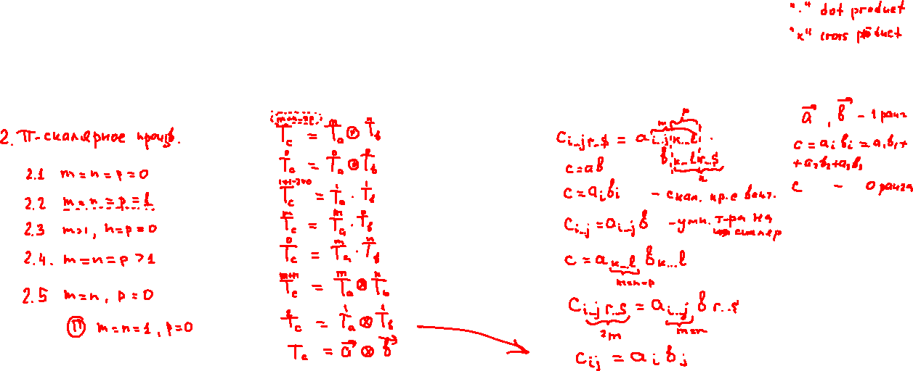
An Introduction to Tensor Calculus. Part 1: Scalars, Vectors and Tensors.

Slide 9
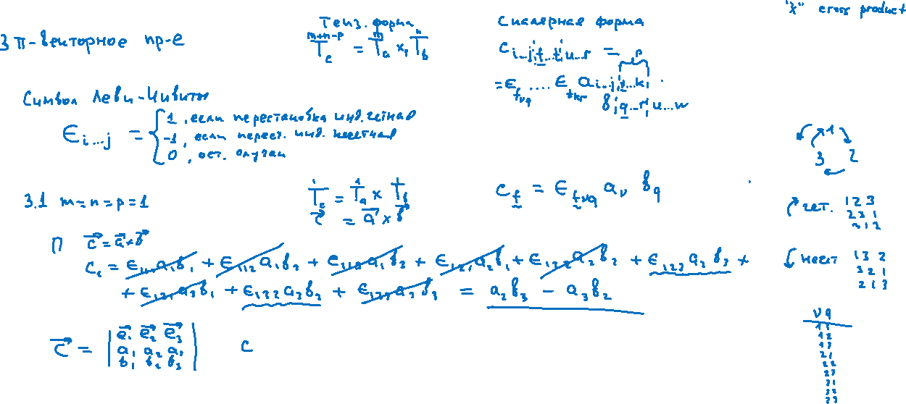
An Introduction to Tensor Calculus. Part 1: Scalars, Vectors and Tensors.

Slide 10
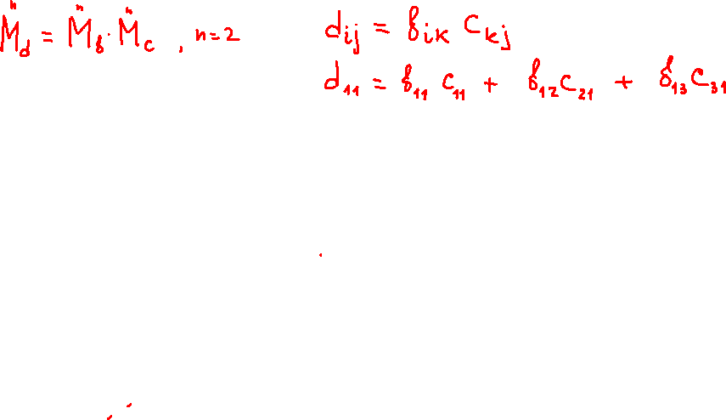
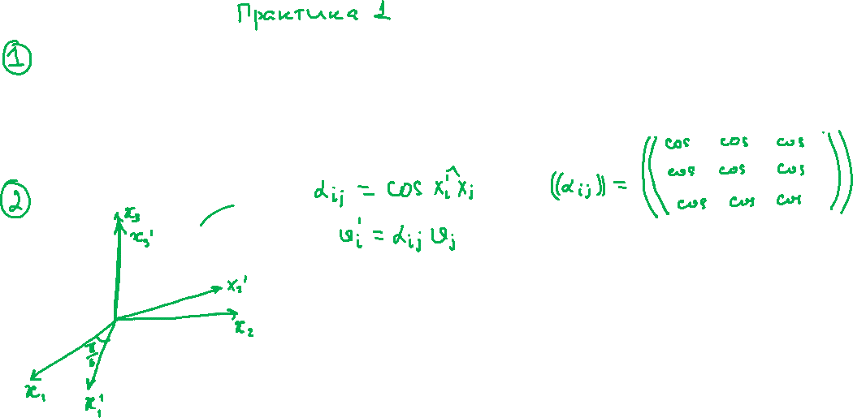
An Introduction to Tensor Calculus. Part 1: Scalars, Vectors and Tensors.

Slide 11
An Introduction to Tensor Calculus. Part 1: Scalars, Vectors and Tensors.

