Slide 1
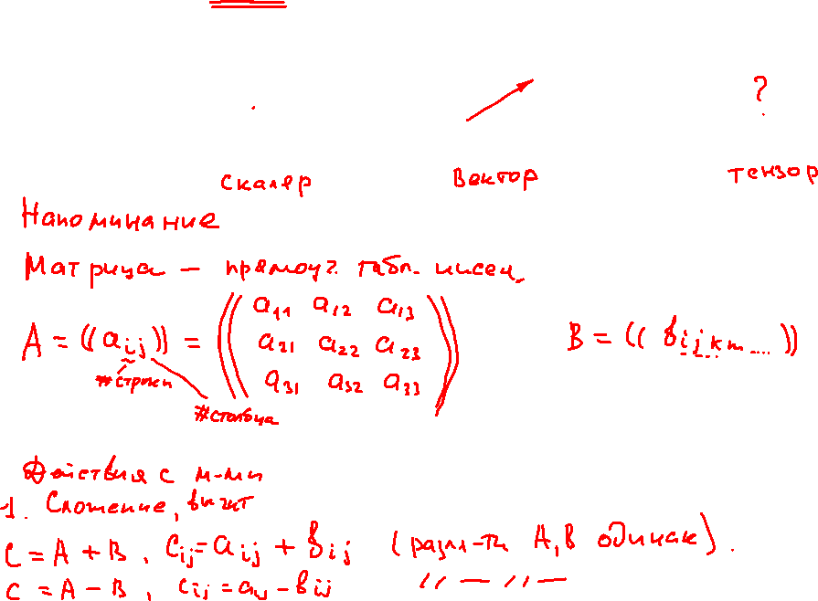
An Introduction to Tensor Calculus. Part 1: Scalars, Vectors and Tensors.

Slide 2
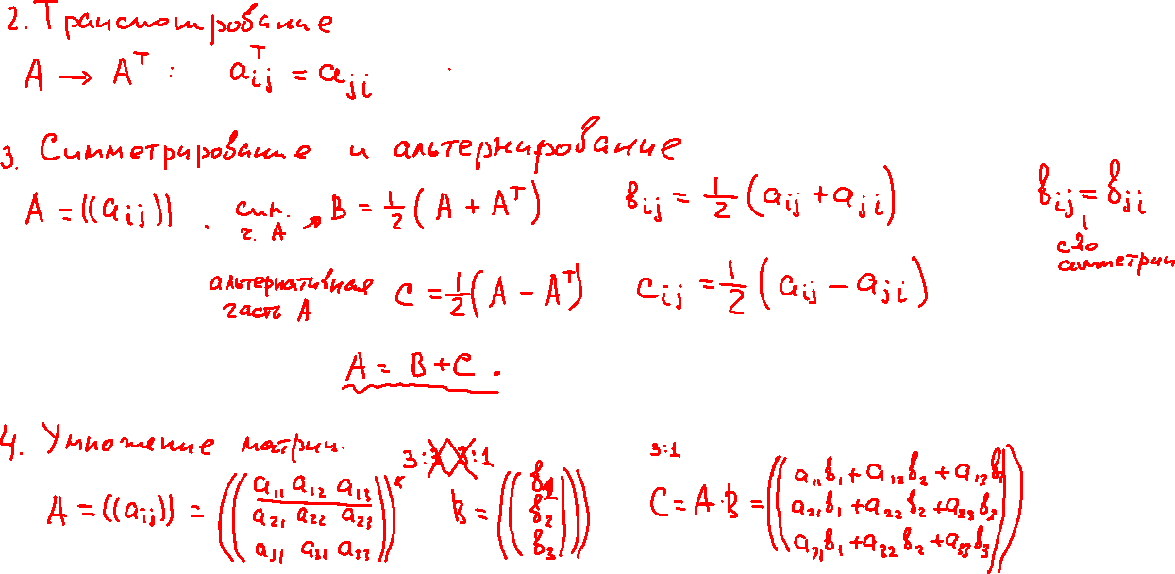
An Introduction to Tensor Calculus. Part 1: Scalars, Vectors and Tensors.

Slide 3
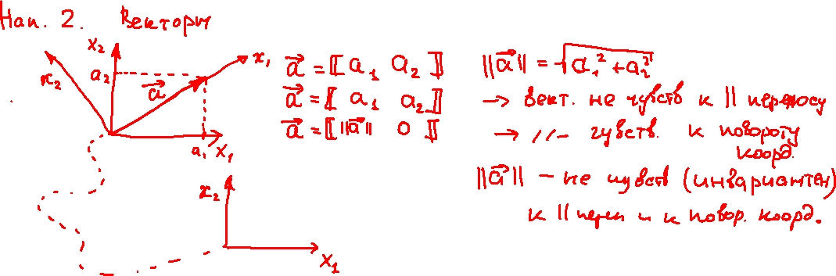
An Introduction to Tensor Calculus. Part 1: Scalars, Vectors and Tensors.

Slide 4
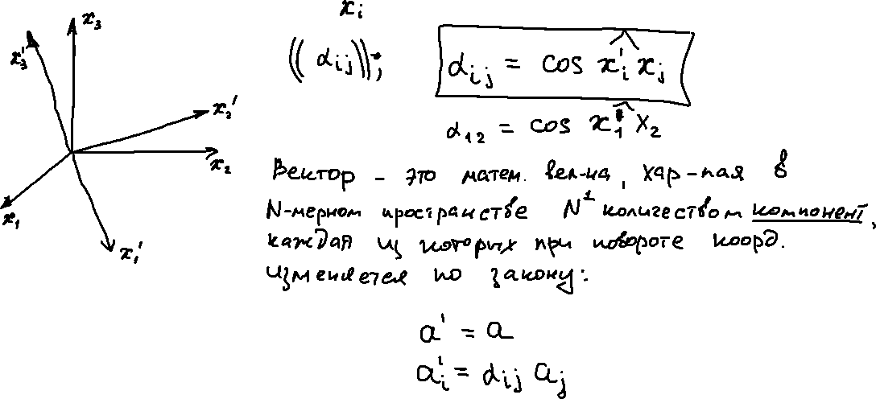
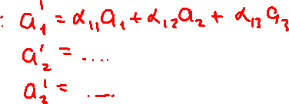
An Introduction to Tensor Calculus. Part 1: Scalars, Vectors and Tensors.

Slide 5
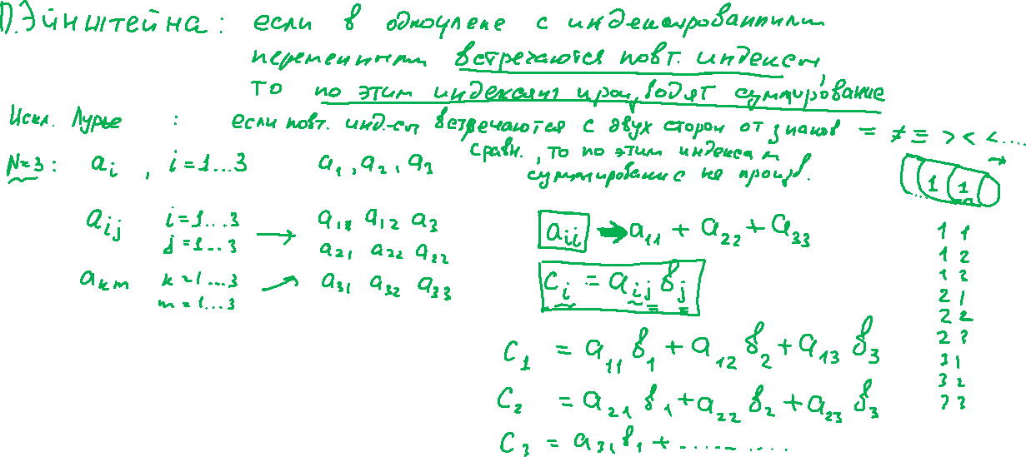
An Introduction to Tensor Calculus. Part 1: Scalars, Vectors and Tensors.

Slide 6
An Introduction to Tensor Calculus. Part 1: Scalars, Vectors and Tensors.

Slide 7
An Introduction to Tensor Calculus. Part 1: Scalars, Vectors and Tensors.

Slide 8
An Introduction to Tensor Calculus. Part 1: Scalars, Vectors and Tensors.

Slide 9
An Introduction to Tensor Calculus. Part 1: Scalars, Vectors and Tensors.

Slide 10
An Introduction to Tensor Calculus. Part 1: Scalars, Vectors and Tensors.

