Slide 1
Intro to GitHub Auto- documentation via
Doxygen
By Rain Chung
(jinrainchung@gmail.com)

Slide 2
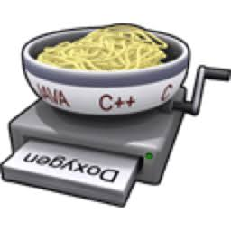
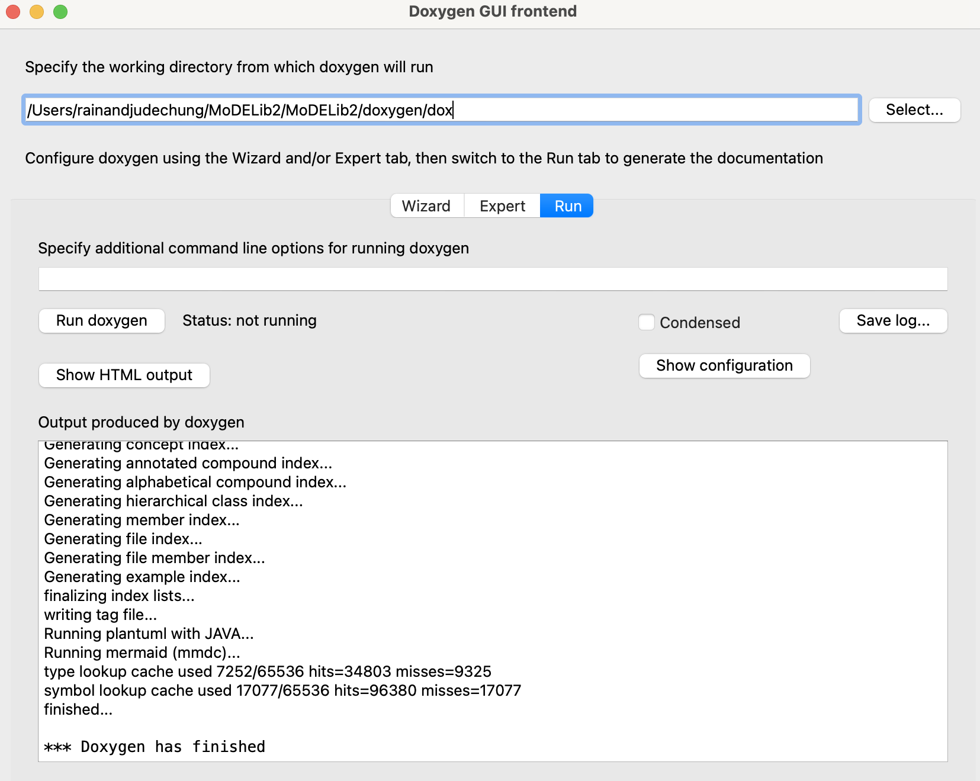
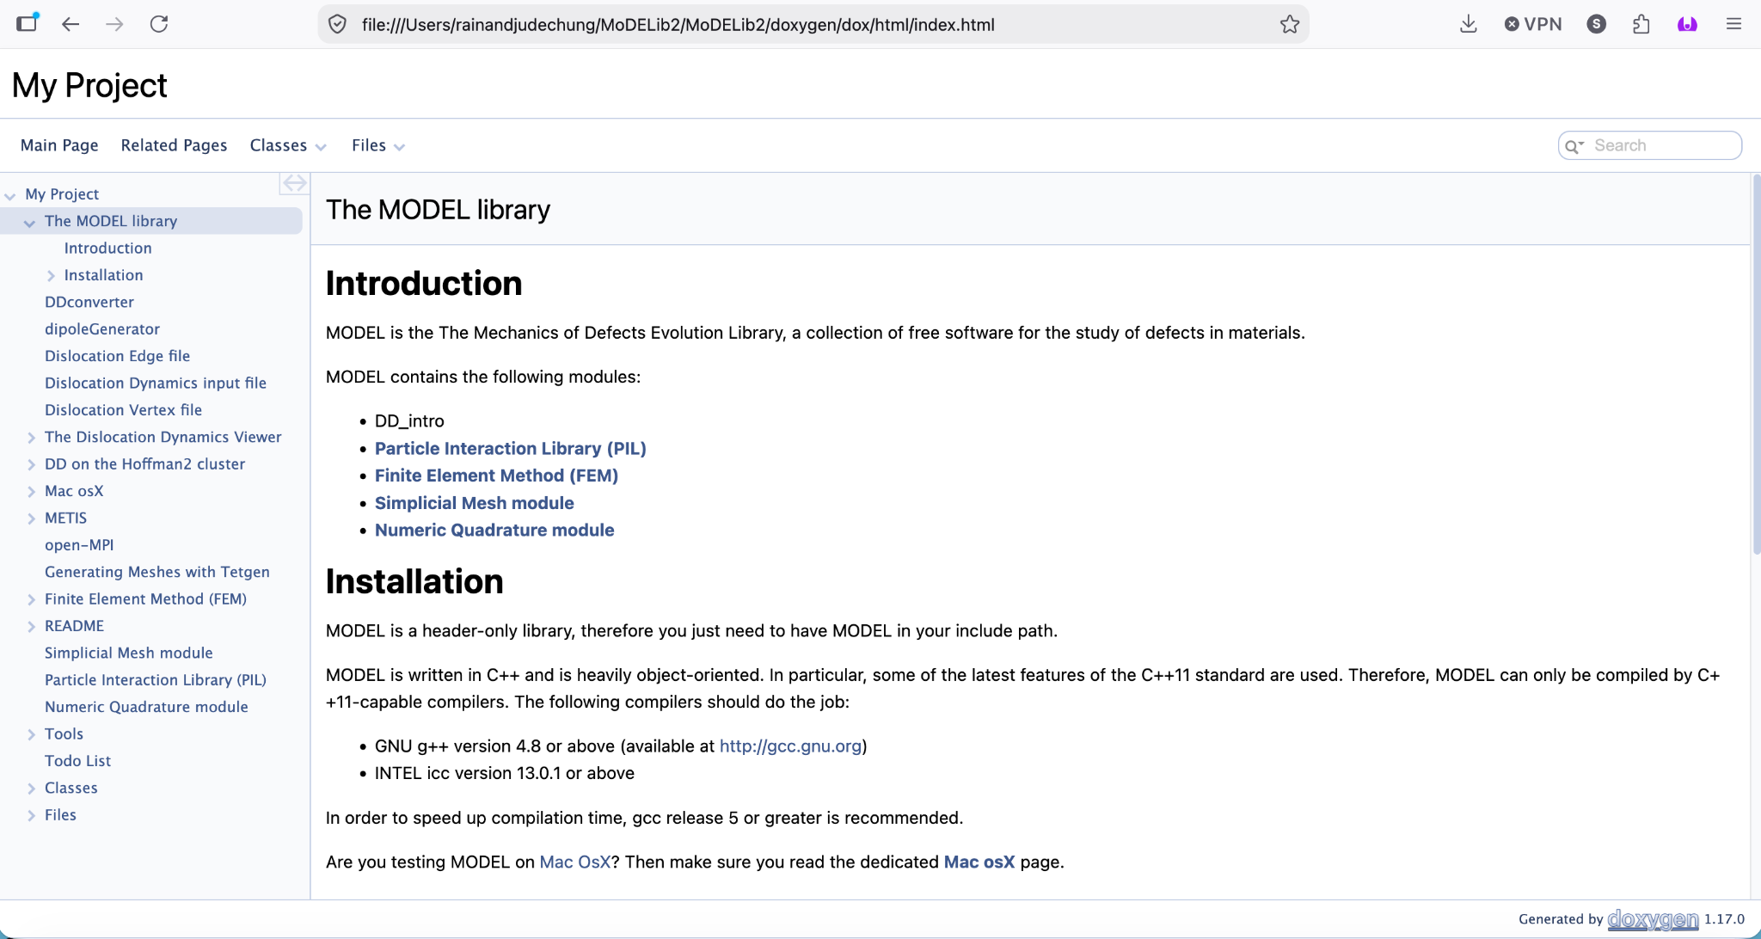
What is Doxygen?
“It automates the generation of documentation from source code comments, parsing information about classes, functions, and variables…”
Even though it primarily outputs in HTML formatting, the files it produces can be converted into other formats, like MarkDown, which is helpful for things in the future…

Slide 3
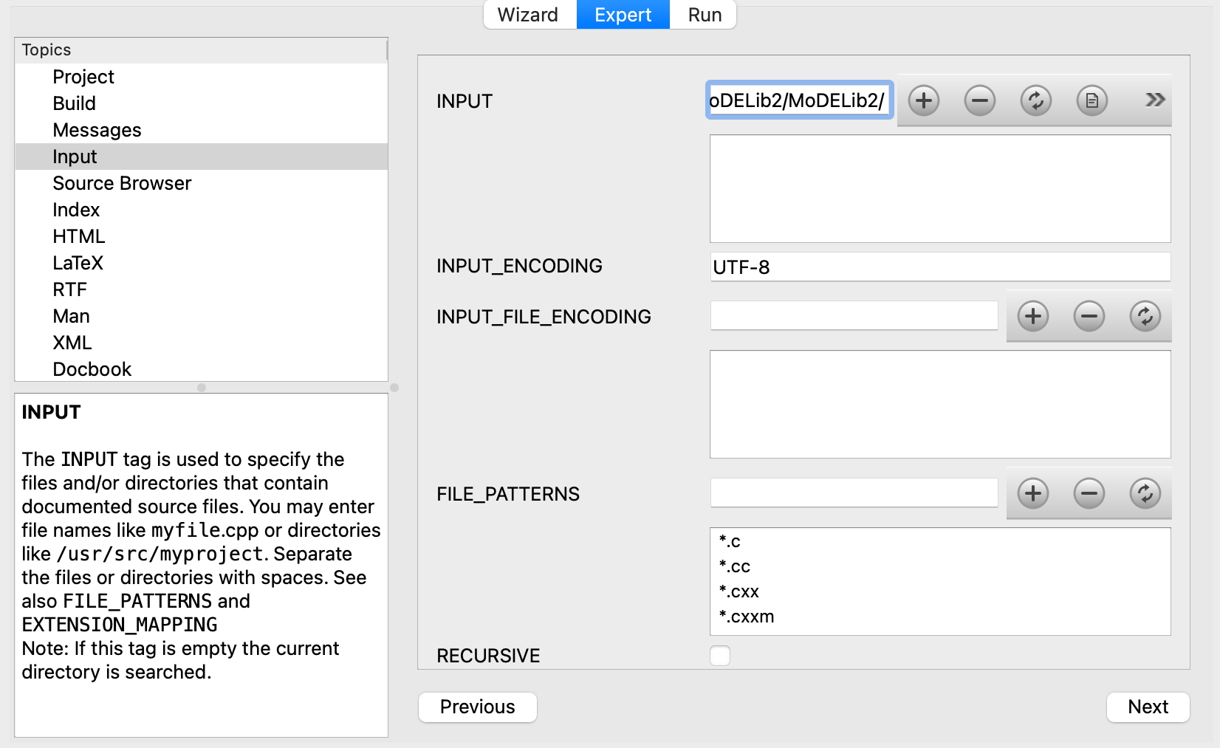
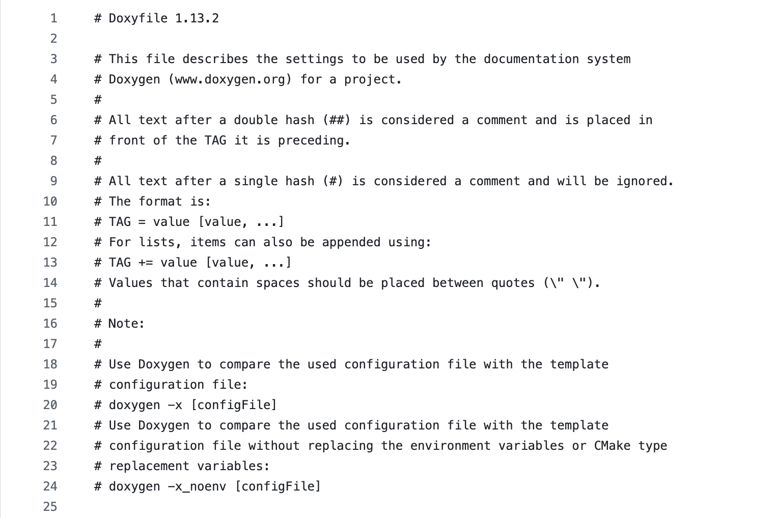
Quick “User Manual”
Through GUI or console commands, direct Doxygen to your source file. This will automatically export into an HTML format.
To run the program more to your specs, you can edit individual settings through the GUI or through a Doxyfile.

Slide 4
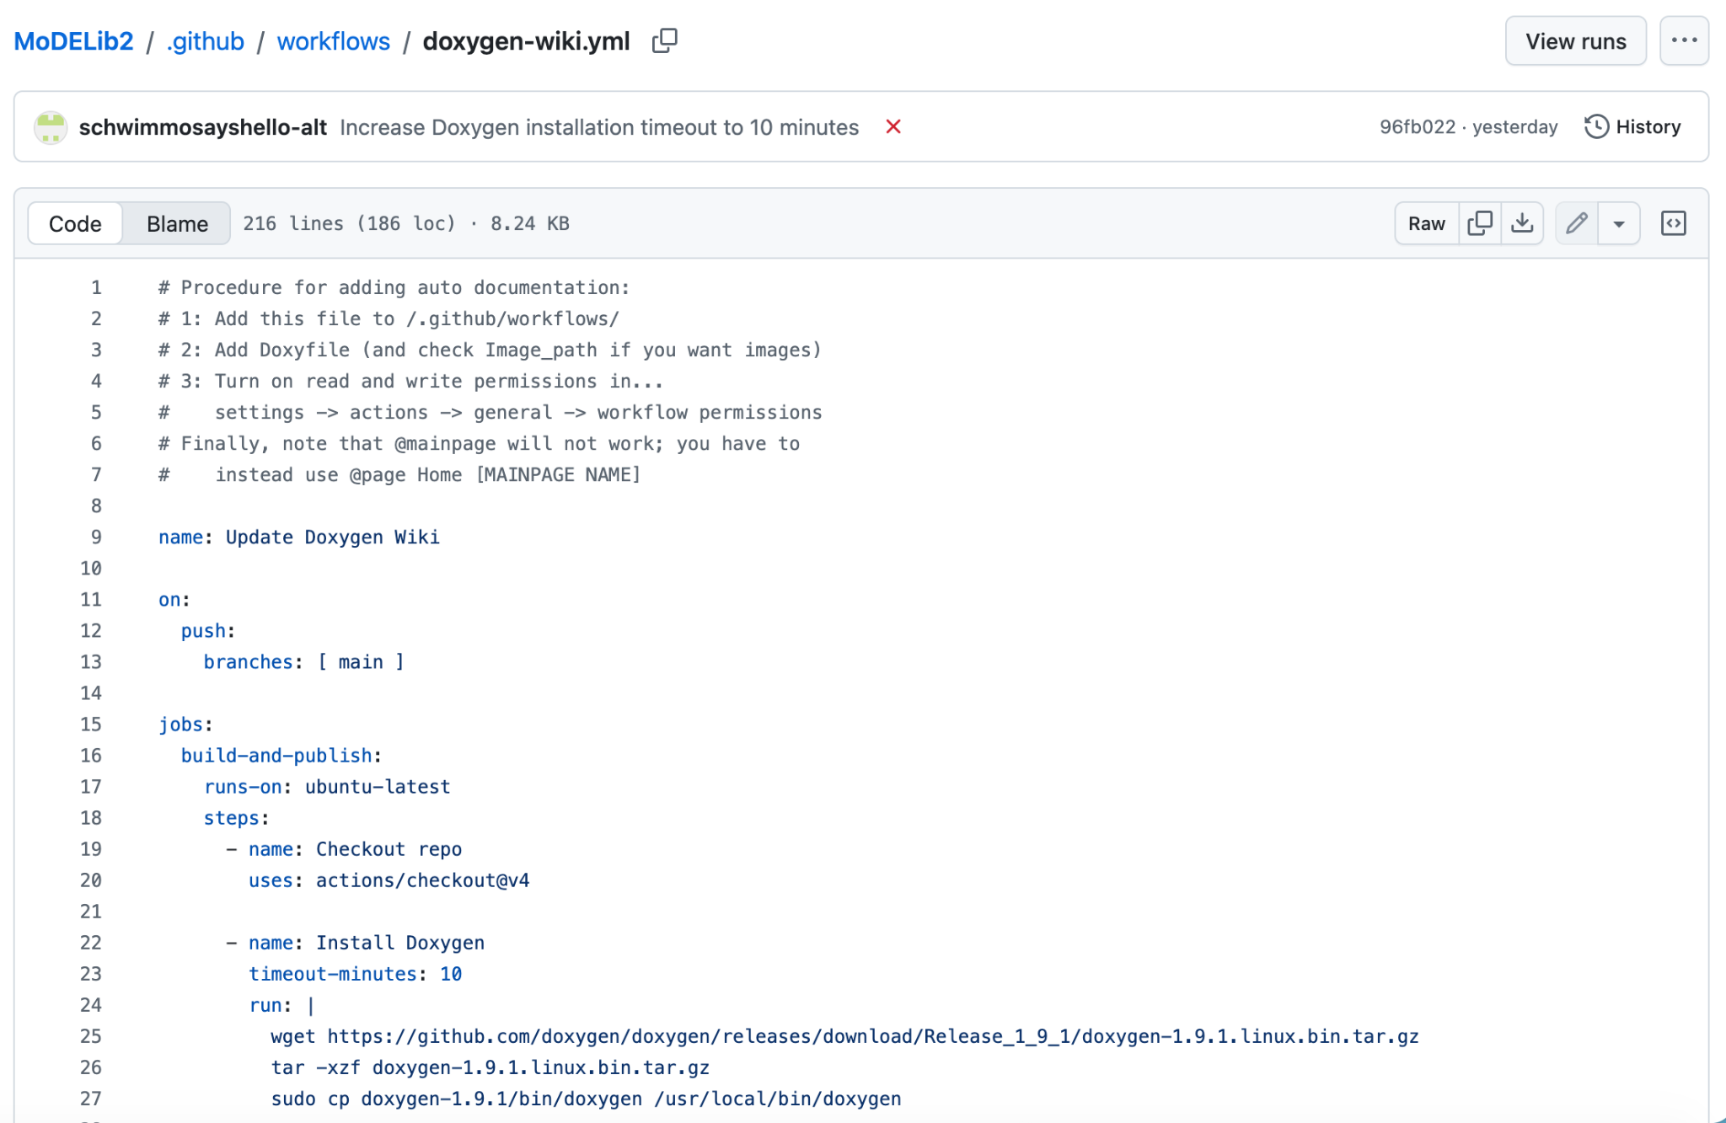
GitHub Auto Documentation
Through a GitHub workflow file (and some preparation), Doxygen should automatically take any changes / files added to the MoDELib2 depository (or any other GitHub project) and either create or update a page in a Wiki for said depository.

Slide 5
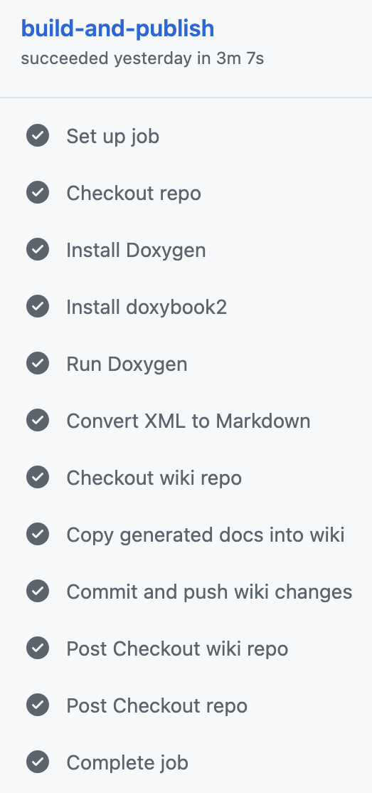
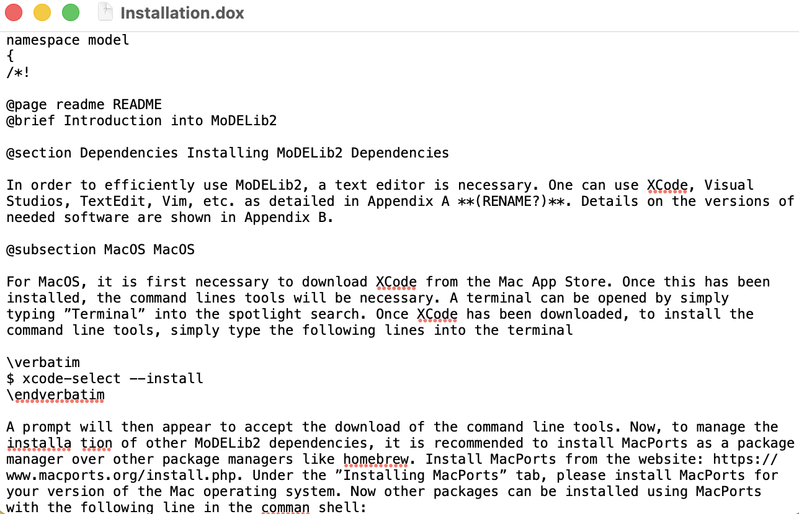
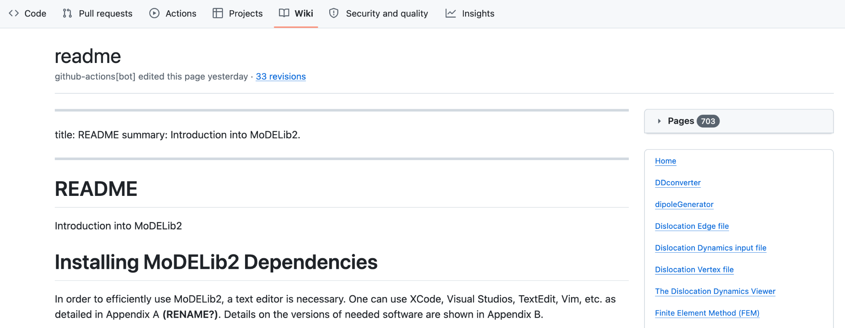
Workflow / Pages of Wiki

Slide 6
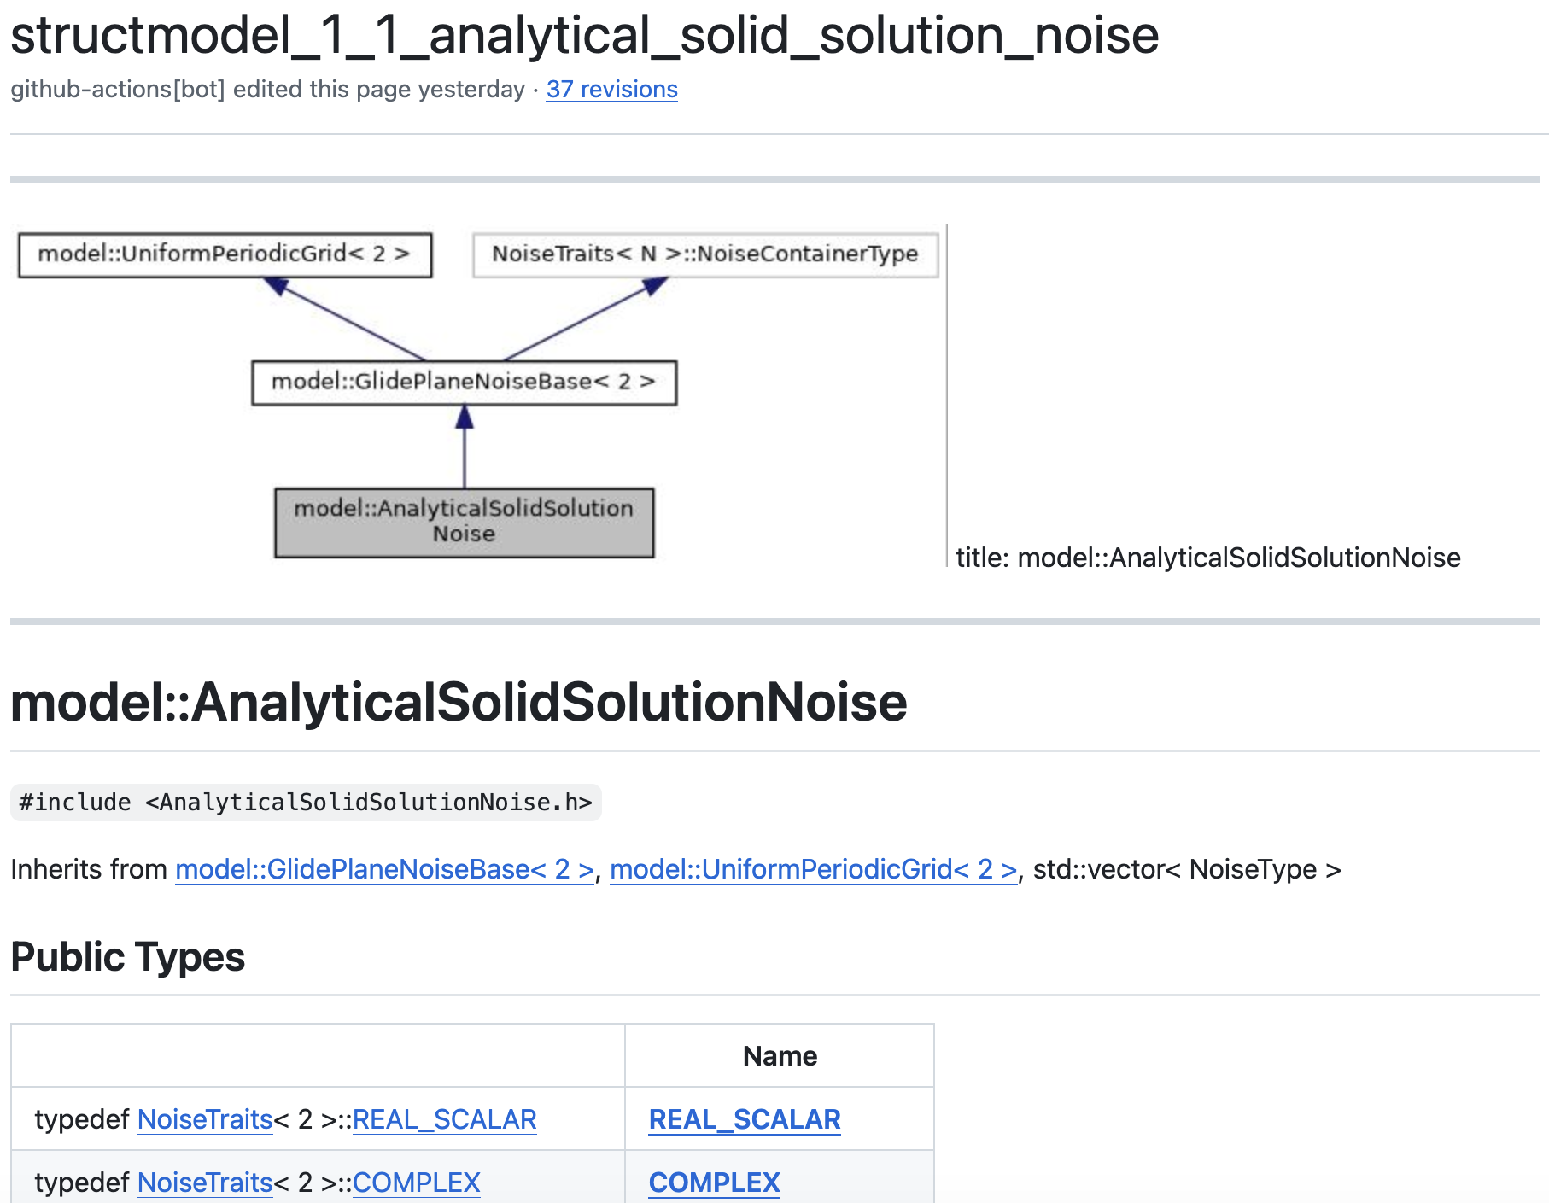
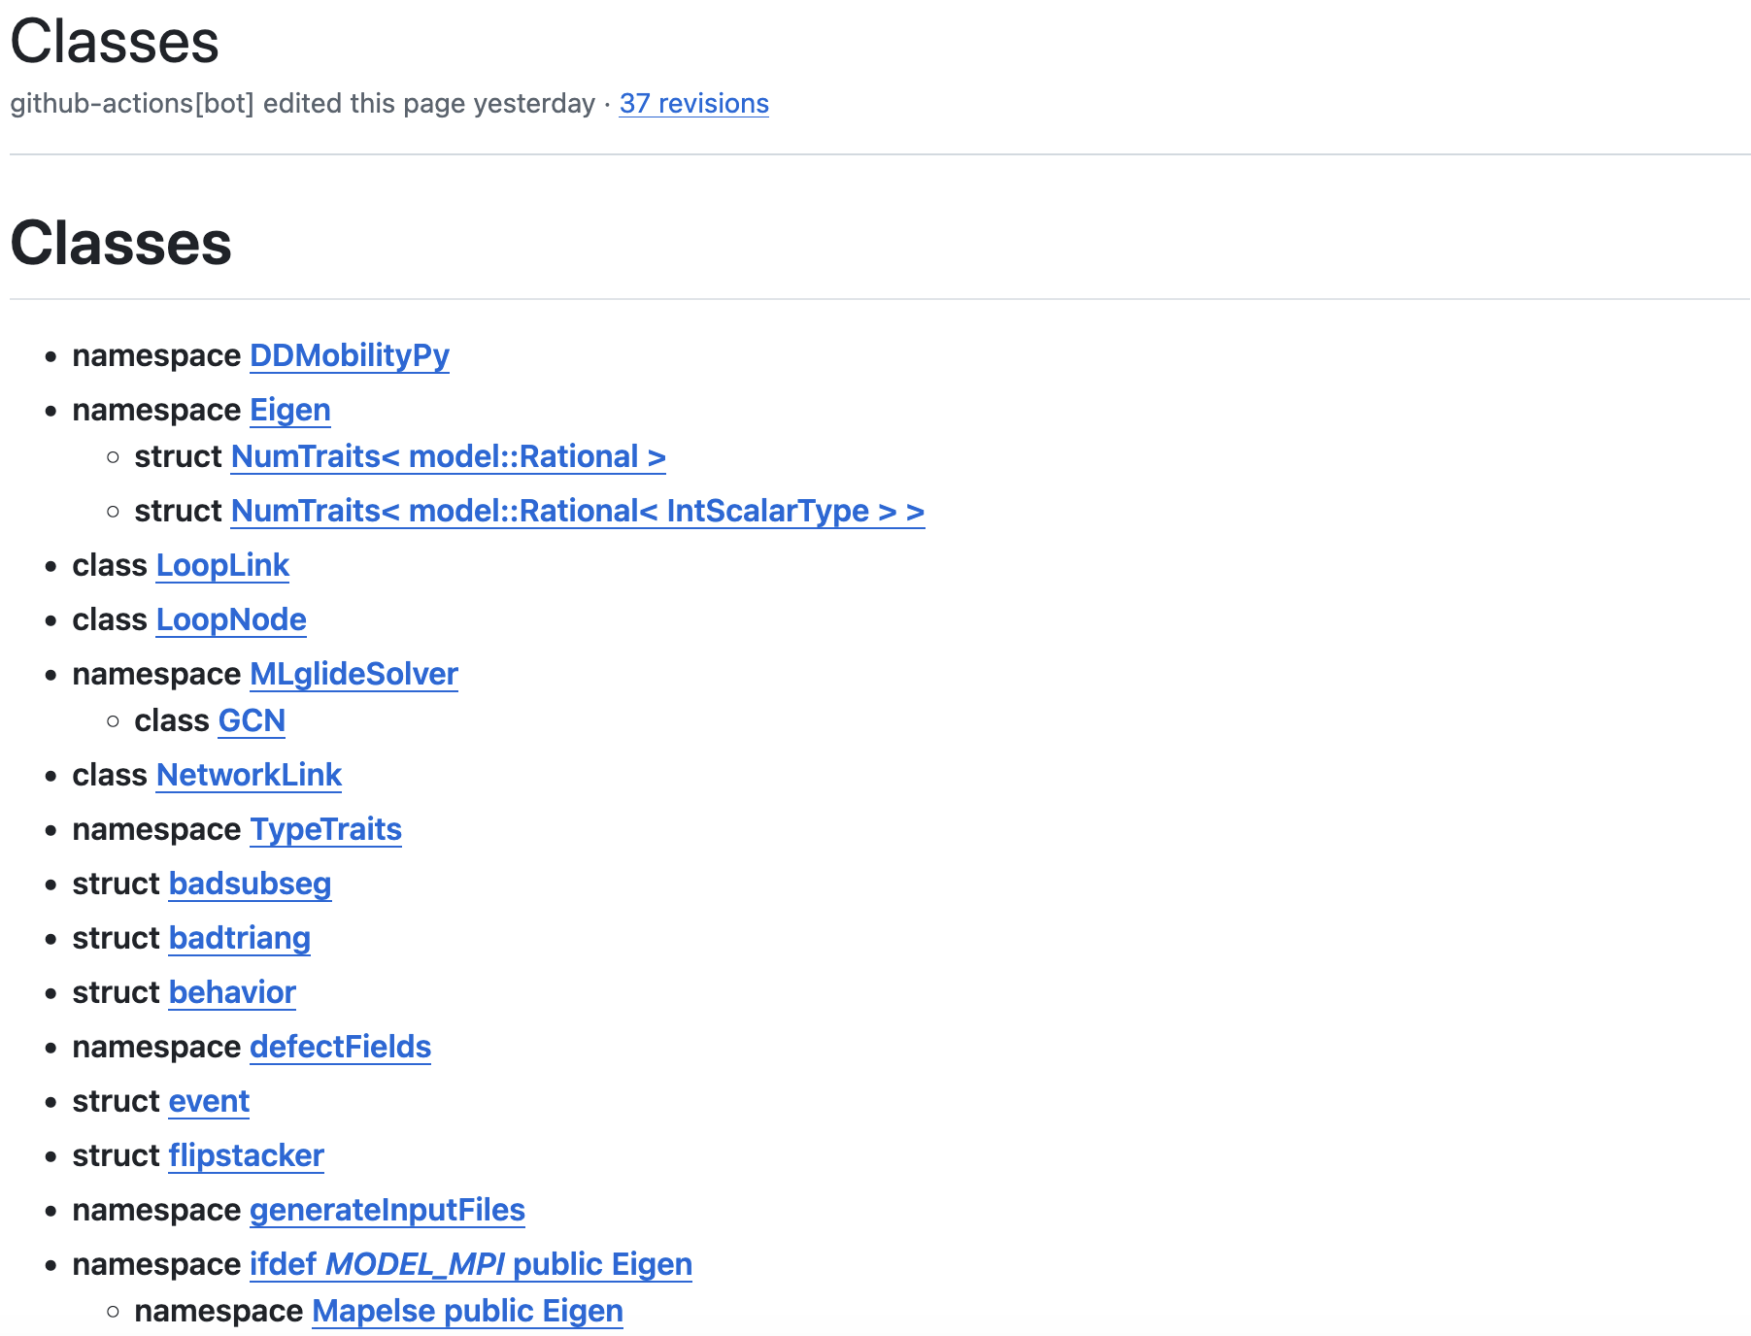
What about you?
Since Doxygen automatically creates the pages (as seen on last slide), you don’t need to be conscious of anything when adding / editing files.
Through the wiki page you can see variables and hierarchies of the C++ and Python classes to hopefully make things easier for you, and (eventually) more detailed pages for select files.

Slide 7

Thank You
jinrainchung@gmail.com

