Slide 1
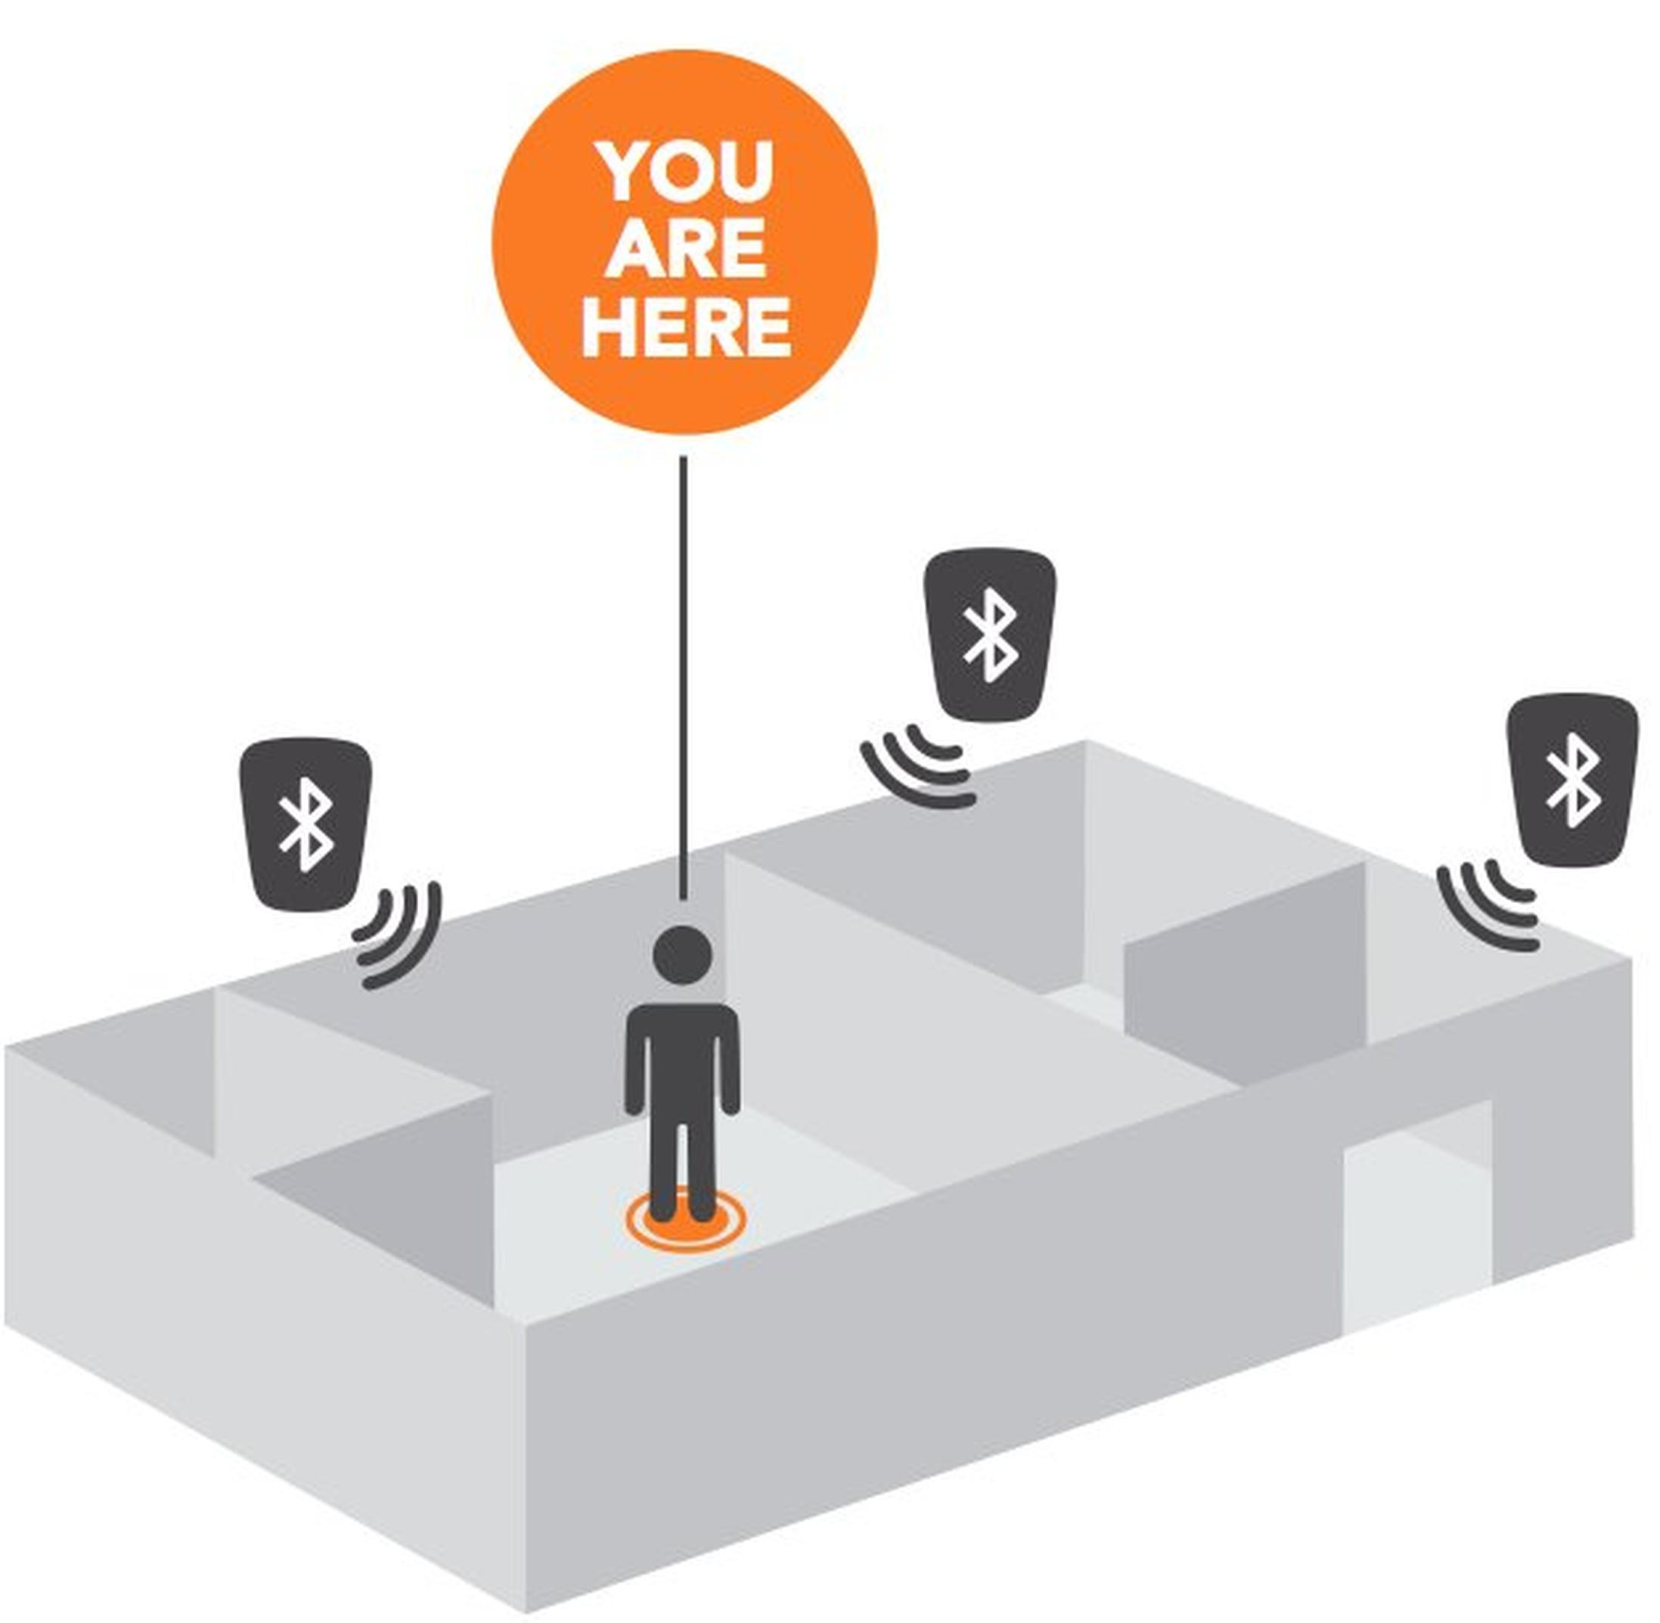
Design of a Data-Driven Indoor Positioning System
Presented By: Azmyin Md Kamal and Allison Mixon
IoT Engineering: Final Project
May 6, 2020

Slide 2
Problem Statement
The objective of our study is to develop a data-driven Indoor Positioning System where we will investigate how the accuracy of the fingerprinting technique changes when the number of deployed beacons is increased

Slide 3
Context of the problem
Why Indoor Positioning System is a useful feature from a user’s standpoint:
Help users navigate around any space and optimize the experience for them
Quickly locate and manage the flow of materials, objects, devices, or people
Display contextual information on nearby screens such as advertisements in a store or exhibit descriptions in a museum
Why Bluetooth Low Energy (BLE) Beacons are a good candidate for IPS:
They are small, wireless devices that continuously advertise a non-connectable signal which can be picked up by the device to be tracked
BLE Beacons are low cost, low maintenance, and low power consumption

Slide 4
Context of the problem
Why a machine learning approach to Indoor Positioning is needed:
Traditional IPS Systems that utilize the Signal Trilateration technique have shown to perform poorly due to the unpredictable nature of RSSI values
This is a multiclass classification problem with complex overlap of signals.
It is a supervised learning problem where RSSI value are mapped to known location points on a grid.

Slide 5
List of Contributions
Deployed a data-driven Indoor Positioning System using Estimote’s BLE Beacons @ iBeacon mode.
Showed that the accuracy of RSSI-Location mapping increases with increase of BLE beacons provided when the room conditions are same.
Proved that if distance between adjacent location point is >=1m, the accuracy of the IPS system improves significantly.
Demonstrated the scalability of this IPS system.

Slide 6
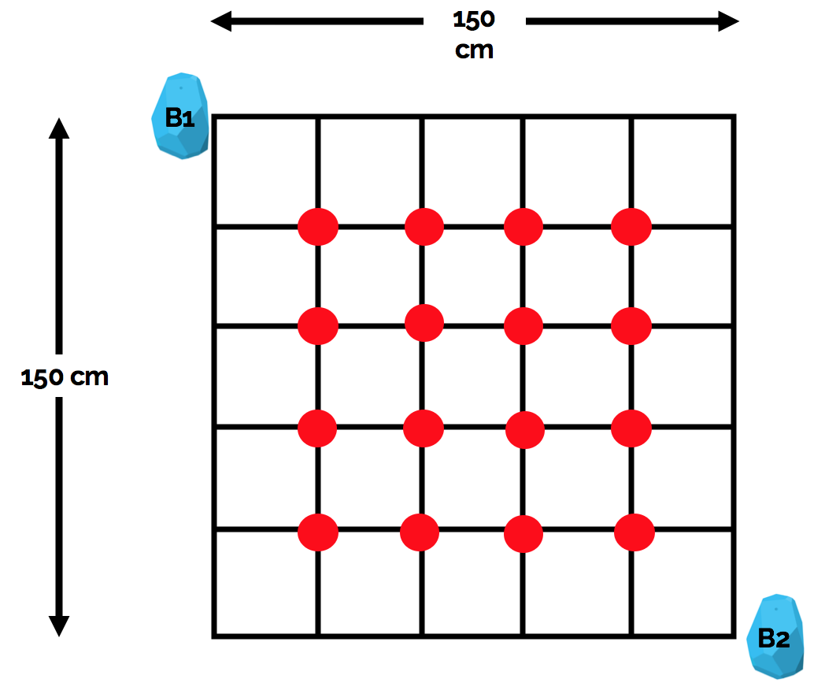
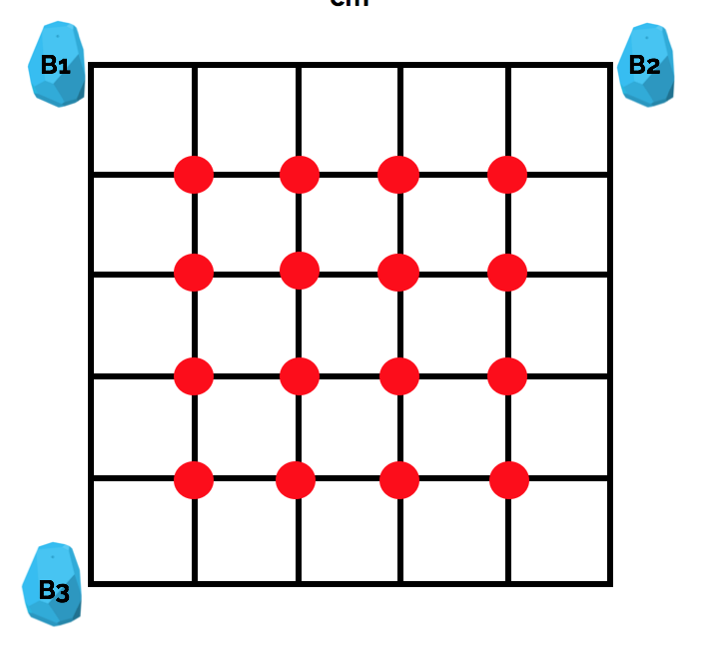
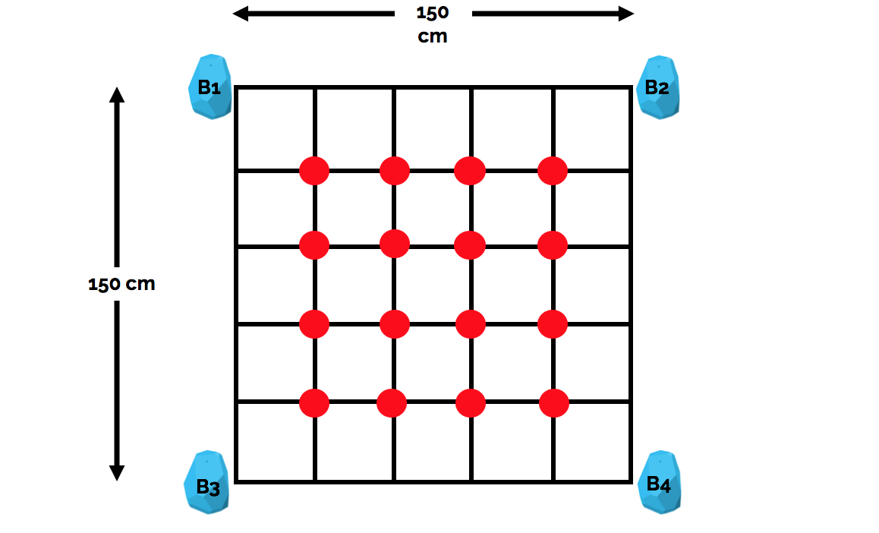
Experimental Setup
Hypothesis 1: Increasing number of BLE beacons increases accuracy of RSSI-Location mapping.
[1]
[2]
[3]
Notes:
We need to correct these images

Slide 7
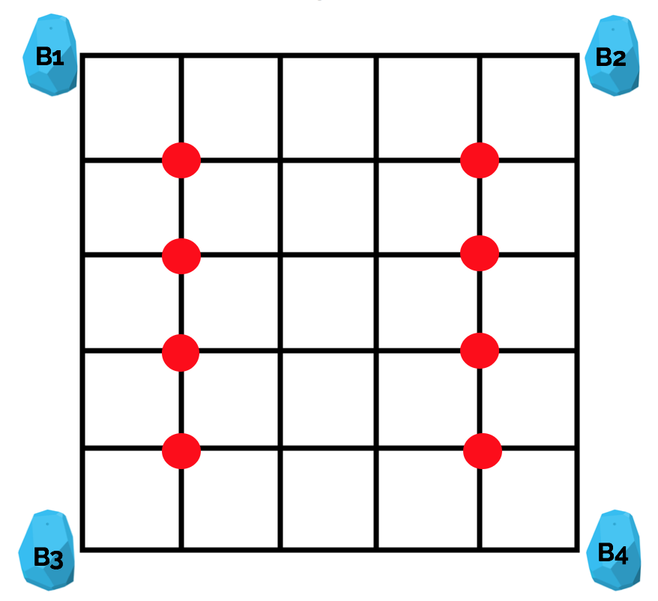
Experimental Setup
Hypothesis 2: When the minimum distance between 2 location points is 1m, given BLE beacons are spaced >=1.5m apart, there is a significant increase in accuracy
[1]
[2]
Notes:
Change Figure 2

Slide 8

Hardware overview: Estimote BLE beacons
Estimote BLE Beacons - Important Specifications
BLE version | BLE 4.2 LE Standard
MCU: | ARM Cortex-M4 32-bit
Range: | 230 feet at full power
Three Types of Broadcasting Protocol Support: | Estimote BLE, iBeacon, Eddystone
Transmit Power: | Adjustable
Broadcast Frequency: | Adjustable
Battery Life: | 1.5-2 years on iBeacon Mode
iBeacon: | Apple’s BLE Protocol with Open-Source Documentations
Figure 1. Estimote BLE Beacons [ Source: Internet]

Slide 9
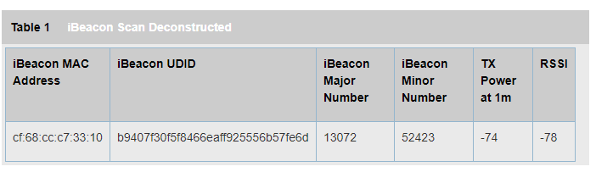
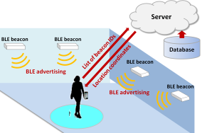
iBeacon and BLE advertisement
iBeacon: Apple’s BLE protocol with open-source documentations.
UUID stands for Universally Unique Identifier. A 32 bit hexadecimal number which separates iBeacons from all other Bluetooth devices in the network[4].
Major and Minor are integer number which gives additional identification characteristics[4].
BLE advertisement: Basically a “Lighthouse” continuously transmitting an iBeacon advertisement packet in form Figure 3.
RSSI value: Relative Signal Strength Indicator, an estimate of range between BLE beacon and receiving device
iBeacon packet has no data except its identity and RSSI.
Receiving device provides decision logic once it identifies a certain beacon.
Figure 2. iBeacon data breakdown in advertisement mode [ Source: Internet]
Figure 3. iBeacons in action [7]

Slide 10
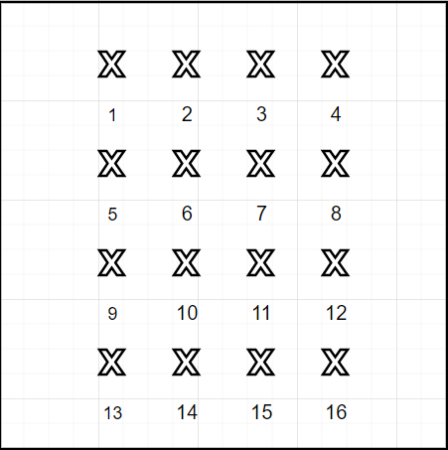
Summary of Experiment Procedure
Setup Estimote BLE Beacons to iBeacon with defined Minor number
Load BLE_Scanner.py[1] in Raspberry Pi
Setup experiment environment (Refer Figure 4)
Run rssi_collect.py via Putty. Rpi connected to PC via WiFi and SSH.
for L in grid_point_count(16):
for k in sample_count(200):
Set grid_position_no = current_pi_location
Collect value in form (minor, rssi) for each BLE beacon
Add class label = L
Write sample to data.csv file
Push file to PC
Data Preprocessing, if any value(p) = 0, set value(p) = value(p-1)
Train-test split (90 – 10)
Run Support Vector Classifiers → GridSearchCV
Run Decision Tree → GridSearchCV
Run RandomForest → GridSearchCV
Choose best model
Compute confusion matrix
End
The above procedure is repeated for all the four scenarios.
Figure 4. Grid Map not drawn to scale
Notes:
Color code this part here for later

Slide 11
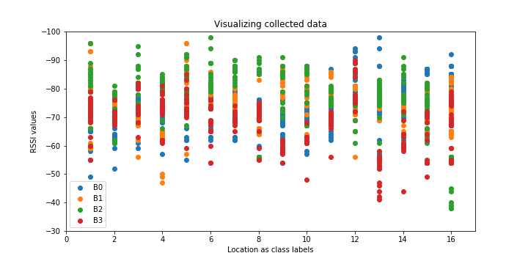
Data Exploration and Preprocessing
Total datapoints per scenario = 3200 samples, 200 for each location.
Complex overlap of RSSI values between different BLE beacons for the same position.
Zero values set to previous sample’s value.
Further discretization of RSSI value leads to poor model performance.
Figure 5. Test set visualized from Scenario 3

Slide 12
ML Models: Hyperparameters
Chosen models
Support Vector Classifier [Linear, Radial Basis Function]
SVC parameters {C, gamma, poly} [7]
Decision Trees (DT) [ DTREE, RandomForest]
DT parameters {n_estimators, criterion, max_depth, min_samples_leaf}
How do we tune so many hyperparameters at once?
How do we reduce effort whilst improve efficiency?

Slide 13
ML Implementation: GridSearchCV
A Scikit Learn’s built-in function.
Iterates over a defined combinaition of hyperparameters
Psuedocode:
Let param = {‘n_estimator’ = [1,5,10], ‘min_samples_leaf’ = [0.1,1,10]}
grid = GridSearchCV(RandomForest(), param)
grid.fit(x_train, y_train)
Outcome, best parameters after training 3 x 3 = 9 models
Selection criterion : Mean Squared Error

Slide 14
Results – 16 point configuration
Hypothesis 1: Increasing number of BLE beacons increases accuracy of RSSI to Location mapping model.
# nodes | SVC, Linear | SVC, RBF | DTREE | RandomForrest
2 | 40% | 52% | 47% | 49%
3 | 41% | 60% | 55% | 61%
4 | 55% | 62% | 64% | 71%
Conclusion:
Increasing BLE beacon count, gave positive gains in accuracy.
RandomForest classifier perform best of all.
Literature indicates, BLE beacons are placed approximately 1.5 ~ 2m apart.
Can we improve accuracy further, given same environment?

Slide 15
Results – 8 point configuration
Hypothesis 2: Minimum distance between two location points is 1m, given BLE beacons are spaced >=1.5m apart.
Scenario: 8-point representation of the Scenario #3
# nodes | SVC, Linear | SVC, RBF | DTREE | RandomForrest
4 | 74% | 81% | 82% | 89%
Conclusion:
Hypothesis 2 is true.
Large gain in accuracy
RandomForest once again is the best model for this experiment.
Notes:
Precision, recall for final paper

Slide 16
Limitations
The experiment environment is an “ideal” scenario, not representative of real-world scenario. Thus, accuracy values are optimistic.
Polynomial kernel for SVC was dropped as it’s Python implementation is very slow.
The data collection procedure does not adequately portrait real-world scenarios.
Inadequate spacing to test full strength of the BLE beacons.
Contribution of interferences from other Wireless devices was not considered.

Slide 17
Future Work
Will expand the experiment to full scale IPS in our lab.
An AGV (Autonomous Ground Vehicle) will be used to collect data as it proceeds through predefined checkpoints
>4 BLE nodes will be used.
kNN model will be added in the new experiments.
Real-time implementation using a handheld Rpi (Raspberry Pi).

Slide 18
Thank You

Slide 19
References
https://www.switchdoc.com/beaconair-ibeacons/
Technical specifications of Estimote BLE beacons, Available at: https://forums.estimote.com/t/technical-specification-of-estimote-beacons-and-stickers/7297
iBeacon protocol, Available at: https://en.wikipedia.org/wiki/IBeacon
iBeacon parameters, Available at: https://support.kontakt.io/hc/en-gb/articles/201620741-iBeacon-Parameters-UUID-Major-and-Minor
Getting started with Estimote, Available at: https://community.estimote.com/hc/en-us/articles/360004683772-Getting-started-with-Estimote
BLE tracking, Available at: https://www.accuware.com/blog/bluetooth-beacons-tracking/
SVC parameters, Available at: https://scikit-learn.org/stable/auto_examples/svm/plot_rbf_parameters.html
RandomForest Hyperparameter tuning, Available at: https://medium.com/all-things-ai/in-depth-parameter-tuning-for-random-forest-d67bb7e920d

