Slide 1
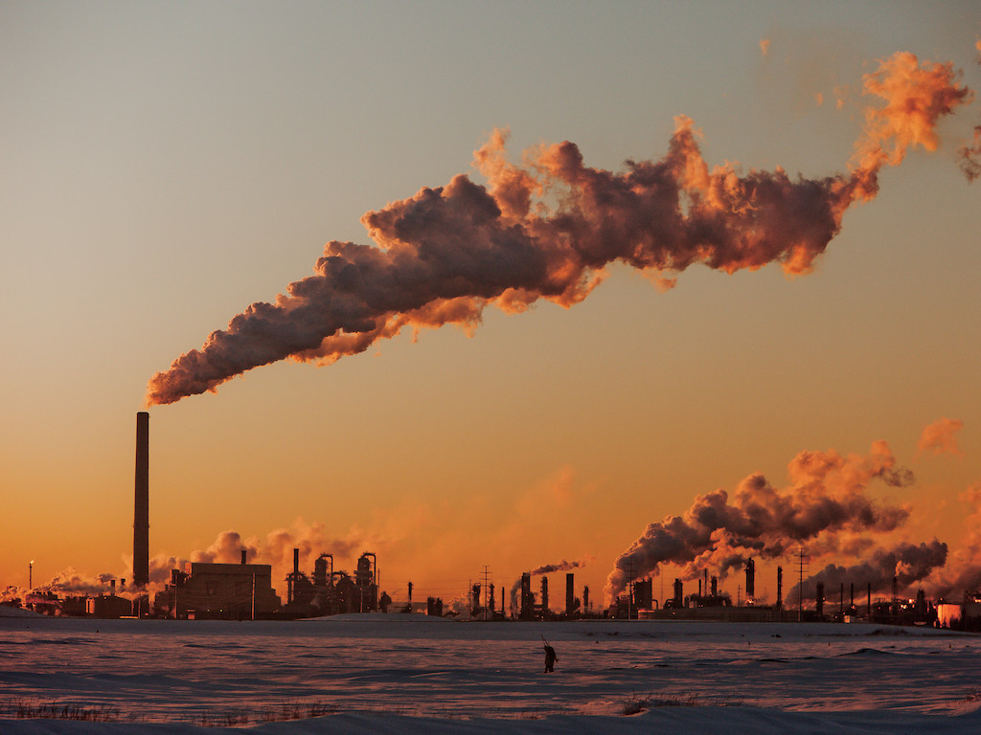
POLLUTION

Slide 2
WHAT WE WILL SEE IN THIS POWERPOINT?
What is pollution?
Types of pollution.
Explain the types.
The sources of each type.
Different ways to stop the pollution.

Slide 3
WHAT IS POLLUTION?
Pollution is an unnatural degradation of the environment by human hand. Actions to disrupt this ecosystem; It is called as contamination.

Slide 4
TYPES OF POLLUTION
Air pollution
Water pollution
Soil pollution
Sound/noise pollution

Slide 5
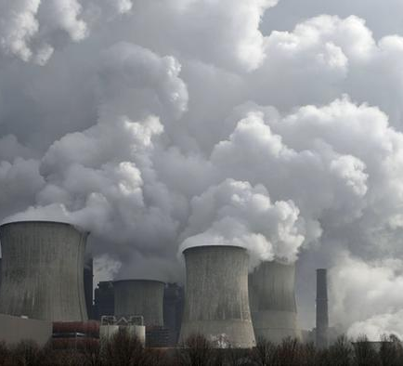
AIR POLLUTION
Air pollution is a mixture of solid particles and gases in the air. Car emissions, chemicals from factories, dust, pollen and mold spores may be suspended as particles. Ozone, a gas, is a major part of air pollution in cities.

Slide 6
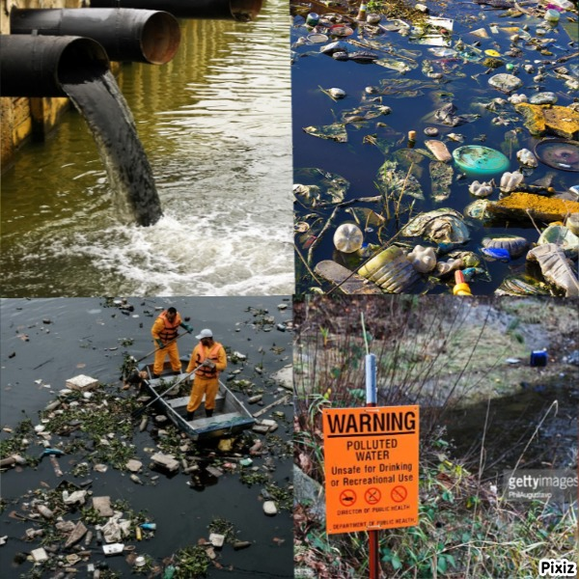
Water Pollution
Water pollution is the pollution of bodies of water, such as lakes, rivers, seas, the oceans, as well as groundwater.

Slide 7
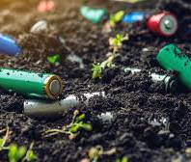
Soil Pollution
Soil pollution is the breakdown of the physical and properties of the soil by solid, liquid and radioactive debris and pollutants.

Slide 8
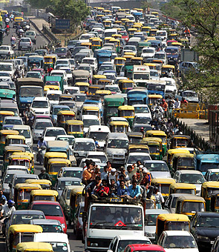
SOUND/NOISE POLLUTION
Noise pollution, also known as environmental noise or sound pollution, harmful contamination on human health and environmental quality is described as undesirable or excessive noise.

Slide 9
SOURCES OF POLLUTION
Air pollution:
mobile sources such as cars, planes.
stationary sources such as power plants and factories.
area sources such as cities.
Water pollution:
Oil Pollution.
Radioactive Substances.
River dumping.
Marine Dumping.

Slide 10
SOURCES OF POLLUTION
Soil pollution:
Industrial sources.
Urban waste.
Mining and Smelting sources.
Nuclear sources.
SOUND/NOISE:
Traffic noise.
Air traffic noise.
Construction sites.
Catering and night life.
Animals.

Slide 11
DIFFERENT WAYS TO STOP THE POLLUTION
AIR POLLUTION:
Walk or bike more.
Do not smoke.
Use public transportation.
Use a push or electric lawn mower instead of gas powered.
WATER POLLUTION:
Do not dump in or around rivers.
Clean up rivers.
Reduce plastic consumption.

Slide 12
DIFFERENT WAYS TO STOP THE POLLUTION
SOIL POLLUTION:
Reduce toxic materials.
Recycle waste materials.
Eat sustainable foodstuffs.
Properly recycle batteries.
SOUND/NOISE POLLUTION:
Upgrade Your Insulation.
Noise Cancelling Headphones and Earplugs.
Turn Off Electrical Appliances.

Slide 13
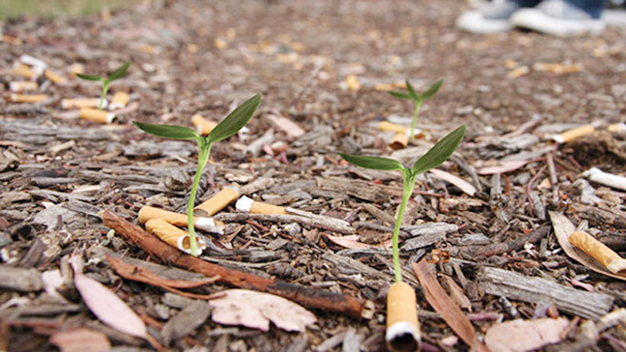
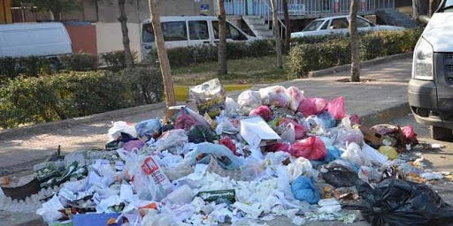
HUMAN

Slide 14

THANK YOU FOR LISTENING WITH INTEREST

