Slide 1

Multithreading in C++

Slide 2
CONCURRENCY AND MULTITHREADING
Concurrency – the execution of several tasks simultaneously.
Allowing one part of a program to progress while another is waiting for a response.
We call an activity potentially executed concurrently with other activities a task.
It done by using several processors for a single computation.

Slide 3
A thread is an abstraction of the computer hardware’s notion of a computation.
We use threads when several tasks in a program need to progress concurrently.
On a system with several processing units (cores), threads allows us to use those units
All threads work in the same address space.
Data Races should be taken care by the programmer by using mutex.

Slide 4
If a thread cannot proceed (e.g., because it has encountered a mutex owned by another thread), it is said to be blocked or asleep.
The thread::hardware_concurrency() operation reports the number of tasks that can simultaneously proceed with hardware support.
The exact meaning of that is architecture-dependent, but it is usually less than the number of threads offered by the operating system (e.g., through time multiplexing or time slicing) and sometimes higher than the number of processors or ‘‘cores.’’

Slide 5
Each thread of execution has a unique identifier represented as a value of type thread::id.
If a thread does not represent a thread of execution, its id is the default id{}.
The id of a thread t can be obtained by a call of t.get_id().
A thread can have its id be id{} if
It has not had a task assigned,
It has terminated,
It has been moved from,
It has been detached.

Slide 6
MULTITHREADING
Multithreading support was introduced in C+11.
The thread classes and related functions are defined in the thread header file.
A thread is also known as a light-weight process.
The idea is to achieve parallelism by dividing a process into multiple threads.
In every application there is a default thread which is main() , inside we create other threads.

Slide 7

std::thread is the thread class that represents a single thread in C++.
To start a thread we simply need to create a new thread object and pass the executing code to be called (i.e, a callable object) into the constructor of the object.
Once the object is created a new thread is launched which will execute the code specified in callable.
After defining callable, pass it to the constructor.

Slide 8
Once a thread has started we may need to wait for the thread to finish before we can take some action. For instance, if we allocate the task of initializing the GUI of an application to a thread, we need to wait for the thread to finish to ensure that the GUI has loaded properly.
To wait for a thread use the std::thread::join() function. This function makes the current thread wait until the thread identified by *this has finished executing.
Let's see how multithreading works.

Slide 9
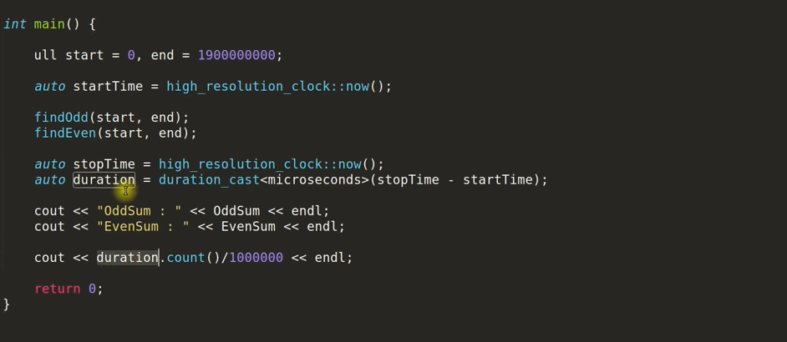


Slide 10
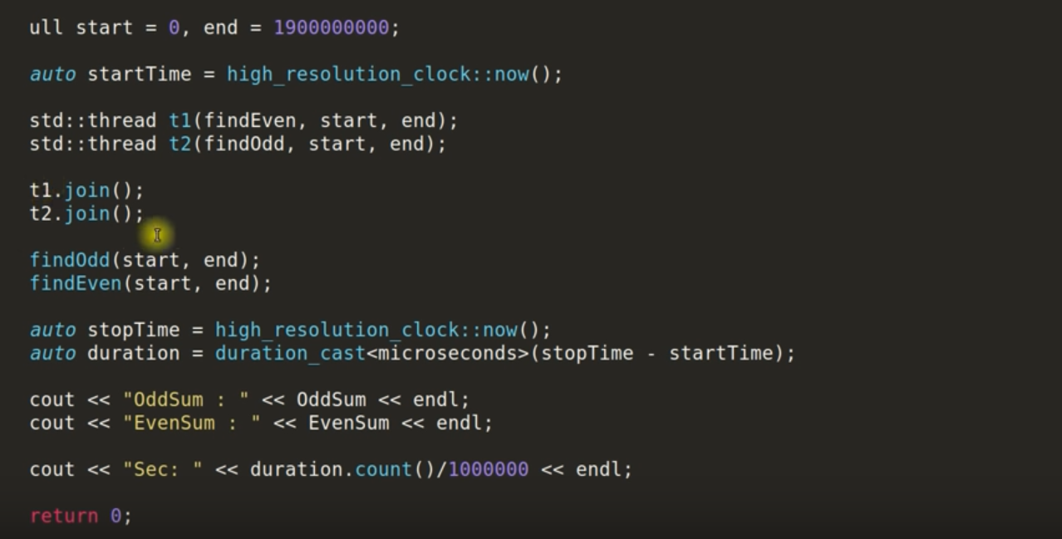


Slide 11
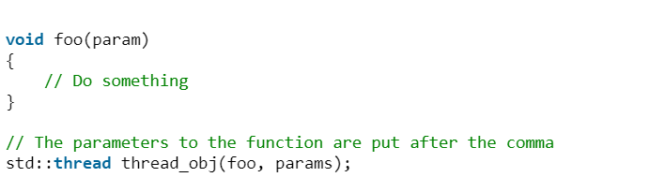
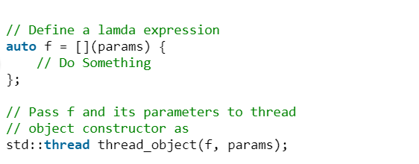
Launching thread using function pointer
Launching thread using lambda expression

Slide 12
Once a thread has started we wait for the thread to finish by calling std::thread::join().
Double join will result in run-time error.
Always check whether a thread is joinable or not with std::thread::joinable().
std::thread::joinable() returns True if a thread already been joined or detached.
False vice-versa.

Slide 13
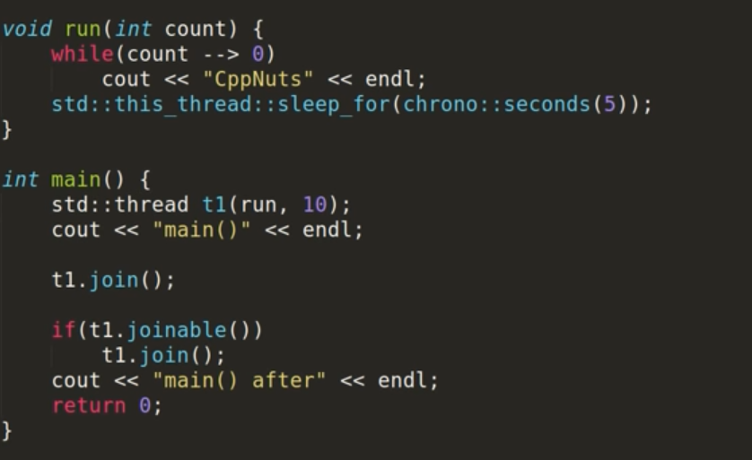
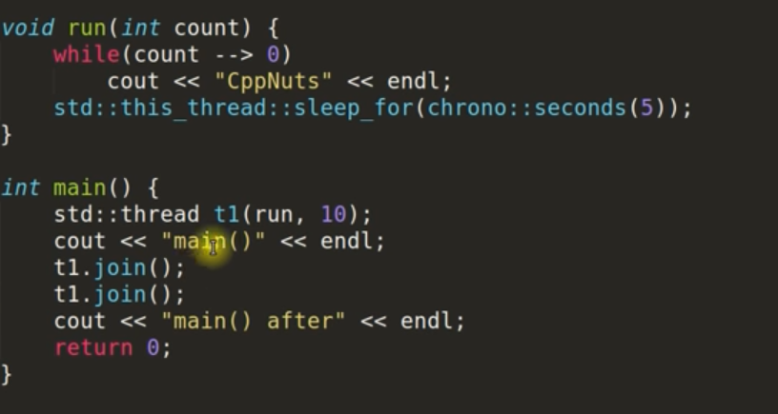

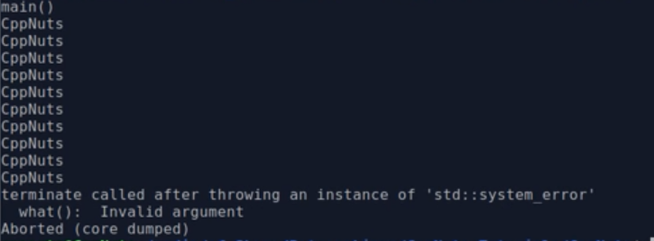

Slide 14
std::thread::detach() is used to detach newly created thread from the parent thread.
main() is itself a single thread and is the parent thread.
Always check whether a thread is detached or not using std::thread::joinable().
Otherwise we may end up double detaching which leads to run-time error.
If a thread is detached and if the main function is returning, the thread gets suspended.

Slide 15
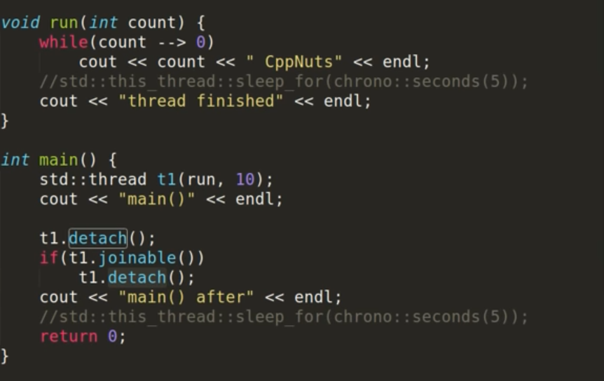
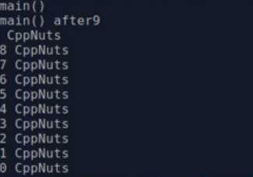


Slide 16
One point is to remember that there are also several outputs for the same program, This is normal.
It depends on how the Operating system deals with the thread, the thread can get finished before the main() or after the main().
This can be avoided by using std::thread::join().

Slide 17
NOTE
Either std::thread::join() or std::thread::detach() is to used by the thread object.
Otherwise thread's destructor will terminate the program.
It is because the destructor checks whether the thread is joinable or not, if not it terminates.

Slide 18
Reference
The C++ Programming Language- Fourth Edition– Bjarne Stroustrup - May 19 2013
http://www.cplusplus.com/reference/multithreading/
https://github.com/PacktPublishing/Mastering-CPP-Multithreading
https://www.geeksforgeeks.org/multithreading-in-cpp/

Slide 19
THANKS

