Slide 1
GEM Final Presentation Title / GEM_03
Names: Chun-Mao Lai, Kaylan Wang, Vishvesh Padmakumar NetIDs: cmlai2, kaylanw4, vp16
Date of presentation: Dec. 5th
Notes:
Problem definition: What problem are you solving? Why is it hard and interesting?
Is the problem formulation detailed enough?
Does the problem formulation show adequate understanding of the problem space?
Appropriately ambitious?
Approach: How you plan to solve the problem?
Do you understand the overall system and its various components?
Which pieces are you going to modify and how?
Preliminary work and progress so far
What are the aspects of the approach that are most novel? Which aspects are easy
Task allocation in group and plan for execution of the plan
Test and evaluation: What are the key metrics for evaluating the solution to your problem. E.g., time-to-collision is a metric for safety;
How are you evaluating your solution with respect to your metrics?
Are you simulating as well as performing field tests? Simulations?
What are the different scenarios under which you are performing evaluation?
Presentation
Design and organization of information
Professionalism of presentation, delivery

Slide 2
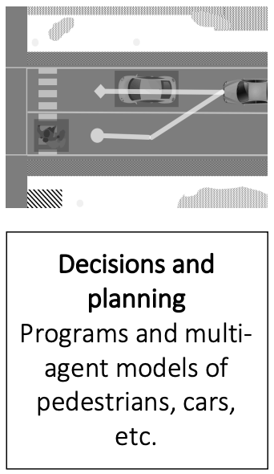
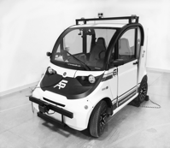
What problem are we solving?
Constructing a decision-maker for vision-only lane detection and lane following to enable the GEM car to successfully navigate the route in both the Highbay and simulated environments.
What difficulties did we encounter?
Since the vehicle’s vision is too narrow, the lane could actually disappear from sight during the turn.
Decision at the T-crossroad.
The GEM car is significantly different from the simulated environment. (speed control, steering latency)
Lecture 7 Slide 3

Slide 3
Final Block Diagram
Lane Detect
Lane Information
# lane
Lane polynomial
Lane validation
Decision Maker
Steering Command
Controller
Speed Command
Current velocity
Current heading
Steering angle
Acceleration
Brake
Camera
Environment
Moter
Noise

Slide 4
Lane Detection
Our decision-maker depends on the accuracy of our lane detection results. The preliminary codebase (MP1) has several issues.
Once it predicts the wrong lanes, it does not correct them.
It may detect an overlap of two lanes.
To address these problems
Split the lane detector into left-lane and right-lane detectors.
If the predicted lanes overlap, decide one of them to be invalid.
If an anomaly is detected, drop the historical data, then re-fit the lane.
Left-lane detector
Left-lane fit
Bird’s Eye View Image
Validation Module
State / Lanes data
Right-lane detector
Right-lane fit

Slide 5
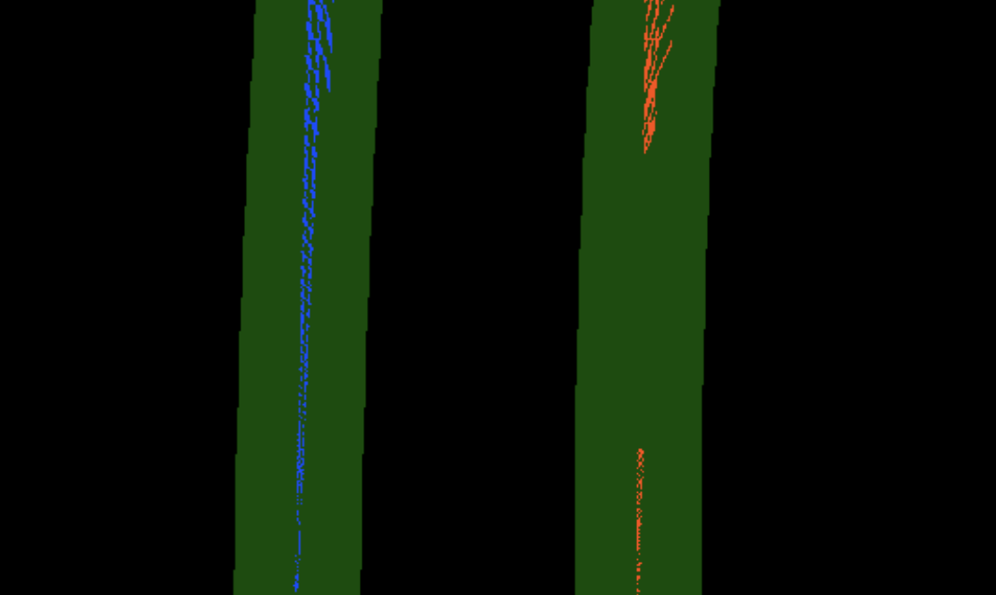

Validation Module
We validate our lanes based on the starting points of the lanes.
The start point of the left lane should be on the left half of the image.
The start point of the right lane should be on the right half of the image.
Additionally, we maintain a state to remember whether the vehicle entered a turn, allowing for a looser threshold during the turn.

Slide 6
Decision Maker
Our decision maker also base on the starting point of the lanes.
Input: 1. State (“LEFT”, “RIGHT”, “BOTH”): which lanes are detected.
2. Lanes fit
Output: 1. Steering Commands (“HARDLEFT”, “LEFT”, “STRAIGHT”, “RIGHT”, “HARDRIGHT”)
2. Speed Commands (“ACCEL”, “BRAKE”)
Input State | Too Right | Safe | Too Left
LEFT | STRAIGHT | RIGHT | HARDRIGHT
BOTH | LEFT | STRAIGHT | RIGHT
RIGHT | STRAIGHT | LEFT | HARDLEFT

Slide 7
Controller
Translate the commands into the low-level control value (steering angle, acceleration)
Commands | HARDLEFT | LEFT | STRAIGHT | RIGHT | HARDRIGHT
Steering Angle | 0.6 | 0.3 | 0 | -0.3 | -0.6
Commands | ACCEL | BRAKE
Desired speed | 1.5 | 0
We use PID controller to translate the current and desired speed into the acceleration and deceleration of the car.
Furthermore, to mitigate the long steering delay in the real GEM car, we reduce our desired speed if the actual steering angle significantly differs from the desired one, employing interpolation.

Slide 8

Demonstration of Simulation (4x)

Slide 9
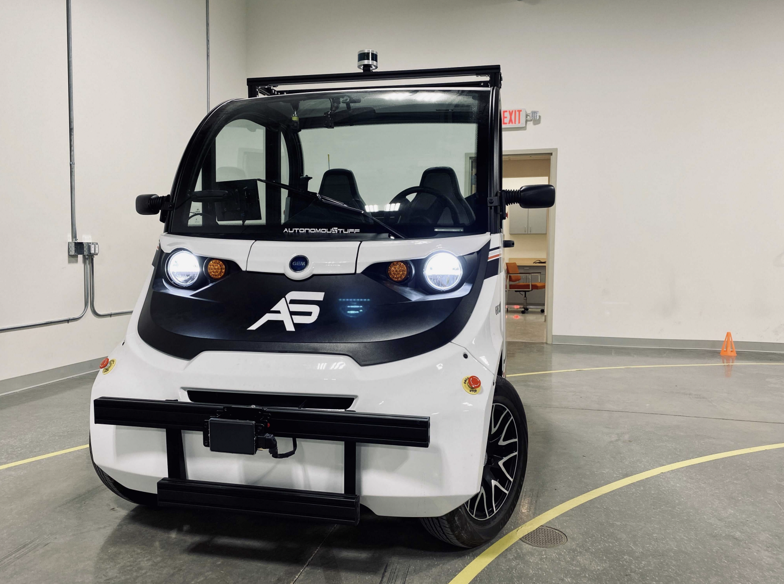
In the Next Two Weeks…
Implement and tune the code on the real GEM car.
Tune the Longitudinal PID controller to enhance the smooth operation of the GEM car.

Slide 10
Questions?

